Slide 1
Supporting coaches and coaching in clinical practice
David Huggins
Mentorship lead – University of East Anglia
School of Health Sciences
February 2016

Slide 2
Aims and objectives
To identify key educational processes used to support learners in clinical practice
To review basic education teaching and learning styles
To recap and expand on coaching and mentorship models
To review the importance of a coaching conversation between a coach and a coachee’s
To understand and implement clinical skill s and competency in coaches and coachee’s
To support reflective practice
To ensure feedback and feed forward are correctly utilised

Slide 3
CE role – key aspects
CE role is pivotal in supporting mentors/coaches in the workplace.
Understanding the key issues such as NMC Standards and HEI process is key
Other key elements include, theories of mentorship/coaching, education theory, learning styles, developing skills and competence as well as developing and supporting reflective practice.
CEs need to support the process of feeding forward and feeding back to mentors and students.

Slide 4
Challenges ?
Selling the role
Being seen as the expert
Developing as you go
Who can support you?
Differences between coaching and mentorship
Managing change
Motivation

Slide 5
Mentorship and coaching
Seen as intertwined
Many definitions so staff confusion exists?
Tobin (2004) see coaching as one of 7 characteristics of being a good mentor. (Others are teacher, sponsor, adviser, agent, role model and confidante)
Comte-Sponville (2003) see the key qualities being empathy, maturity, self confidence, resourcefulness and willingness to commit time and energy to others
Do we all have these qualities?

Slide 6
Mentoring models
Classical mentoring
(natural, mutual self chosen relationship)
Reflective mentoring
(based on learning theories i.e. andragogy, styles of learning and student-centred approaches. Mentor is a critical friend and co-enquirer).
Apprenticeship model
(mentor is a skilled craftsperson and the mentee learns by copying their
Competence-based model
(mentor enables mentee to achieve a set of practice objectives)
Team-mentoring
(A team of mentors mentor one or more students)
Contract mentoring
(Formal mentoring that is time/objectives restricted)
Pseudo-mentoring
(Appearance only and usually for a specific task i.e. supervision of a dissertation)
(Gopee 2015)

Slide 7
Coaching
Seen by Race (2010) as the highest form of learning.
One to one
Group/team
Systems
Other models GROW, NLP, spiral and so on.
Definitions vary Hudson (1999:22) sees coaching as
“..the art of guiding another person, persons or human systems towards a fulfilling future… Coaches help the clients invent futures that are exciting, valuable and intensely personal. Coaching is (therefore) more about doing than being”.
Coaching can be a powerful resource when it is done by highly competent and experienced coaches in appropriate circumstances (Neal et al 2009)

Slide 8
Coaching conversation
Key to setting aims and objectives
Coachee encouraged to set their own aims and objectives (GROW?)
Goal, Reality, Options and Wrap
Use of SMART
Use of a model for identifying the correct course of action (adapted from Egan 1998)
Questions asked in model | Answers
What is your goal? | To clinically examine a patient
How will you know when you’ve achieved it? | To be able to combine theory and practice
How much of it do you think you will achieve/ | The examination part but not the theory
What style of coaching do you prefer? | Communication style
When would you like your goal to be achieved? | In one year?
How long do you think it will actually take, and why? | 18 months, because not enough time can be spent in clinical practice

Slide 9
Communication
Pivotal to everything
Remember verbal and non verbal's
Listening skills (interactive). Ideal skill to coach
How is power affecting things (mentor/coach/CE and all in practice)?
Interaction is key clarifying, verifying and reflecting?
Use empathy in your communication.
6 C’s in mentorship (Duffy 2015)
Makes coaches become “insider experts” by having interactive listening skills.(Hameric et al 2000).

Slide 10
Educational theory. A reminder
Domains of learning
Blooms (1956) taxonomy
Andragogy and pedagogy
Educational theories
Learning styles
Teaching methods

Slide 11
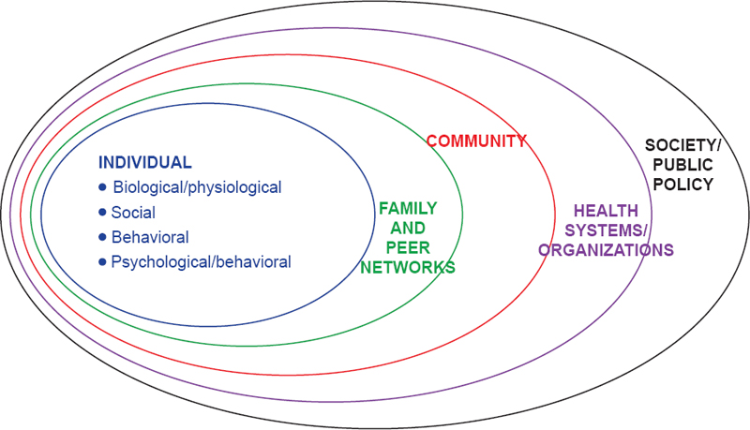
Nursing curriculum 2011 Bronfenbrenner’s Bio-Ecological Model (2005)

Slide 12
Skills development and competency
Helping coachee’s reach competency
Difference between confidence, competent and competency?
Confidence is generally described as a state of being certain either that a hypothesis or prediction is correct or that a chosen course of action is the best or most effective.
Self-confidence is having confidence in oneself.
Overall knowledge, skills and attitude. (Their Fitness to Practice)
NMC (2004) see a competent nurse as one who consistently demonstrates fitness to practice.
Specific clinical skills indicate competency.
Dreyfus (1980)model, Benner (1984) and Millers (1990)pyramid.

Slide 13
Reflecting and giving Feedback
Fluffy process?
Model to use?
Schon (1983)
Gibbs (1998), Driscoll (2003), Rolfe (1997), Johns (2006), De Bono (1987)…etc
Constructive feedback and feed forward essential but often poorly done.
Students want this on ALL aspects of their performance.
Use a model I.e. Pendleton's rules of 4 steps ( Benson 2005)
What has gone right
What are the coachee’s strengths followed by coaches views on this
What needs to be improved (coachee’s and coaches views)
Develop an action plan.

Slide 14
Motivation
Motivation is goal-directed behaviour
Motivational influences (good and bad)
Maslow (1943)
Herzberg et al (1959)
McClelland (1987)
McGregor’s theory x and y (1960)
Vroom (1964)

Slide 15
Summary
Clinical Educators play a vital role in supporting learning in clinical practice.
Challenges exist!
Be aware of support available
Keep updated on education theory and put theory into practice.
Have a good understanding
Use good communication skills
Keep your self motivated and be a role model (6 C’s)

Slide 16
Any questions?

Slide 17
References/reading
Benson BJ (2005) Medicine Paediatrics Residency Programme: Ward feedback
Benner P (1984) From Novice to Expert: Excellence and power in clinical nursing practice. Addison Wesley. Menlo Park. CA.
Bloom BS, Englehard MD, Furst EJ, Hill WH, Krathwohl DR(1956) Taxonomy of educational objectives: The classification of educational goals. Handbook Cognitive domain, David McKay, New York
Bronfenbrenner’s Bio-Ecological Model (2005) Making human beings human: Bioecological perspectives on human development. Thousand Oaks, CA: Sage Publications.
Comte-Sponville A (2003) A Short Treatise on the Great Virtues: The use of philosophy in everyday life. Vintage. London.
DeBono E (1987) 6 Thinking hats: Penguin books. London.
Dreyfus S and Dreyfus H (1980) A Five-Stage Model of the Mental Activities Involved in Directed Skill Acquisition. California.
Driscoll MP (2003) Psychology of Learning for instruction. Allyn and Bacon. Needham. MA.
Duffy K (2015) Integrating the 6 C’s of nursing into mentorship practice. Nursing Standard. 29, 50, 49-58.
Egan G (1998) The Skilled Helper: A problem management approach to helping. 6th Ed. Brookes Cole .London.
Gibbs G (1988) Learning By Doing: A Guide to Teaching and Learning Methods. FEU. London
Gopee N (2015) Mentoring and Supervision in Healthcare. Sage. London.
Herzberg, F, Mausner, B. and Snyderman, B.B. (1959), The Motivation to Work, Wiley, New York, NY
Hudson FM(1999) The Handbook of Coaching. Jossey-Bass. San Francisco.
Johns C (2006) Engaging Reflection in Practice: A Narrative Approach. Blackwell Publishing Ltd, Oxford.
MacGregor DM (1960) The Human Side of Enterprise, McGraw‐Hill Book Co., New York, NY.
Maslow, A.H. (1943), “A theory of human motivation”, Psychological Review, Vol. 50, pp. 370‐96 .
McClelland D (1987) Human Motivation. Cambridge University Press
Miller GE (1990) The assessment of clinical skills/competence/performance. Academic Medicine, 65, 563-567.
NMC (2004) Fitness to Practice. Nursing and Midwifery Council.London.
Race P (2010) Making it Happen: A guide for Post-compulsory Education. Sage. London.
Rolfe G (1997) Beyond expertise: theory, practice and the reflexive practitioner. Journal of Clinical Nursing, 6 (2), 93–97.
Schon D (1983) The Reflective Practitioner. How professionals think in action. Avebury Press. London.
Tobin MJ (2004) Mentoring: seven roles and some specifics. American Journal of Respiratory and Critical Care Medicine. 170, 114-117.
Vroom V (1964) Work and motivation. Oxford, England: Wiley

