Slide 1

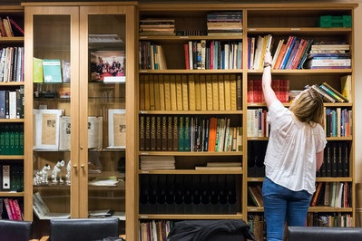
Webinar November 2024
Angela Graham – Head of Archive Services, East Anglian Film Archive

Slide 2
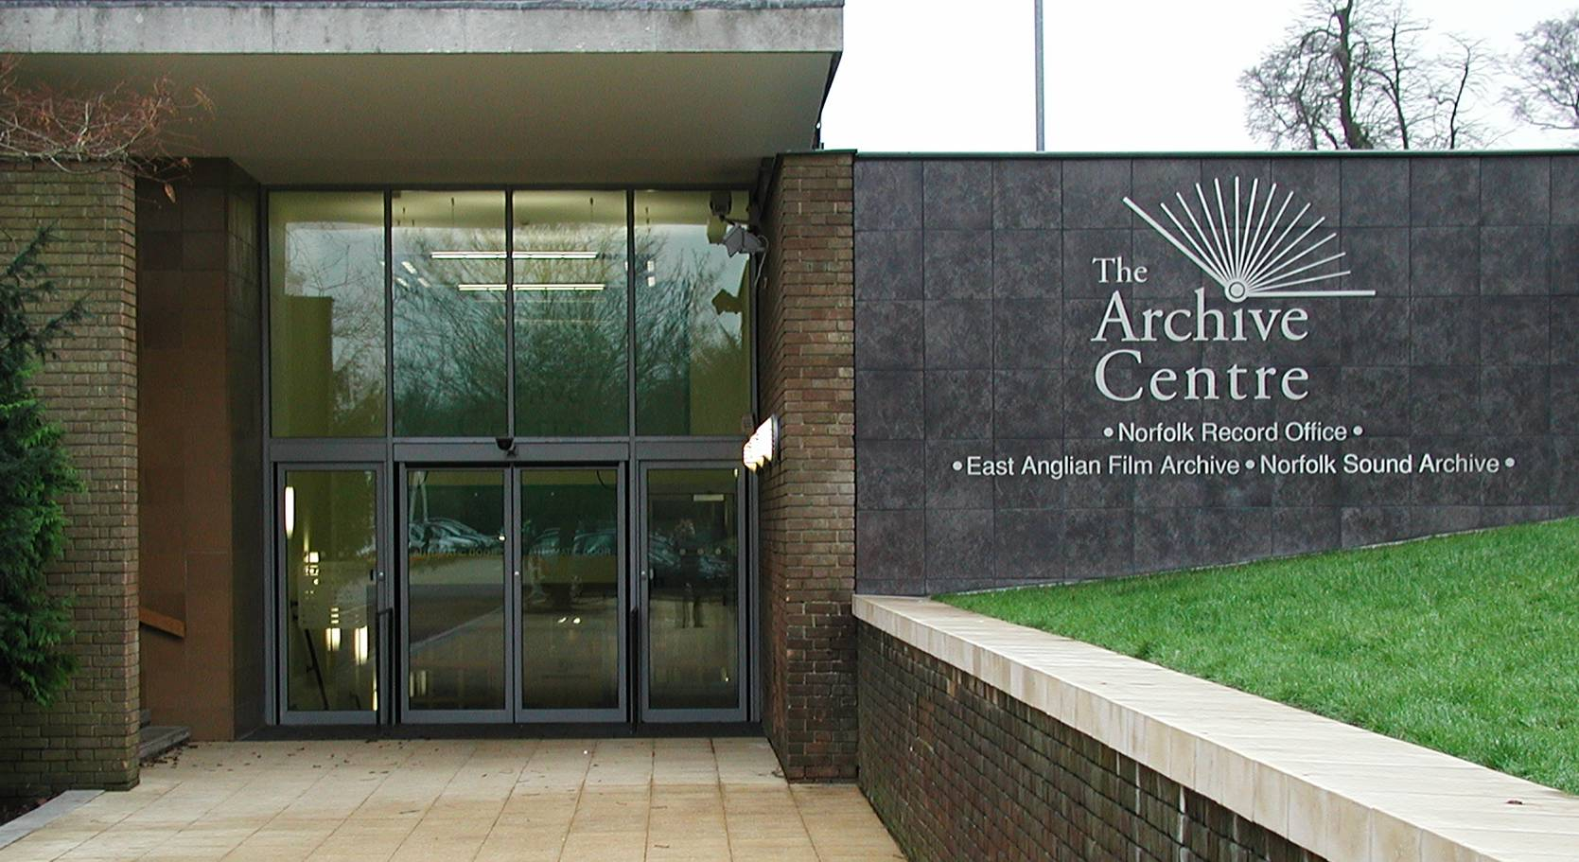

First regional film archive
Accredited archive
Top 5% of archives nationally
State of the art digital film archive
Owned & operated by UEA

Slide 3
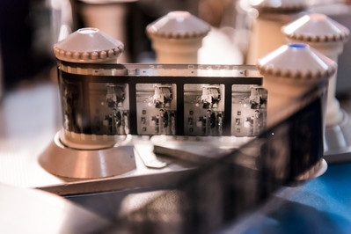
collections
Collections include:
Amateur film, advertising films, local newsreels, publicity films, travelogues, documentaries, educational films, animation, artist films.
75,ooo catalogue titles
148,000 items

Slide 4
Why use archive films?
Nature: Venture on the Wind (4234)
Family and relationships: Stasjonen/The Station (3885),
Susan’s birthday (970).
War and conflict: Captain Rowsell’s Norwich (1292), Ipswich Air Raid (1015)
Power and politics: The Prendergast File (4088), The New Councillor (6569)
Genre, context, inspiration (An Inspector Calls) 1912
A Dream Of Toyland (1907) | East Anglian Film Archive (eafa.org.uk)
Tramway Ride Through Principal Streets (1902) | East Anglian Film Archive
Narrative Enter Horlick Soames (1932) | East Anglian Film Archive
Non – linear narrative ‘The Station’
Storyboard creation/ narrative with parallel stories

Slide 5
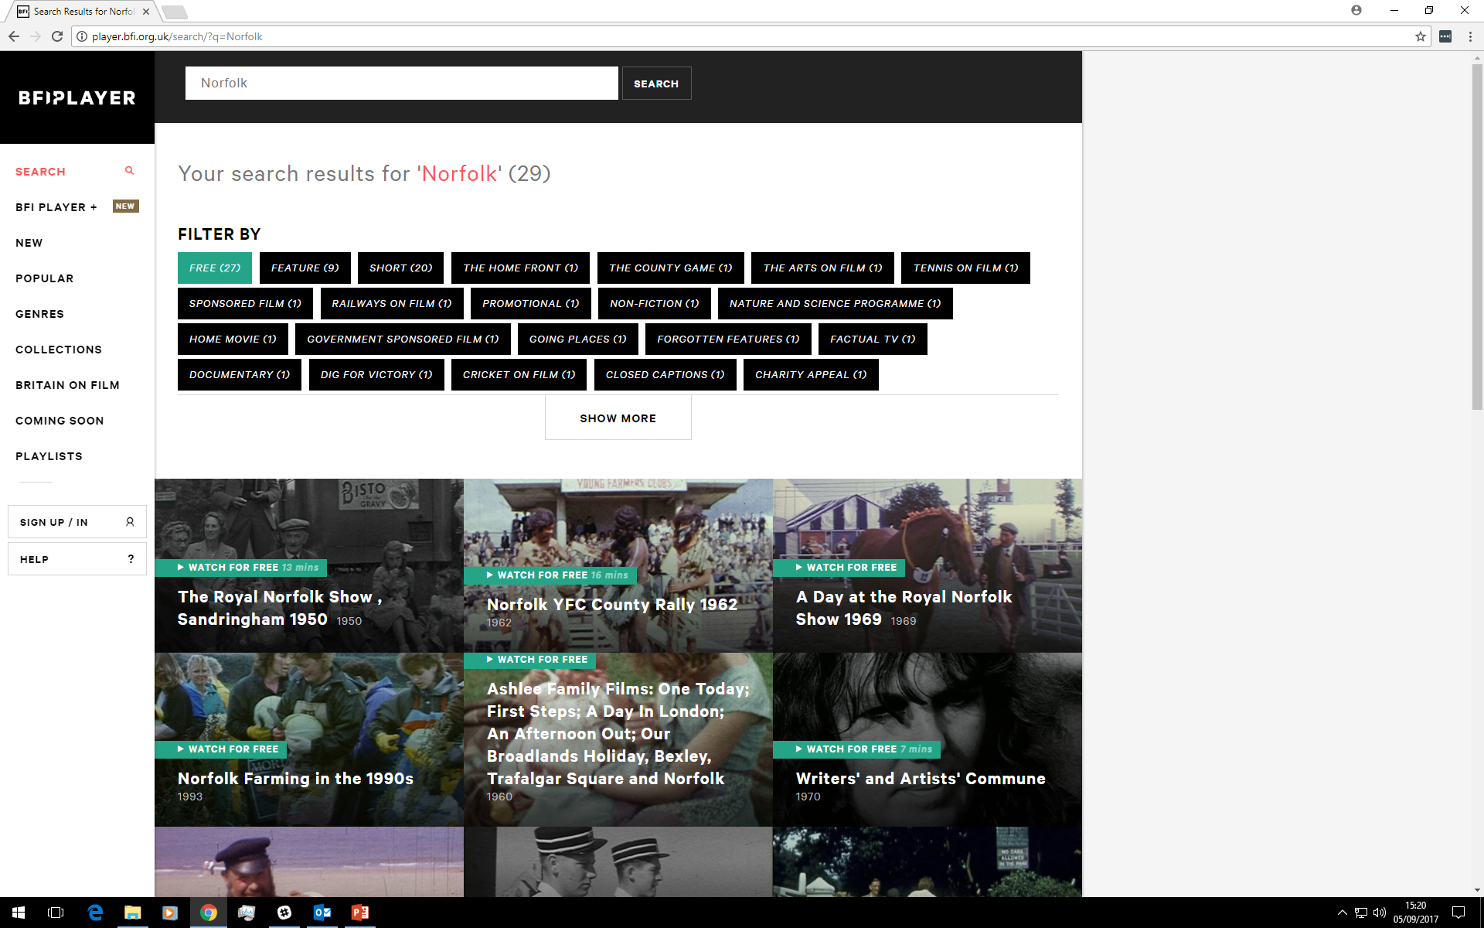
player.bfi.org.uk/britain-on-film
EAFA’s films are also on the BFI Player

Slide 6
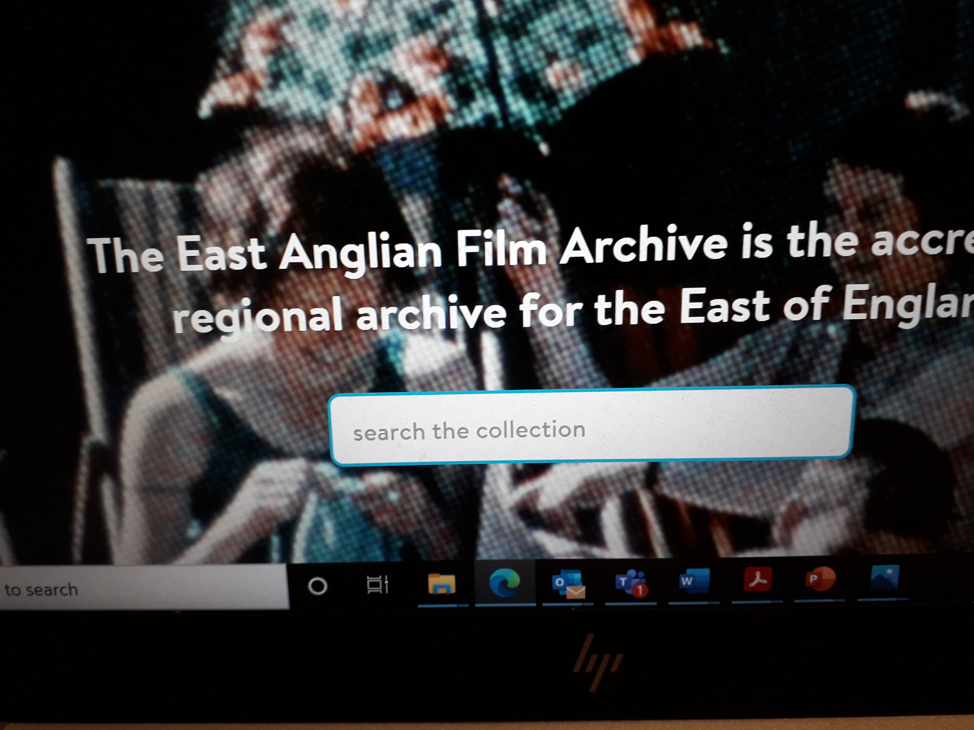
eafa.org.uk

Slide 7
Digital toolkit
Digital-toolkit.pdf

Slide 8
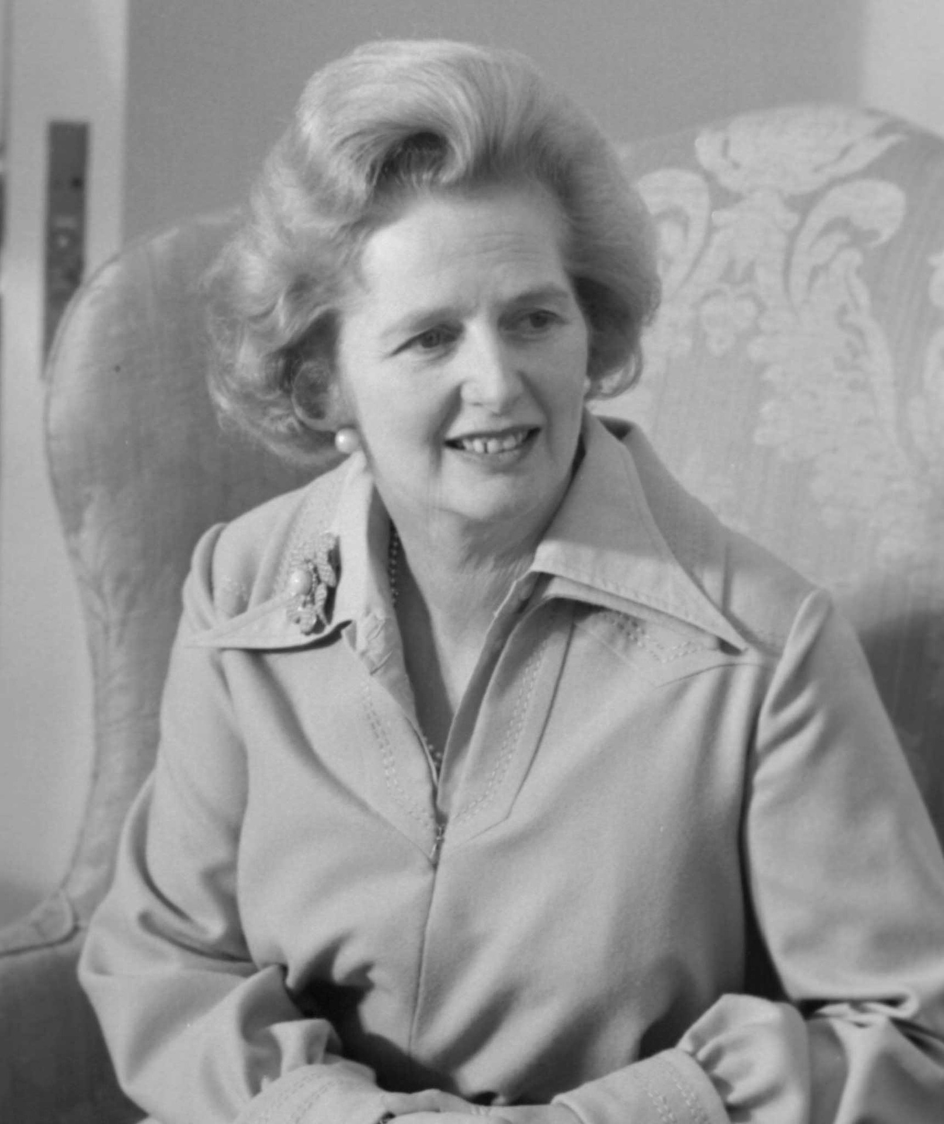
Ima
BFI Replay
Making the most of BFI Replay | BFI
‘Balanced Reporting’
ITV Anglia news content from 1980s
Video filmed to be inserted during live broadcast of Anglia Television’s early evening news / magazine programme ‘About Anglia’. The live studio presentation provided context for the video as part of a news story or magazine feature within the programme. ‘About Anglia’ was not recorded during broadcast, so it is usually just the pre-recorded programme inserts which survive. Image by Wilkimages by Pixaplay

Slide 9

Mash up competition

Slide 10
Mash Up
Make a short film of between 1 to 5 minutes in duration.
At least 50% of the total duration of your film must consist of archive footage from the competition package supplied by EAFA.
Filmmakers can also choose to combine the EAFA archive footage with other audio-visual material, for example, contemporary footage shot by the filmmaker or footage sourced from elsewhere.
Mashup Filmmaking Competition 2024-25 - East Anglian Film Archive

Slide 11
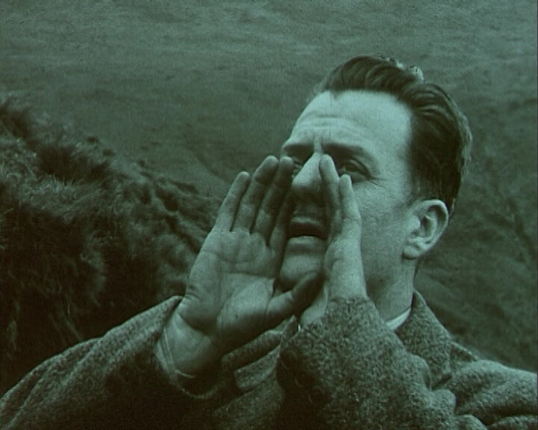
Questions

