Slide 1
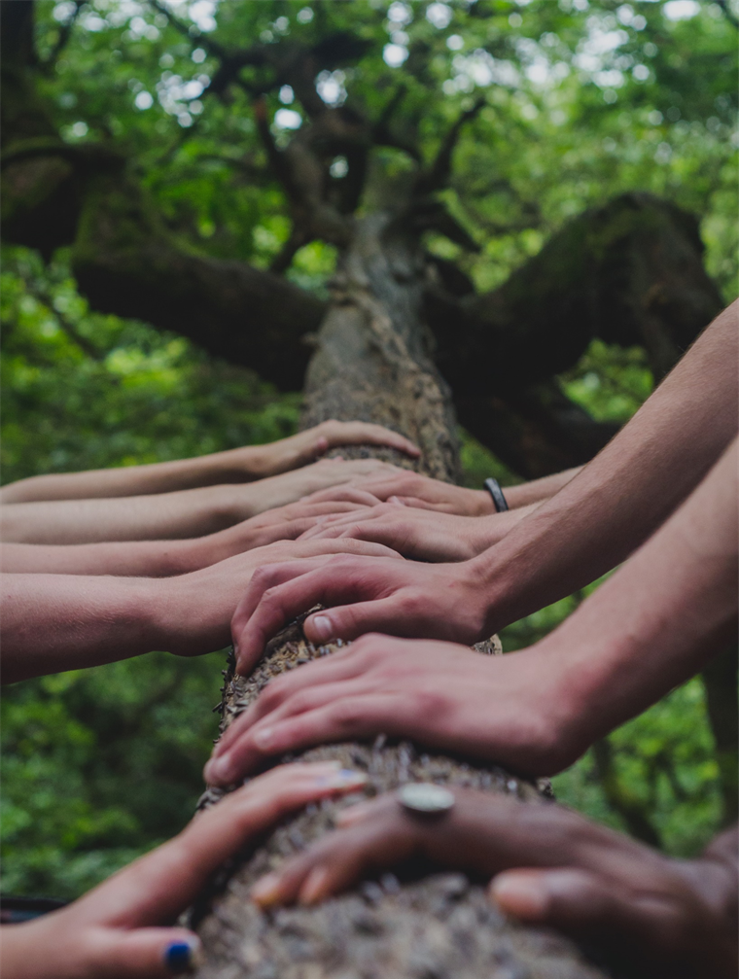

Learning, becoming and being an effective critical companion: Part 1
Critical companionship video & resource guide: Facilitating career progression from person-centred practice to person centred systems: DOMAIN 2: LEARNING, DEVELOPING, IMPROVING
Michele Hardiman
Education & Research Facilitator Galway Clinic, Republic of Ireland
Transforming culture, relationships, practice and systems through critical companionship means learning to transform oneself first
Michele dedicates her video to Professor Jan Dewing,
her PhD supervisor & critical companion, who died in 2022
Notes:
V11 TITLE SLIDE Link slide to Domain 2: References and Resources (over the text ABOVE ‘LEARNING, IMPROVING, DEVELOPING’)

Slide 2
Domain 2 Resources & Recommended reading
Main CC frameworks & references
Critical companionship video & resource guide: Facilitating career progression from person-centred practice to person centred systems: DOMAIN 2: LEARNING, DEVELOPING, IMPROVING

