Slide 1
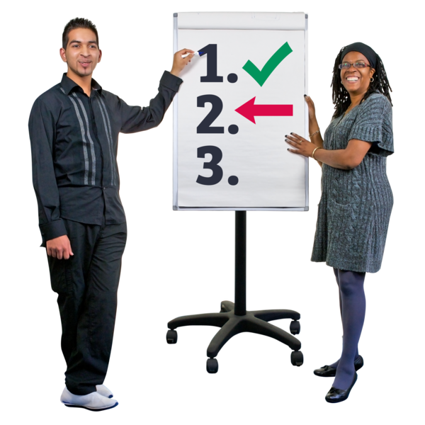

Part 2.
More Findings

Slide 2

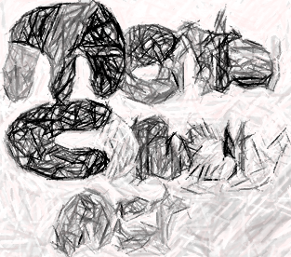


Our findings
Stage 1: The law and safe research
Mental Capacity Act (2005)
We found some problems.

Slide 3





There is a lot about:
treatment
welfare
There is not much
on research.
and money
matters.

Slide 4



There is not a good balance between
protection and
empowerment.

Slide 5
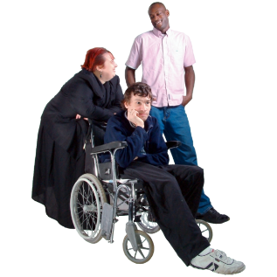


Having another person (consultee) say
what a person thinks
is not good.

Slide 6
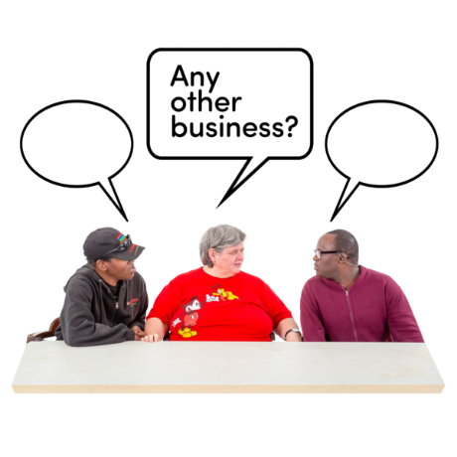


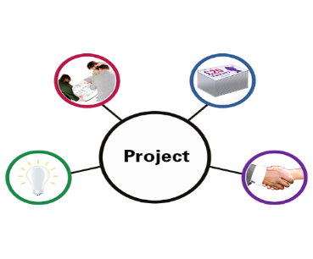

People on a Research Ethics Committee
decide whether
a project
is safe and sound.

Slide 7




But the law is not clear.
This makes it difficult
for researchers
?
to include people with capacity and communication difficulties.

Slide 8


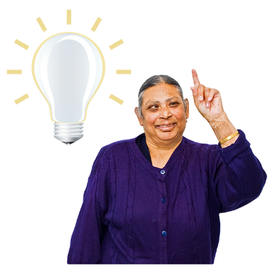
Research advice
There were 14 advice documents on the Health Research Authority website.
x 14
They mainly talked about safety issues.
and people understanding and
making decisions.

Slide 9


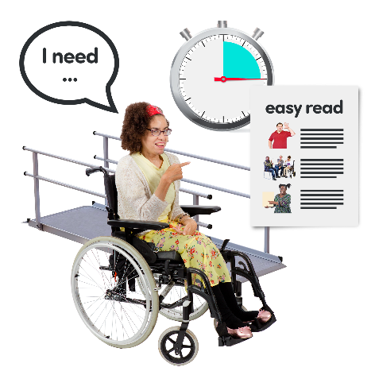
There was a lot about protecting people
and making sure they are safe.
They described the different ways for giving information.

Slide 10



Research articles
We found 28 articles
?
about people with capacity and communication difficulties
in research.

Slide 11


15 projects
?
included people unable
to make their own decisions.
They asked the advice of other people called consultees.

Slide 12


7 projects said no
?
to people who cannot
make their own decisions.

Slide 13


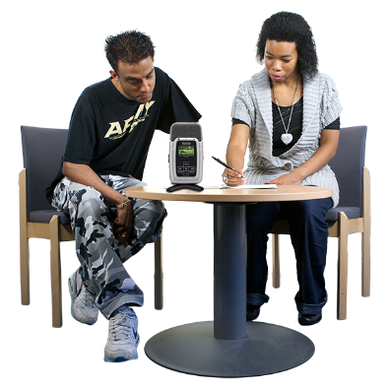
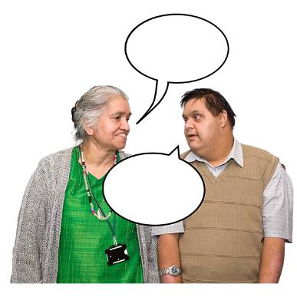


Different materials were used to present project
Information.

Slide 14

Only a small number of
research projects
?
include people with capacity and communication difficulties.

Slide 15
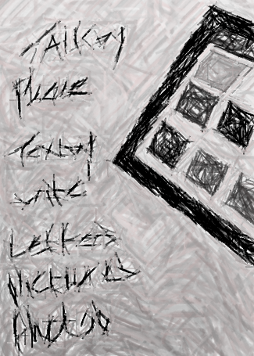

Stage 2
About research projects that include
adults with capacity and communication
difficulties
Surveys

Slide 16

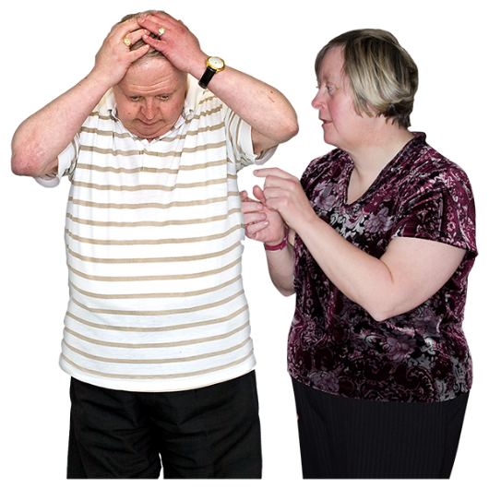
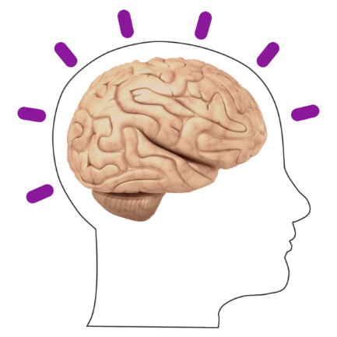

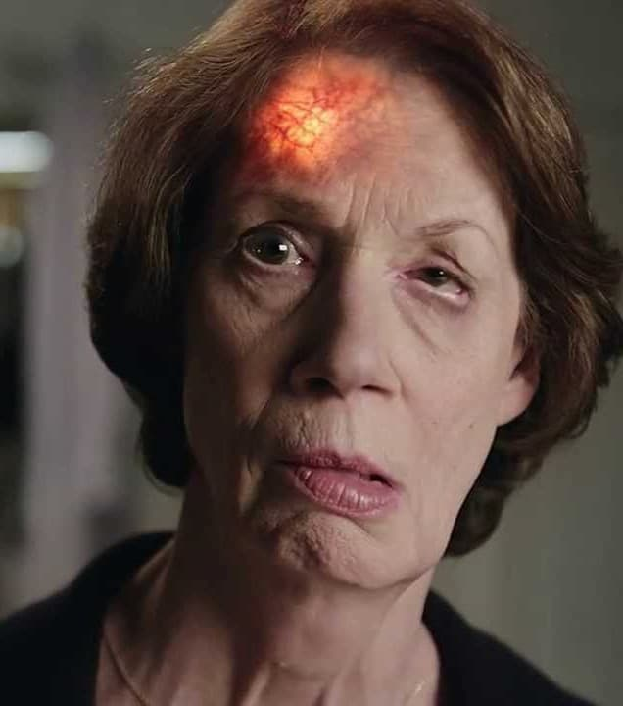
Research in the past
Most projects looked at:
older people
with dementia
people with
a head injury
and people
who have had
a stroke.
people with
mental health
problems,

Slide 17
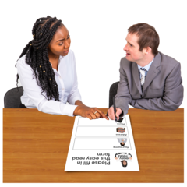
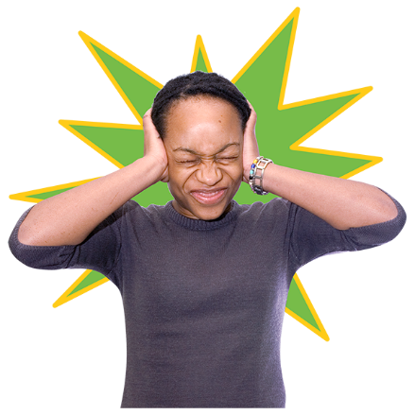

Projects on people with learning disabilities
and people with autism
were lower.

Slide 18

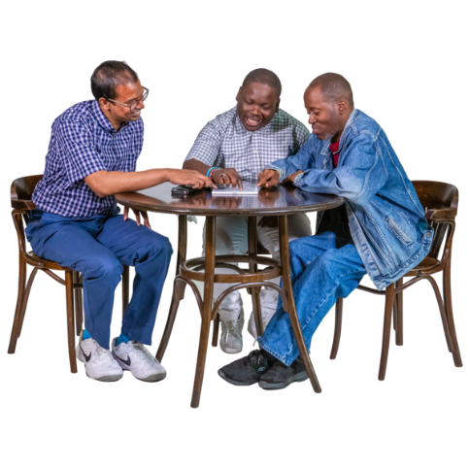
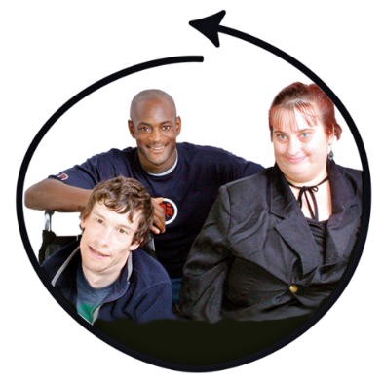
Most of the projects looked at
activities of everyday life
and how people get on with it.

Slide 19


Some of the projects looked at different treatments to help them.
Most of the projects were safe and sound.

Slide 20



Research happening now
We looked at 83 projects.
About half of the projects looked at
people with dementia.

Slide 21


18 projects said
‘no’ to people with
capacity difficulties
taking part.

Slide 22

5 projects said
‘no’ to people with
communication difficulties
taking part.

Slide 23





About half the projects
gave printed information to people
using pictures
and large print

Slide 24

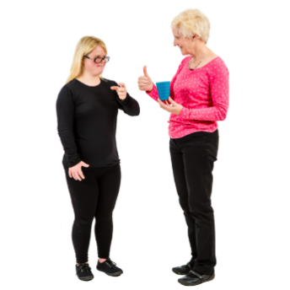

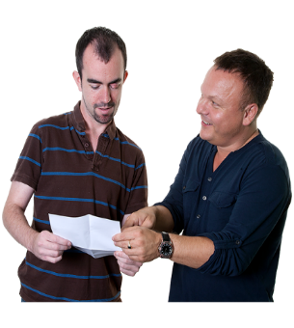

21 projects used techniques, such as:
talking
slowly,
using simple
words,
and repeating
things for people.
Having support from carers was also important.

Slide 25

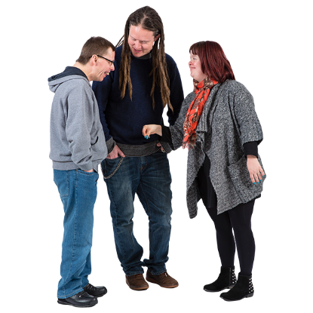

5 projects got advice from
another person – a consultee.
This was to see if the person with difficulties could take part.

Slide 26




Information about projects
We received 30 project information sheets.
5 were left out
?
because they were not about people with
capacity and communication difficulties.

Slide 27



This left us with 25 project information sheets
About half were for
people with
dementia
adults with learning
disabilities
Only 2 were for

Slide 28
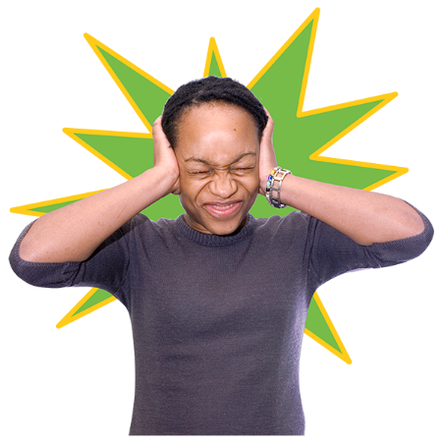

0
and none for
people with
autism
and people with
head injury

Slide 29

Info
Pages 1-4
The average information book had around 4 pages.
Info
Pages 1-24
The highest number of pages was 24.
Info
1 page only
The lowest number of pages was 1.

Slide 30


Just over half of the information sheets
used pictures.

Slide 31

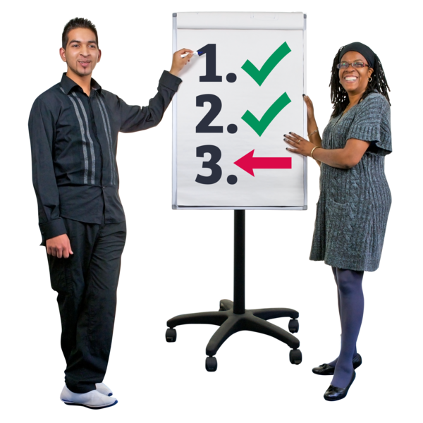
They told us what they think about them.
Go to Part 3 for more findings.

