Slide 1
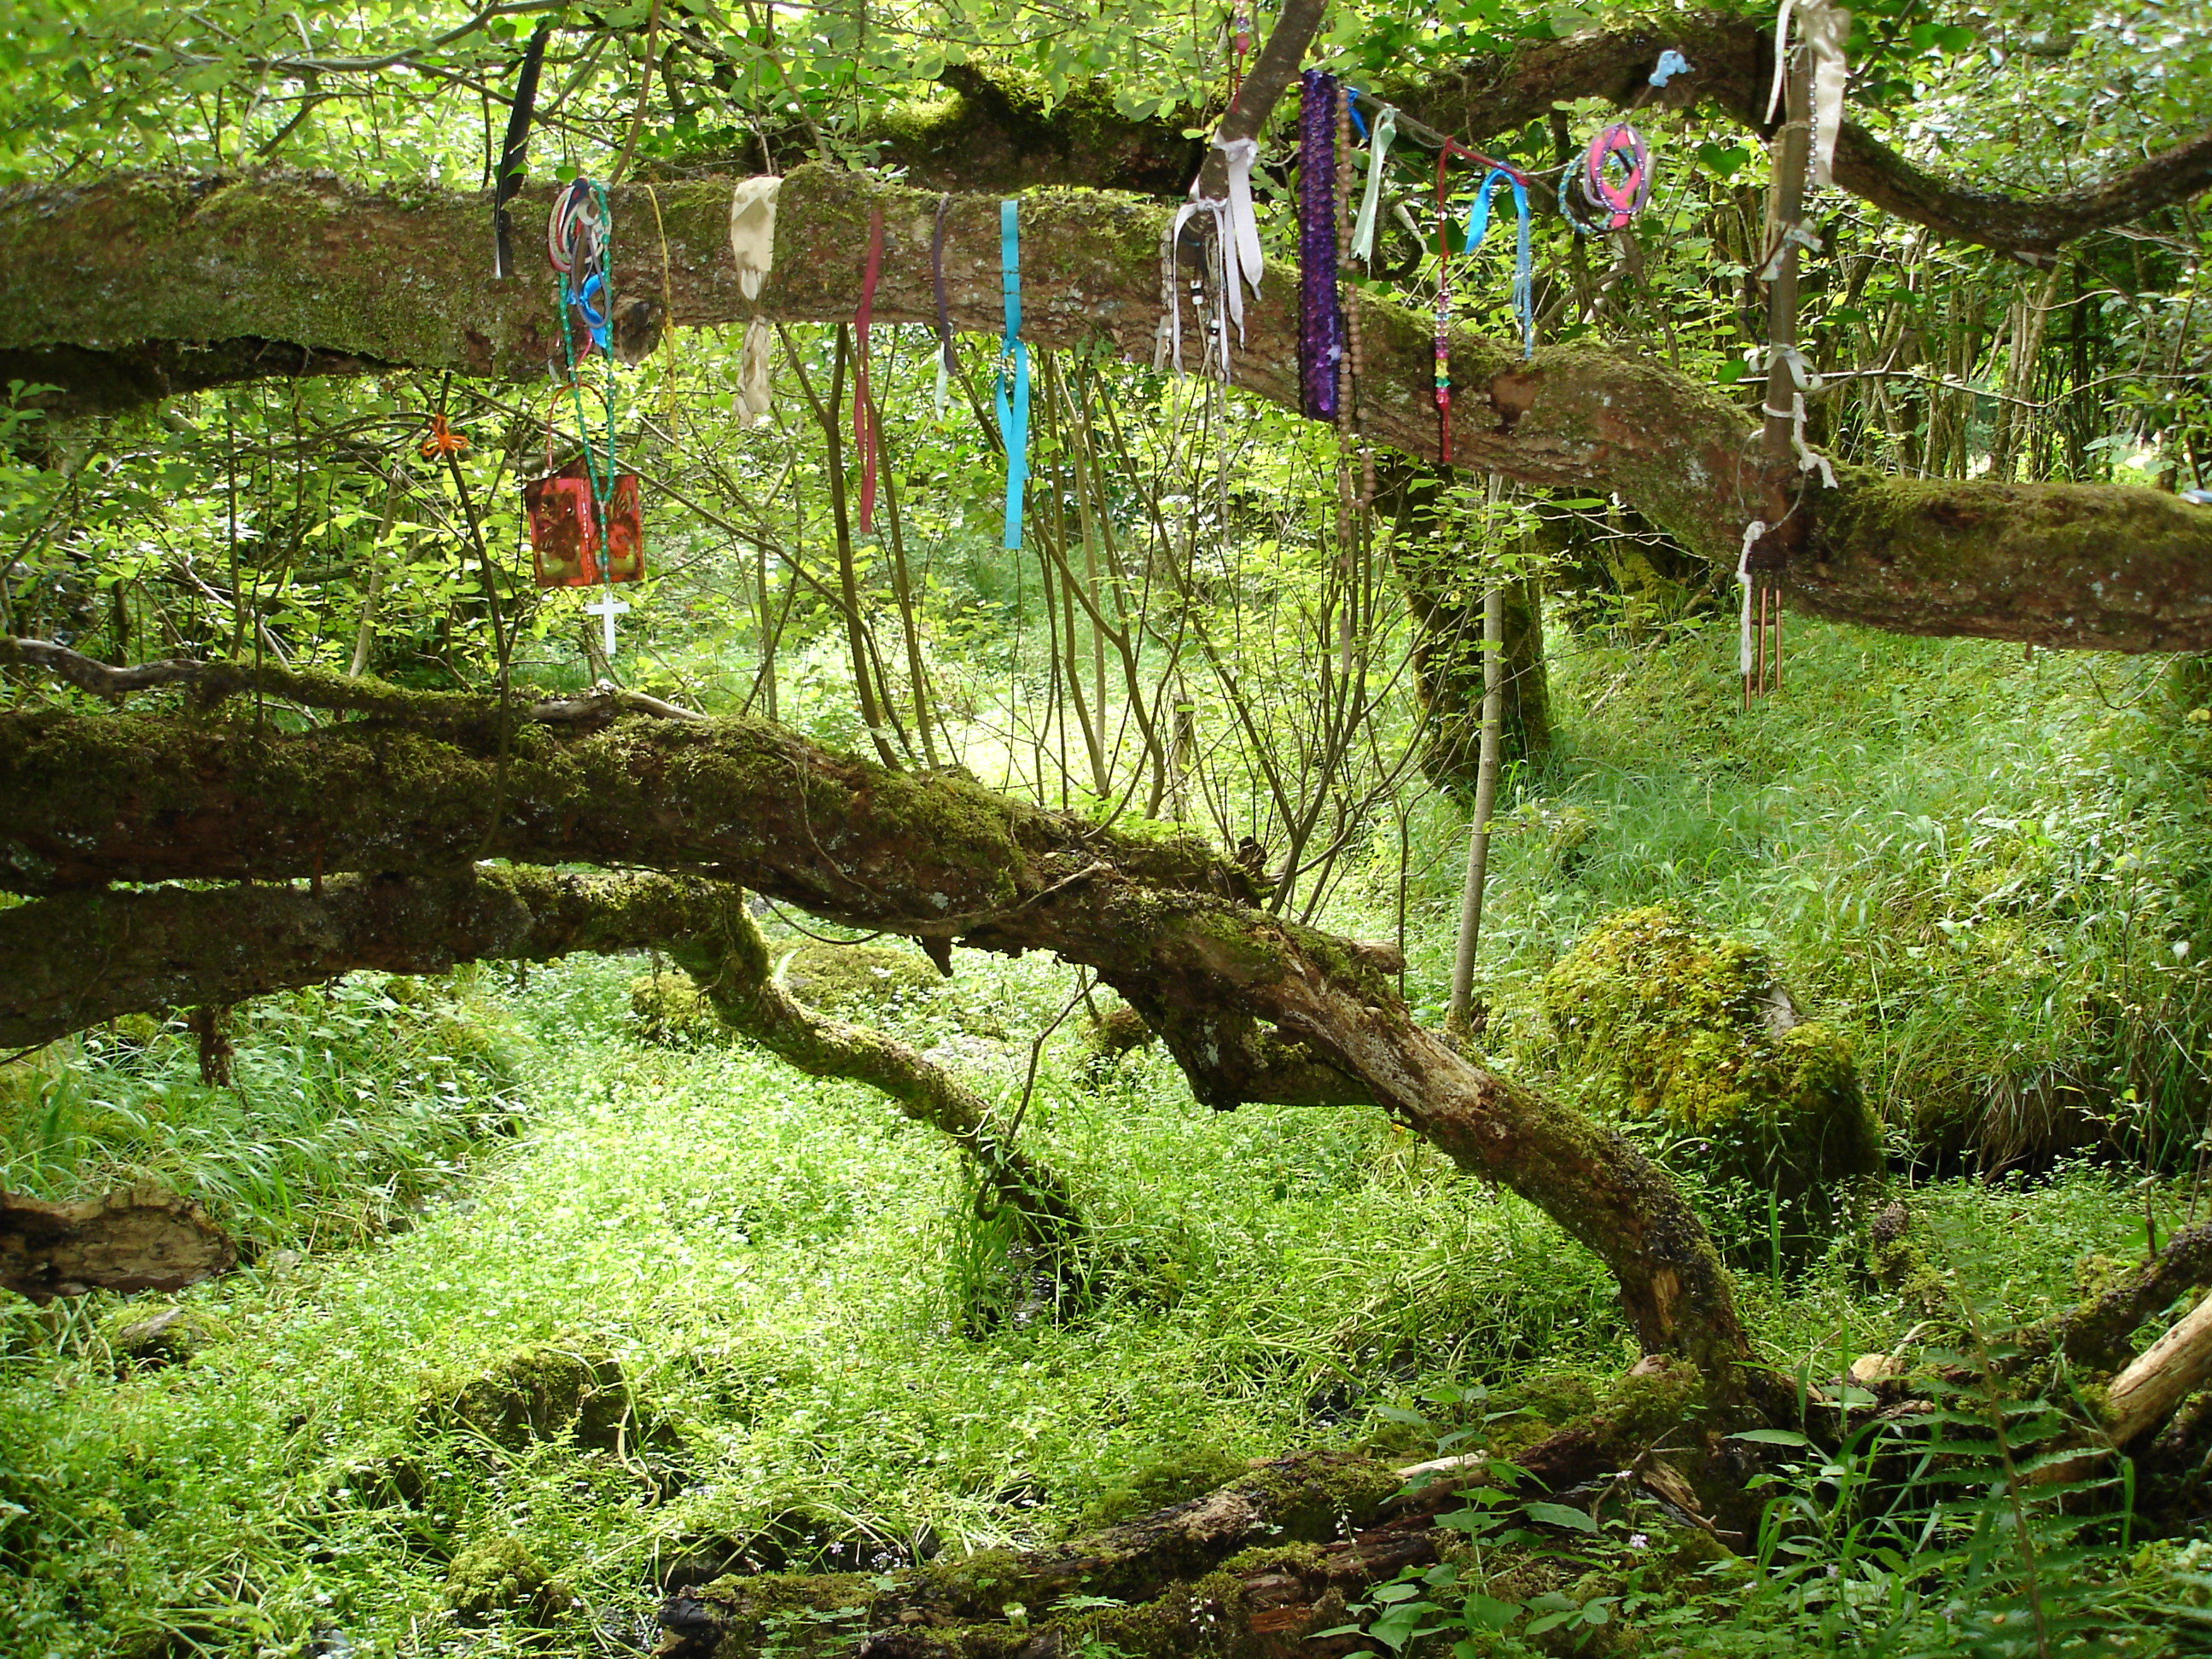

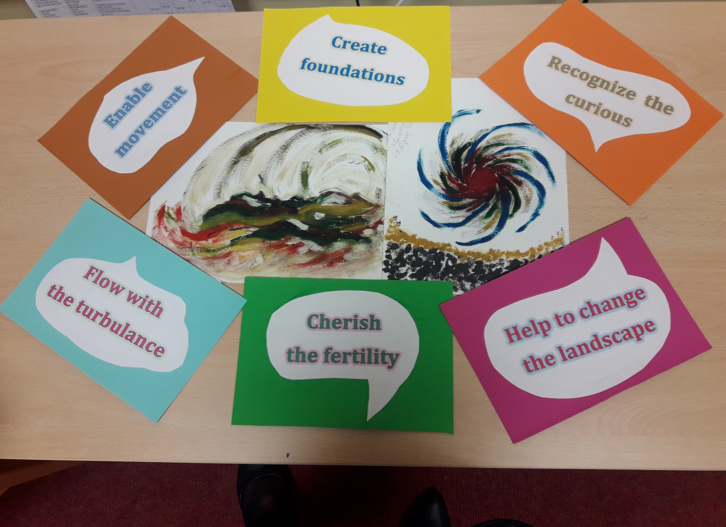

Dismantling silos through working differently
Critical companionship video & resource guide: Facilitating career progression from person-centred practice to person centred systems: DOMAIN 5: WORKING ACROSS SYSTEMS
Margaret Codd, Human Factors Lead Lorna Peelo-Kilroe, Director of Nursing The Health Service Executive
Republic of Ireland

Slide 2
Domain 5 Resources &
Recommended reading Main CC Frameworks & References
Critical companionship video & resource guide: Facilitating career progression from person-centred practice to person centred systems: DOMAIN 5: WORKING ACROSS SYSTEMS

