Slide 1
Personalised care and support planning in dementia
Dr Sarah Griffiths Senior Research Fellow University College London
22/01/2026
Research department of primary care and population health

Slide 2
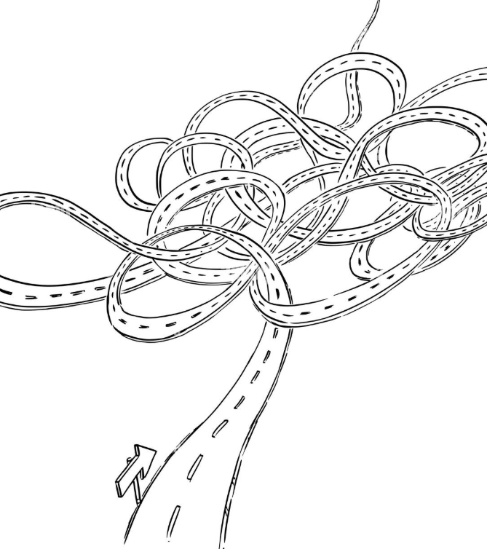
Pathway into dementia care research
Speech and language therapist (SLT)
Senior Lecturer BSc SLT course
PhD: Everyday conversations in Parkinson’s
Dementia Research Fellow – Plymouth
Senior Dementia Research Fellow – UCL

Slide 3

What is personalised dementia care planning
Person centred dementia care (Tom Kitwood)
“Personhood is a standing or status that is bestowed upon one human being by others, in the context of relationship and social being.”
“Dementia does not take away personhood – so core to this is the importance of relationships and communication.”

Slide 4
Personalised care, built on person centred care principles
World Alzheimer’s Report (2022) -Care plans: support needed, how it will be provided and by whom
NHS England (2017) - Achieved through ‘personalised conversations’ focusing on ‘what matters?’
Quality Outcomes Framework: Annual dementia reviews

Slide 5


PriDem: Best practice in primary care led dementia support (2018-2023)

Slide 6
Research Aims
Develop and test a primary care led model of post-diagnostic dementia support
Evaluate whether model is feasible and sustainable for primary care to implement long-term

Slide 7
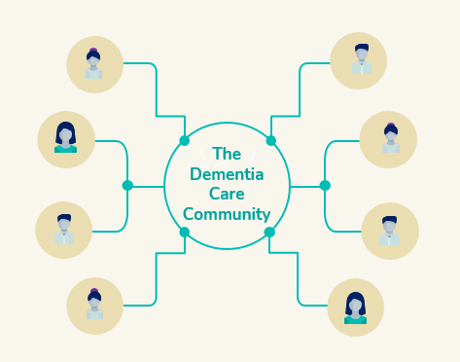
Developing the PriDem approach
Evaluating current ways of delivering dementia care
Identifying components of good practice in post-diagnostic dementia care
Developing an evidence-based approach for primary-care led post-diagnostic support

Slide 8
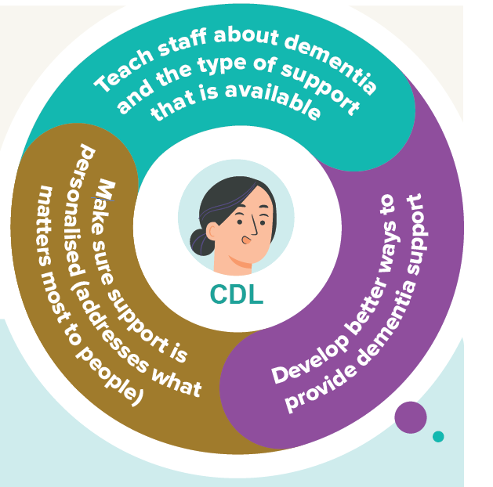
The PriDem approach
Primary care staff (GPs and GP practice staff) provide day-to-day dementia support, rather than specialists based in hospitals, who can be hard to access.
Clinical Dementia Leads (or CDLs) with expertise in dementia work with and support GP practice teams to improve/strengthen their dementia care systems

Slide 9
Testing the PriDem approach
Two Clinical Dementia Leads
7 GP practices - Southeast and Northeast of England
12 months intervention
Interviews
Audit

Slide 10
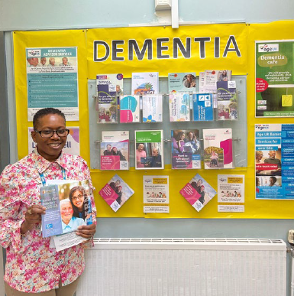
Some intervention highlights
Changes to annual dementia reviews
Practices becoming more ‘dementia inclusive’ e.g., signage, information stands
Formal/informal training delivered by CDLs to range of staff – including joint home visits
CDLs mapped national and local services and produced directories for practitioners

Slide 11
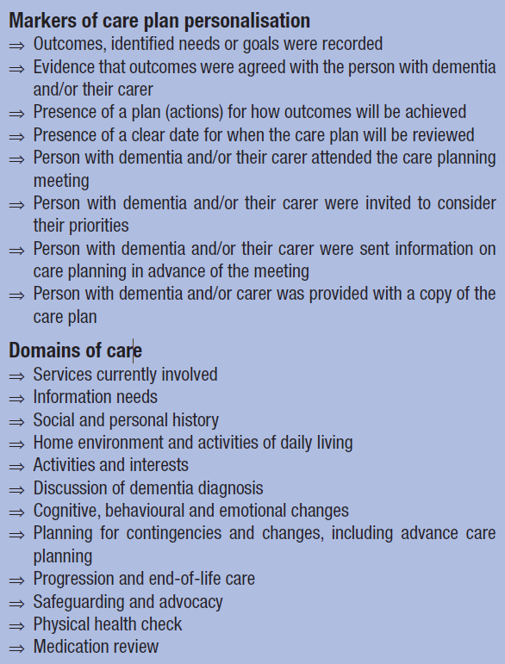
Audit
Comparing pre-intervention year (April 2018-March 2019) with intervention year (April 2022-March 2023)
Presence/absence of care plan
Degree of personalisation
Domains of care covered

Slide 12
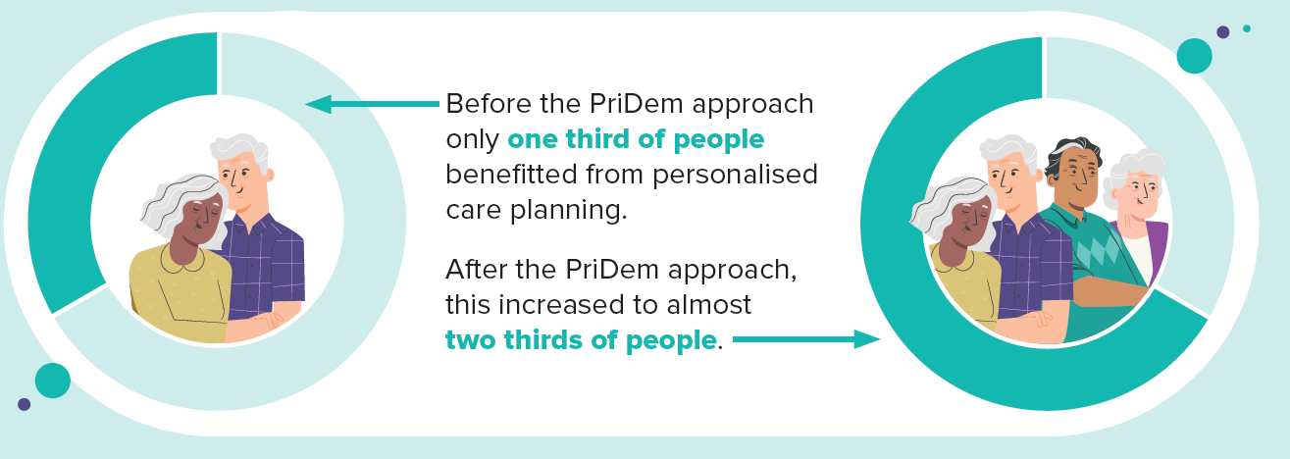

Slide 13
Changes within care plans
Indicators of personalisation increased across the board e.g., Agreeing outcomes with person with dementia more than tripled.
Most areas of care and support covered increased e.g., activities and interests. Suggests move to more holistic care planning

Slide 14
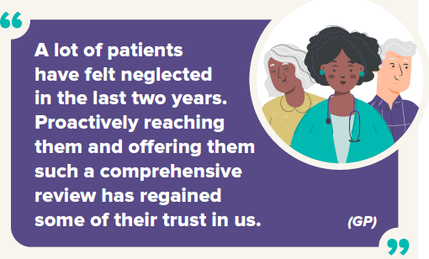
Examples of interview findings
Challenging the status quo: reimagining care planning
Most practices made changes to annual review and care planning systems e.g., One-Stop-Shops
(cited in local Dementia Strategy)
PriDem evidence-based resources used and adapted
CDLs helped staff improve their knowledge of local and national dementia services

Slide 15
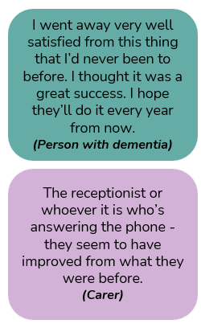
Positive and longer lasting effects
Staff feeling more confident and knowledgeable about supporting people with dementia and carers
Majority of people with dementia and carers found attending an annual review helpful
Some people noticed that the practices had become more dementia inclusive
Some changes sustained beyond project lifetime

Slide 16
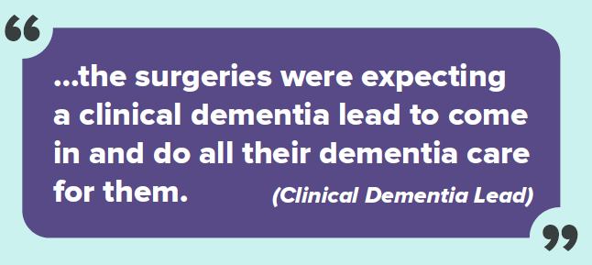
Clinical Dementia Leads = extra pair of hands
Areas that did not show improvement:
Progression of dementia and end of life care
(stayed at 5%)
Medication reviews (57% to 58%)
Copy of care plan shared with person with dementia/carer (1% to 4%)
Follow up after a care planning meeting
Challenges and areas for improvement

Slide 17
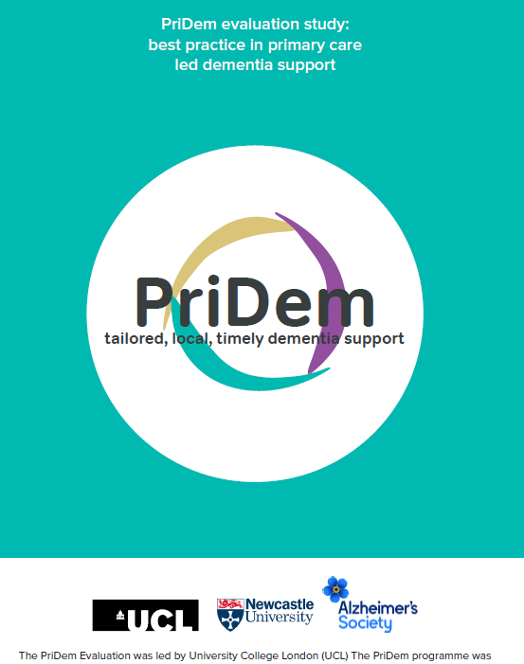
Find out more
PriDem information on Alzheimer’s Society website
https://www.alzheimers.org.uk/what-we-do/our-research/research-projects/pri-dem-project
Infographic
https://www.alzheimers.org.uk/sites/default/files/2024-12/PriDem_Infographic.pdf
Animation for people with dementia and carers
https://www.youtube.com/watch?v=9Jen1IxeNjU
Animation for practitioners and commissioners
https://www.youtube.com/watch?v=aiBBNMnfWiU
Study Report for practitioners and commissioners https://www.ucl.ac.uk/population-health-sciences/sites/population_health_sciences/files/pridem_report_for_practitioners_and_commissioners.pdf

Slide 18

CAPPD: Communication Aspects of Personalised Care Planning in Dementia Jan 2024 – Dec 2026

Slide 19
Background to the project
NHS England (2017) – Care planning achieved through ‘personalised conversations’ focusing on ‘what matters?’ - but lacks detail on how to have these conversations
Wider primary care workforce (e.g., social prescribers, dementia advisors, care co-ordinators, health and wellbeing coaches) to play a greater part in personalised care planning conversations
BUT many practitioners lack confidence in having these conversations

Slide 20
Aim of project: Develop ‘Training and Guidance Toolkit’: communication strategies for the wider primary care workforce
Supporting them to facilitate care planning conversations and work alongside GPs to provide holistic and timely personalised care.

Slide 21

📹
Collected 6.5 hours of video: real life care and support planning conversations
✅ Reviewed the research – and published a summary of it (see below)*
Effective dementia care and support requires both practical communication techniques and genuine emotional connection
Workshops where researchers, people with dementia, carers, and practitioners will use all the findings to create a training toolkit together
💬
Interviewed 11 people with dementia, 13 carers, and 19 practitioners about their experiences of care planning conversations
*Sunjaya, A. M., Schreiber, T., Kantilal, K., Davies, N., & Griffiths, S. (2025). Communication strategies for delivering personalised dementia care and support: a mixed-methods systematic review and narrative synthesis. Age and Ageing, 54(5) https://doi.org/10.1093/ageing/afaf120

Slide 22
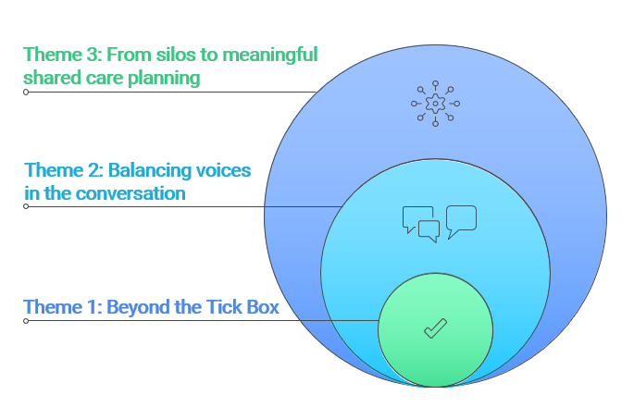
Interview findings – three themes

Slide 23
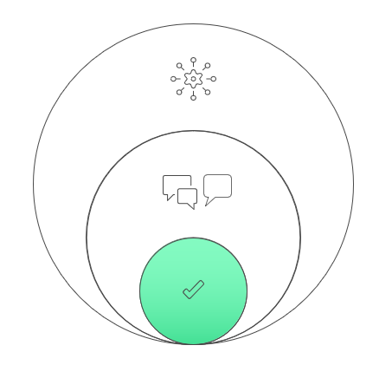
Theme 1: Beyond the tick box
Over reliance on check-list approaches
Time and preparation essential
Communication adaptations (e.g., visual resources)
Cultural humility
Unhurried talk enables storytelling, enables disclosure
Conversation as intervention
It was an entire tick box exercise whereby it was merely yes or no, and even if it was a no, it wouldn’t have made any difference, there was no follow-on from the no.
(Person with dementia)

Slide 24
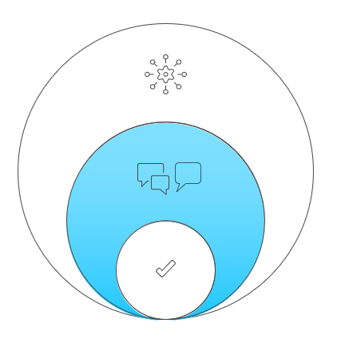
Theme 2: Balancing voices in the conversation
Conversations often default to carers
Carers feel pressured speaking on behalf of others
Differing perspectives are hard to manage
Skilled facilitation and careful framing are required
On the phone…you’re having to be really careful cos it’s my interpretation of what’s going on…it’s not necessarily correct, is it?
(Carer)

Slide 25
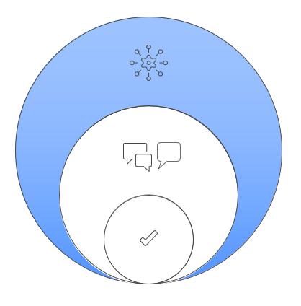
Theme 3: From silos to shared care planning
Social prescribers have time… I’d like us to be more connected to clinicians…Our job is to make their job better… We sit and talk…most doctors would love that luxury. If they guide us on what they want… what do you want us to do? What are you trying to achieve here …getting it nailed what this care plan is supposed to achieve.
(Social prescriber)
Dementia care often feels fragmented and confusing
Poor communication makes people feel lost and unsupported
Non-clinical practitioners have the time and capacity to do care planning conversations well
Services work in parallel rather than together
Better conversation and coordination could transform care
Notes:
This theme focuses on the wider system. It shows how hopes for personalised dementia care are often undermined by a fragmented and poorly connected system. Silos in this contexts means different services operating separately and not talking to each other or collaborating effectively
Dementia care often feels fragmented and confusing. People with dementia, carers, and professionals described a system that feels disjointed, with lots of different services that don’t seem to talk to each other. This leaves people unsure who is responsible for what, and where to turn for help.
Poor communication makes people feel lost and unsupported. Gaps in communication mean people often don’t understand their care, who is involved, or what a “care plan” even is. Many had never seen a care plan or been clearly involved in creating one.
Non-clinical practitioners have the time and capacity to do care planning conversations well, but don’t have the support or recognition to do this Roles like social prescribers and dementia advisors frequently become the default main point of contact for families. They have the time and relational skills to build trust and support meaningful conversations, but this work is often informal, unrecognised, and emotionally demanding.
Services work in parallel rather than together. Even when professionals can see each other’s notes, they rarely have time to talk and think together. This means care plans continue being tick-box exercises rather than living, shared guides that reflect changing needs.
Better conversation and coordination could transform care. When teams had time to talk, shared systems, and clearer roles, care felt more joined-up and person-centred. These findings show that meaningful care planning depends not just on forms and systems, but on real conversations—between professionals and with people with dementia and their carers.

Slide 26
Persistent gap between policy ambitions for personalised dementia care and practice
Time-poor, checklist-driven encounters and fragmented systems
NHS Dementia Training Standards - communication as core competency not yet consistently embedded

Slide 27
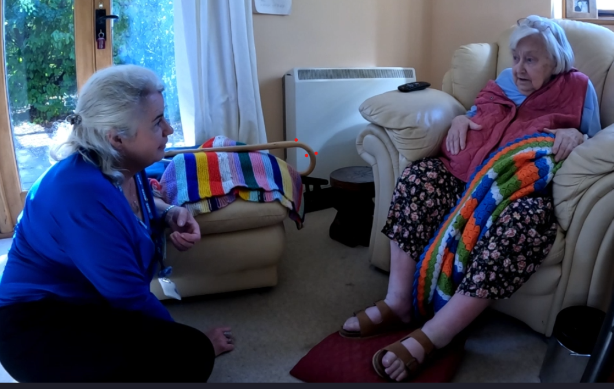
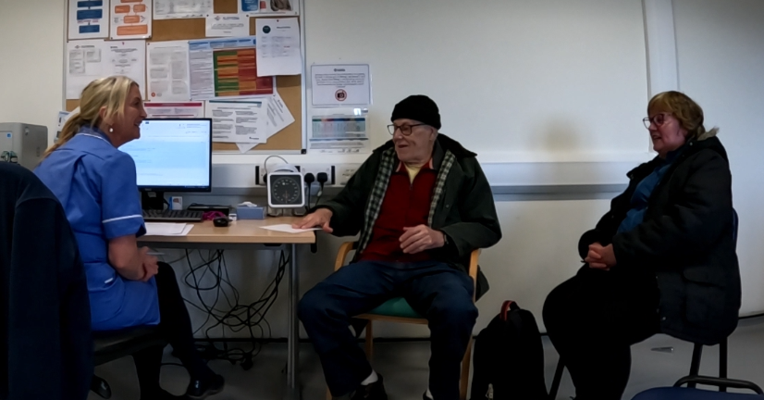

Video observations

Slide 28
Observation insights so far
Strengths
Potential areas for training
Preparing for the conversation
Structuring the conversation
How to ask questions
Missed opportunities to delve deeper
Use of visual resources
Providing reassurance
Use of joint problem solving
Normalising the use of strategies

Slide 29
There is a lack of robust evidence that having a care plan alone results in measurable benefits for people with dementia or their caregivers (Low et al, 2023)
Notes:
Low, L.F. et al. (2023). Care planning for community-dwelling people with dementia: a systematic scoping review
Maybe that’s because there is so much more to it that a care plan – the conversation as an intervention in itself

Slide 30

Thank you for listening
Questions and thoughts
Email: s.a.griffiths@ucl.ac.uk

