Slide 1
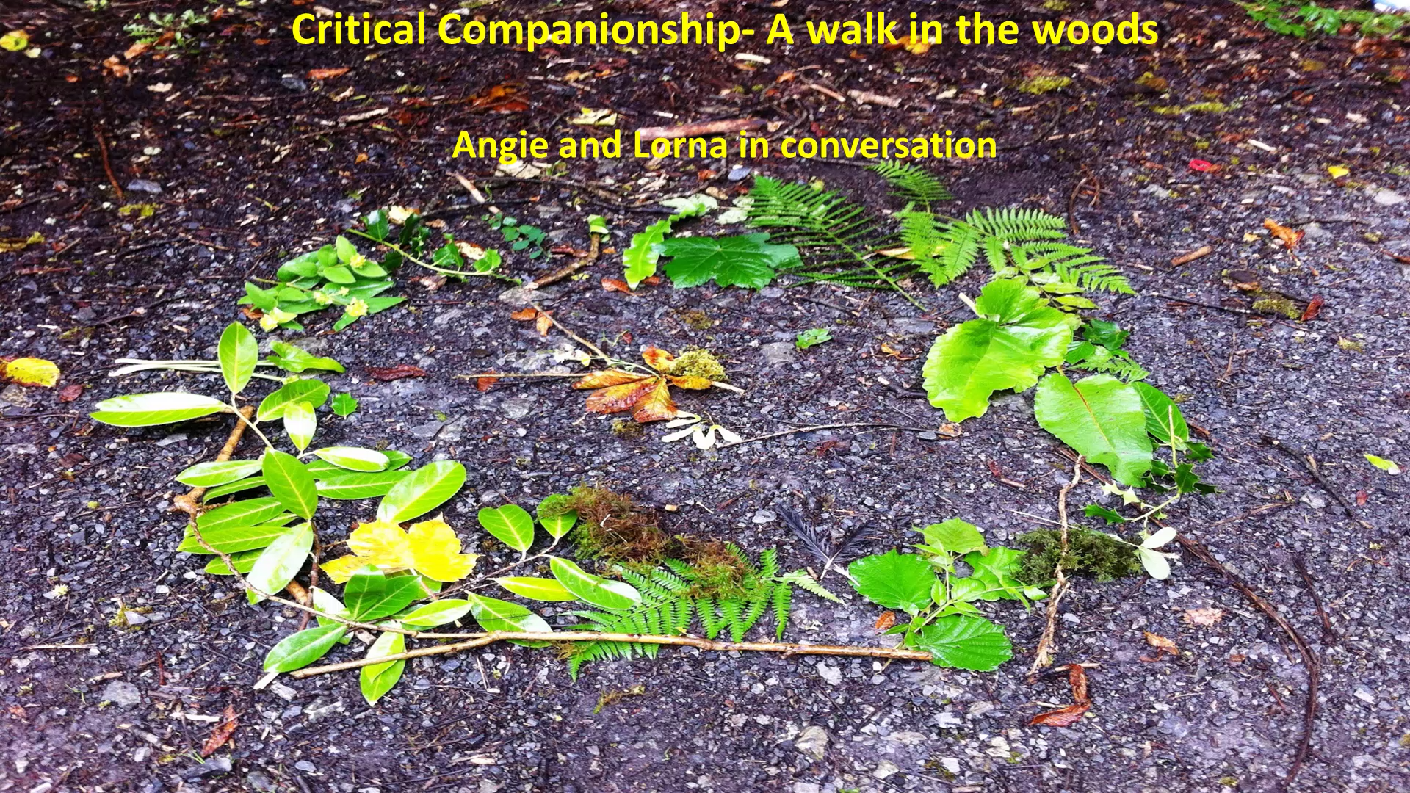

Lorna and I have been critical companions within a doctoral supervision relationship. At some point, I asked Lorna if she would help me with an inquiry question about how I could use critical creative approaches (particularly in Nature) in her supervision sessions. She eagerly agreed and what turned out to be a co-learning through co-inquiry was really powerful for us both.
The story to which this background relates, takes place when Lorna was a strategic leader in the Health Service Executive in the Republic of Ireland. Lorna had invited two groups of clinicians who practised in the community, in two overlapping palliative care services, to work with her in a collaborative, person-centred research study. Together, they decided that they wanted to create synergy between their services and to explore how, as critical companions, they could achieve this synergy in ways that enabled them to flourish. And to do this, collaboratively, through embedded research in which they would be looking at themselves as persons, as well as professionals. So right from the start, Lorna embodied the critical companionship process Mutuality, that is, working in partnership.
Early on, Lorna intuited that her companions would need help to step out of their usual ways of working, thinking and relating if they were going to achieve their goal of synergy and human flourishing. So she created space and conditions for this by suggesting, that at their next meeting, they go for a walk in the woods ….
Critical companionship video & resource guide: Facilitating career progression from person-centred practice to person centred systems: DOMAIN 2: LEARNING, DEVELOPING, IMPROVING

Slide 2
Domain 2:
Domain 2 Resources & Recommended reading
Main CC frameworks & references
Critical companionship video & resource guide: Facilitating career progression from person-centred practice to person centred systems: DOMAIN 2: LEARNING, DEVELOPING, IMPROVING

