Slide 1



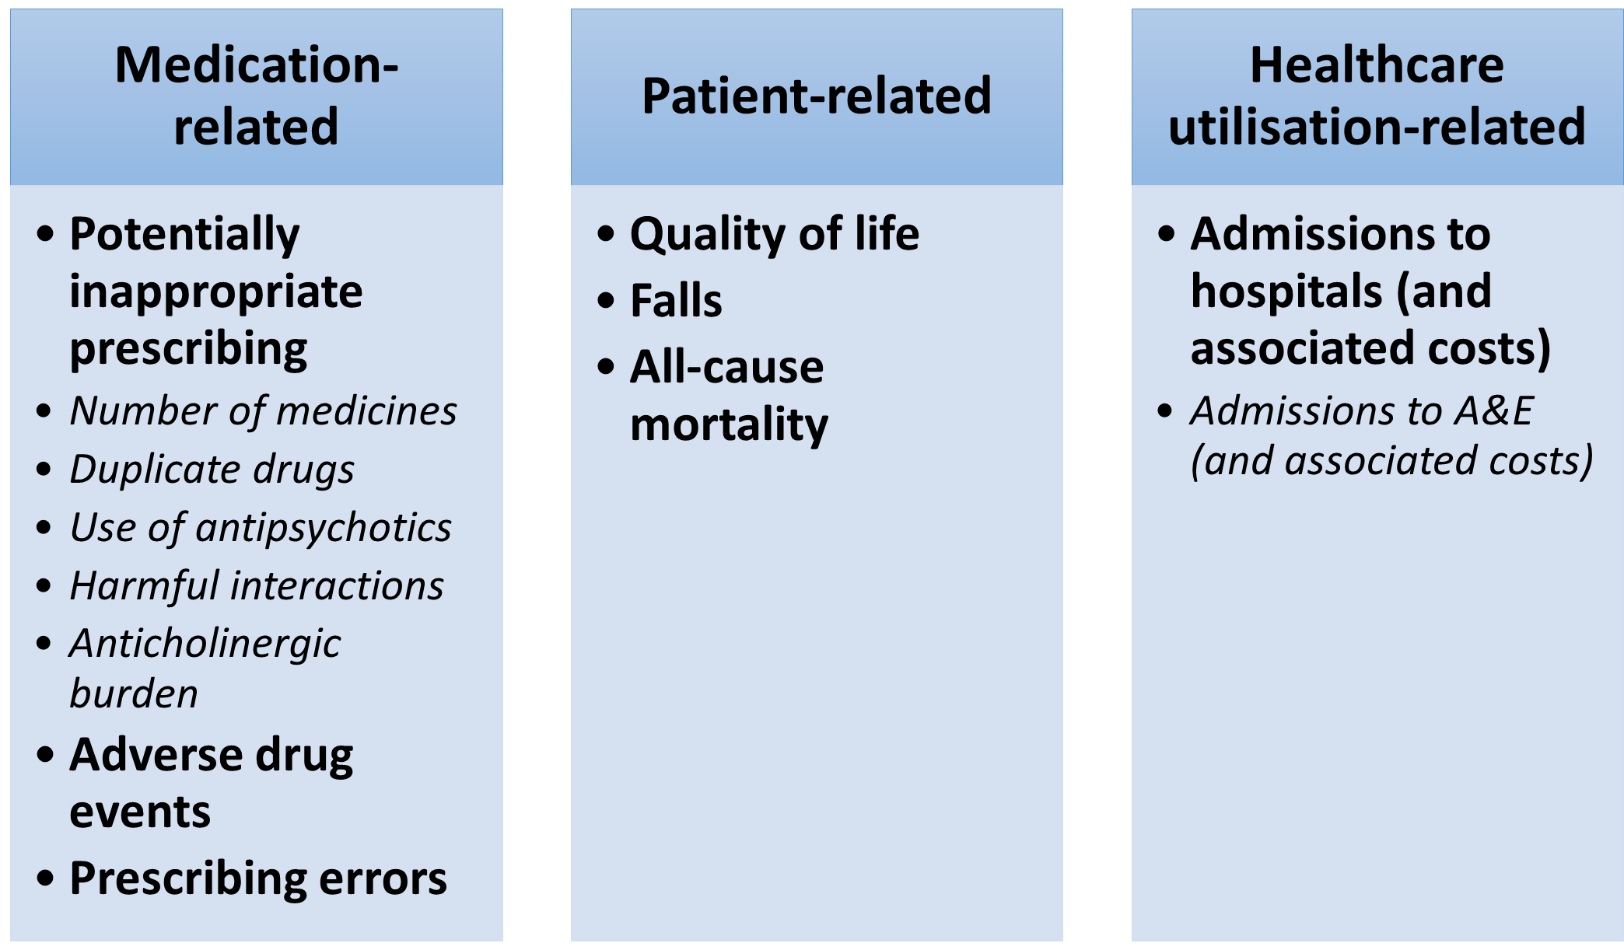

@CHIPPS_Study
uea.ac.uk/chipps/home
 anna.millar@qub.ac.uk
Anna Millar¹, Carmel Hughes¹, on behalf of the CHIPPS Team:
Wright D², Holland R², Alldred DP³, Arthur A², Barton G² , Blyth A², Bond C⁴, Daffu-O’Reilly A³, Desborough J², Handford C⁵, Hill H⁵, Inch J⁴, Lane K², Maskrey V², Massey K⁶, Myint PK⁴, Norris N², Notman F⁴, Poland F², Shepstone L², Small I⁶, Swart AM², Symms C⁷, Turner D², Zermansky A³
¹Queen’s University Belfast; ²University of East Anglia; ³University of Leeds; ⁴University of Aberdeen; ⁵Public and Patient Involvement in Research, Norfolk & Suffolk; ⁶NHS North & East London Commissioning Support Unit; ⁷NHS South Norfolk CCG.
Background
Medicines management for older adults in care homes (CHs) is known to be suboptimal for a variety of reasons including lack of responsibility for review of patients’ medicines. The Care Homes Use of Medicines Study (CHUMS) reported that ≥70% of CH residents are exposed to ≥1 medication error^{[1]} .
Consequently, it has been suggested that one person should take overall responsibility for medicines management in CHs.
CHIPPS is a 5-year (2015-2020) NIHR- funded programme of research which is aiming to determine the effectiveness and cost-effectiveness of pharmacist independent prescribers (PIPs) assuming responsibility of care home residents’ medications.
Led by the University of East Anglia, CHIPPS comprises 6 Work Packages with sites in Norfolk, Belfast, Aberdeen & Leeds.
CHIPPS Programme Overview
Focus on WP2: Core Outcome Set development
WP1
WP2
WP3
WP4
WP5
Feasibility study (involving 1 PIP, 1 GP Practice, 1 CH, 10 residents per site) over 3 months
WP6
Cluster- randomised controlled trial (involving total of 90 CHs and 900 residents with 6 PIPs per site) over 6 months
Development and testing of PIP training package
Development of health economic approaches (e.g. tools to capture costs associated with intervention)
Identification of outcomes to be measured in CHIPPS/development of a Core Outcome Set (COS) for all studies aimed at optimising prescribing in CHs
Systematic review of evidence on medicines optimisation / stakeholder involvement to inform PIP service specification & training programme
Background: Heterogeneity in outcome measurement across studies testing similar interventions is a recognised problem. A proposed solution is the development and use of COSs. A COS is a list of outcomes which should be measured and reported, as a minimum, in all effectiveness studies in a specific area ^{[2]}.
Method: 1) Potential outcomes for inclusion in the COS were identified (by review of published literature & stakeholder involvement). Stakeholders included GPs, pharmacists, CH managers & staff, CH residents & relatives. 2) A Delphi consensus exercise was conducted to refine the COS. An expert Delphi panel (n=19) rated the importance of the proposed outcomes. Inclusion criteria for the COS was defined as ≥70% of panel participants scoring the outcome as ‘very important’ and <15% scoring as ‘not important.’
Results: The final COS comprises 13 outcomes organised into 7 domains (in bold text below) and 3 overarching categories:
References:
[1] Barber ND, Alldred DP, Raynor DK et al. Care homes’ use of medicines study: prevalence, causes and potential for harm of medication errors in care homes for older people. Qual Saf Health Care. 2009; 18:341-6.
[2] Williamson PR, Altman DG, Blazeby JM et al. Developing core outcome sets for clinical trials: issues to consider. BMC Trials. 2012; 13:132.
Discussion/conclusion: We have developed a COS for effectiveness trials aimed at optimising prescribing in older adults in CHs. Future work should focus on evaluating appropriate tools for these key outcomes to further reduce heterogeneity in outcome measurement between studies.
CHIPPS acknowledges the support of the National Institute for Health Research Clinical Research Network (NIHR CRN).
This poster presents independent research funded by the National Institute for Health Research (NIHR) under its Programme Grants for Applied Research (PGfAR) Programme (Grant Reference Number RP-PG-0613-20007). The views expressed are those of the author(s) and not necessarily those of the NHS, the NIHR or the Department of Health.

