Slide 1
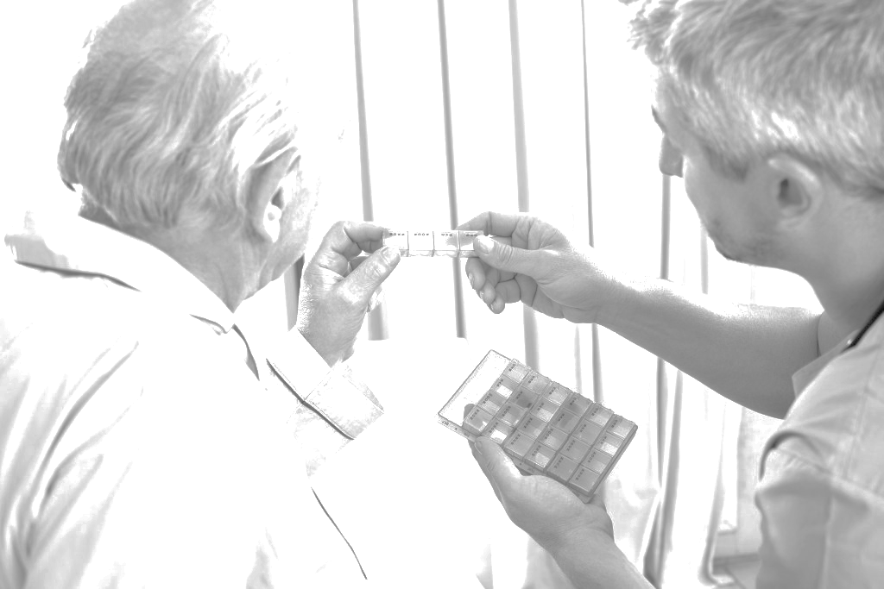

Care Homes Independent Pharmacist
Prescribing Study (CHIPPS): Feasibility study
Frances Notman
on behalf of CHIPPS team
Notes:
Blue text slide with orange bullet points

Slide 2
Background: the context
Medicines use in care homes is suboptimal
One person should assume overall responsibility for medicines management
Pharmacist independent prescribing (PIP) provides an opportunity for pharmacists to assume this role
National programmes investing in increased pharmacist roles
Care homes are an identified priority area
Evidence needed to develop services

Slide 3
Aim and objectives
Aim: To develop and deliver a cluster randomised controlled trial to assess the effectiveness and cost effectiveness of pharmacist independent prescribers (PIPs) assuming responsibility for medicines management within care homes compared to usual care
Main Objectives:
  test and refine service specification
  assess service and research acceptability
  explore recruitment and retention
  evaluate potential outcome measures
  assess appropriateness of PIP training package

Slide 4
CHIPPS Overview
WP1: Systematic Review (SR) of evidence on medicine optimisation, stakeholder views, service spec.
WP2:Identification and evaluation of potential out come measures
WP3: Development of Health Economic approaches
WP4: Develop and test training
WP5: Non-randomised feasibility study
WP6: RCT with internal pilot

Slide 5
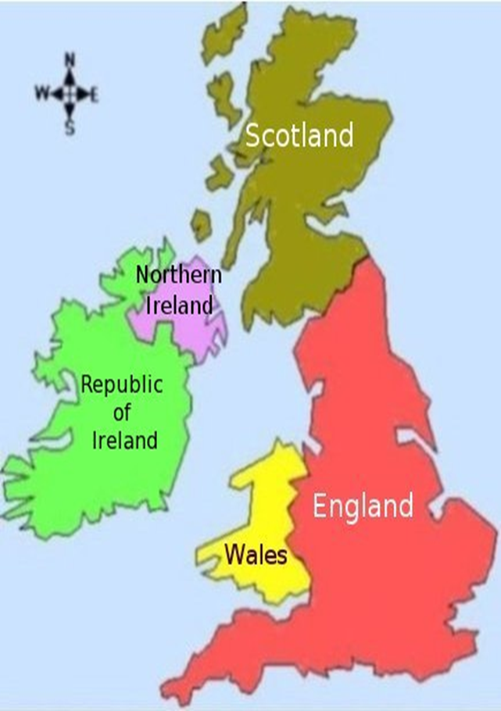

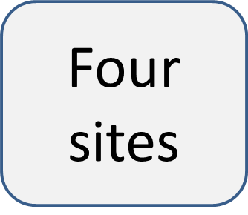



Method
GP/PIP
Registered PIP
Trained and competent
CH (s)
Working with GP
10
residents
65 years and older
At least one regular med
16 hours per month
Not end of life

Slide 6
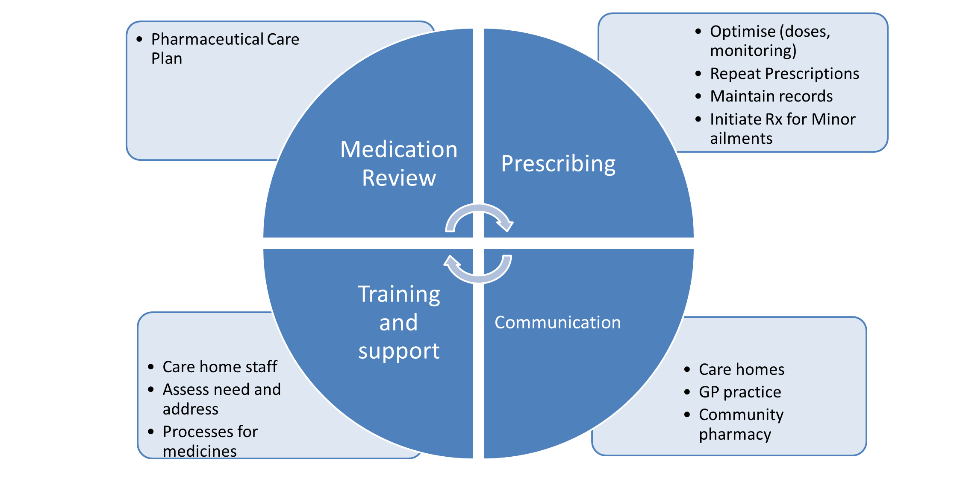
PIP Service

Slide 7
Qualitative outcomes- Interviews
GP, CH manager and staff, Relatives
Overall very positive
Minimal changes suggested
Few negative comments

Slide 8
Qualitative outcomes- Interviews
I’ve been struggling with getting the monthly script and the systems the cycles already started ….think with the research project on … this is what the care homes need (DementiaNurseLeeds)
….we’ve been looking at somebody who we want some pain relief, it didn’t arrive, it was supposed to arrive on Friday ……..but one word from XXXX (PIP) and there it is. N01/01CHMan
I think pharmacists are increasingly a crucial resource within primary care and there have been moves over the last couple of years to bring in more pharmacists to GP practices on a full time basis. (B01GP)
If GPs want us to alter things you know they have to send faxes and I know they’re busy, so she’s kept us safe and it’s been easy to make those changes really, really quickly, so no, it’s been really safe practice for us. (BCHM03)
I think it’s of benefit in this setting. I think, I think one of the main problems we have sort of in this setting getting medications is getting past the receptionists in the GP surgery, they’re very much programmed into the computer says, you can’t have this and it’s, you know, I go through look it’s gone out of cycle because x, y, z, this is a new drug, we’re in the middle of our medicine cycle, I need this and it’s just like, it’s trying to just get through layers and layers and layers before you actually get through to the person that you need to. So having somebody that you can say I need to speak to XXX (PIP), or whatever, and explaining to them and literally having it sorted out immediately can only be a benefit …. (B01/CHstaff)
I think you know overall it just had led to better patient care, better medicines management you know for those patients and nursing homes. (B01GP)
Well, I know his respiradone had been reduced and he’s much more like himself now, although the psycho- geriatrician did mention about reducing that as well but, he’s just back to his old self really, I think he’s on the minimum dose now morning and night so he’s less sleepy and more with it and just you know carrying on a conversation just as usual. So I see a big difference in him now that’s been reduced. B01-02-007 REL
so I think it has to be that the service becomes more effective, you know, residents will be reviewed more regularly with the service, which makes their life a better quality of living, especially if they’re in pain and not getting the right type of pain relief, you know, and GPs just firing out different things, they can really hone in on it as well. And also it will save the care home and the NHS (money). (BCHM03)
I also know there’s a professional behind me that’s doing something that I don’t have to double check at all. I don’t have to turn round and double check what she’s doing as this day of audits and auditing everything that happens, with somebody like that around I have got somebody else to share the job… N01/01 CHMan
‘I think the pharmacist was able to spend more time with us and the resident looking at the medications that they were on, speaking to the staff who knew the residents really well and getting a detailed history which unfortunately we know the GPs haven’t got the time to do …..really helpful, yeah.’ (A0101CHMAN)
because XXXX (PIP) is going in and dealing with maybe some of the issues that we would have dealt with in the past, that there’s the potential that you see your patients less and you have less of a close relationship with some patients in the nursing homes so that would be a potential negative going forward(B01GP)
so we see it as a very positive thing. XXX (PIP) brings a lot of knowledge and time-efficiency to us and we work I guess side by side is the best way to put it. (A01/01/GP)

Slide 9
Focus groups: PIP
Service pressures impacting on time to meet care home staff
Pharmaceutical Care Plans were time consuming
Difficulty meeting GP (CCG employed pharmacist)
Suggested time insufficient (20 hours cf 16 hours per month
Training appropriate

Slide 10
Focus groups: PIP
…and I think that’s fine if you have a good working relationship with that GP practice and from my point of view I’ve worked with them for a long time, it’s a care home that I know well, there’s not going to be anything too awful on that because I’d been dealing with that care home so I have that kind of reassurance, whereas if you were an independent prescriber pharmacist going in and it was a strange GP practice and you didn’t know any of the residents, then actually signing those prescriptions before you’ve actually done your care plan is perhaps a big ask…(A01Ph)
It (the training) has made you more motivated and … more confident in going in and making changes to a patient’s medications (PIP)

Slide 11

Acknowledgement
This presentation summarises independent research funded by the National Institute for Health Research (NIHR) under its Programme Grants for Applied Research Programme (Grant Reference Number RP-PG-0613-20007). The views expressed are those of the author(s) and not necessarily those of the NHS, the NIHR or the Department of Health.
The CHIPPS Research team acknowledges the support of the National Institute of Health Research Clinical Research Network (NIHR CRN).

Slide 12
CHIPPS Research team https://www.uea.ac.uk/chipps
D. Wright Professor of Pharmacy Practice, University of East Anglia
R. Holland Head of Medical School and Professor of Public Health Medicine, University of Leicester
D.P. Alldred Associate Professor of Pharmacy Practice, University of Leeds
A. Arthur Professor of Nursing Science, University of East Anglia
G. Barton Professor of Health Economics, University of East Anglia
A. Blyth Research Fellow, University of East Anglia
C. Bond Professor of Primary Care, University of Aberdeen
A. Daffu-O’Reilly Research Fellow, University of Leeds
J. Desborough Senior Lecturer in Pharmacy Practice, University of East Anglia
J. Ford Consultant in Older Peoples' Medicine, NNUH NHS Foundation Trust
C. Handford Public and Patient Involvement in Research, Norfolk and Suffolk
H. Hill Consultant, Director Healthcare Homes, Essex
C. Hughes Professor of Primary Care Pharmacy, Queens University
J. Inch Research Fellow, University of Aberdeen
V. Maskrey Research Fellow, University of East Anglia
K. Massey Public and Patient Involvement in Research, Norfolk and Suffolk
A. Millar Research Fellow, Queen’s University Belfast
P. Myint Professor of Old Age Medicine, University of Aberdeen
N. Norris Professor of Education, University of East Anglia
F. Notman Research Fellow, University of Aberdeen
F. Poland Professor of Social Research Methodology, University of East Anglia
L. Shepstone Professor of Medical Statistics, University of East Anglia
I. Small Deputy Head of Prescribing Pharmaceutical Medicine, NHS Commissioning Board
AM. Swart Professor of Medicine and Epidemiology, Director Norwich CTU, University of East Anglia
C. Symms Sponsor’s Representative, Norfolk & Suffolk Primary and Community Care Research Office, NHS South Norfolk Clinical Commissioning Group, Norfolk
D. Turner Senior Research Fellow Health Economics, University of East Anglia
A. Zermansky GP and Visiting Honorary Senior Research Fellow, University of Leeds

