Slide 1
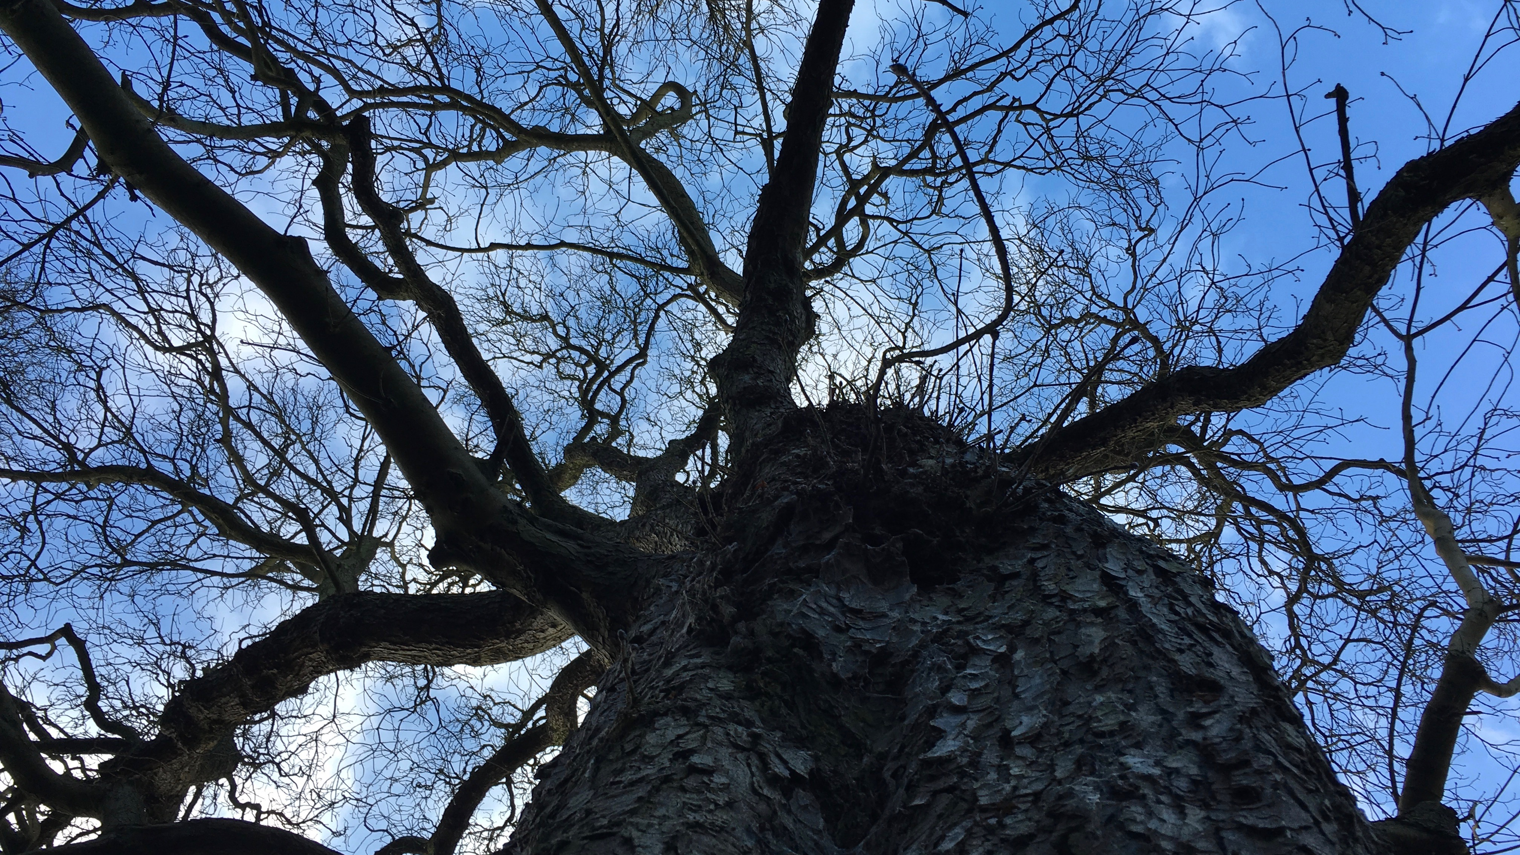

Critical companionship video & resource guide: Facilitating career progression from person-centred practice to person centred systems
DOMAIN 1: BUILDING ON EXPERT PERSON-CENTRED PRACTICE THROUGH CRITICAL COMPANIONSHIP
Journey to Consultant Practitioner and Beyond: Jonathon Webster in conversation with Angie Titchen

