Slide 1

Aims of the session
To provide an introduction to the Secure Base model
To consider ways of applying the model to practice

Slide 2
What is the Secure Base model?
A framework for therapeutic caregiving
Based in every day interactions of family life
Promotes security and resilience
Drawn from theory, research and practice

Slide 3
Who can use the Secure Base model?
Foster carers and adopters
Social workers
Residential workers
Any professionals involved in promoting children’s learning and development

Slide 4
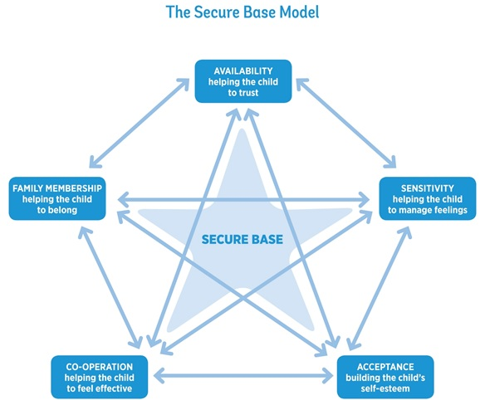

Slide 5
Caregiving dimensions that promote security and resilience
Availability – helping the child to trust
Sensitivity – helping the child to manage feelings
Acceptance – building self-esteem
Co-operation – helping the child to feel effective
Family membership – helping the child to belong

Slide 6
Why are secure base relationships important?
Provide comfort, closeness, reassurance
Reduce anxiety
Promote exploration, learning, development

Slide 7
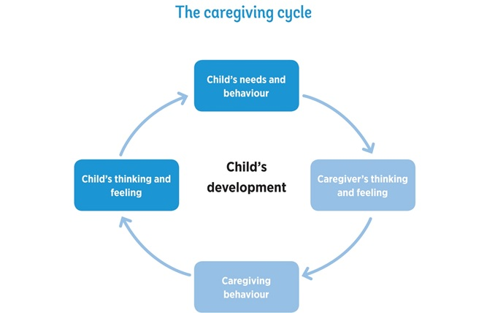

Slide 9
Therapeutic caregiving might involve:
Thinking differently
Doing differently
Being persistent
Trying different approaches

Slide 10
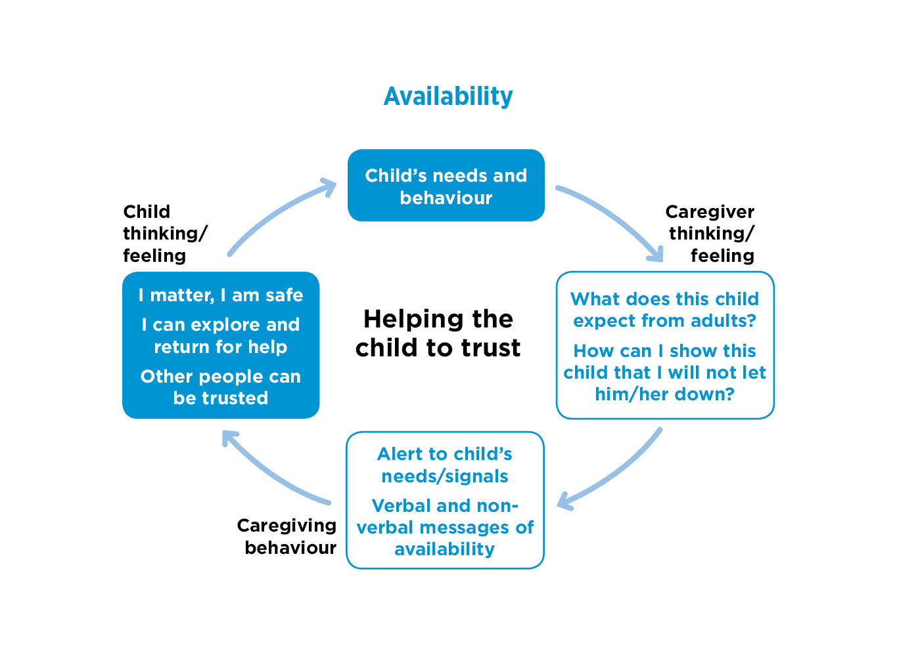

Slide 11
Behaviour that suggests lack of trust
Infants (0 – 18 months)
Early childhood (18 months – 4 years)
Middle childhood (5 – 10 years)
Adolescence (11 – 18 years)

Slide 12
Availability: caregiver thinking
What does this child expect from adults?
How can I show this child that I will not let him/her down?

Slide 13
Availability – caregiver behaviour
‘Being there’ - physically and emotionally
Alert to child’s needs and signals
Take the relationship at the child’s pace
Verbal and non-verbal messages of availability - including when apart

Slide 14
Being alert to the needs and signals of a small baby
When Jennie came to me at 12 weeks old, she was completely unresponsive, not waking for feeds, not responding to me, not showing any emotion. She had just switched off. I had to stay close to her and respond to even the slightest sound or facial movement and keep talking to her and touching her. It took time to replace those first weeks, but gradually she started to show different feelings and become more responsive. (Foster carer)

Slide 15
Helping a child to trust in the caregiver’s availability when they are apart
When Aiden (4) had contact with his father he was always very anxious about what might happen and whether he would come back to me and I would be here for him. On one occasion I gave him a small cushion to take with him so that he had something to hold onto, but also so that he would know he would be coming home. (Foster carer)

Slide 16
Demonstrating availability to teenagers
I try, if they talk to me, to stop what I’m doing. Because there’s a lot of young people in the house, I feel it’s important because otherwise, opportunities disappear. With Liam (13) in particular, I might take the long road home if I sensed he wanted to talk about something. (Adopter)

Slide 17
Availability: child thinking and feeling
I matter, I am safe
I can explore and return for help
Other people can be trusted

Slide 18
Refreshment break

Slide 20
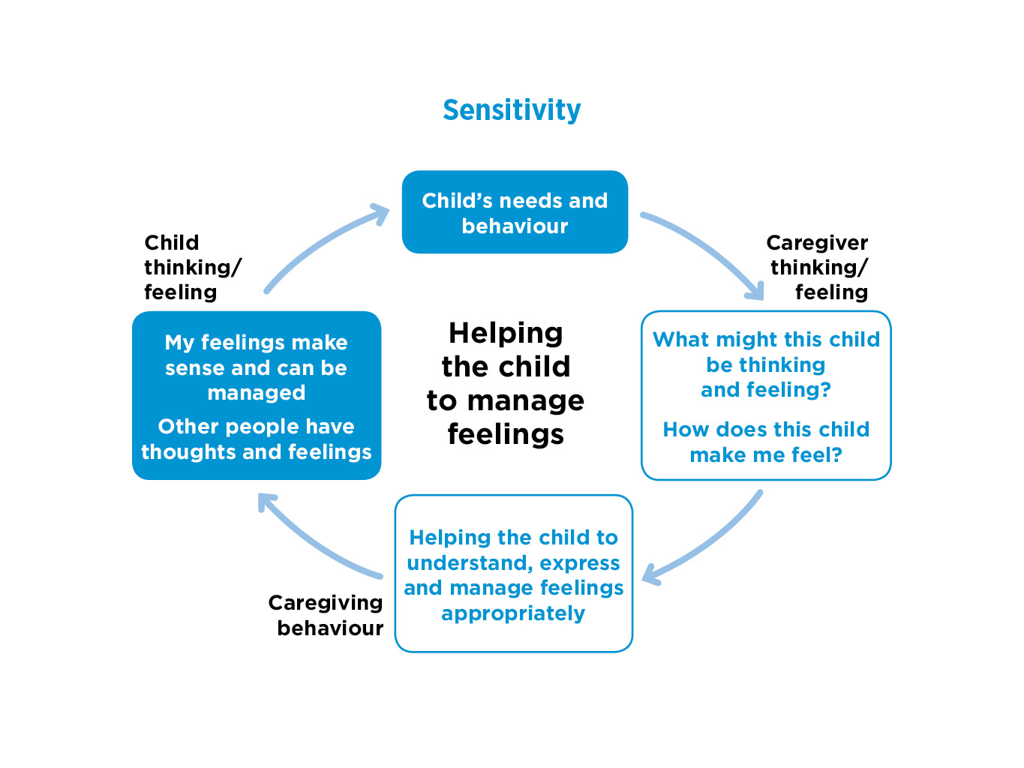


Slide 21
Children’s needs and behaviour when feelings cannot be managed
Feelings shown excessively
Feelings denied or repressed
Feelings chaotic or dissociated
Feelings expressed through bodies

Slide 22
Sensitivity: caregiver thinking and feeling
What might this child be thinking and feeling?
How does this child make me feel?

Slide 23
Exercise 2
What might this child be thinking and feeling?
Write some statements from the child’s perspective. E.g. ‘I am not loveable’.
What might this caregiver be thinking and feeling?
Write some statements from the caregiver’s perspective. E.g. ‘He doesn’t like me’.

Slide 24
Case examples
Jay (6 months) has just come into foster care. Previously, jay had many caregivers, many were neglectful. He is pale and lifeless and he sleeps a lot. He doesn’t smile or interact with his caregivers.
Connor (3) has recently been placed in an adoptive family. He spent nearly two years with his bridge foster family. He is tearful. He says he wants things (e.g. a bath or certain foods) and then refuses them.
When Jamilla (7) is praised or admired she seems angry and says ‘don’t say that’. Often she will then do something ‘naughty’ to invite a negative response.
Alisha (15) is in a new placement. She was rejected in her birth family and has had three moves including an adoption breakdown. She spends most of her time in her bedroom and has started to scratch her arms.

Slide 25
Sensitivity – caregiver behavior
Describe and name feelings
Provide a verbal and non-verbal ‘commentary’ to daily events
Use practical tools to help the reflect on feelings
Promote empathy in the child

Slide 26
Using stories to promote empathy
I think Jenna (9) spent so long in self-defence and looking after herself that she never learned to look at things from anyone else’s point of view. Even things like stories. When you say, ‘why is that person doing that?’, she hasn’t got a clue, she doesn’t follow the motives of what people are doing, or how they are feeling. So we do a lot of story reading together and I talk it through. (Adopter)

Slide 27
Using an experiences book
Paula (8) couldn’t remember or didn’t want to remember what happened this morning or yesterday or last week and couldn't anticipate ‘next week’. So we started to do an experiences book together – each day writing down what had happened and her feelings about it. This helped her to reflect on the shape of each day and the immediate past and build her capacity to remember. (Foster carer)

Slide 28
The worry jar
Sometimes he will really shout and stomp about, so you know something is brewing and he won’t tell anybody, because he doesn’t want to upset anybody. So he has a worry jar, he writes it and puts it in a worry jar and that goes under his bed and then when he wants me to read it, he gives me the jar and I read his worries. Because if it is out of you, you feel better. (Foster carer)

Slide 29
Sensitivity: child thinking and feeling
My feelings make sense to others and so can be managed
Other people have feelings

Slide 31
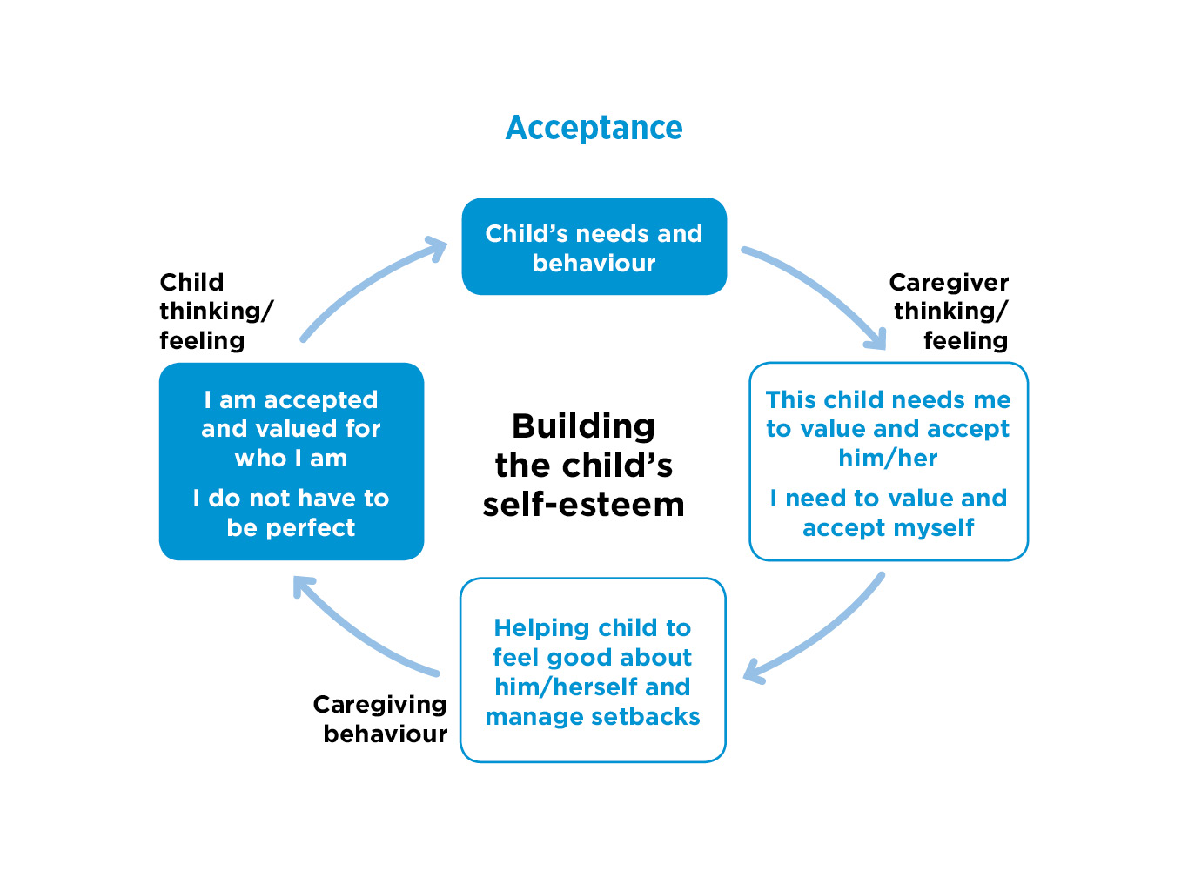


Slide 32
Children with low self-esteem
May:
Have had experiences of abuse and neglect
Feel unworthy of love, success, praise
Fear failure
Defend themselves with untrue claims

Slide 33
Acceptance: caregiver thinking and feeling
This child needs me to value and accept him/her
I need to value and accept myself

Slide 34
Acceptance – caregiving behaviour
Praise and positive attention
Encourage activities and interests
Model and teach the child to accept and celebrate difference – ethnicity, personality, talents
Support setbacks and disappointments

Slide 35
Offering targeted praise
She’s not used to being praised and she doesn’t always make the connection, so you have to spell it out to her. Instead of just ‘well done’ we might say ‘you’ve done really well to get a good behaviour star. You must have tried hard. We’re proud of you’. (Foster carer)

Slide 36
Building self-esteem through activities
We encourage a lot of activities, because we want to build her confidence and get her to be more sociable. So she goes to theatre school, and since she has done this we feel her confidence has grown more. I mean this year she took the part of the main character in the school play and she was amazing – and she knew she was. (Foster carer)

Slide 37
Acceptance
How might these children be helped to build self-esteem?

Slide 38
Case studies
Jay (6 months) has just come into foster care. Previously, jay had many caregivers, many were neglectful. He is pale and lifeless and he sleeps a lot. He doesn’t smile or interact with his caregivers.
Connor (3) has recently been placed in an adoptive family. He spent nearly two years with his bridge foster family. He is tearful. He says he wants things (e.g. a bath or certain foods) and then refuses them.
When Jamilla (7) is praised or admired she seems angry and says ‘don’t say that’. Often she will then do something ‘naughty’ to invite a negative response.
Alisha (15) is in a new placement. She was rejected in her birth family and has had three moves including an adoption breakdown. She spends most of her time in her bedroom and has started to scratch her arms.

Slide 39
Acceptance: child thinking and feeling
I am accepted and valued for who I am
I do not have to be perfect

Slide 40
Lunch break

Slide 42



Slide 43
Why do some children find it hard to co-operate?
Little experience of co-operation with others
Lack confidence in getting their needs met
The care system may have increased sense of powerlessness

Slide 44
Co-operation: caregiver behaviour
Clear rules and boundaries/willing to negotiate within them
Offer safe choices
Help the child to achieve results
Use fun and playfulness where possible/appropriate
‘Attending’ - allowing child to take the lead

Slide 45
Attending
George (3) would only relax in the garden, so although it was winter we wrapped up warm and everyday we spent time outside. He would potter about, looking at stuff and I would follow him sometimes and talk occasionally and he would stop and he’d look at an insect, or whatever it was he’d found. I pretty much let George lead, but sometimes I’d draw his attention to things. (Foster mother)

Slide 46
Helping an oppositional child to feel effective
We try, actually, never to tell Salim (7) to do anything. It’s a matter of phrasing it differently, so that you are not triggering his feelings of threat. So, instead of saying, ‘Please wash your hands before you have a sandwich’ we might just say ‘Would you like to come and have a sandwich after you’ve washed your hands?’ (Adopter)

Slide 47
Using fun to achieve co-operation
Kane (7) often doesn’t want to go to bed. He loves stories and when it is bedtime, I might say ‘race you up the stairs. First one up gets to choose the story’. This works well as Kane knows that I will choose a shorter story, and Kane wants a long story. Kane is eager to run upstairs first so that he can choose his long story. Bedtime is no longer a battle. (Foster carer)

Slide 48
Helping children to feel effective/ be co-operative
Taylor (6 months) does not show interest in toys
James (4) can’t sit still, runs around, jumps on furniture
Toby (8) is angry. He often kicks the cat
Annette (15) stays out later than agreed

Slide 49
Co-operation: child thinking and feeling
I feel effective
I can make choices
I can co-operate with others

Slide 51
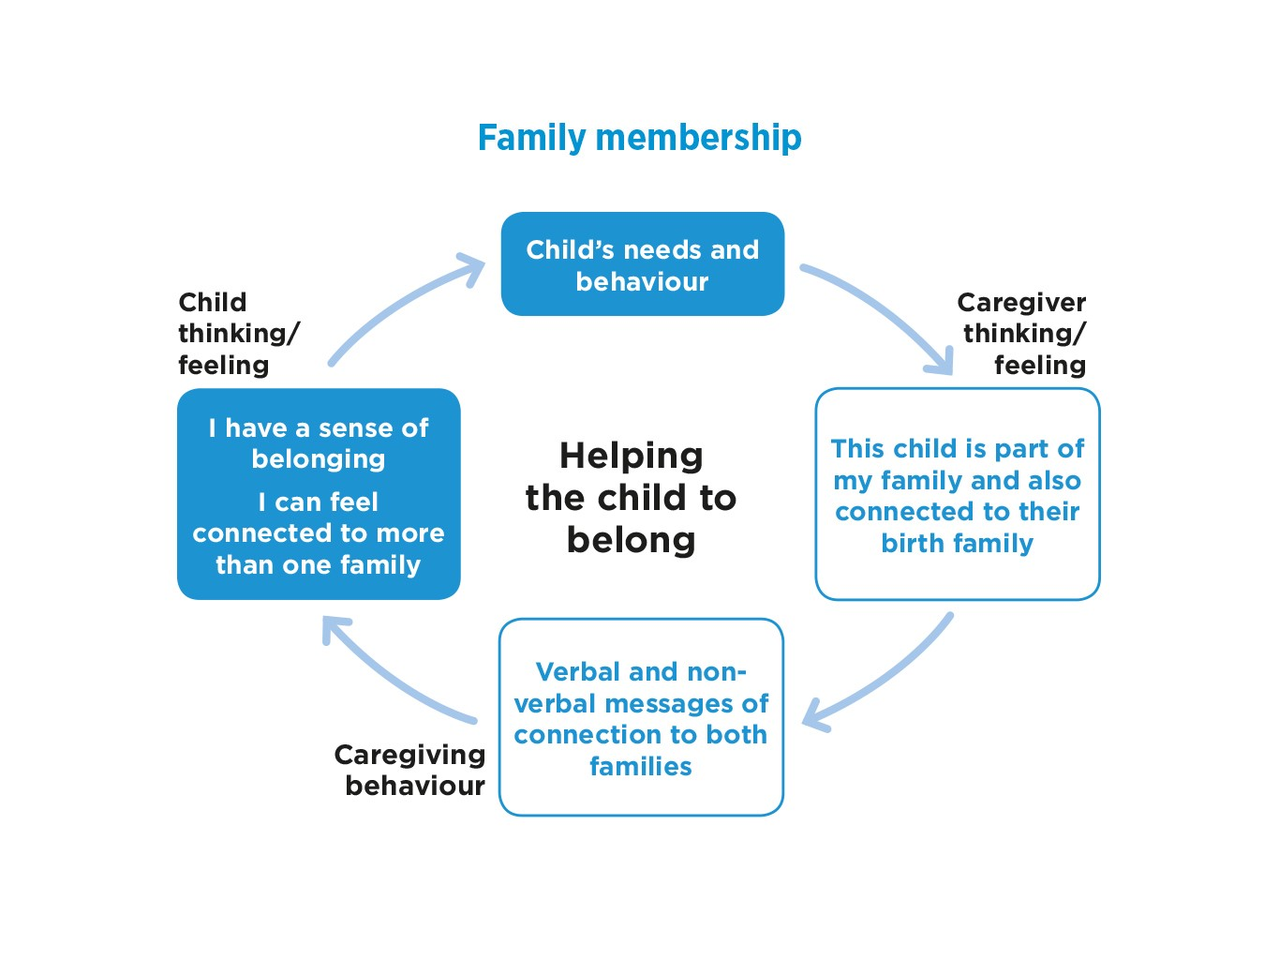

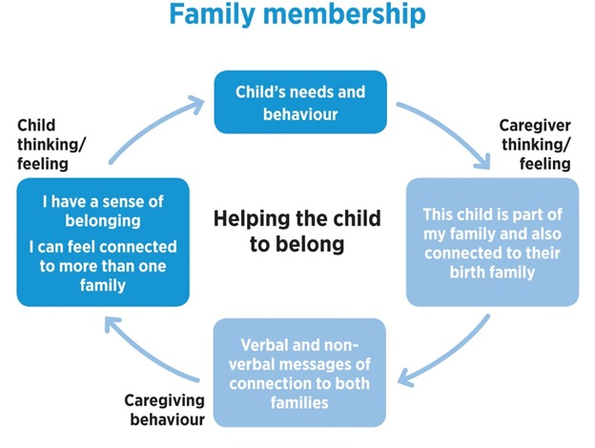


Slide 52
Family membership
Why is family membership important for all children?
Which of these things can present additional challenges for looked after and adopted children?

Slide 53
Family membership: caregiver thinking and feeling
This child is part of my family
And also connected to their birth family

Slide 54
Family membership: caregiver behaviour
Help the child to feel welcome in the family
Make physical space for child
Promote birth family identity
Manage contact positively

Slide 55
Foster family membership
We always say – from the moment you walk through the door, you are part of us. No matter how long you’re staying or how many other families you relate to, you are part and parcel of our family, the same as everyone else who lives here. We say it and we show it to them as well. (Foster carer)

Slide 56
Birth family membership
My foster family is amazing! They have given me opportunities that I would have never been able to have and it is really lovely how much they are there for me. You know, because I am not with my family, they sort of fill that space, but never replace. They wouldn’t, they are respectful, they know how much I love my family, they know that I care so much equally about all of them and that I could never choose between them. (Young person in long-term foster care)

Slide 57
Comfortable contact
I usually see my (birth) grandad once a fortnight if I can. He’s 83. he used to be in the Navy so that kept him fit and stuff. When I go down there we read the news, talk about stuff, maybe I’ll watch a bit of telly, he reads his book and makes me egg and chips and then I go home. (Young person (16) in long-term foster care)

Slide 58
Family membership: child thinking and feeling
I have a sense of belonging
I can belong (comfortably) to more than one family

Slide 59
Refreshment break

Slide 60
Using the Secure Base model
Assessment of children in any context
Assessing, preparing and supporting foster carers and adopters
Matching
Placements – assessing progress, setting goals and monitoring progress
Assessing placements in difficulties

Slide 61
Secure Base website
https//www.uea.ac.uk/providingasecurebase

Slide 62
Using the Secure Base model
How might you/your team/your organisation use or develop the use of the Secure Base model?
List the next steps that you would need to take to achieve this

Slide 63
Additional resources
Schofield, G and Beek, M (2006) Attachment Handbook for foster care and adoption, London: BAAF.
Schofield, G and Beek, M (2014) The Secure Base model: promoting attachment and resilience in foster care and adoption, London: BAAF.
Schofield, G and Beek, M (2014) Promoting attachment and resilience: a guide for fostrer cares and adopters on using the Secure base model, London: BAAF.

