Slide 1
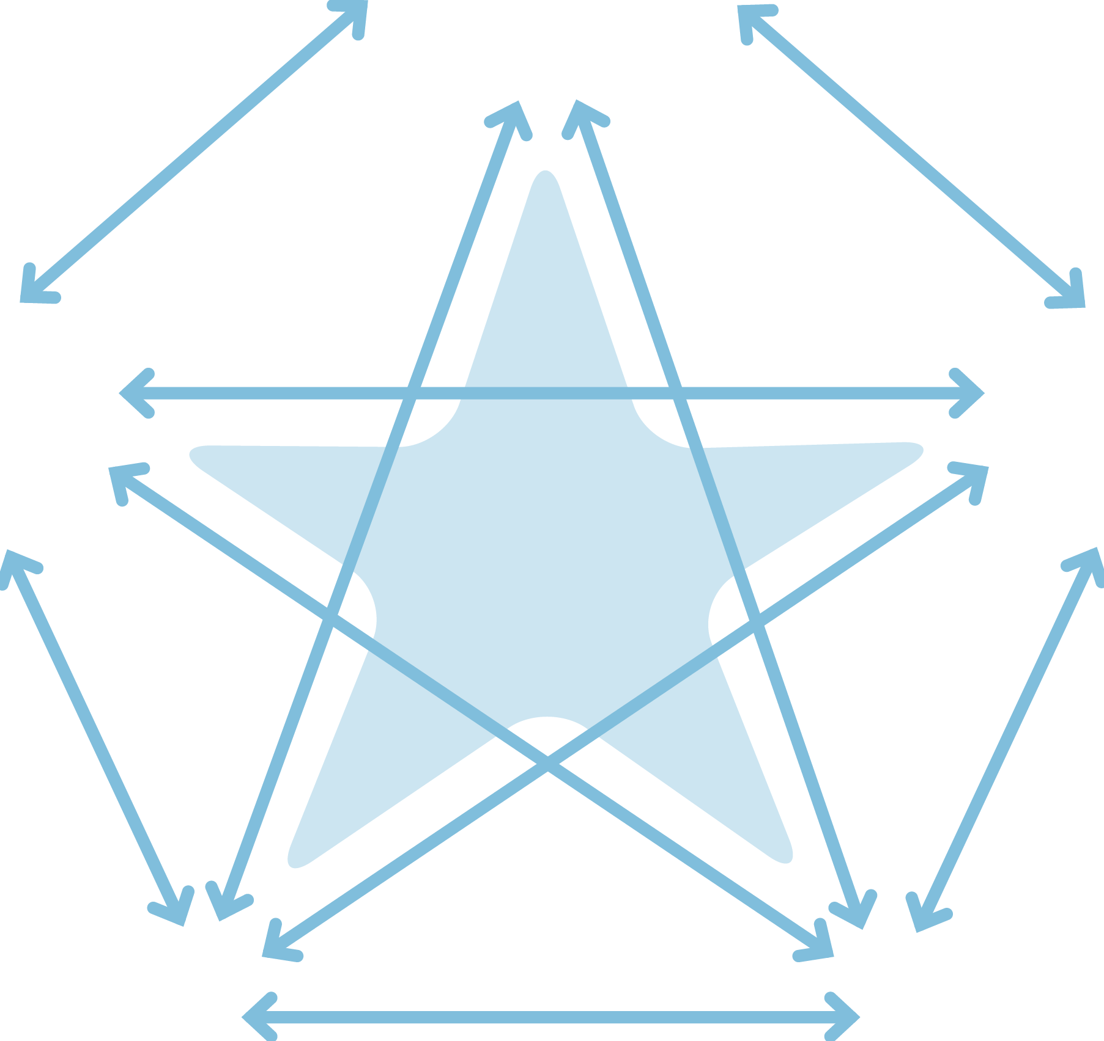
The Secure Base model
AVAILABILITY
helping the child to trust
FAMILY MEMBERSHIP
helping the child
to belong
SENSITIVITY
helping the child
to manage feelings
SECURE
BASE
CO-OPERATION
helping the child
to feel effective
ACCEPTANCE
building the child’s self-esteem
Gillian Schofield and Mary Beek

Slide 2
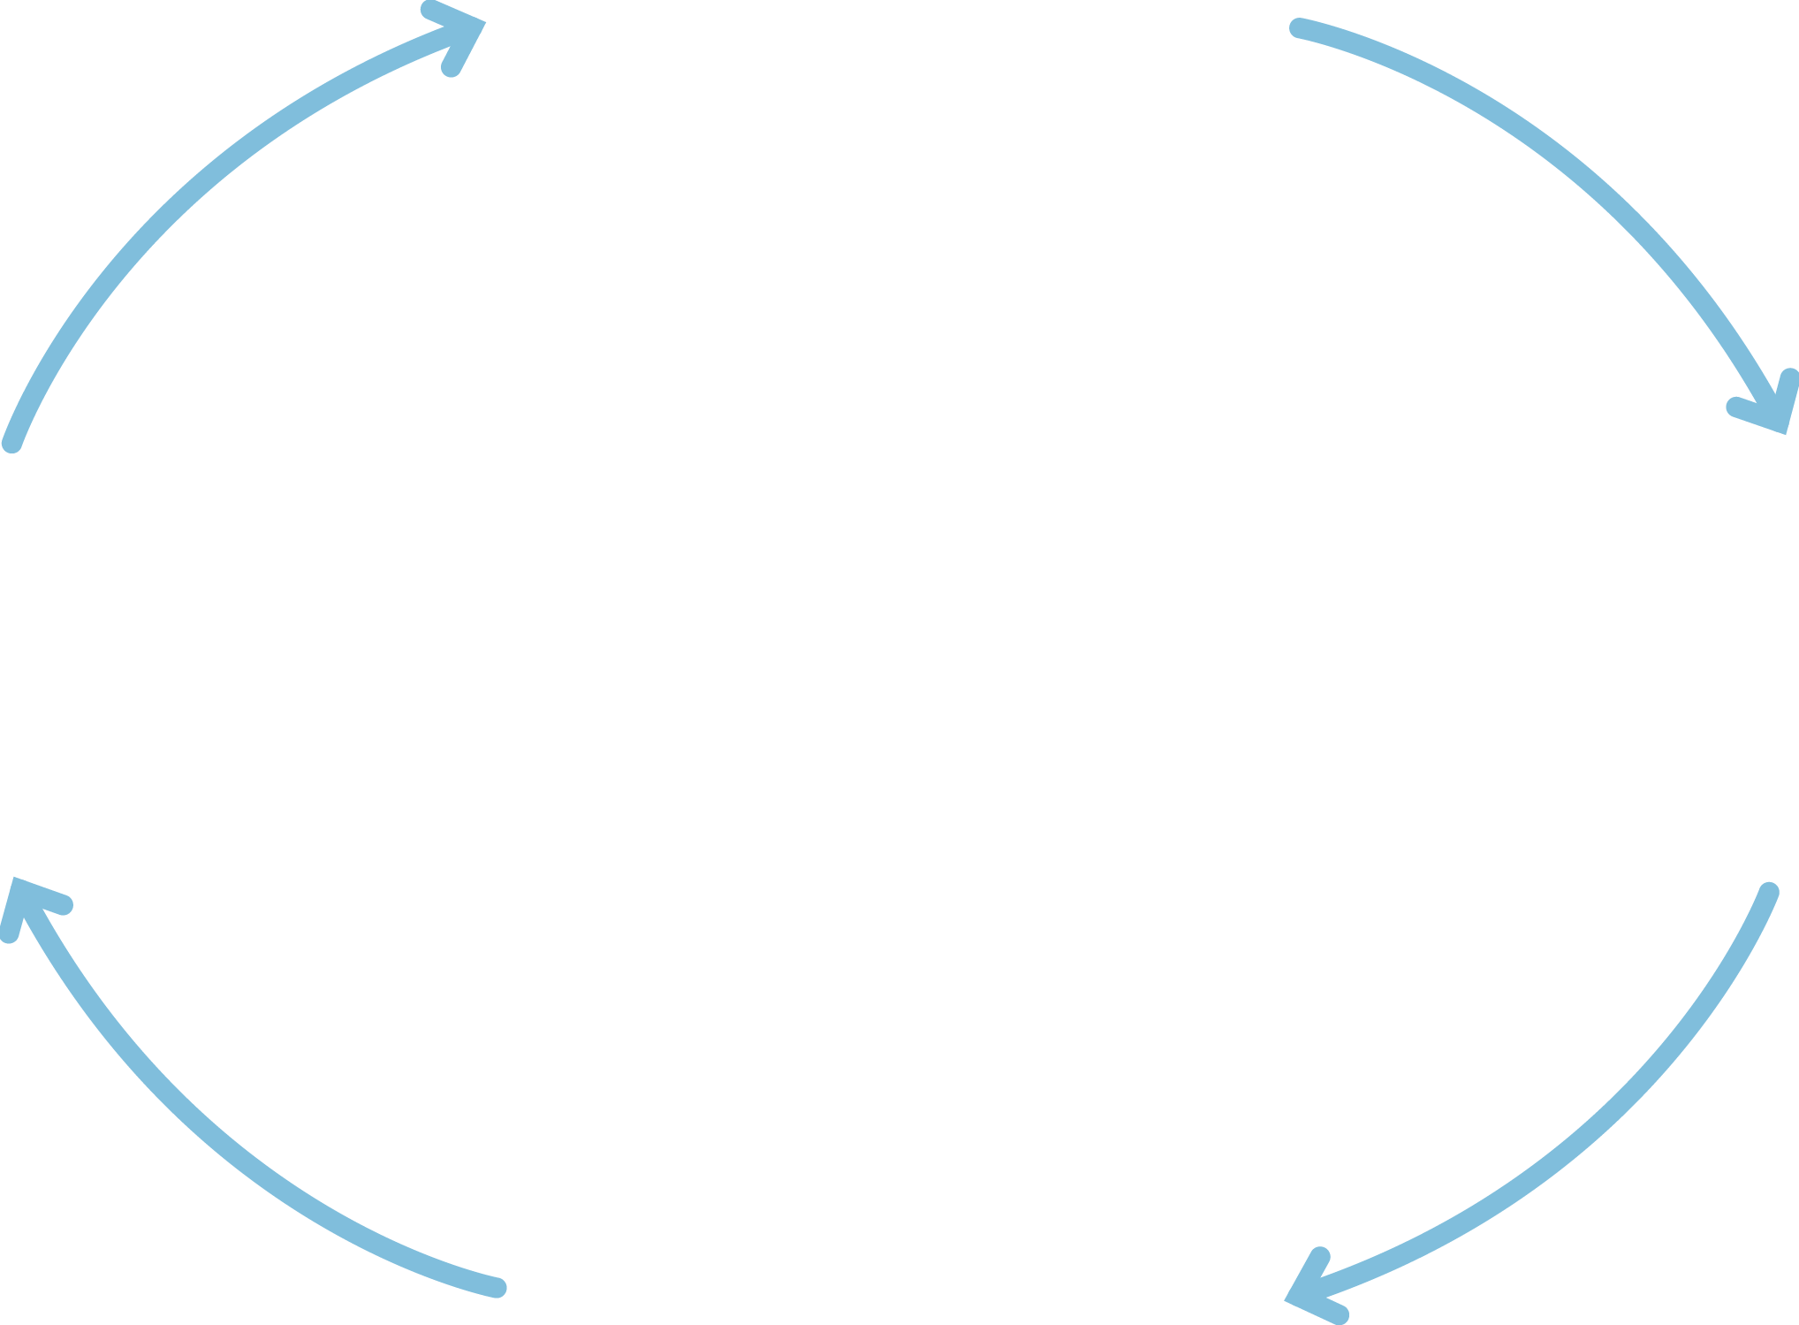
The caregiving cycle
Child’s needs
and behaviour
Child’s thinking
and feeling
Child’s
development
Caregiver’s
thinking and
feeling
Caregiving
behaviour

Slide 3
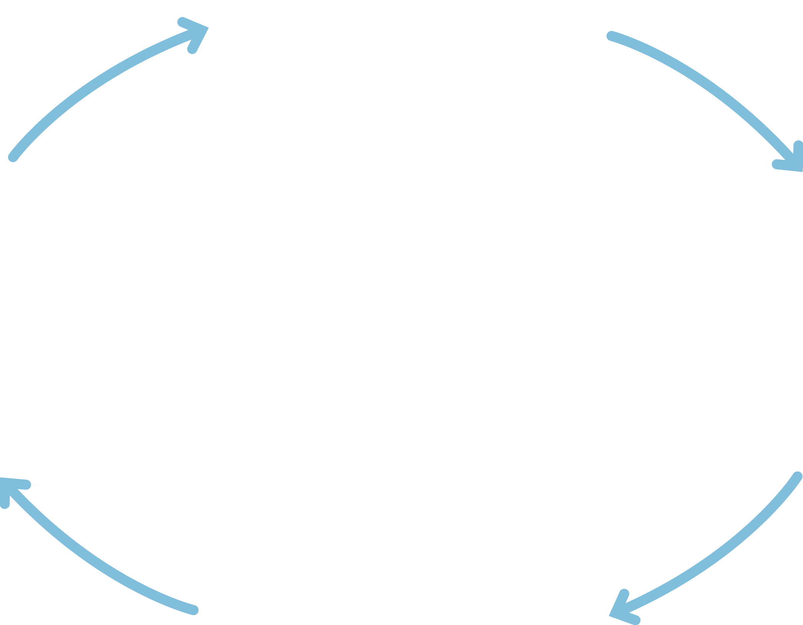
Availability
Child’s needs
and behaviour
Child
thinking/
feeling
Caregiver
thinking/
feeling
I matter, I am safe
I can explore and return for help
Other people can
be trusted
What does this child expect from adults?
How can I show this child that I will not let them down?
Helping the child to trust
Alert to child’s
needs/signals
Verbal and non-verbal messages of availability
Caregiving behaviour

Slide 4
Sensitivity
Child’s needs
and behaviour
Child
thinking/
feeling
Caregiver
thinking/
feeling
My feelings make sense and can be managed
Other people have thoughts and feelings
Helping the child to manage feelings
What might this child be thinking and feeling?
How does this child make me feel?
Helping the child to understand, express and manage feelings appropriately
Caregiving behaviour

Slide 5
Acceptance
Child’s needs
and behaviour
Child
thinking/
feeling
Caregiver
thinking/
feeling
I am accepted
and valued for
who I am
I do not have to
be perfect
Building
the child’s
self-esteem
This child needs me to value and accept them
I need to value and accept myself
Helping the child to feel good about themself and manage setbacks
Caregiving behaviour

Slide 6
Co-operation
Child’s needs
and behaviour
Child
thinking/
feeling
Caregiver
thinking/
feeling
I feel effective
I can make choices
I can co-operate
with others
Helping the child to feel effective
This child needs to feel effective and competent
How can we work together?
Promoting competence
Offering choice
Negotiating within firm boundaries
Caregiving behaviour

Slide 7
Family membership
Child’s needs
and behaviour
Child
thinking/
feeling
Caregiver
thinking/
feeling
I have a sense of belonging
I can feel connected to more than one family
Helping the child to belong
This child is part of my family and also connected to their birth family
Verbal and non-verbal messages of connection to both families
Caregiving behaviour

