Slide 1
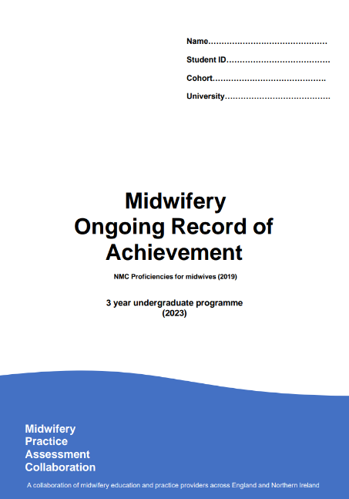


Midwife guide to accessing MORA on PebblePad

Slide 2
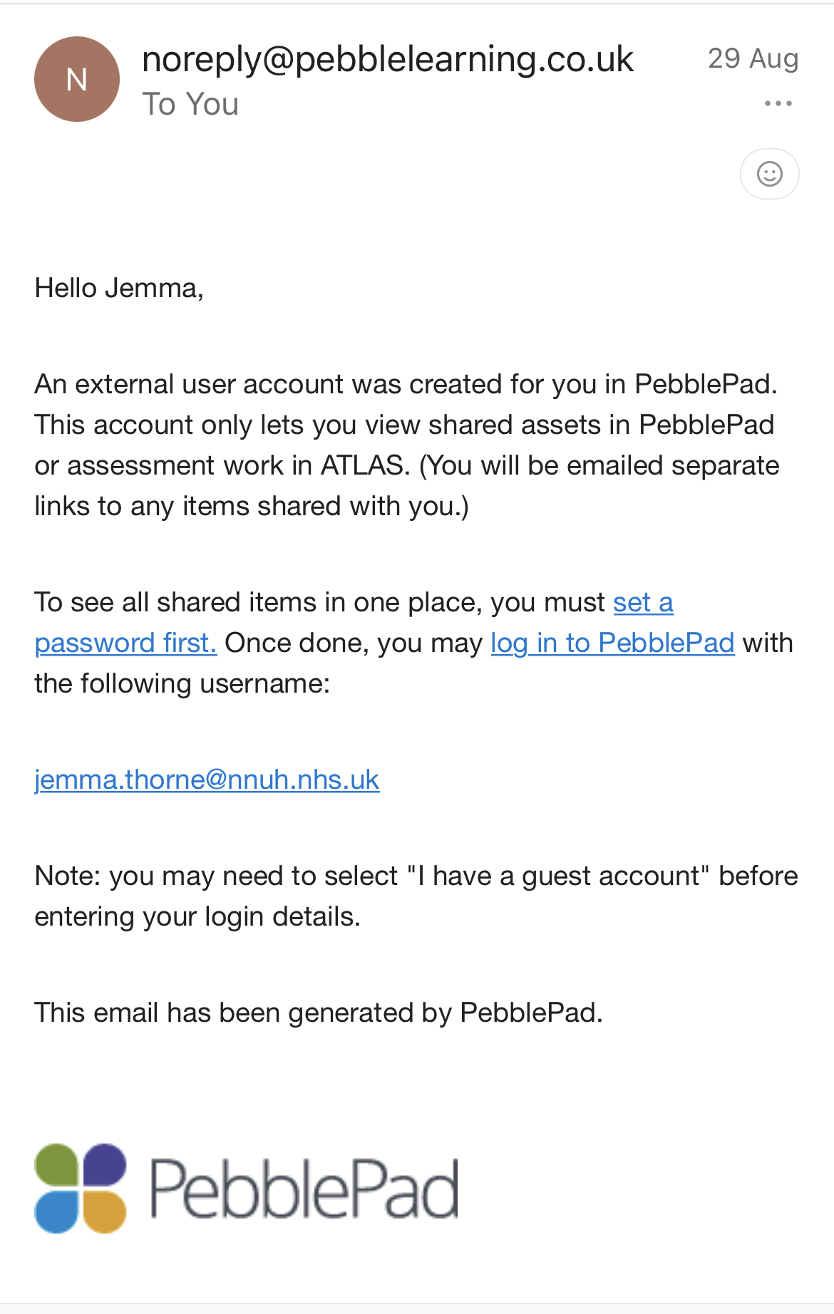
You should have received an email from PebblePad asking you to set a password
Please click on set a password first

Slide 3
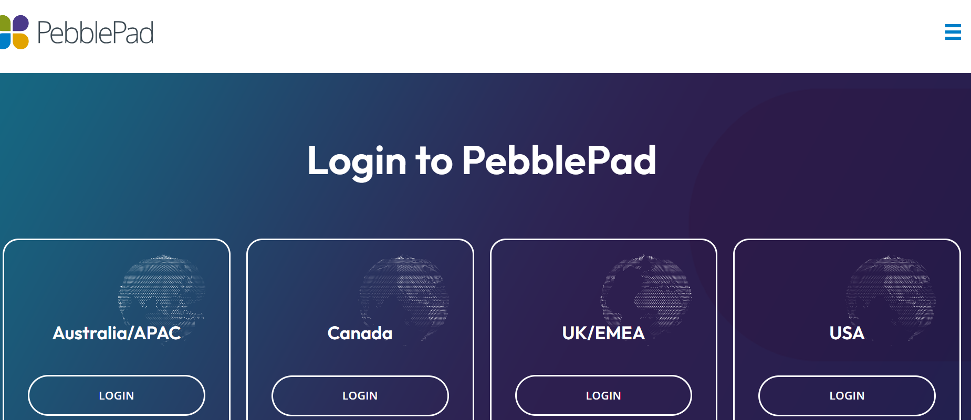
If you are having difficulty logging in for the first time and unable to find an email from PebblePad Please open www.pebblepad.com

Slide 4
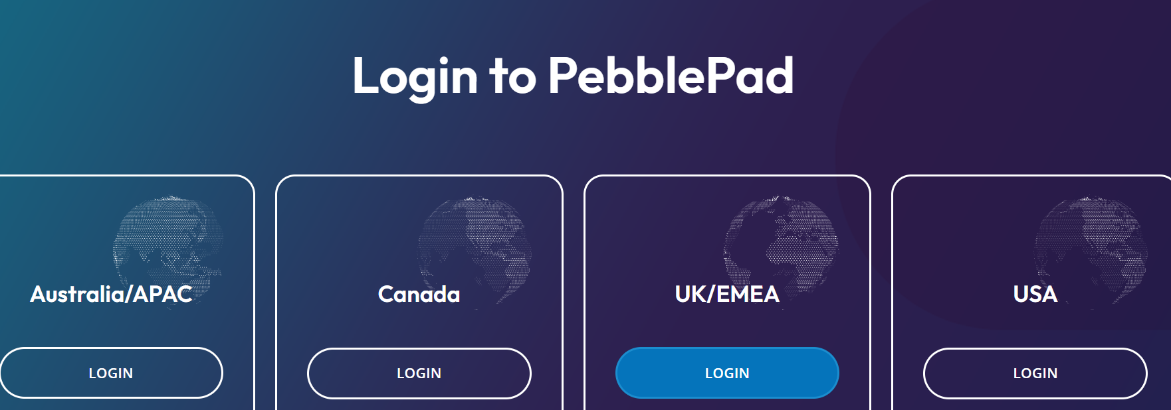
Select UK/EMEA

Slide 5
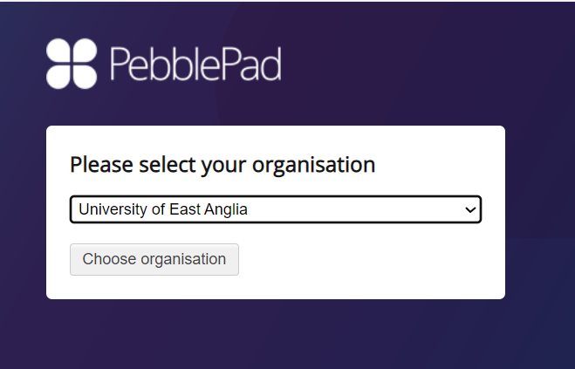
Then choose UEA from the drop down menu and click "Choose organisation"

Slide 6
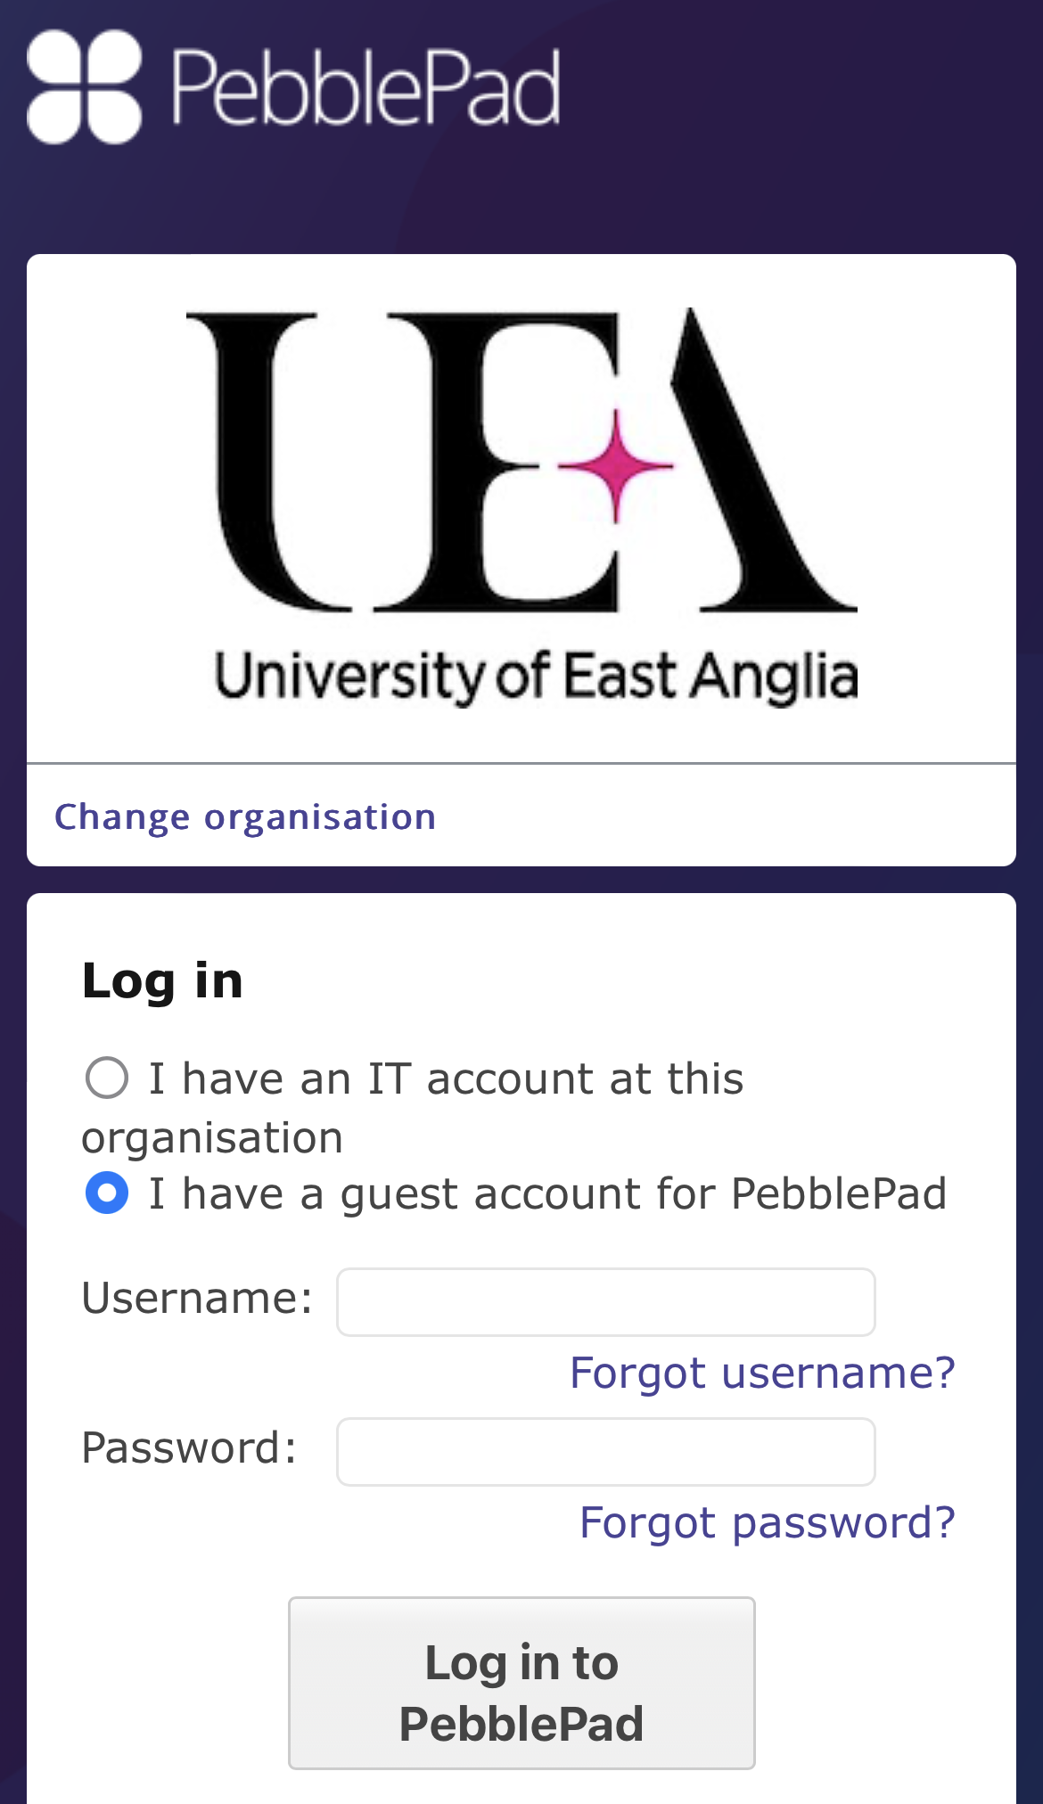
Always make sure to click on I have a guest account for PebblePad

Slide 7
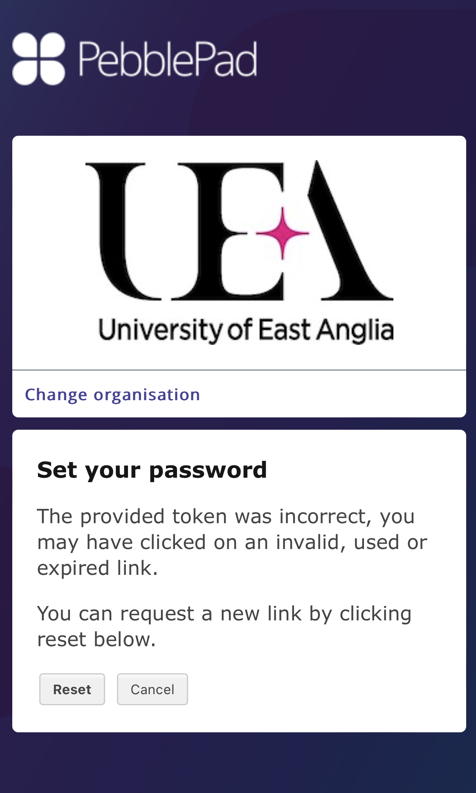
Please click on Reset

Slide 8
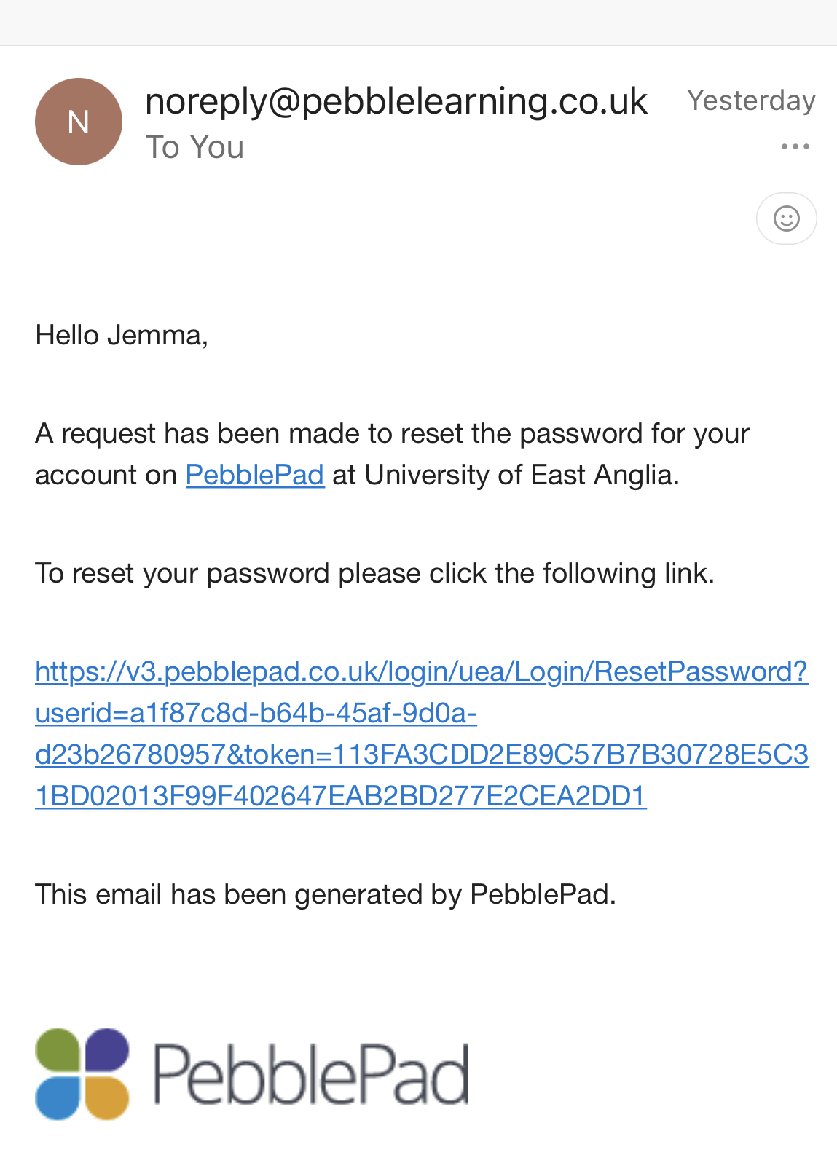
An email with a link to reset your password will be sent

Slide 9
Please ensure to select "I have a guest account for PebblePad"

Slide 10
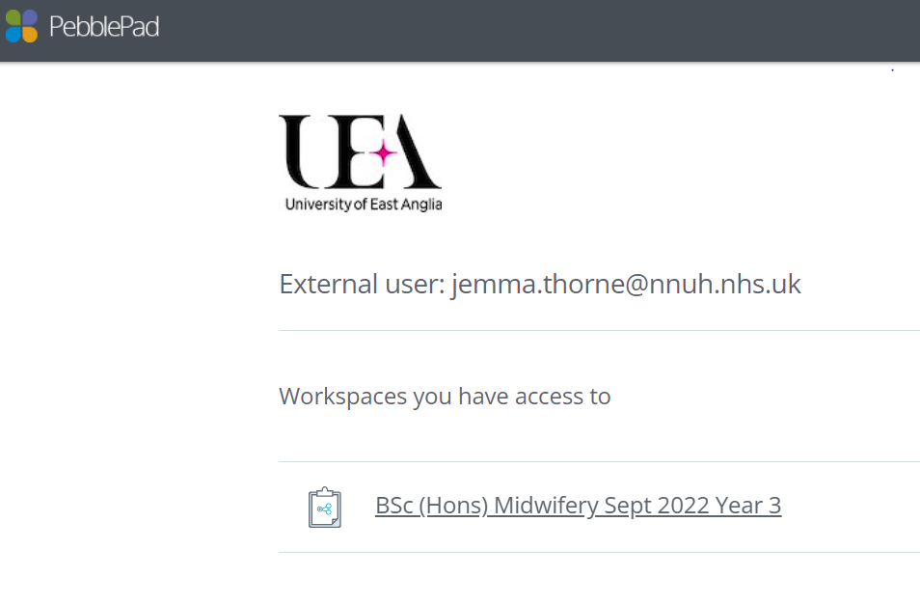
Click on appropriate year group

Slide 11
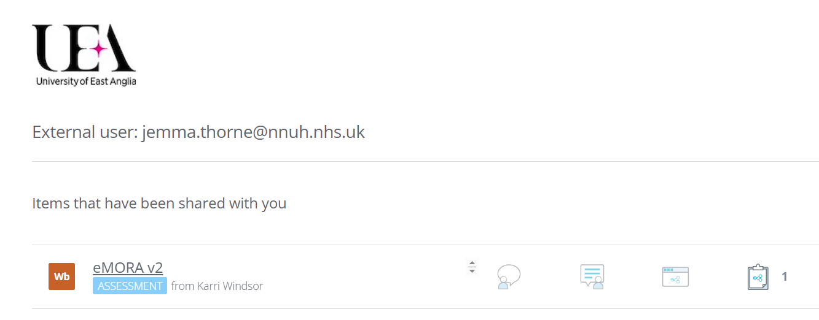
Once students have started accessing their MORA's and have shared access with you. You will then be able to see their individual documents

Slide 12
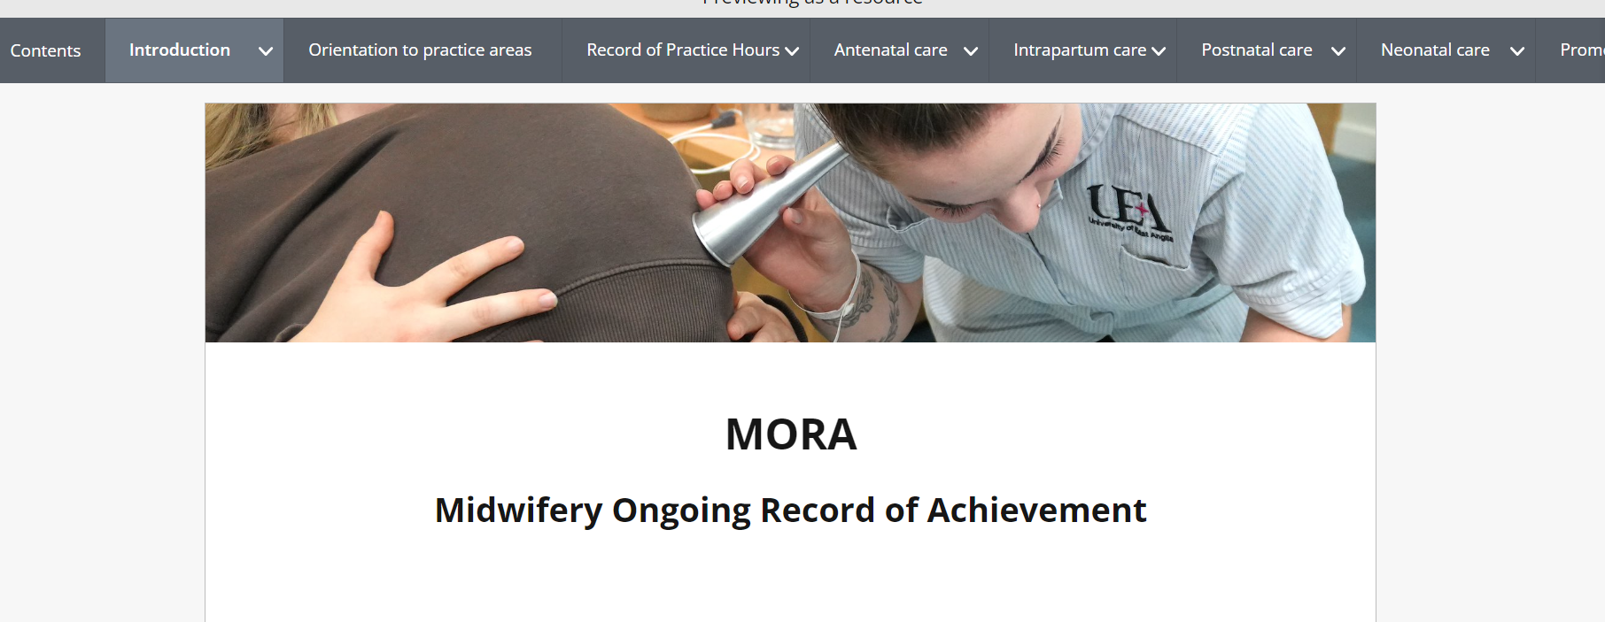
Use individual menus

Slide 13
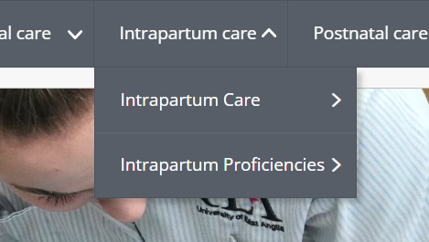
Where you can sign off episodes of care and proficiencies

Slide 14
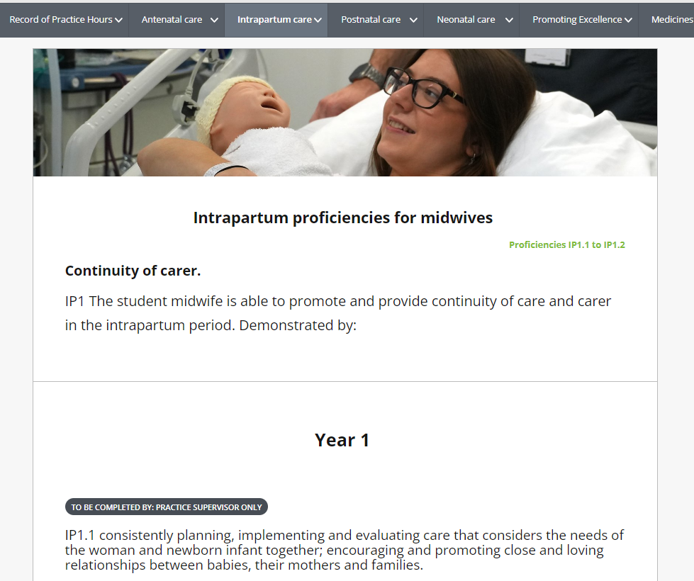
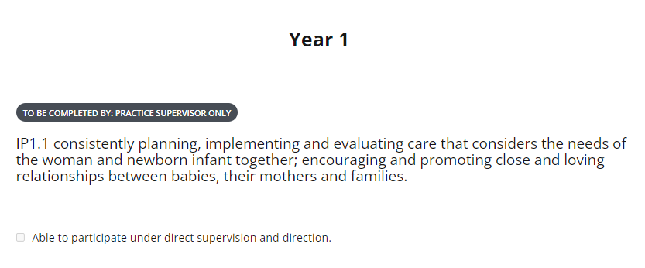
Proficiencies are displayed in list order with a tick box which acts as a signature Students are able to add more evidence in relation to a proficiency in a text box towards the bottom of the page

Slide 15
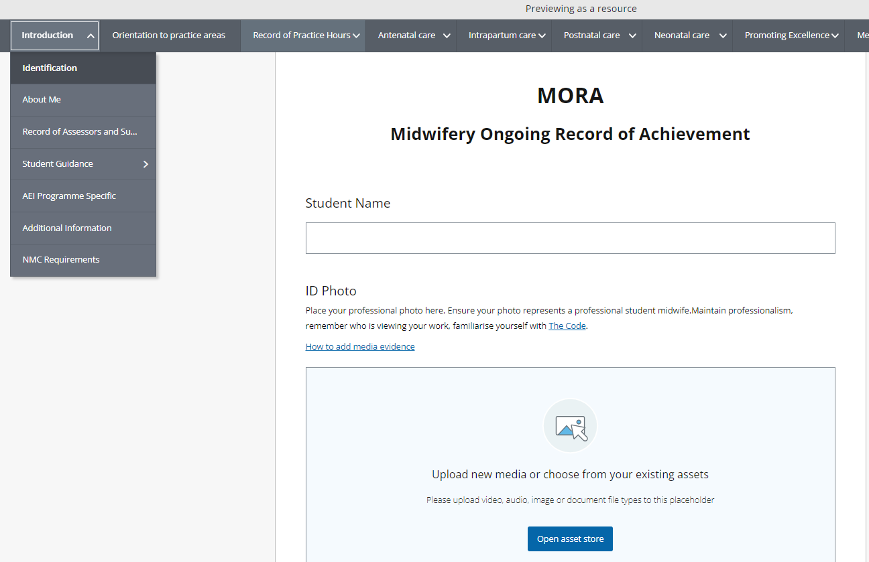
Students are able to add information about themselves including their photo NMC Requirements shows a table of AN/PN/NN examinations, births and labour care
Within the first menu "Introduction"

Slide 16
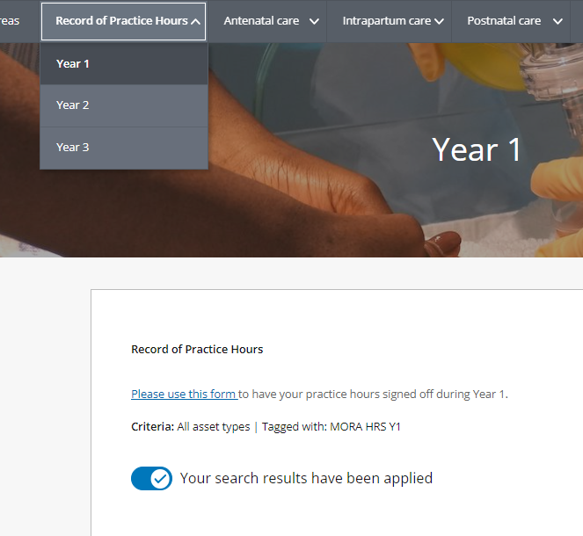
Timesheets can be signed within the Record of Practice Hours menu, where students will generate timesheets with dates and times, they will ask you to sign

Slide 17
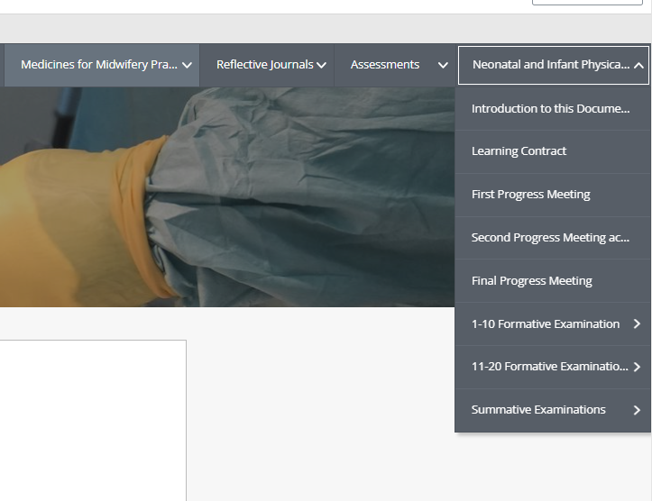
The NIPE assessent can also be found within the menus on the far right

Slide 18
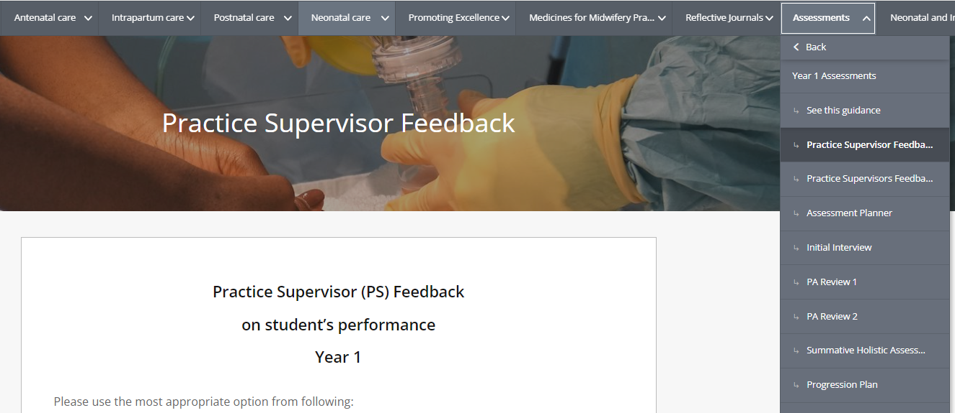
Practice Supervisor feedback forms are now generated by the student, and you will be asked to complete these

Slide 19
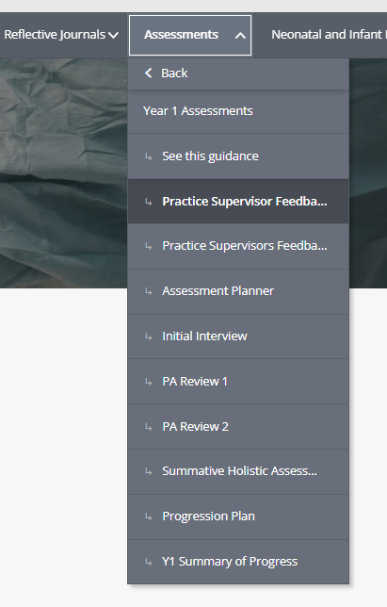
You can also see within this menu, separated by year groups, the areas for practice assessor meetings

Slide 20
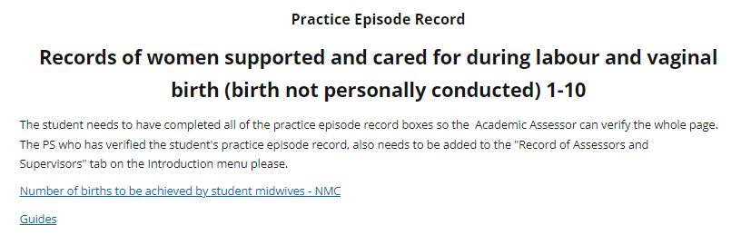
NMC has recently changed the language within the MORA to conducted

Slide 21

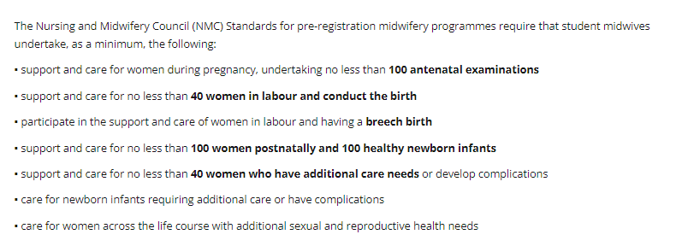
Current NMC requirements

Slide 22

Further questions?
Contact your trust specific clinical educators
UEA Contacts
Email - HSC.pebblepad@uea.ac.uk
Email – j.thorne@uea.ac.uk
Email – midwifery.clinicaleducators@uea.ac.uk

