Slide 1

The Secure Base model: promoting attachment and resilience
A TRAINING PROGRAMME
Notes:
Notes
Welcome to this five-session training programme on the Secure Base model.: promoting attachment and resilience
Introductions.
Background information
This training programme can be used for social workers or caregivers - or groups that include, for example, both supervising social workers and foster carers. Exercises are worded to allow for this variation, so trainers can adjust the wording to suit their participants.
The programme can be delivered in person or online. Exercises are flexible to facilitate both. If delivered online, additional instructions regarding using the chat function, raising a hand, keeping camera on /microphone off when appropriate etc. will need to be given.
Each session will be around two and a half hours long, including a refreshment break, with timing suggested for exercises but some flexibility allowed.

Slide 2
Aims of the programme
To learn about the Secure Base model as a framework for therapeutic caregiving
To consider ways of applying the model in practice
Notes:
Notes
READ SLIDE
The focus of this programme will be on Secure Base caregiving relationships and social work practice in all family placement settings.
Exercises will focus on practice applications and will encourage sharing of ideas and experiences.
Please feel free to raise issues / ask questions at any time.

Slide 3
Guidelines for the programme
It is important to respect differences of perspective and opinion.
All discussion is confidential to the group - unless someone was felt to be at risk, which would be discussed with the participant.
Do take a break or discuss with the trainer if the teaching or the discussion provoke difficult feelings.
Notes:
Notes
READ SLIDE
These guidelines set out some core principles for the conduct of the training programme.

Slide 4
What is the Secure Base model?
A strengths-based framework for therapeutic caregiving
Drawn from attachment and child placement theory, research and practice
Based in the everyday interactions of family life
Designed to promote children’s security and resilience
Helpful to caregivers and practitioners
Developed by Gillian Schofield and Mary Beek at the University of East Anglia
Notes:
Notes
READ SLIDE
Add - the key foster care research studies which informed the development of the Secure Base model were conducted at the University of East Anglia by Gillian Schofield and Mary Beek. This research drew on the voices of foster children, foster carers, birth parents and social workers.
The Secure Base model is also informed by practice. Gillian Schofield and Mary Beek have social work backgrounds and their ongoing connection with child placement practice through teaching and consultation as well as research has continued to inform the model.

Slide 5
Who can use the Secure Base model?
Social workers
Foster carers, adopters and kinship carers
Residential workers
Any professionals involved in promoting children’s learning, welfare and development
https://www.uea.ac.uk/groups-and-centres/centre-for-research-on-children-and-families/secure-base-model
Notes:
Notes
Social workers can use the Secure Base model with a range of caregivers, including foster carers, kinship carers and adopters, to help them think about children’s behaviour and development and to develop positive caregiving approaches. It is also used as a framework for recruitment, assessment, matching and support/supervision.
Foster carers, kinship carers and adopters can use the model as a way of structuring their caregiving so that they can more actively support children’s development and build their security and resilience.
Residential workers can also use the model as a relationship-based framework for building children’s trust, security and resilience in a setting where there are a range of caregivers working with children at different times. There is a separate one-day training programme for residential care workers on the Secure Base model website.
Other professionals who are involved in promoting children’s development (e.g. teachers or youth workers) can use the model as a framework for reflecting on children’s developmental needs and the ways in which they can be met in different settings. There is also a separate training programme for schools on the website.
The Secure Base model website makes information and practice tools, including training programmes, freely available - reference should be made to the source of the materials: Gillian Schofield and Mary Beek, University of East Anglia.

Slide 6
What is Secure Base caregiving?
  Secure Base caregiving provides a child of any age with reliable comfort, closeness and reassurance.
  This reduces the child’s anxiety and provides the child with a secure base from which to explore, play, learn and fulfil their potential.
Notes:
Notes
READ SLIDE
A relationship that provides a child with reliable comfort, closeness and reassurance as a secure base for exploration is very important for babies and young children, who need to learn to cope with the many ‘ups and downs’ of everyday life (for instance, hunger, thirst, discomfort, separation). But a reliable, sensitive secure base relationship is also necessary for older children and teenagers, who face additional complex challenges in communicating their needs and managing relationships in families, at school and in their peer groups.
The term 'secure base for exploration' was first used by John Bowlby but has continued to be a key part of attachment theory, research and practice.
This secure base helps the child – whether an infant, toddler or teenager- to enjoy all kinds of exploration, because they know and trust that their needs will be met and that support and help will always be available to them.

Slide 7
Therapeutic care: the significance of Secure Base caregiving for children from troubled backgrounds
Because of the impact of abuse, neglect, trauma and loss, children will need therapeutic Secure Base caregiving.
Everyday interactions between caregiver and child can be therapeutic; helping the child to recover from difficult experiences in previous relationships, trust new relationships and become more secure and resilient.
The child’s internal working model (their beliefs about self and others) can change from negative to positive – to become ‘I am lovable, I can achieve things’; ‘Other people are available, care about me, understand my needs and can be trusted’.
Notes:
Notes
READ title and first bullet point
It’s important to think about the impact on the child’s thinking, feeling and behaviour of their previous experiences of caregiving before this placement – especially harmful caregiving and separations - and the implications for the therapeutic care they now need.
READ second bullet point
The Secure Base model emphasises how each moment of each day in a family is an opportunity for therapeutic care- promoting positive experiences, security, resilience and healing.
READ third bullet point
A child’s beliefs and expectations about self and others ( their internal working model) develop in early relationships and are key to building security and resilience. Children may have developed negative beliefs such as ‘I’m not a good person’ ‘adults can’t be trusted’, ‘other children don’t like me’, ‘the world is frightening and unpredictable’.
This can lead children to develop patterns of behaviour/relating to others that may have helped them survive in their previous relationships (for example, withdrawing and not sharing their feelings) but are unhelpful and a barrier when building new relationships in a caring family.
However, a troubled child’s internal working model can change to become more positive over time, as they start to trust caregivers and other significant adults, such as teachers. Thus, Secure Base caregiving helps children to believe that they are loved and lovable and that adults can be available and trustworthy.

Slide 8
EXERCISE 1
What is a secure base?
Think of a relationship that has been significant /positive/supportive /special for you in your past or current lives.
This could be with a partner, family member, friend, colleague or team/ faith /activity group.
Note down words to describe what made that relationship special.
Notes:
Notes
READ slide
Thinking / noting down key words is an individual part of this exercise. Discussion for this first exercise can then be in pairs or /and as a group.
The aim is to identify words or phrases that capture the nature and contribution of these valued relationships.
The aim is to start to make connections between what emerges from participants’ experiences and the Secure Base dimensions-on the next slide. e.g.
He’s always there for me’ – suggests availability. The participant trusts that this person is available to them.
‘She can read me like a book’ – suggests that this person shows sensitivity to what the participant is feeling. This might help them to understand and manage their feelings.
‘He makes me feel good about myself’ – suggests that this person or group accepts the participant for who they are. This builds self-esteem.
‘We work as a team’ – suggests a co-operative relationship. This helps the participant to feel effective and competent.
We’re like family – suggests a sense of family membership. This promotes a feeling of belonging.

Slide 9
Secure Base caregiving dimensions that promote security and resilience
Secure Base caregiving dimensions that promote security and resilience
Availability – helping the child to trust
Sensitivity – helping the child to manage feelings
Acceptance – building the child’s self-esteem
Co-operation – helping the child to feel effective
Family membership – helping the child to belong
Notes:
Notes
These are the five caregiving dimensions that come from attachment and child placement research and make up the Secure Base model – with each caregiving dimension having a specific developmental benefit for the child. It is possible to see connections with the words / dimensions and benefits identified in the last exercise.
READ SLIDE
The first four dimensions come from attachment and child placement research and the fifth - family membership-comes specifically from child placement research and practice.
We will explore each dimension in turn during this training programme, but first we need to think about how they interact with each other.

Slide 10
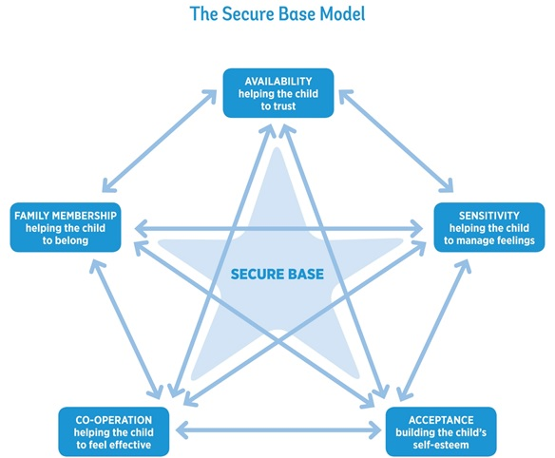
Notes:
Notes
As this diagram of the Secure Base model illustrates, the five dimensions interact to create the Secure Base for the child – for example, the child needs to begin to trust caregivers if they are to manage their feelings and the child also needs to feel accepted in order to feel that they belong in the family.

Slide 11
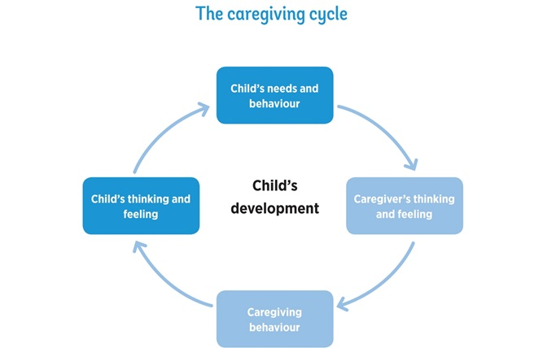
Notes:
Notes
This caregiving cycle is at the heart of the Secure Base model and represents the interaction of thinking, feeling and behaviour in the caregiver-child relationship. It begins with the child’s needs and behaviour and next focuses on what is going on in the mind of the caregiver in response.
How a caregiver thinks and feels about a child’s needs and behaviour will determine their caregiving behaviour. The caregiver will draw on their own ideas about what this child may need or how a good caregiver should respond from, for example, their own experiences as a child or parent or from what they have learned in training.
The different caregiving behaviours that result from caregivers’ different thoughts and feelings convey very different messages to the child, which could be positive or negative.
The child’s thinking and feeling about themselves and other people will be affected by these messages and there will be a consequent impact on their behaviour and development.
This caregiving cycle goes round many times in a day and can build positive or negative beliefs and feelings in the child. For example, a caregiver believing positively ‘I care about and can help this child’ will lead to supportive behaviour and build positive self-esteem in the child. Negative caregiver thinking, such as ‘This child doesn’t like me’, can lead to anxious or negative feelings and behaviour towards the child, increasing the child’s anxiety and doubts about their lovability - in turn affecting their behaviour.

Slide 12
Therapeutic caregiving might involve
Thinking differently
Doing differently
Trying different approaches
Being patient
Needing additional support
Notes:
Notes
READ slide
Children who have had difficult experiences of harm, trauma and loss have had to find ways of coping and surviving these experiences and so their ways of thinking and behaving can be very different from children who have lived only in secure, stable environments.
Caregivers may need to work hard to understand what is in their child’s mind (e.g. their memories, their coping strategies, their expectations), to see the world from the child’s perspective and therefore to think differently about their choice of caregiving approach.
Caregiving approaches may need to be different to those that have previously been successful with another child- even a child of the same age and similar background. Caregiving must be sensitively adjusted to the thinking, feeling and behaviour of this particular child.
Children’s deeply entrenched thinking and feeling can be very resistant to change. Caregivers will therefore need to be patient and persistent and try different approaches before the child’s thinking and feeling - and therefore behaviour- begins to change.
We can never know exactly what a child is thinking and feeling and so gaining some understanding is a gradual process. Caregivers may need to try different approaches at different times in order to find a way that is truly helping this child.
This therapeutic caregiving requires additional support for caregivers- from professionals and other caregivers but also from their own support networks of family and friends.

Slide 13
Availability – helping the child to trust
Notes:
Notes
READ SLIDE

Slide 14
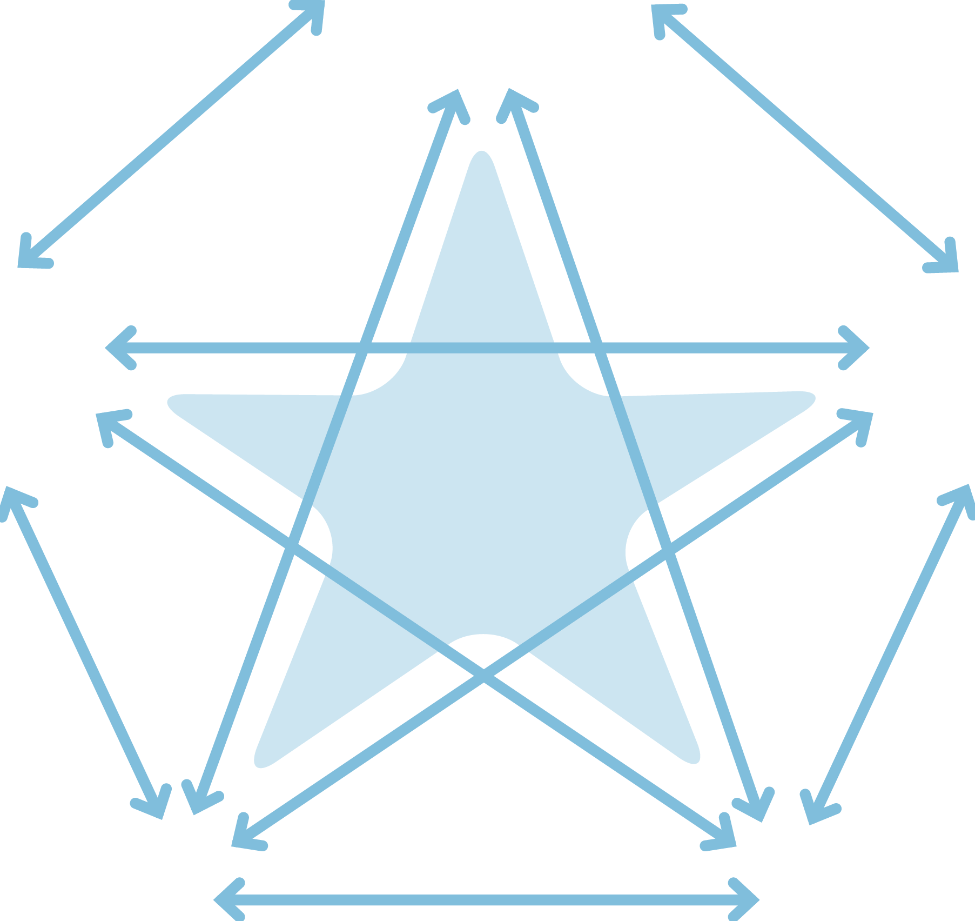

The Secure Base model
AVAILABILITY
helping the child to trust
FAMILY MEMBERSHIP
helping the child
to belong
SENSITIVITY
helping the child
to manage feelings
SECURE
BASE
CO-OPERATION
helping the child
to feel effective
ACCEPTANCE
building the child’s self-esteem
Notes:
Notes
We are going to start today with Availability -helping the child to trust--and then work clockwise round the dimensions in subsequent sessions of the programme.
This is likely to be the order in which work with a caregiver would be undertaken.
Bear in mind though that it may be that the caregiver's availability will be best demonstrated, for example, in situations that build a child's self-esteem - for example, reliably supporting a child to try a new activity, such as a football team or drama club. So starting with availability and trust does not mean waiting till that dimension is working well before looking at other dimensions. Sharing this diagram of the whole model with a caregiver can give them a sense of the different but linked goals for the child.

Slide 15
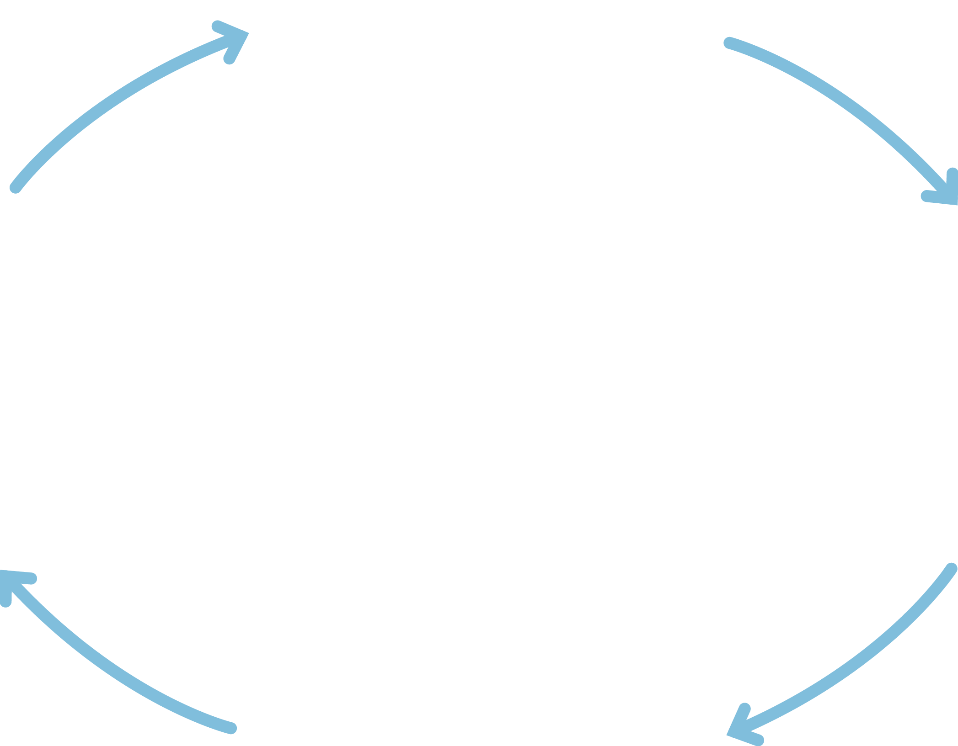
Availability
Child
thinking/
feeling
Child’s needs
and behaviour
Caregiver
thinking/
feeling
I matter, I am safe
I can explore and return for help
Other people can
be trusted
What does this child expect from adults?
How can I show this child that I will not let them down?
Helping the child to trust
Alert to child’s
needs/signals
Verbal and non-verbal messages of availability
Caregiving behaviour
Notes:
Notes
The caregiving cycle is used for each dimension – showing the interaction of minds and behaviour in the relationship between caregivers and children that is relevant for that dimension.
Availability is a good starting point and underpins the others - because of the importance of the caregiver’s practical and emotional availability and the link to the child’s need to learn to trust.
Read round the cycle.
We will now look at each element of this cycle in turn.

Slide 16
Why children may lack trust
Troubled children have often lacked consistent care and protection from reliable caregivers.
Previous caregivers may have been unavailable through domestic abuse, misuse of drugs, mental health difficulties, learning disability, abuse in their own childhood.
Caregivers may have
  rejected the child’s emotional demands
  responded unpredictably
  been frightening or frightened
Insecure children will have developed patterns of behaviour to cope with this lack of trust e.g. shutting down on feelings; being excessively demanding; becoming chaotic or controlling.
Notes:
Notes
READ SLIDE – then add
Children may also lack trust if they have experienced multiple moves – they may have felt that family members, carers and professionals had let them down or given up on them.
It's important to look at the links- for example between the child experiencing rejection from parents when they made emotional demands to then shutting down and avoiding showing their feelings in later relationships in family placements and in school.
Note that these descriptions of different patterns of insecure behaviour are used here instead of the language of attachment patterns. Although it is helpful to be aware of attachment research, social workers are not qualified to classify children and it can be unhelpful to apply labels. So when working with caregivers or writing reports these descriptions of a child's insecure behaviour pattern, that can change as the child becomes more secure, are preferable to using labels to define the child, such as an 'avoidant child'.

Slide 17
EXERCISE 2
Lack of trust in children of different ages
Think about examples of behaviour that might suggest a child’s lack of trust - in one of these age groups.
  Infants (0 – 18 months)
  Early childhood (18 months – 4 years)
  Middle childhood (5 – 10 years)
  Adolescence (11 – 18 years)
Notes:
Notes
Exercise 1 20 minutes
This exercise can be done in pairs or small groups.
The focus in this exercise is on the first part of the cycle – how might a child's lack of trust show in their behaviour? What might a caregiver observe / be looking for?
Ask for examples of specific behaviour for each age group.
After participants have had about 10 minutes for discussion, the whole group discussion (10 minutes) should highlight
the range of behaviour in each age group
how children's lack of trust in caregivers may look different at different ages
the importance of caregivers being helped to observe and note the detail of a child’s behaviour.
Mention the Secure Base Development Checklists - which are on the Secure Base model website, under Resources. These are for each dimension and for children in each age range. The checklists can help practitioners reflect on children’s development and progress. They can also be useful in helping social workers and caregivers observe and think about where the child is in their development of trust and what caregivers might be working towards by offering their availability.

Slide 18
Refreshment break

Slide 19
Availability-helping the child to trust: caregiver thinking and feeling
What does this child expect from adults?
How can I show this child that I will not let them down?
Notes:
Notes
The caregiver’s capacity to be available and build this child’s trust will depend on the caregiver's thinking and feeling- asking themselves first, ‘What does this child expect from adults?’
The previous exercise showed the importance of observing and reflecting on the child’s behaviour and its possible meanings.
THEN the caregiver needs to ask themselves, 'How can I show this child that I will not let them down?’
For the supporting social worker, it is necessary to give the caregiver time to discuss / reflect on the child’s behaviour and what that might suggest about the child’s thinking and feeling /capacity to trust and where that may have come from in their history- before discussing practical and age-appropriate ways in which to offer availability and provide a secure base for exploration.

Slide 20
Availability-helping the child to trust: caregiver behaviour
Being alert to the child’s needs and signals
Being available physically and emotionally, when together and apart
Signalling availability verbally and non-verbally in age-appropriate ways
Timing the relationship interactions at the pace of the child
Notes:
Notes
It is important for caregivers to be alert to the child’s needs and signals so that they can give reassurance when it is needed- verbally and non-verbally. This reassurance may need to be given repeatedly in many different situations, especially at times of potential anxiety, such as mealtimes, bedtime, separation when going to nursery or school.
Physical availability includes having time and energy to focus on the child’s needs.
Emotional availability includes being able to reflect on the child’s emotional state. If caregivers are preoccupied by their own unresolved emotional issues, it can be more difficult for them to respond to the emotional needs of the child.
Caregivers will also have to think through with their support worker what they can do to demonstrate their physical and emotional availability in age-appropriate ways for this particular child. This includes demonstrating to the child that the caregiver is thinking about them when apart.
When building trust, it is important to time interactions and take the relationship at the child’s pace and be ready to respond to the smallest signals from the child. Some children may not signal their needs clearly or they may give misleading signals. Caregivers may need to gently prompt the child by talking about their possible needs (are you hungry? tired?) and then respond to these needs in ways that are comfortable and acceptable to the child.

Slide 21
Being alert and responding to the needs and signals of a small baby
‘When Jennie came to me at 12 weeks old, she was completely unresponsive, not waking for feeds, not responding to me, not showing any emotion. She had just switched off. I had to stay close to her and respond to even the slightest sound or facial movement and keep talking to her and touching her. It took time to replace those first weeks, but gradually she started to show different feelings and become more responsive.’ (Caregiver)
Notes:
Notes
READ SLIDE
By the age of 12 weeks- and even earlier- children who have not experienced responsive, available caregivers may have learned not to trust adults. For example, even at four weeks a baby may start to avoid eye contact with their parent during a nappy change. So it is important that caregivers of small babies who have had difficult previous experiences actively use their availability, as this caregiver describes, to help the child to recover, become more responsive to the caregiver and be able to explore and enjoy their environment.
This takes time and commitment. But this caregiver also shows how thinking about the baby’s early experiences and the impact on the baby's thinking and behaviour has helped them plan how they need to care for this baby.

Slide 22
Helping a child to trust in the caregiver’s availability when they are apart
When Aiden (4) had contact with his father he was always very anxious about what might happen and whether he would come back to me and I would be here for him. On one occasion I gave him a small cushion to take with him so that he had something to hold onto, but also so that he would know he would be coming home. (Caregiver)
Notes:
Notes
READ SLIDE
This is a powerful example of a caregiver tuning in to this young child’s anxiety and finding a practical and sensory way of making them feel safe - and communicating the caregiver's ongoing availability when apart.

Slide 23
Demonstrating availability to teenagers
I try, if they talk to me, to stop what I’m doing. Because there’s a lot of young people in the house, I feel it’s important because otherwise, opportunities disappear. With Liam (13) in particular, I might take the long road home if I sensed he wanted to talk about something. (Caregiver)
Notes:
Notes
READ SLIDE
This is another good example of a caregiver finding a simple strategy for communicating availability and building trust that is right for a particular child, even in a busy household.

Slide 24
EXERCISE 3 Availability- building trust: caregiver behaviour
Discuss one of the case examples on the following slide.
What does this child expect from adults?
How might caregivers show this child that they are available and help them to build trust?
What might we look for as signs of progress?
Notes:
Notes
Divide into small groups. Allocate one case from the next slide to each group.
Encourage a range of creative approaches and specific examples, with attention to the detail of the child's possible thoughts, feelings and expectations and targeted available caregiving. Ask participants to list as many ideas as they can.
Feedback a range of caregiving ideas for each child to the whole group. Consider similarities and differences for children of different ages and backgrounds.

Slide 25
EXERCISE 3 What does this child expect from adults? How might current caregivers show this child that they are available and help them to build trust? What might we look for as signs of progress?
Jamie (9 months)
Early life: Parents misused drugs; domestic violence; multiple caregivers
Current difficulties: Cries almost constantly; fretful when held and fed; rejects affection
Seb (3)
Early life: Parents had mental health problems; believed food was poisoned;
provided a lot of physical affection
Current difficulties: Cannot settle to play or activities; won’t sit at the table for meals, runs around
Emily (7)
Early life: Single mother severely depressed; cared for her mother and younger sister; stole food from shop
Current difficulties: behaves like older child; self-reliant, doesn’t seem to want carers to get close; takes herself to bed
Marcia (14)
Early life: Mother died, was severely neglected by Aunt; socially isolated.
Current difficulties: Fearful of new situations; low self-esteem; has panic attacks at school- only feels safe in foster home
Notes:
Notes
Show this slide during the discussion.

Slide 26
Availability: additional support needs for caregivers
Time and energy depleted by needy child
Child’s needs trigger difficult memories/feelings
Child rejects availability
Notes:
Notes
In introducing this slide on caregivers' additional support needs, it is important to show empathy for caregivers and for children in relationships where showing availability and building trust are more challenging.
Time and energy may be depleted by needy child: Troubled children can be extremely time and energy consuming to care for. Their additional needs can arise at any time, and in many different forms. Caregivers and social workers may not have been able to predict at the start of a placement the amount and intensity of input that a particular child might need. And even the most available caregivers can find their energy drained by a child at times. It is easy at these times for caregivers to feel overwhelmed by the child’s demands and they may need practical and emotional support to release time and renew their energy levels.
Child’s needs trigger caregivers' difficult memories/feelings: If caregivers have themselves been let down by adults in the past or struggled to care for previous children, their own difficult feelings and memories can sometimes re-surface as they become close to children who find it hard to trust. Caregivers may need support to recognise a possible connection with their own experiences and feelings, and to know that this is normal and understandable. This can help caregivers to manage feelings about their own experiences separately and focus more fully on the child’s needs.
Child rejects availability: If children reject closeness, caregivers may feel disappointed, or that they are not ‘right’ for the child, or that the child does not need them. They may need additional support in recognising the child’s underlying needs and finding ways of being available that are meaningful for this particular child.

Slide 27
EXERCISE 4
Supporting availability to build trust
What might a supervising or child’s social worker say and do to help Ann and Steve to be available/build Ellie’s trust?
Ann, foster carer, is feeling increasingly distant from Ellie (8). Ellie seems suspicious of Ann. She smiles in a ‘false’ way and frequently lies to Ann. She rejects cuddles from Ann, but wants them from Steve, her foster father.
Ann feels that Ellie doesn’t like her and that she might do better in another foster family. Steve recognises the problems, but feels they should keep trying with Ellie. Ann is allowing Ellie to spend more and more time in her bedroom or playing computer games as she feels stressed when Ellie is near her.
Notes:
Notes
This exercise can be done in pairs or small groups with feedback in the whole group.
The aim is to elicit practical suggestions for caregiving approaches or activities that can help these caregivers to be available / build Ellie’s trust.

Slide 28
Availability
Child
thinking/
feeling
Child’s needs
and behaviour
Caregiver
thinking/
feeling
I matter, I am safe
I can explore and return for help
Other people can
be trusted
What does this child expect from adults?
How can I show this child that I will not let them down?
Helping the child to trust
Alert to child’s
needs/signals
Verbal and non-verbal messages of availability
Caregiving behaviour
Notes:
Notes
Showing the Availability - helping the child to trust cycle slide again here is to remind participants of how caregiver thinking, feeling and behaviour impacts on the child’s thinking and feeling.
And how the cycle goes round multiple times in the course of a day, with opportunities to try different ways of being available.

Slide 29
Availability: child thinking and feeling
I matter, I am safe
I can explore and return for help
Other people can be trusted
Notes:
Notes
READ SLIDE
The caregiver's consistent physical and emotional availability provides the Secure Base which, over time, reduces the child’s anxiety and will help them start to enjoy play and learning - even small steps must be valued as progress.
Seeking comfort AND then starting to play, learn and enjoy activities are good evidence that the child is beginning to trust and to feel more secure - and that the caregiver's availability is working.
Availability and sensitive responsiveness can help a child to think and feel better about themselves and others – developing a more positive internal working model that will help them to feel lovable and to trust and enjoy relationships inside and outside the family.

Slide 30
Availability- helping the child to trust: reflections task
Before the next session, think about the learning from this session and this dimension in relation to children in families you work with or children in your care.
Are there particular children who you can see have gained trust and feel more secure because of the availability of a caregiver?
Are there particular children who you think may be able to gain trust and feel more secure because of the availability of a caregiver?
What are the benefits and challenges of offering availability to a range of children who lack trust?
Notes:
Notes
This is a suggested activity to help participants reflect on on their learning and understanding from this session / this dimension - and will act as a bridge to the next session / next dimension
Explain that there will be a whole group discussion at the start of the next session.

Slide 31
Notes:
Notes
Thank you for your ideas and participation. I hope you found this first session on the Secure Base model interesting and helpful.
We will build on this in the next session, when we will explore and discuss the second dimension- Sensitivity- helping the child to manage feelings.

