Slide 1
SESSION 4
Co-operation-helping the child to feel effective
Notes:
Notes
Welcome to the fourth session- Co-operation –helping the child to feel effective.

Slide 2


The Secure Base model
AVAILABILITY
helping the child to trust
FAMILY MEMBERSHIP
helping the child
to belong
SENSITIVITY
helping the child
to manage feelings
SECURE
BASE
CO-OPERATION
helping the child
to feel effective
ACCEPTANCE
building the child’s self-esteem
Notes:
Notes
This fourth Secure Base dimension again builds on the previous dimensions. Enabling children to feel effective requires caregiver availability / building trust, sensitivity/promoting the capacity to manage feelings and acceptance/building self-esteem.
Before we move on to look at this fourth dimension, in more detail, we will start with feedback and discussion on the reflection task on acceptance and self-esteem from last session - the child's self-esteem is very much linked to their capacity to exercise choice /agency and to enjoy co-operation.

Slide 3
Acceptance-building the child’s self-esteem: reflection task
Think about the learning from this session and this dimension in relation to children in families you work with or children in your care.
Are there particular children who had low self-esteem, but who started to value themselves once accepted and encouraged by caregivers?
Are there children who would benefit from some of the accepting caregiving strategies discussed today e.g. praise, help to enjoy activities?
What are the benefits and challenges of offering acceptance and support to children of different ages with low-self-esteem?
Notes:
Notes
This slide is a reminder of the reflections task suggested at the end of the last session-acceptance- building the child’s self-esteem.
Encourage feedback and discussion as a full group. Time needed will depend on how many participants have undertaken this task / feel able to share their ideas- but max 10-15 minutes.
Prompt questions could focus on the last bullet point and include - since the last session, have you found the concept of acceptance - building the child’s self-esteem helpful in thinking about enabling a child to feel more secure?

Slide 4
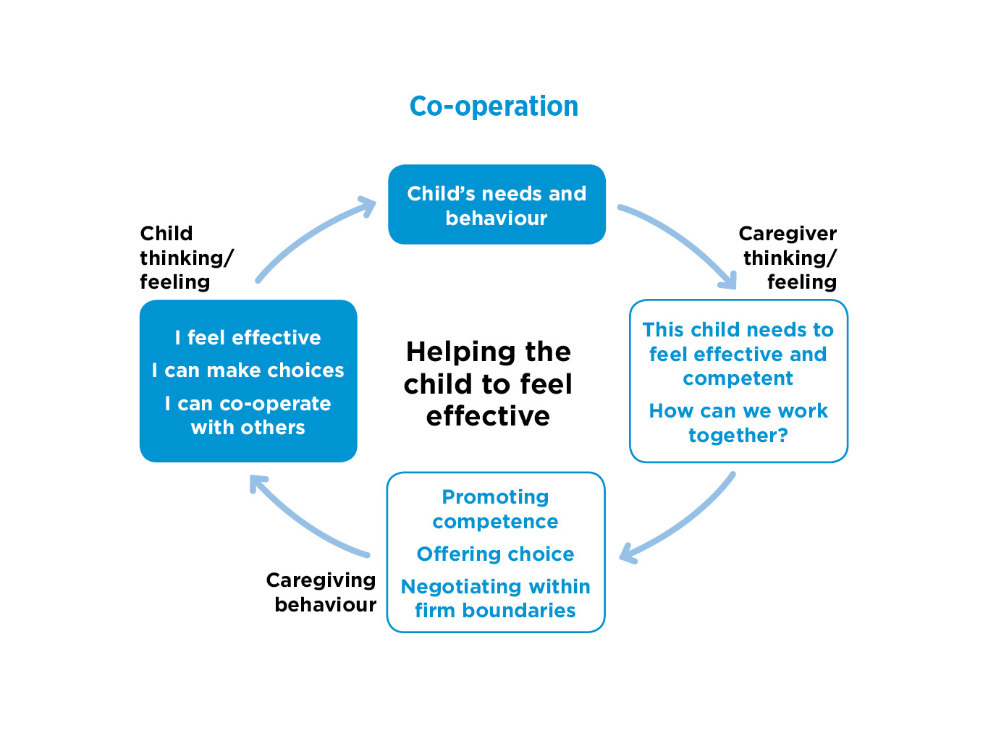
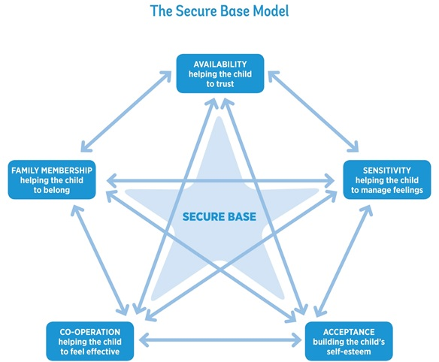

Notes:
Notes
Read round the cycle
Co-operation means caregivers setting appropriate boundaries, but also enabling the child to have agency and choice within them.
For children and young people, feeling effective means feeling competent and able to have some choice and control over events that affect them.
Feeling effective will increase a child's capacity to co-operate and negotiate - a quality that enables relationships to become mutually rewarding but can be difficult for many troubled children, as we will explore in this session.
This dimension can have particular challenges for some caregivers, especially if they have previously found it difficult to care for anxious children who feel the need to control caregivers and their environment.
It is understandable for caregivers to then feel that they have to prioritise taking control and this may lead to battles that make day-to-day interactions with the child feel negative.
It is important to emphasise with caregivers that co-operation does not imply a lack of boundaries or structure to keep the child safe but that working together to help the child to feel appropriately effective will reduce conflict and build a more positive relationship.

Slide 5
Why children may not feel effective and find it hard to co-operate
Children may
lack confidence in getting their needs met
have rarely experienced co-operative caregiving
have previously felt powerless or too powerful in their birth families or in the care system
Notes:
Notes
READ SLIDE
Children may lack confidence in getting their needs met. Many children who enter the care system have rarely experienced co-operative caregiving where they were able to ask for what they needed and get a positive response. Their caregivers, perhaps because of their own histories or current circumstances, may have been at times either too controlling and not giving children choices or neglectful and ineffective or inconsistent. Boundaries may have been harsh and rigid or weak and uncertain.
Children may feel powerless when they are moved within families, placed into care or moved within the care system. They may have had little preparation for some moves, have little understanding of the reasons for mooving and been left feeling that they do not have a say in what happens to them.
As a result, some children may become over-compliant, passive, unable to assert their views and wishes – and be vulnerable. In contrast, some anxious, insecure children may feel too powerful and out of control - perhaps being so challenging that they cause placements to break down They may feel they need to control adults they don’t trust, both at home and at school, so find it hard to co-operate and small issues become battles. They may also be controlling with peers and become unpopular at school.
For all these reasons, this is an important but complex dimension of children's development to think about.

Slide 6
EXERCISE 1 What behaviours suggest a child feels ineffective?
Infants (0 – 18 months)
Early childhood (18 months – 4 years)
Middle childhood (5 – 10 years)
Adolescence (11 – 18 years)
Notes:
Notes
Exercise 1 20 minutes
This exercise can be done initially as individuals, in pairs or small groups, ensuring the age ranges are all covered, with feed back to the whole group.
Think of children (in the different age groups) that you have worked with / cared for. Have you observed / are you aware of behaviours that suggest children feel ineffective?
Ask the group to think of small indicators – perhaps issues that occur in normal development, e.g. a toddler who refuses to comply, as well as more serious issues of extreme compliance or controlling behaviour in an older child. This helps to build a picture of the full range of behaviours that can occur.
Ask for specific examples of behaviours. e.g. ‘gives away her dinner money’, as well as ‘too compliant with peers’. Encourage participants to consider children who are too compliant as well as those who are unco-operative and controlling.

Slide 7
Co-operation-helping the child to feel effective: caregiver thinking and feeling
This child needs to feel effective and competent.
How can we work together?
Notes:
Notes
Caregivers need to be thinking / helped to think about how important it is for children’s development that they feel effective. The link between effectiveness and co-operation needs some explanation i.e. the more trusting and effective the child feels in relationships, the more likely they will be to let go of controlling behaviours, to co-operate and to compromise.
When children appear to be too powerful and controlling, it can be hard to think that they need to feel more effective, but thinking in this way can lead to strategies that promote co-operation and reduce battles.
Then the question in the caregiver's mind needs to be - how can we (this caregiver and this particular child) work together?
.

Slide 8
EXERCISE 2: Co-operation- helping the child to feel effective – Caregiver thinking
The foster family expectation is that everyone sits down together at the table for their evening meal. Lois, newly placed, refuses to do this. Her foster carer, Joe, thinks that Lois needs to have a sense of choice and control in her currently chaotic life. He suggests that he will lay a place for Lois at the table each evening, but it is up to her whether or not she joins the family. If she prefers, he will keep her dinner and she can have it at the table after the family have finished. After several weeks, Lois chooses to join the family for dinner– quietly at first, then with full participation.
How is Joe showing co-operation- but also availability, sensitivity, acceptance?
Notes:
Notes
Exercise 2 20 minutes Discussion of the case example in small groups- then take feedback.
This is an example of a foster carer thinking of the child’s need to feel effective and looking for a way in which they can work together.
The foster family always has dinner together, but Joe can see that for Lois the need to be in control leads to a refusal to participate in this and other aspects of family life. Joe looks for a way of working together to help her make choices but move towards participation. He finds a way to hold on to one part of the family expectation (i.e. Lois has her dinner at the table), but allows Lois to choose the point at which she feels ready to move closer to the family.
Re-cap on Secure Base model
Suggest that the 4 dimensions of the model discussed so far interact with each other in this caregiver’s thinking.
How is Joe also showing availability? e.g. He is thinking that Lois needs to build trust and he is supporting this through providing a reliable routine, time and attention.
How is Joe showing sensitivity-helping Lois to manage her feelings? e.g. He is thinking that she might feel nervous/ anxious about joining the family etc. and he is helping her to manage this by finding an approach that reduces these more difficult feelings.
How is Joe showing acceptance / building Lois’ self-esteem? e.g. He is respecting her feelings and thinking that Lois needs to feel valued and accepted, laying her place at the table but building the relationship at her pace.

Slide 9
Refreshment break

Slide 10
Co-operation-helping the child to feel effective: caregiver behaviour
Offering choices
Enabling the child to take the lead
Helping the child to achieve results on their own and with help
Setting clear rules and boundaries – but being willing to negotiate within them
Using fun and playfulness to achieve co-operation
Notes:
Notes
Offering choice (within safe limits), even in small things and from the start of a placement, can help children to feel more effective and able to have some influence in their lives. e.g. ‘Which breakfast cereal would you like?’ ‘Would you like to wear your blue T shirt or the red one today?’
Enabling children to take the lead, feel effective and competent playing or exploring in a safe, structured setting.
Supporting children to achieve positive results (e.g. completing small household tasks, planning an activity, using construction toys) is beneficial for effectiveness and self-esteem.
Caregivers need to have clear rules and boundaries, which are appropriate and reasonable for the child’s age and stage of development. These should be clearly explained to the child, along with the reasons for them but caregivers and children should be supported to negotiate and compromise within these boundaries.
Using fun and playfulness to achieve co-operation, where possible. This can avoid unnecessary battles and will help the child to understand that it is safe and rewarding to co-operate.

Slide 11
Helping a child to feel effective - and be co-operative
‘We try, actually, never to tell Salim (7) to do anything. It’s a matter of phrasing it differently, so that you are not triggering his feelings of threat. So, instead of saying, “You must wash your hands before you have a sandwich”, we might just say “Would you like to come and have a sandwich after you’ve washed your hands?” ’ (Caregiver)
Notes:
Notes
READ SLIDE
This is a good example of a caregiver using small but important changes in their language and approach - based on their sensitive knowledge of the child- offering choice and working together with the child to avoid getting into a battle.

Slide 12
Using fun and offering choice to achieve co-operation
  ‘Jack (7) often doesn’t want to go to bed. But he loves stories and when it is bedtime, I might say “Race you up the stairs. First one up gets to choose the story”. This works well as Jack is keen to run upstairs first so that he can choose a long story.’ (Caregiver)
Notes:
Notes
READ SLIDE
A good example of a caregiver tuning into the child and using fun to engage them in making a positive choice that they both enjoy and avoiding the conflict that had dominated the early weeks of the placement.

Slide 13
EXERCISE 3 The therapeutic effect of enabling a child to take the lead
  ‘George (3) would only relax in the garden, so although it was winter we wrapped up warm and everyday we spent time outside. He would potter about, looking at stuff, sometimes pulling up flowers, and I would follow him and talk occasionally and he would stop and he’d look at an insect, or whatever it was he’d found. I pretty much let George lead, but sometimes I’d draw his attention to things.’ (Caregiver)
Notes:
Notes
Exercise 3 10 -15 minutes
READ SLIDE
George was very troubled - he had been with multiple previous foster carers who found it difficult to take to him / cope with him as he was so challenging and unresponsive, and he was developmentally delayed.
The timing of this therapeutic approach was important, given his age. This caregiver needed to help George become more secure and be able to function age appropriately. There was less than two years to help him to be developmentally ready for school - so an intensive therapeutic approach to his daily care was crucial.
Discussion as a whole group
How does this example illustrate co-operation –helping the child to feel effective? - but also the three previous dimensions?
For example-participants may raise the following- this caregiver knew that they needed to build George’s trust through their availability, think about his troubled feelings and help him to manage them, accept George and give him the opportunity to feel valued and to find and value himself – as he had been unable to do as an infant. This meant finding a safe space for him, then allowing George to take the lead, make choices and explore the world around him freely and together. Thus providing a secure base experience to build on for the future.

Slide 14
EXERCISE 4 Helping children to feel effective and be co-operative
Taylor (6 months) does not show interest in toys
Janie (4) can’t sit still, runs around, jumps on furniture
Toby (8) is angry. He often kicks the cat
Annette (15) stays out later than agreed
Notes:
Notes
Exercise 4 – approximately 15 minutes
Ask participants to consider these behaviours and jot down first ideas for what caregivers might need to think, say and do to care for each child in ways that could help the child to feel more effective/be more co-operative.
Then discuss in whole group.
As in the previous exercise, after discussing co-operation-helping the child to be more effective, this can include discussion of previous dimensions.

Slide 15
Co-operation: additional support needs
The child’s need to be in control may trigger difficult memories or current feelings in caregivers around having or not having agency and control.
Lack of co-operation by children can be undermining and discouraging for caregivers, in the family home but also in public spaces.
Notes:
As with previous sessions, this section on caregivers' additional support needs should be presented in a way that is empathic and sensitive to caregivers, with emphasis on the fact that all caregivers, at times may experience these difficulties, especially when children are very troubled.
This can promote a supportive environment that makes it comfortable for social workers and caregivers to discuss difficult issues around control and co-operation openly and respectfully. Allow time for informal sharing of experiences.
Child’s behaviour may trigger difficult memories/feelings: If caregivers have had difficult experiences of controlling relationships in the past, their own difficult feelings and memories can sometimes re-surface as they become close to children who seek to control adults or who are over-compliant. Caregivers may need support from trusted professionals to recognise a possible connection with their own experiences and feelings, and to recognise the impact that this may have on the child. This can help caregivers to separate their own experiences and focus more fully on the child’s needs.
Lack of co-operation can be undermining and discouraging. Caregivers may feel helpless and inadequate when children are unco-operative. They may find it hard to share these feelings with professionals. They will need reassurance that their feelings are normal and understandable and that they are valued and trusted as caregivers. Peer support can be helpful for some caregivers in this situation.

Slide 16
Co-operation- helping a child to feel effective: child thinking and feeling
I feel effective.
I can make choices.
I can co-operate with others.
Notes:
Notes
Finally, this slide completes the cycle and summarises the goals of this dimension for the child.
When children begin to feel more effective, able to make choices and appropriately in control of their lives within safe boundaries, they will be better able to let go of inappropriate control and be more willing to compromise and co-operate.
This will help the child to build more positive relationships - at home, at school or in activities.

Slide 17
Co-operation- helping a child to feel effective: reflections task
Think about the learning from the session and this dimension in relation to children in families you work with or children in your care.
Are there particular children who found it difficult to be appropriately assertive but made more positive choices / became less controlling with help from caregivers?
Are there children who would benefit from some of the co-operative caregiving strategies discussed today e.g. offering choice, working together?
What are the benefits and challenges of offering more co-operative caregiving to children of different ages?
Notes:
Notes
This is a suggested activity to help participants reflect on their learning and understanding of this session / this dimension - and will act as a bridge to the next session / next dimension
Explain that there will be a whole group discussion of these reflections at the start of the next session.

Slide 18
Notes:
Notes
Next session – the fifth and final session- we will move on to Family membership- helping the child to belong - which builds on the other dimensions but has important additional issues for children in terms of managing multiple families, contact and identity.
We will also spend time thinking about how you and you agencies might be able to use or further develop the use of the Secure Base model in your practice.

