Slide 1
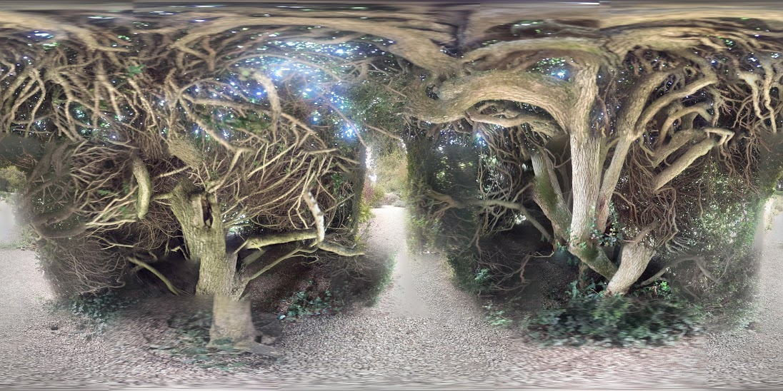
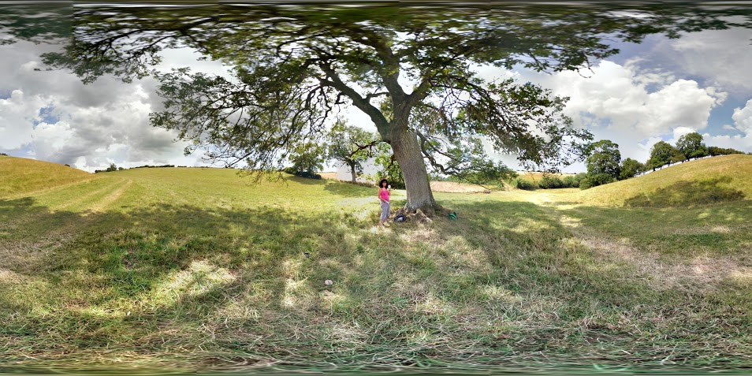

Working with Systems
Alex Fink
Teacher, Researcher, Assistant Professor - Participatory & Youth-Led Work for Social Change, Augsburg University, Minneapolis, Minnesota, United States
Critical companionship video & resource guide: Facilitating career progression from person-centred practice to person centred systems: DOMAIN 5: WORKING ACROSS SYSTEMS
Notes:
Add link to V.19 on the title

Slide 2
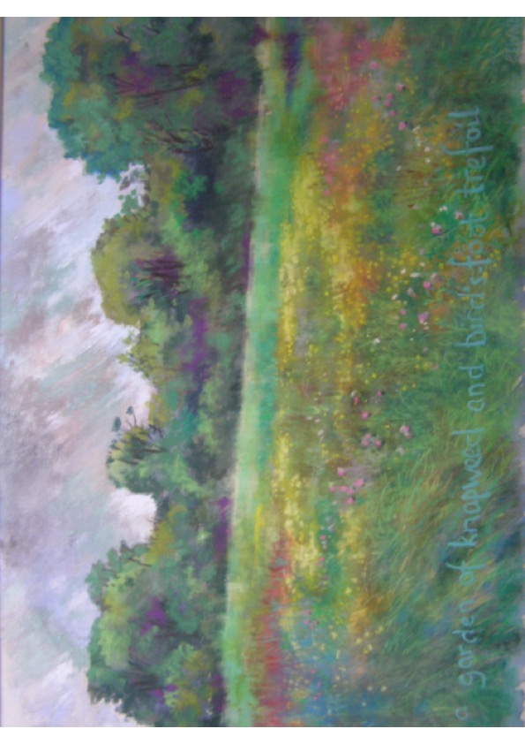
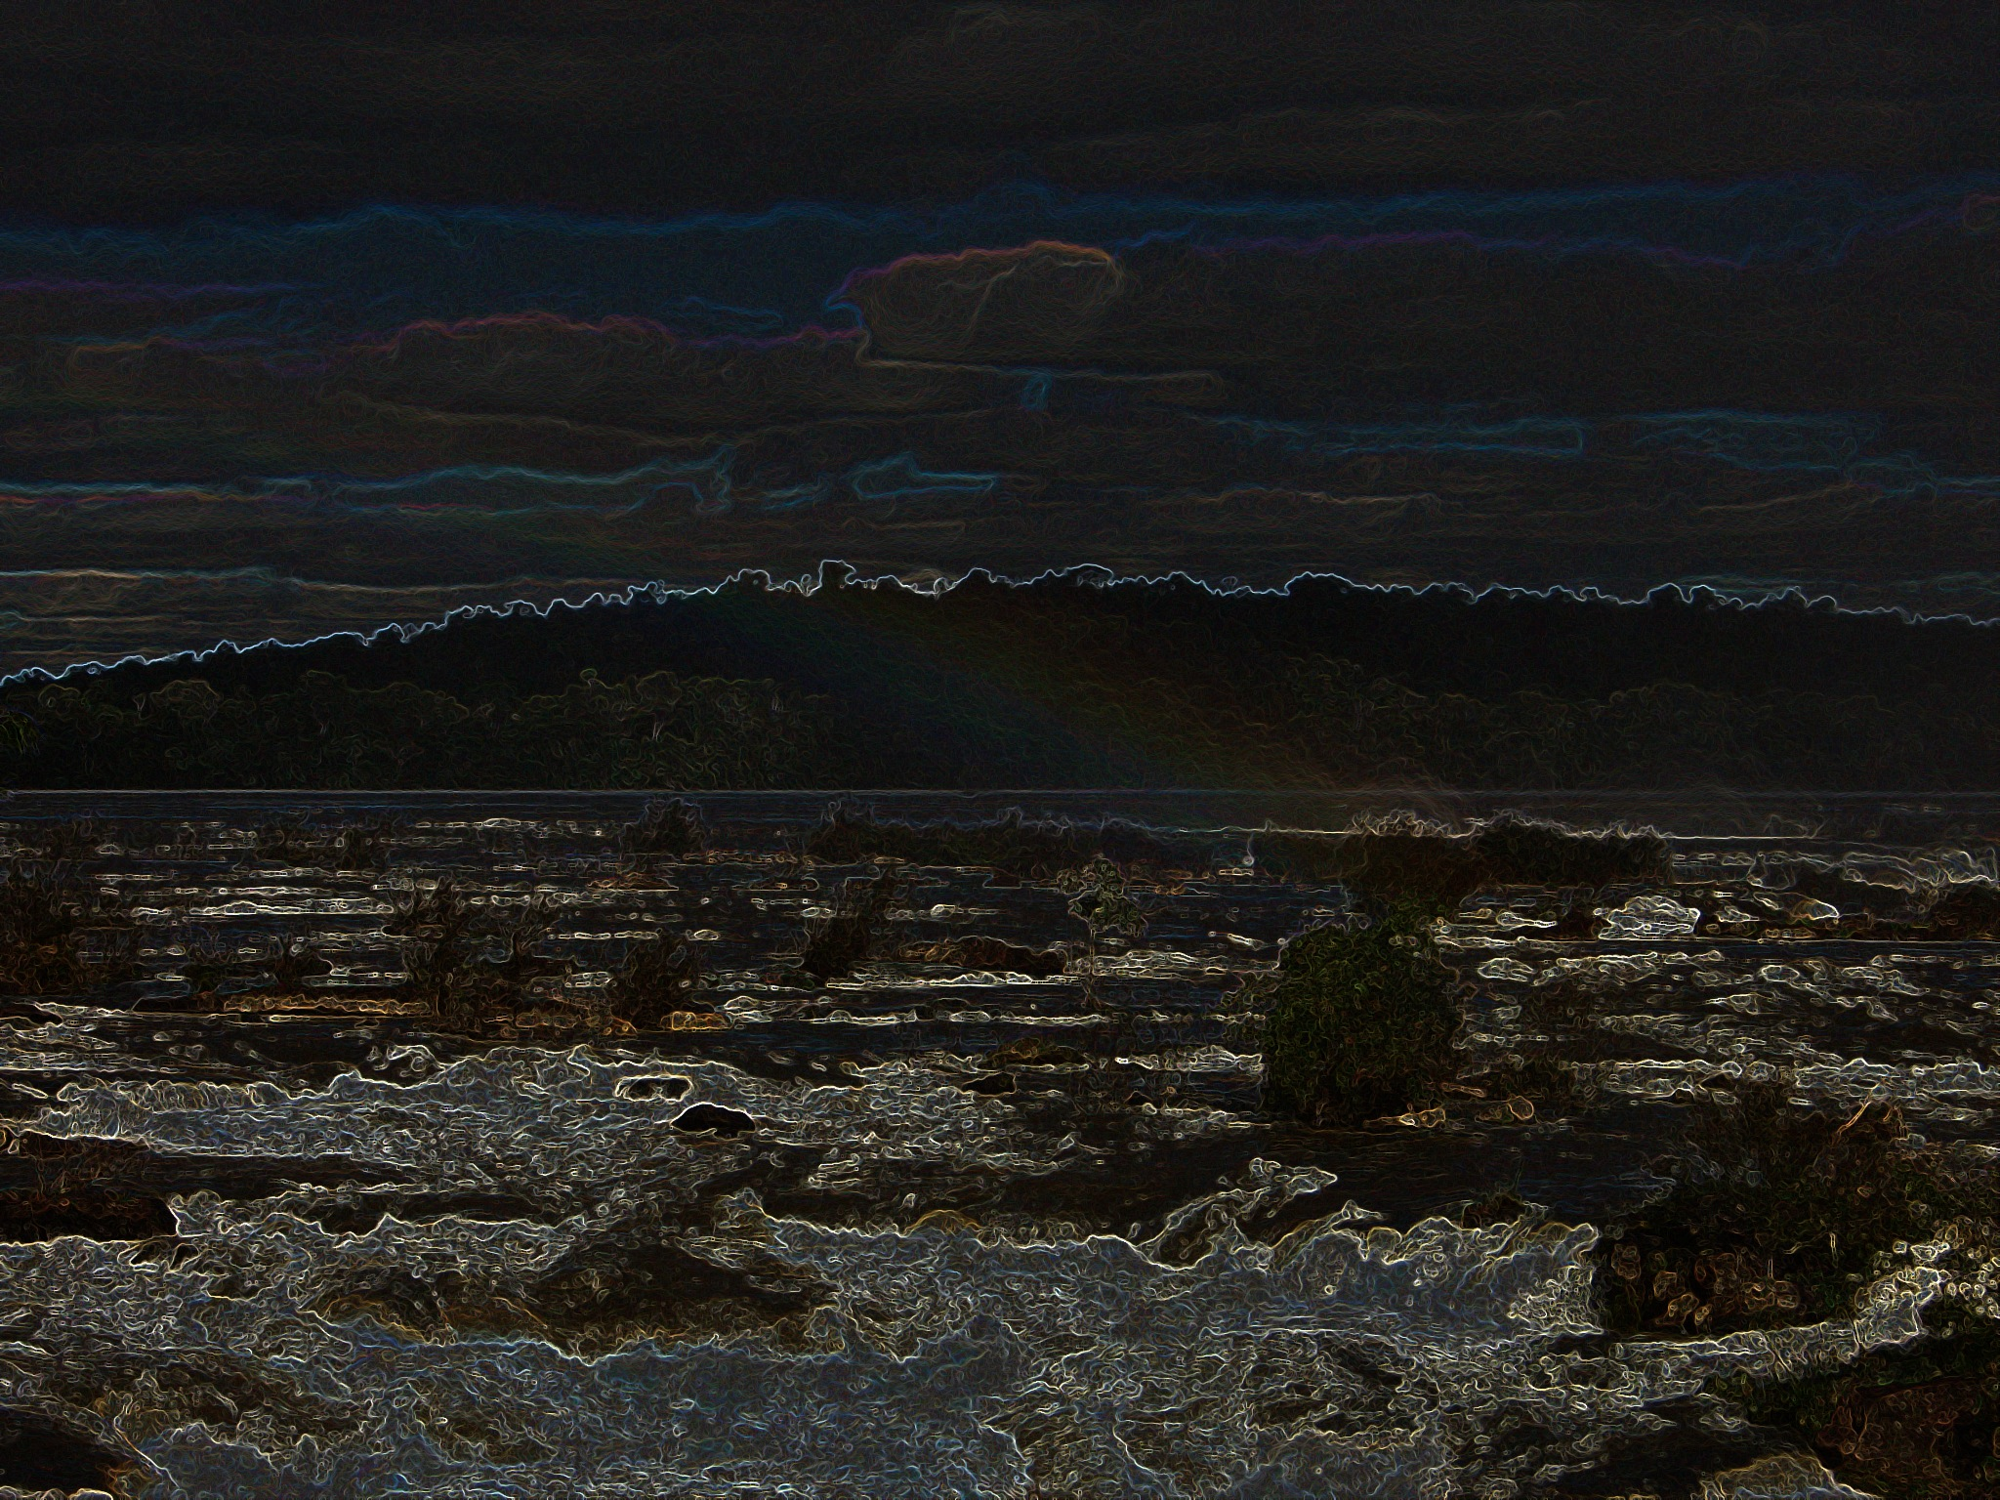
Critical Creativity
Critical companionship video & resource guide: Facilitating career progression from person-centred practice to person centred systems: Domain 5. Working Across Systems
Critical creativity is a paradigmatic synthesis in which the assumptions of the critical paradigm are blended and balanced with, and attuned to, beauty, Nature and creative and ancient traditions, for the purpose of human flourishing (Titchen & McCormack, 2020)
Alex and other critical companions on this website often work in this way.
Huge thanks to Eric White for allowing this re-interpretation of his painting for a ‘good cause’ (in his words!)
Notes:
Criitical creativity is a paradigm or landscape if you like, for action-oriented practice development and research. (https://www.cpcpr.org/_files/ugd/26205d_f2fe903feb034753b3b789db2c72c5ad.pdf)
Human flourishing focuses on maximising individuals’ achievement of their potential for growth and development as they change the circumstances and relations of their lives. People are helped to flourish (i.e. grow, develop, thrive) during the change experience in addition to an intended outcome of wellbeing for the beneficiaries of the work.
Flourishing is supported through contemporary facilitation strategies, connecting with beauty and nature and blending with ancient, indigenous and spiritual traditions (c.f., Senge et al 2005) and active learning (Dewing 2008).

Slide 3

Domain 5:
Resources & recommended reading
Main CC frameworks & references
Critical companionship video & resource guide: Facilitating career progression from person-centred practice to person centred systems
DOMAIN 5: WORKING ACROSS SYSTEMS
Huge thanks to Eric White
Notes:
Add links to Resources etc

