Slide 1







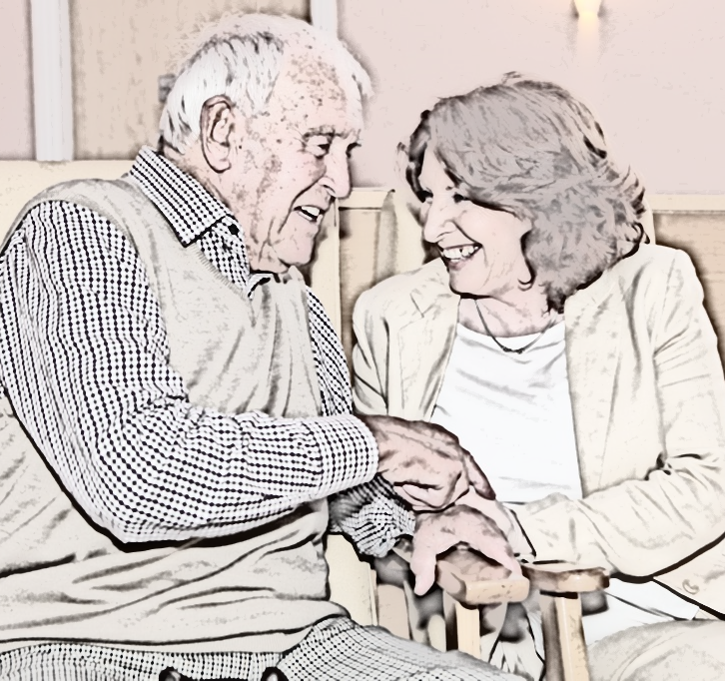
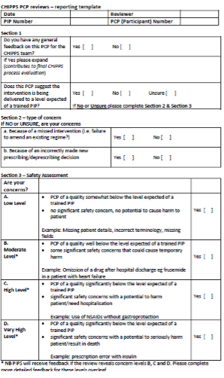

Development and testing of an effective model for monitoring patient safety within the Care Homes Independent Pharmacist Prescribing Study (CHIPPS). D.Wright, C.Bond, C.Hughes, D.Alldred, R.Holland on behalf of the CHIPPS team
https://www.uea.ac.uk/chipps*
Background
Hypothesis: A pharmacist with independent prescribing rights (PIP) could assume the central role of medicines management in care homes.
Pharmacist independent prescribing removes reliance on the general practitioner to agree with and implement recommendations.
Frail population.
Identified need to reassure stakeholders of:
  standard of the pharmacist service
  patient safety.
Figure 1. Form completed by consultant geriatricians when assessing pharmaceutical care plans
Aim
To develop and test a model for monitoring the quality of the CHIPPS intervention and patient safety.
Method
Results
Cluster randomised controlled trial with internal pilot study conducted in four UK sites
  Aberdeen, Belfast, Leeds, Norfolk.
  Internal pilot assessed safety and feasibility of recruitment
  Eight triads (two per site), each comprising
    General Practitioner
    PIP
    Care homes with at least 30 residents> 65 years old prescribed at least one regular medication
  Main trial: 47 triads
Randomisation 1:1 Intervention: Control (usual care)
Intervention (3 hours per week over 6 months)
    pharmaceutical care planning
    repeat prescription authorisation
    medicines systems review
    staff training
Findings from Internal pilot are described below:
  36 SAEs reported:
    10 deaths
    26 hospitalisations
  No GP identified causality with PIP activities.
  Consultant geriatricians assessed one submitted care plan as having ‘moderate concerns’ and one ‘low concerns’ due to poor ‘quality of care plan completion’
  For one care plan, views of the consultant geriatricians disagreed. Consensus reached after discussion
  No reports of concerns received via the dedicated email address.
Patient Safety
Conclusion
Intervention PIPs trained using systematically developed competency framework
Accredited via oral examination with GP and pharmacist.
Care homes were contacted on a monthly basis to identify any potential significant adverse drug events (SAEs) i.e. deaths or unplanned hospitalisation
SAEs independently reviewed by the resident’s GP to ascertain likelihood of PIP causality.
Random sample (20%) of PIP pharmaceutical care plans were submitted monthly for three months and reviewed by consultant geriatricians for quality and safety (Figure 1).
Dedicated email address for care homes to report concerns.
Results suggest that PIP training and accreditation process are fit for purpose with no adverse events linked to their activities.
Concerns regarding quality of pharmaceutical care plan completion identified a need to enhance this training element.
Main trial (440 residents) is ongoing and early safety data confirm intervention is safe.
This poster presents independent research funded by the National Institute for Health Research (NIHR) under its Programme Grants for Applied Research Programme (Grant Reference Number RP-PG-0613-20007). The views expressed are those of the author(s) and not necessarily those of the NHS, the NIHR or the Department of Health.
Acknowledgement
The CHIPPS Research team acknowledges the support of the National Institute of Health Research Clinical Research Network (NIHR CRN).
CHIPPS TEAM: UEA: David Wright (PI), James Desborough, Fiona Poland, Garry Barton, David Turner, Nigel Norris, Annie Blyth, Viv Maskrey, Laura Watts, Lee Shepstone, Anthony Arthur; University of Leeds: David Alldred, Amrit Daffu O’Reilly; Queens University Belfast: Carmel Hughes. University of Aberdeen: Christine Bond, Jacqueline Inch, Frances Notman & Phyo Mint; University of Leicester: Richard Holland(PI); Consultant: Arnold Zermansky; Addenbrooke's Hospital: Jo Ford; Norwich CTU: Ann Marie Swart; PPI: Christine Handford, Kate Massey; Consultant: Helen Hill

