Slide 1
Notes
This presentation has been created with the view of taking around 15- 20 minutes
The information is correct when created in June 2025 – please check any key information before delivering as the landscape can change!
User instructions
The presentation is really split into two parts- a price guessing game, then information
For guidance, please use the explanation sheets
For the price game, it may be beneficial for students to have pen and paper to write their guesses down

Slide 2
Get Set:
GCSE to HE
Financial Support at University

Slide 3

Aims
To outline the financial costs and financial support available for university
Notes:
We know that one thing students can worry about is how they are going to afford university. The aim of this session is to outline the financial costs of going to university, but also the financial support that is available.

Slide 4
Guess the price
For each item, write down how much you think it might cost
We will then reveal the answer, and you can see how close you were!
It is important to be savvy with your money when at university – you will need to learn how to budget
Notes:
*read through the information on the slide. If you would like students to write the guesses down, they will need a pen and paper*
One thing students have to do is learn how to budget their money. Let's have a guess at some prices of every day items that students might want or need to buy.

Slide 5


Pasta and Sauce
75p + 69p
= £1.44
Notes:
*click to reveal the price for each one*

Slide 6

University book
£41.99
Note – you don't have to buy new books! Universities will have libraries to access and there are often second-hand book fairs from previous students too!

Slide 7

Domino's medium pizza
£21.99
(unless you get offers!)

Slide 8


Milk and cereal
£3.35 + £1.20 =
£4.55

Slide 9
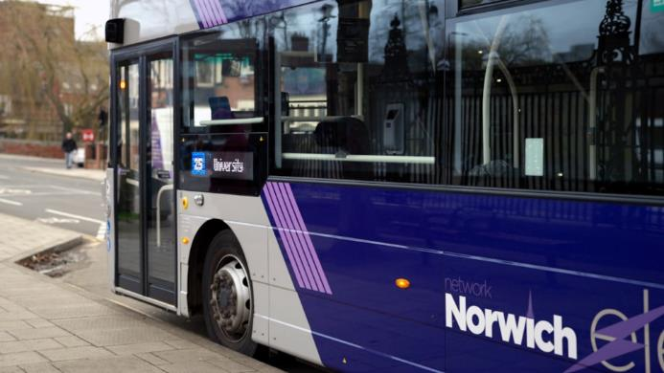
Annual bus pass for Norwich
£320

Slide 10

Cinema ticket at Vue, Norwich
£7.99

Slide 11

Jacket potato with cheese and beans on campus
£3.60

Slide 12

Gym membership at the UEA per month
£29

Slide 13







Guess the price: Reflection
How did you get on?
Did any of the prices surprise you?
Discuss with the person next to you: if you were living on a limited budget, what would be the things you would prioritise paying for (aside from accommodation/bills)?

Slide 14

A final guess the price...
How much do you think it costs to pay for
tuition fees for
learning at university each year?
In 2025-2026, the cost is £9535 per year!

Slide 15

University costs: Watch the video to find out more
Tuition fees
Cost of living
This is the cost of studying your course, paid directly to the university.
This is the cost of everything else – your accommodation, food, phone bill, hobbies, etc.
Notes:
There are two main costs involved with going to university – tuition fees, and the cost of living. Tuition fees means the cost of studying your course, and is money paid directly to the university. The cost of living is the cost of everything else – your accommodation, food, phone bill, money for hobbies, meals out, days out and much more! However, there is help available for you for both parts of these costs.
*please then show the video which gives a more detailed look at student finance*

Slide 16
Available funding: Student Finance
Tuition fee loan
Paid to university
Everyone can access
Pay back when earning over a certain amount
How can you pay for the tuition fees?
What help can you get with living costs?
Maintenance loan available
Everyone can access some
Household requirements for maximum amounts
Pay back when earning over a certain amount
Notes:
So, let's break down a little bit more the details about the tuition fee loan and maintenance loan.
How can you pay for tuition fees? *click for next animation*
A tuition fee loan is available, which is paid directly to the university. Everyone can access this loan, and you will pay it back when you are in a job and earning over a certain amount of money.
*click for next animation*
What help can you get with living costs? *click for next animation*
There is a maintenance loan available. Everyone can access some money, but there are household income requirements to be able to access over the full amount. Again, you would not pay this back until you are earning over a certain amount of money. So, let's look at how this would work...

Slide 17
Student finance: Repaying the loans
Tuition Loan
Paying it Back
£9535 per year from 2025-26.
You only pay back 9% of what you earn over £25,000. Then, after 40 years, it disappears!
Maintenance Loan
Between £3,790 and £13,348 per year.
Notes:
So, as you can see here, currently tuition fees can be up to £9535 per year. The maintenance loan that you can access is between £3,790 and £13,348 per year.
As for paying it back, you will only pay back 9% of what you earn over £25,000. Then, if there is any remaining loan left after 40 years, it will disappear and you will no longer have to pay it back.

Slide 18
Student finance: Repaying the loans
Example
Paying it Back
Imagine you earn £25,000 a year. Each month, your student loan will cost you:
You only pay back 9% of what you earn over £25,000. Then, after 40 years, it disappears!
£0
Notes:
We are just going to have a look at how paying it back works, as again it can be something that students worry about. So as you can see, if you earn £25,000 a year exactly, your student loan repayments each month would be £0. This is because you only pay back what you earn OVER £25,000.

Slide 19
Student finance: Repaying the loans
Example
Paying it Back
Imagine you earn £30,000 a year. Each month, your student loan will cost you:
You only pay back 9% of what you earn over £25,000. Then, after 40 years, it disappears!
£37.50
Notes:
However, say you were earning £30,000 a year, you would pay back 9% on what you earn over £25,000. So in this case, each month, you would pay back £37.50. It is worth saying that nearly all students have student loans – very few people can afford to pay for university without them! They also don't affect your credit score in the same way other 'loans' might as they are for educational purposes.

Slide 20




How else can you pay for your living costs?
Support for specific groups eg parents/carers, or those who are care experienced or have a disability
Bursaries and scholarships from universities
You could be eligible for an NHS bursary
Working a part-time job
Notes:
There are also a number of other ways you may be able to gain or make some money to pay for your living costs. Lots of universities offer bursaries or scholarships – these may be things you apply for, or are given automatically if you meet certain criteria. For example, UEA students whose household income is less than £20,000 will receive up to £1600 per year. Many students also choose to work a part-time job to fit around their studies, whether this be a job on campus (such as in the shop or the bar), or something in the local area. There are also extra pots of money available for specific groups, such as people who go to university who are parents, who are care experienced or have a disability. In addition, if you are studying a healthcare course, you may be entitled to money from the government.

Slide 21

Where else can you look for information?
www.gov.uk/studentfinance
www.savethestudent.org
www.ucas.com/money-and-student-life/money
www.everwondered.uea.ac.uk
UEA Specific: www.uea.ac.uk/study/fees-and-funding

