Slide 1

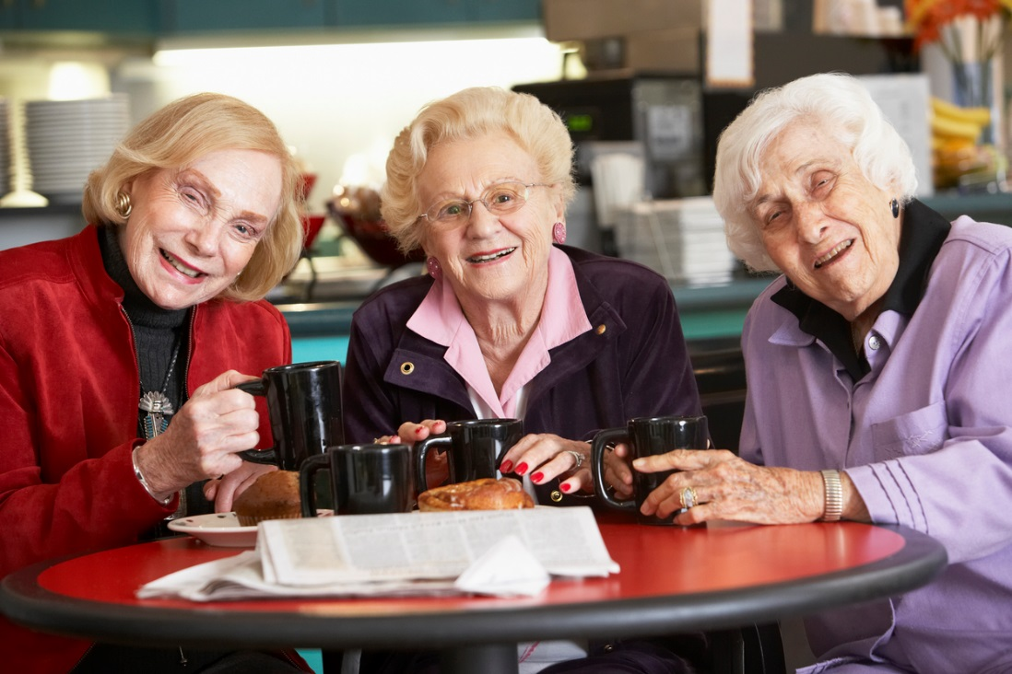
Drinking & Dehydration
Florence Jimoh
Diane Bunn
Lee Hooper

Slide 2
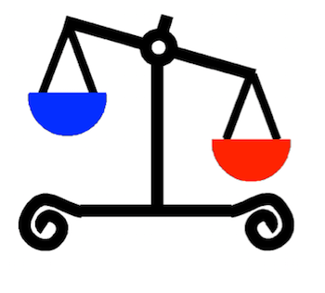
What is dehydration?
When we don’t drink enough fluid the amount of fluid in our body falls.
This is dehydration.
Dehydration happens when fluid intake is less than fluid losses.
Water
out
Water in
Notes:
Ask participants how they feel when they have not been drinking well. Allow discussions and sharing of experiences. Possible experiences could include tiredness, headaches, disorganised, confused, lethargic etc
Water comes into our body in several ways - through what we drink (80%), what we eat (20%) and a small amount is made in the body. Water leaves our body when we make urine, faeces, sweat and breathe. Dehydration happens when the amount we are drinking is less than the amount we are losing.
Low-intake dehydration happens when we drink too little. it is most common in older people. (The other type of dehydration is due to vomiting or diarrhoea, called salt-loss dehydration as we are short of both water and salt).
This talk is about low-intake dehydration as it is most common in older people, and less obvious (as we don’t have diarrhoea or vomiting as clues).

Slide 3
Some effects of dehydration on health
Unplanned hospital admissions
Confusion & delirium
Pressure ulcers
Poor wound healing
Constipation
Urinary tract infections (UTIs)
Heat stress, infections, kidney stones
Drug toxicity
Stroke
Falls
Deaths
Disability
Notes:
Ask participants what additional effects are for older people when they don’t drink enough – let them suggest health effects before clicking to show the list above.
Low-intake dehydration can cause serious health effects in older people (note some of those in the list above). This is why we need to be aware of low-intake dehydration and work to prevent it – by helping older adults to drink well.

Slide 4
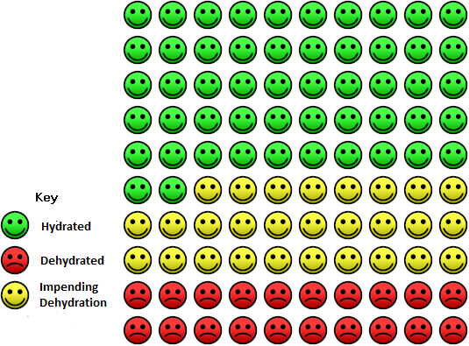
DRIE study
Dehydration Recognition In our Elders
How many older people living in UK long-term care are dehydrated?
20% are dehydrated
1 in every 5 older people is dehydrated
A further 28% are at risk of dehydration (have impending dehydration)
Dehydrated: serum osmolality >300mOsm/kg
Impending dehydration: 295-300mOsm/kg
Hydrated: 275 to <295mOsm/kg
Hooper L et al, J Gerontol A Biol Sci Med Sci. 2016;71(10):1341-7. doi: 10.1093/gerona/glv205.
Notes:
Research in Norfolk and Suffolk care homes in UK found that 1 in every five older residents were dehydrated (the DRIE study). A further 28% were borderline. This was assessed using a blood test (the best method).
Other tests like urine colour and skin turgor don’t work for older people. This is because our kidneys don’t work so well as we get older (so may not concentrate our urine even though we are dehydrated) and our skin is often already wrinkled with age.
As blood tests are difficult and cannot be carried out routinely in care homes, prevention is the best option. We need to work hard to help our residents drink well.

Slide 5
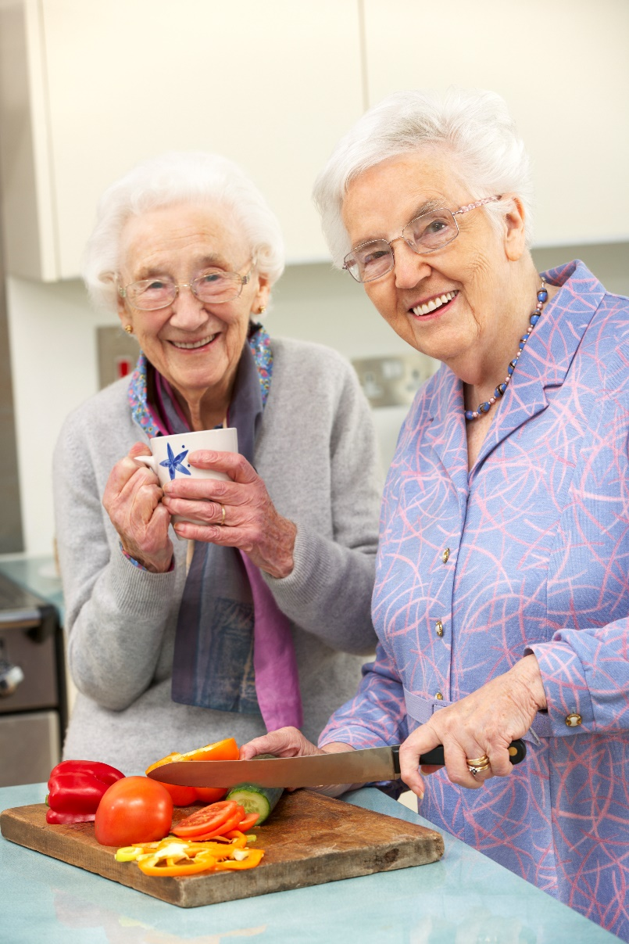
DRIE study
Dehydration Recognition In our Elders
Older people most likely to
be dehydrated:
Those with
poorer cognitive function
any diabetic medication
All those living in care homes were at risk.
Most with dehydration were not thought at high risk of dehydration by care staff.
Hooper L et al, J Gerontol A Biol Sci Med Sci. 2016;71(10):1341-7. doi: 10.1093 /gerona/glv205.
Notes:
The DRIE study also found that all older people living in care homes were at risk. Those with poorer cognitive function (e.g. dementia) and those using diabetic medication were at higher risk than usual.

Slide 6
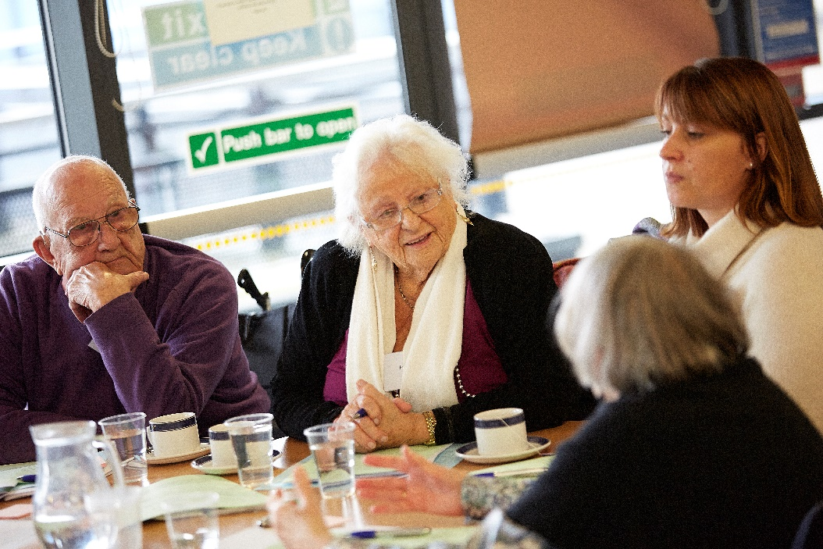
Why dehydration?
Older people usually don’t feel thirsty – so if they drink too little they don’t know.
DRIE advisory groups (care home residents) have told us that they sometimes drink too little:
To avoid visiting the toilet so often (day or night)
Dementia may mean people forget to drink, or think they have drunk.
Reduced social contact reduces social drinks.
Physical access may be limited.
  Hooper L et al, Mech Ageing Dev 2014; 136-137: 50-58. doi: 10.1016/j.mad.2013.11.009
Notes:
Why are older people at increased risk of low-intake dehydration?
Older people do not feel thirsty like young people, so can’t tell when they need to drink. This means they are unlikely to help themselves or ask for drinks. So we have to make sure they are provided with plenty of drinks.
Older people often choose to drink less to reduce burden on carers, and to avoid visiting the toilet so often (when this can be difficult or painful). These issues need to be discussed to help older people drink well.
Drinking is a very social activity - we offer tea or coffee to visitors, share a pint or a coffee when we bump into an old friend. Support social time and contact around drinking to help your residents drink well.
Older people may forget whether they have had a drink recently – we need to offer, encourage and remind.
We need to make sure that our residents have equipment that helps them drink independently, safely, with enjoyment and dignity.

Slide 7
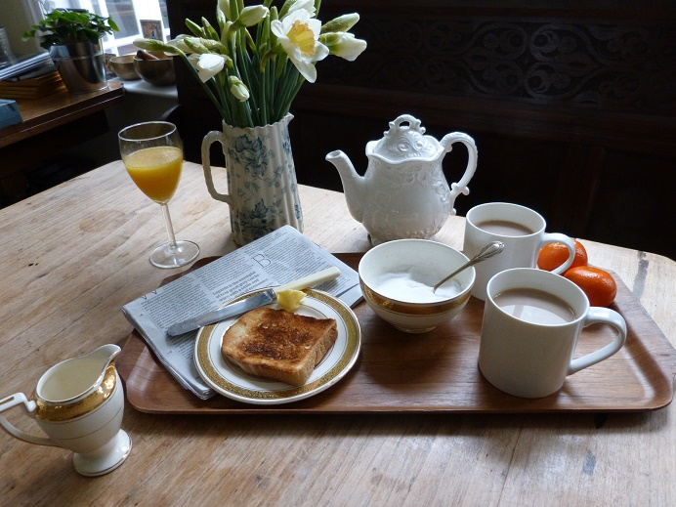
Fluid –how much?
European guideline:
Men: 2.0L/d of drinks
Women: 1.6L/d of drinks
Men: 3 ½ pints or 14 teacups
Women: almost 3 pints or 11 teacups
Food: 20 -30%
Drinks: 70- 80%
Fluid – what drinks count?
All drinks are great at providing fluid, including coffee, tea, shandy, fruit juice, milk, squash, milky drinks, soups, Bovril, oxo, water, cola, lemonade, beer, milk shakes etc.
Volkert D et al, Clin Nutr 2019;38(1):10-47. doi: 10.1016/j.clnu.2018.05.024
Notes:
How much should older adults be drinking each day?
This is the same as for all adults. AT LEAST 1.6L or 1600mls every day for women (just under 3 pints each day), 2.0L or 2000mls for men (about 3 ½ pints) every day. This is in addition to fluid from foods (based on European Guidance)
Drinks that can add up to 1.6 or 2 L include tea, coffee, beer, milk shakes, fruit juice, milk…… etc. Only strong alcohol (wine and spirits) don’t count.
Work out the volume of cups and glasses in your care home to see how many will be required each day by men and women – are you giving out enough drinks?

Slide 8
Dehydration prevention – summary
1 in every 5 older people in care homes are dehydrated
Older people with diabetes or poor cognition are most at risk – but all older people are at risk
Older people usually don’t feel thirsty when dehydrated – so don’t know they need to drink more
All drinks (except strong alcohol) help to keep us hydrated – we don’t have to drink water
Men need to drink at least 2L (3 ½ pints) each day
Women need to drink at least 1.6L (almost 3 pints) daily
Activity times are great times to help older people drink.
The more drinks residents are offered the more they drink
Offer drinks first thing in the morning – before breakfast
Offer plenty to drink with medications
Notes:
To summarise this session, I will recap the main content.
[Read through the list above.]
Lets go out there and make a difference to the lives of our residents. Thank you!

Slide 9

1-hour Hydration Training for all care home staff
A training kit for use in care homes to equip care home staff with basic knowledge, skills and attitudes needed to support older adults living in care homes to drink well.
Funded by the UEA Impact Fund
1-hour Hydration Training was developed by Lee Hooper, Diane Bunn and Oluseyi Florence Jimoh at the University of East Anglia, with funding from the National Institute for Health Research, The Dunhill Medical Trust and UEA Impact Funding. Training pack available from:
https://www.uea.ac.uk/groups-and-centres/uea-hydrate-group
For further details contact Lee Hooper, Norwich Medical School, UEA, Norwich NR4 7TJ, 01603 591268, l.hooper@uea.ac.uk.
September 2019
This work is licensed under a Creative Commons Attribution-NonCommercial-NoDerivatives 4.0 International License.
© 2017-2019, University of East Anglia.

