Slide 1
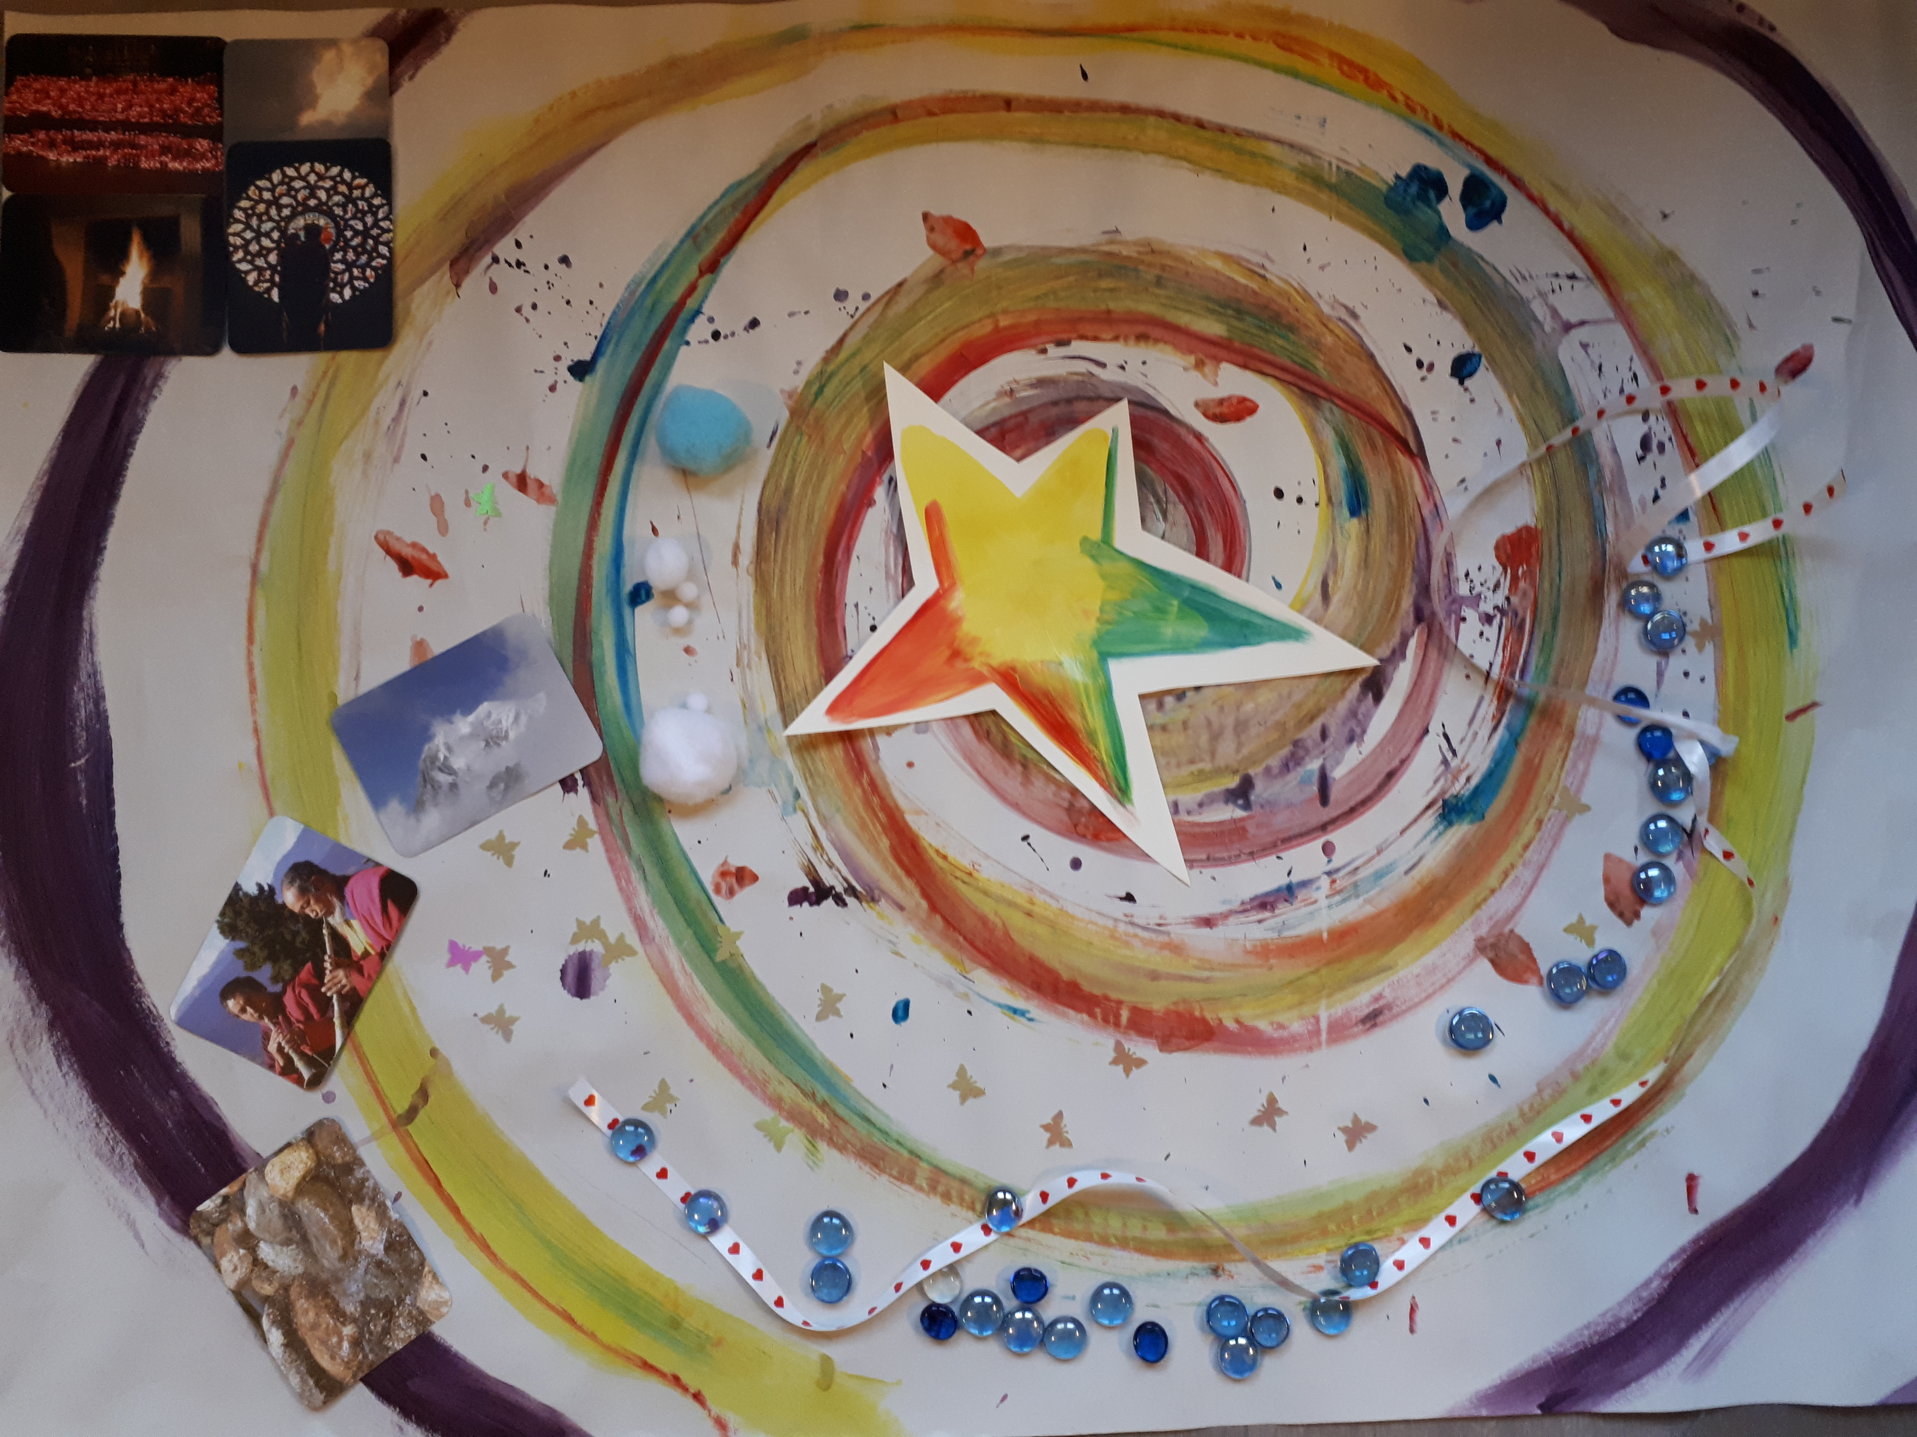
Researching your own practice: Donna Frost, PhD, NZRN
Fontys University of Applied Sciences, Tilburg, The Netherlands
Critical companionship video & resource guide: Facilitating career progression from person-centred practice to person centred systems. DOMAIN 4 Embedded Research
Notes:
Vaibhav Please put link to Embedded Research domain

Slide 2
DOMAIN 4
RESOURCES
RECOMMENDED READING
Main references & Critical companionship frameworks
Critical companionship video & resource guide: Facilitating career progression from person-centred practice to person centred systems. DOMAIN 4 Embedded Research
Notes:
Please put link to Main Video V17 Embedded Research domain

