Slide 1


Using a Coaching approach to enhance your Mentorship
Using a Coaching approach to enhance your Mentorship
David Huggins
Strategic Lead for Mentorship
School of Health Sciences
UEA
July 2014
(Revised December 2014 with thanks to Gurpreet Gill and Steve Oldfield CSED, UEA)
Working across the east of England

Slide 2
Aims and outcomes
An interactive session of training that gives you additional tools to add to your current role as a Mentor.
To be able to define the role of a coach and to understand the similarities and differences between coaching and mentorship
Enhance your existing mentoring skills and give you confidence to be able to apply core coaching skills to support your student.
Assist you to support the students in setting their own appropriate goals and meeting practice placement competencies.

Slide 3
Drivers for change
Increasing the numbers of nurses in training and qualifying
UEA intake by a third in September 2014
Maximising the use of a smaller number of placements and fewer mentors
Reducing the ‘burden’ of mentorship
Current situation is unsustainable
Improving the student/employer experience
(developing competence and confidence)

Slide 4

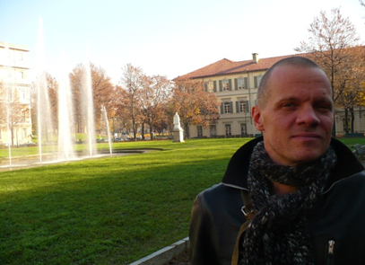

VU medical centre - Amsterdam
Frans Farber Coach
Marcel Bruist Practical Training Tutor

Slide 5
The Dutch experience
Began with similar drivers for change
Introduced a (voluntary) model of ‘coaching’ for student placements
Use situational leadership (Hersey and Blanchard, 1988) and Miller’s (1990) competency model.
Nearly all wards have become Real Life Learning wards in 10 years
Supported by ward based practice educators and university lecturers
Better overall staff : patient ratios
Different culture of care!!

Slide 6
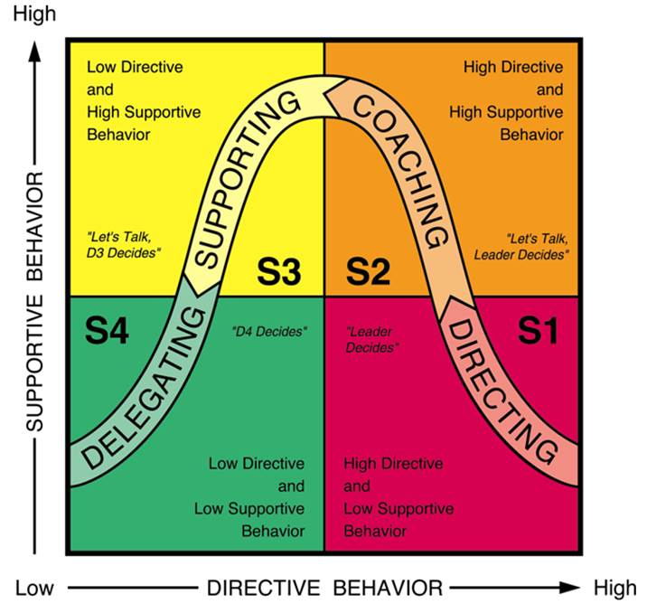
Situational leadership

Slide 7
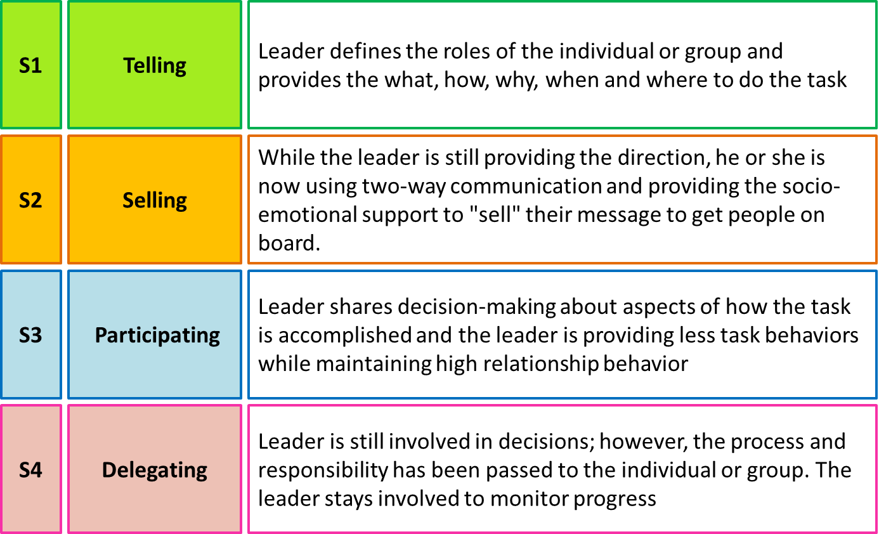
Situational leadership

Slide 8
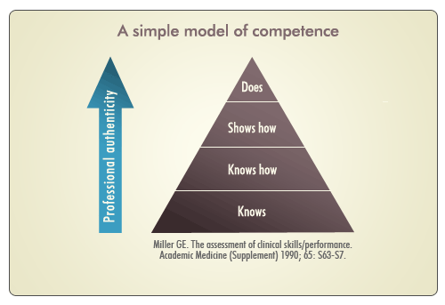
Millers competency model

Slide 9
Clinical educator
Teaching nurse-coaches how to implement training in real life situations
Managing the daily matters on the training wards
Organising and providing clinical lessons
Overseeing the training of student nurses
Coaching of the nurse-coaches on the job

Slide 10
Exercise
What are the similarities and
differences between coaching and
mentoring in your experience?

Slide 11
Similarities
Roles performed by a mentor (Turner 2010) (and a coach?)
Sounding board
Facilitator
Advisor
Coach
Expert
Source of organisational material
Role model
Source of feedback
Confidant
Motivator
Challenger
Others: Teacher, assessor, counsellor, interpreter, leader, critical “friend”… etc.)

Slide 12
Differences
Mentoring and Coaching (NHS Scotland)
Mentoring Coaching
Focus on progress Focus on task
Usually long-term Usually short term
Intuitive feedback Explicit feedback
Develops capabilities Develops skills
Driven by mentee/learner Driven by coach
Helps you to work it out yourself Shows you where you went wrong

Slide 13

Mentoring umbrella

Slide 14
What is coaching?
The key to coaching is the ability to help students arrive at their own solutions through the use of active listening, observation and questioning.
http://www.youtube.com/watch?v=nFx6yKZrzco
The Dutch experience
http://www.uea.ac.uk/foh/mpe/

Slide 15
Setting goals
Desired outcomes - Destination
Shift or change - Milestones
Achievement - Coachee’s Target
Can be short, medium or long term.
Small, medium or large
Small goals can be stepping stones to larger goals
Where do they want to get to? How will they know they have succeeded?
Try mind mapping with your coachee?

Slide 16
Listening
Key aspect of coaching
Are your listening skills cosmetic, conversational or active
Coaches need ACTIVE communication skills
Active listening
Presence (concentration)
Verbal (prompting, tone of voice, summarising)
Non – verbal (posture, eye contact, paralinguistic)

Slide 17

Questioning
Essential to overall process
Find out about coachee (entry behaviour)
Explore any issues
Clarify goals and actions
Encourage coachees to make progress (you can do it!)
70% Coachee
30% Coach

Slide 18
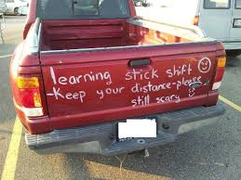

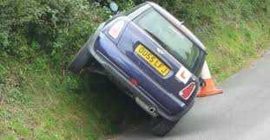
Learning to drive

Slide 19
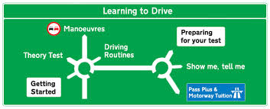


Learning to drive

Slide 20
Mentor/Practice Educator and coach roles (morning shift)
Mentor/PE
(at desk)
3 students
(Bay 1 Learning bay)
Coach/ 2 x student
(Bay 2)
Coach/ 2 x student
(Bay 3)
Coaches can be other staff including HCAs and other students.
HCAs and students do not set aims and objectives for the
Students being coached. The “main coach” (mentor?) does that.
Clinical educator available to “stand –in” when interviews are
being done.

Slide 21
Summary
A coaching approach relieves the sometimes burden of mentorship. (But you have to “let go!”).
Using challenging questions empowers the student
Students take ownership of learning
Coaching aids to mentorship and does not replace it.
Don’t forget that NMC standards still apply.

Slide 22
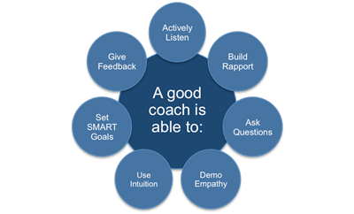
A good coach

Slide 23
Any Questions?

Slide 24
Reading/references and resources
Price B (2005) Mentoring Learners in practice. Building a rapport with the learner. Nursing Standard. 19(22).
Clutterbuck D and Megginson D (2005) Making Coaching Work. Creating a Coaching Culture. London. CIPD
Dennison B & Kirk R (1990), Do Review Learn Apply: a simple guide to experiential
learning, Oxford: Blackwell
* Hersey P and Blanchard K (1988), Management and Organizational Behaviour Englewood Cliffs, NJ: Prentice-Hall, 1988.
Kolb, D.A. (1984) Experiential learning: experience as the source of learning and development. Englewood Cliffs, NJ: Prentice Hall.
Kram K (1983) Phases of the mentor relationship. Academy of Management Journal. 26(4); 608 – 625.
Lewes J (2000) Mentoring and Coaching at Work. A practical Toolkit. Kent: Agora Consultancy.
Miller G (1990) The assessment of clinical skills/competence/performance, Acad. Med 65(9): 63-67.
Morton-Coper A and Palmer A (2000) Mentoring, Preceptorship and Clinical Supervision. 2nd Ed. Blackwell. Oxford.
Munro Turner M (2010) Mentoring: an overview. Coaching Today. Issue 5.
NHS Education for Scotland (2007) Guidance series: Mentoring Framework.
NMC (2008) Standards to Support Learning and Assessment in Practice: NMC Standards for Mentors, Practice Teachers and Teachers. London. NMC.
http://www.uea.ac.uk/foh/mpe/

Slide 25

This work is licensed under a Creative Commons Attribution-NonCommercial-NoDerivatives 4.0 International License.
© 2017 University of East Anglia. All Rights Reserved.
CLiPTM was developed by Charlene Lobo in the School of Health Sciences at the University of East Anglia with the support of NHS Health Education East of England and can be downloaded at http://www.uea.ac.uk/foh/mpe/clip-project
If you have any questions about CLiPTM or wish to cite this work please contact David Huggins
Email: d.huggins@uea.ac.uk
Tel: +44 (0)1603 59 7049
Address: School of Health Sciences, University of East Anglia, Norwich Research Park, Norwich, NR4 7TJ

