Slide 1
SESSION 3
Acceptance –building the child’s self -esteem
Notes:
Notes
Welcome to the third session: Acceptance -building the child's self esteem.

Slide 2
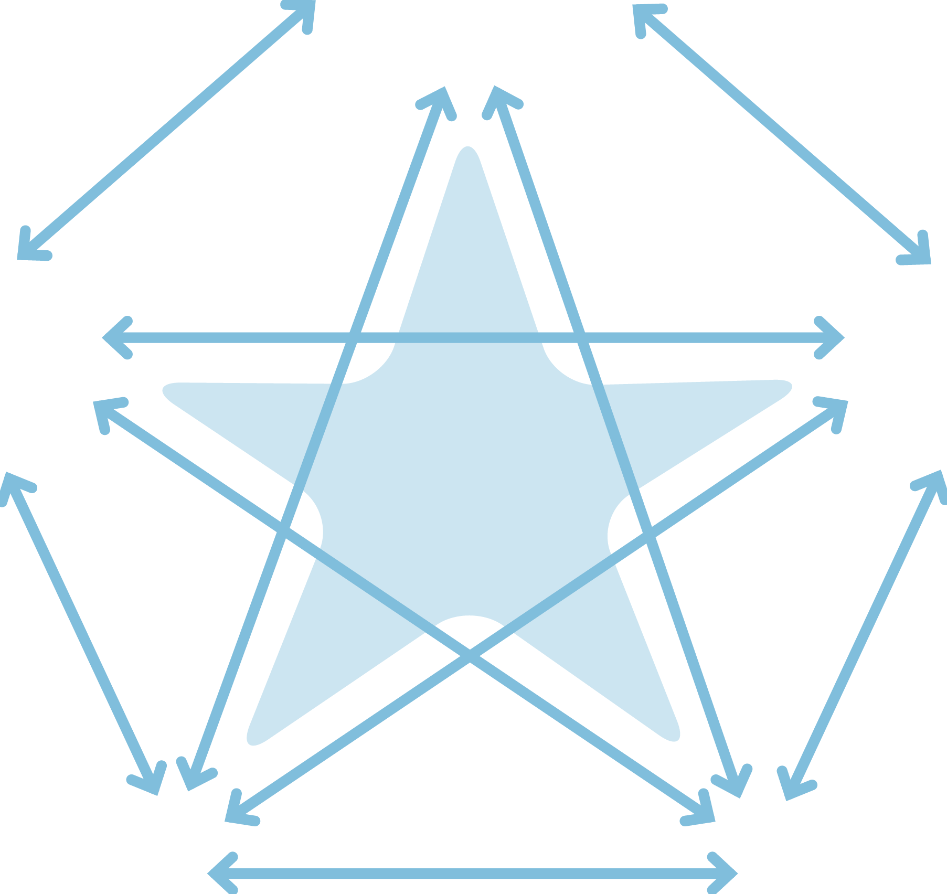

The Secure Base model
AVAILABILITY
helping the child to trust
FAMILY MEMBERSHIP
helping the child
to belong
SENSITIVITY
helping the child
to manage feelings
SECURE
BASE
CO-OPERATION
helping the child
to feel effective
ACCEPTANCE
building the child’s self-esteem
Notes:
Notes
As we move on to this dimension, it's important to note that self-esteem and feeling accepted are recognised as important issues for all children – but can be especially challenging for children from troubled backgrounds of trauma and loss.
It’s important to think about the ways in which this dimension builds on caregiver availability enabling the child to begin to trust and sensitivity -helping the child to manage their feelings.
But it is also important to note the ways in which raised self-esteem can feed into other dimensions- for example helping the child to trust and to feel that they belong.
Before we move on to look at this third dimension, acceptance and building self-esteem, in more detail, we will start with feedback and discussion on the reflection task on sensitivity-helping the child to manage feelings from last session - as managing feelings is an important foundation for today.

Slide 3
Sensitivity- helping the child to manage feelings: reflections task
Think about the learning from the session and this dimension in relation to children in families you work with or children in your care.
Are there particular children who have become better able to express and manage their feelings because of the sensitive responsiveness of a caregiver?
Are there particular children who you think need help to express and manage their feelings and could benefit from some of the sensitivity caregiving strategies discussed e.g. naming feelings, story reading?
What are the benefits and challenges of offering sensitive, attuned care to children who struggle to manage their feelings? ?
Notes:
Notes
This slide is a reminder of the reflections task suggested at the end of the last session.
Encourage feedback and discussion as a full group. Time needed will depend on how many participants have undertaken this task / feel able to share their ideas- but max 10-15 minutes.
Prompt questions could focus on the last bullet point and include - after last session, have you found the concept of sensitivity, tuning into children, a helpful /necessary caregiving concept?

Slide 4
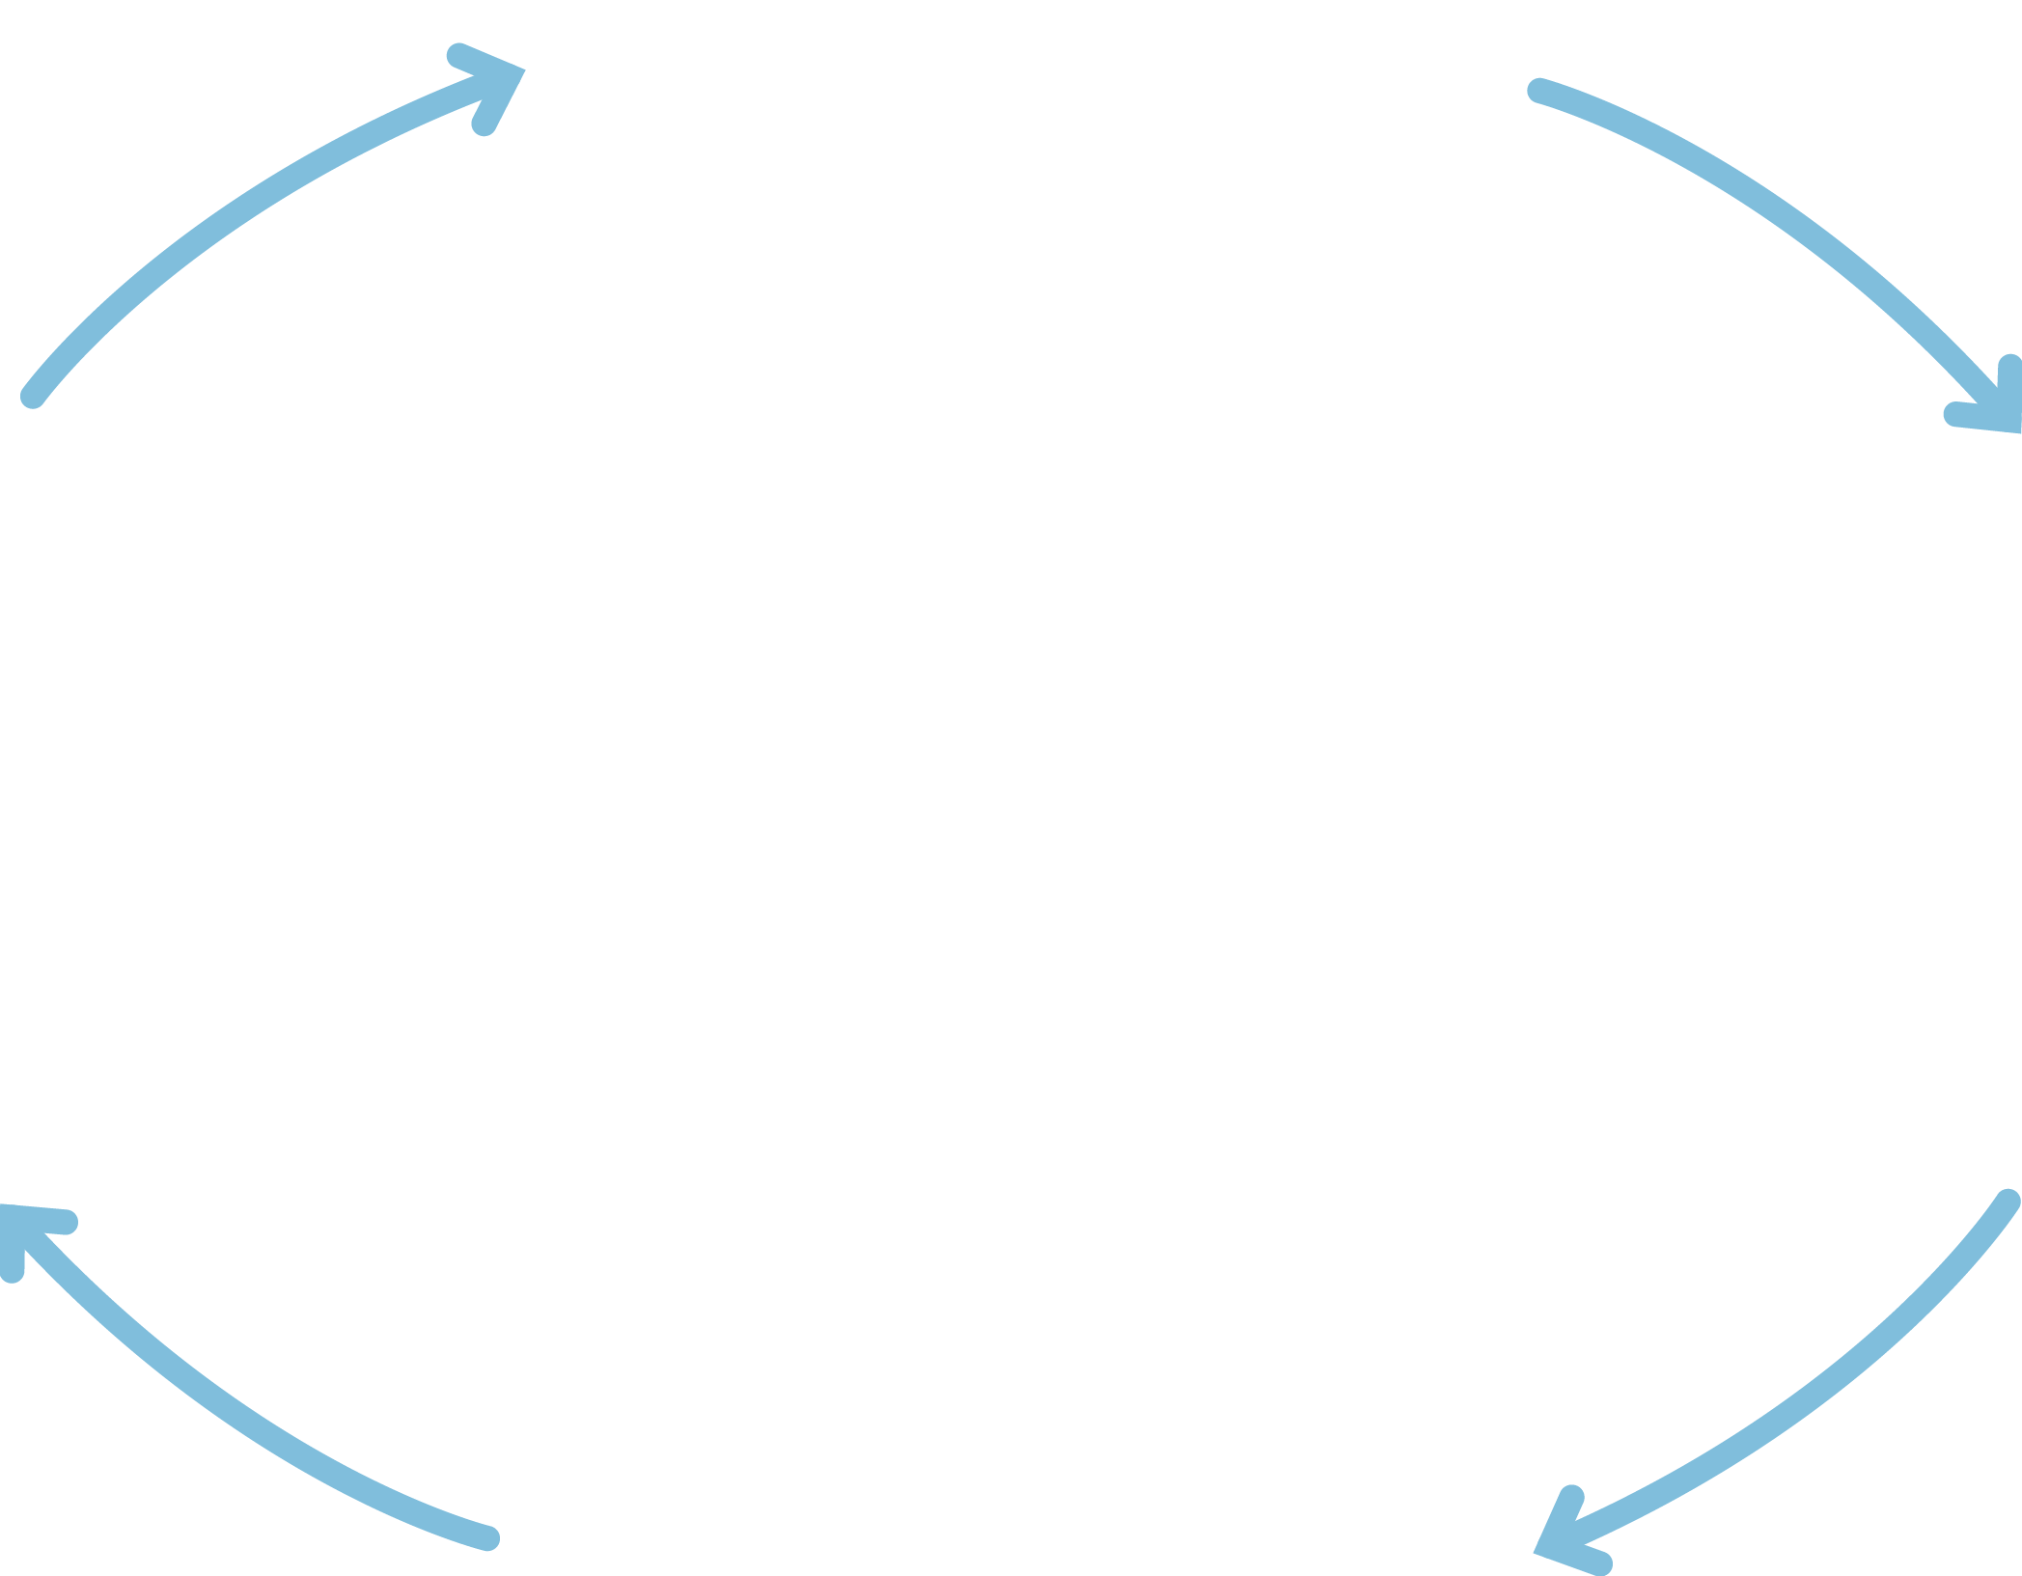

Acceptance
Child
thinking/
feeling
Child’s needs
and behaviour
Caregiver
thinking/
feeling
I am accepted
and valued for
who I am
I do not have to
be perfect
Building
the child’s
self-esteem
This child needs me to value and accept them
I need to value and accept myself
Helping the child to feel good about themself and manage setbacks
Caregiving behaviour
Notes:
Notes
Now we move on to the caregiving cycle for the third dimension- Acceptance- building the child’s self-esteem.
READ round the cycle on the slide
Acceptance refers to the fundamental acceptance of the child – from infancy to adolescence - for who they are, as a person of value, interest and concern, even when some of their behaviour may need help to change.
Praise and positive attention in a form a child can accept can be powerful in helping children to feel accepted for who they are, feel good about themselves but also manage the inevitable setbacks and disappointments that all children need to manage.
Positive self-esteem – in children and caregivers - is an important aspect of resilience (that is, the capacity to manage difficult experiences from the past and face new challenges with skills and confidence).
Acceptance and self-esteem can also support the healthy development of personal and social identity.

Slide 5

Why children may have low self-esteem
Children may have
had experiences of abuse, neglect and loss
been treated as different or of less value
started to feel unworthy of love, success, praise
learned to fear failure and avoid new activities
had to find ways to defend against feelings of failure
Notes:
Notes
READ SLIDE
All forms of abuse and neglect, especially caregiving that was negative, harmful and lacked warmth and sensitivity, can make children feel profoundly worthless.
Some children may blame themselves for family difficulties and for their own or their siblings’ removal from the family, which can further lower self-esteem.
Losses and moves within the family and the care system can also contribute to low self-esteem.
Children who have not found play and activities rewarding or been supported to manage setbacks may have a deep fear of failure and so will not take risks / try new things - for example, they may refuse to join in with games and activities.
Some children develop a deep-rooted sense of being inferior, different, unworthy of success.
Children may then defend against these feelings of worthlessness -for example, by becoming boastful or making exaggerated/untrue claims (for example, ‘I am the best in my class at football’, ‘I’ve got hundreds of friends’). The caregiver needs to find a way to respond to this that shows acceptance and understanding.

Slide 6
EXERCISE 1 Acceptance –building the child’s self-esteem
Behaviour that suggests low self-esteem
Infants (0 – 18 months)
Early childhood (18 months – 4 years)
Middle childhood (5 – 10 years)
Adolescence (11 – 18 years)
Notes:
Notes
Exercise 1
This exercise can be done in small groups
Think of children (in these different age groups) who are cared for in families you have worked with or children you have cared for? Have you observed behaviours that suggest low self-esteem?
Ask the group to think of small indicators – perhaps issues that can occur in normal development e.g. a young child who is nervous about trying a new activity, as well as more serious issues such as self- destructive behaviour in older children. This helps to build a picture of the full range of behaviour and degree of difficulty.
Ask for specific examples of observed behaviour. e.g. ‘She won’t allow me to take a photo of her’, as well as ideas about what the child may be thinking e.g. ‘She doesn’t like the way she looks’.
As a whole group, gather examples for each age group.

Slide 7
Acceptance
Child
thinking/
feeling
Child’s needs
and behaviour
Caregiver
thinking/
feeling
I am accepted
and valued for
who I am
I do not have to
be perfect
Building
the child’s
self-esteem
This child needs me to value and accept them
I need to value and accept myself
Helping the child to feel good about themself and manage setbacks
Caregiving behaviour
Notes:
Notes
Show slide - we are now going to focus on the caregiver's thinking and feeling in response to the child's self-esteem needs and behaviour.

Slide 8
Acceptance: caregiver thinking and feeling
This child needs me to value and accept them
I need to value and accept myself
Notes:
Notes
Caregivers must hold in mind that this child needs me to value and accept them– however the child reacts to praise and whatever may be the stresses of caring for the child.
Alongside this, and especially if caring for the child is challenging, it is important for caregivers to hold in mind the need to value and accept themselves, so that their own emotional resources do not become depleted.
This can be a key area of intervention for support workers. Caregivers who are feeling overwhelmed by their children’s needs and finding it hard to parent positively may need to be reminded of their strengths and skills and that it is the child’s history that is creating problems in the family, making it difficult for them to parent the child in the way they would want.
In that context caregivers and the social workers who support them need help to remain hopeful that even very troubled children can and do change with the right support, but it takes time.

Slide 9
EXERCISE 2
Valuing yourself
Complete these statements
I am good at working with /caring for children because…
My best qualities are…
I am proud of the way I…
I have helped a child/children by…
Add two more positive statements about yourself.
Notes:
Notes
Exercise 2 Allow 15 minutes
Show slide
Ask each participant to complete the four statements – and add two of their own. Followed by a whole group discussion.
Participants do not need to share their examples unless they wish to do so. But after they have completed their statements, the trainer can introduce a discussion about how it feels to recognises one's own strengths, why it can be hard, what things are easier/harder to acknowledge and why this might be the case.
Acknowledging one’s own strengths and skills doesn’t come easily to everyone and it is important for caregivers and social workers to practice this as part of maintaining positive self-esteem. It is also important to model enjoying successes and managing setbacks positively to children so that they can learn that it is OK for them to recognise and celebrate their own strengths and skills - and also important to accept that we all have disappointments and setbacks.

Slide 10
Refreshment break

Slide 11
Acceptance
Child
thinking/
feeling
Child’s needs
and behaviour
Caregiver
thinking/
feeling
I am accepted
and valued for
who I am
I do not have to
be perfect
Building
the child’s
self-esteem
This child needs me to value and accept them
I need to value and accept myself
Helping child to
feel good about themself and manage setbacks
Caregiving behaviour
Notes:
Notes
Show slide - we are now going to move on to focus on the caregiver's behaviour - which is founded on the caregiver's thinking and feeling in response to the child's needs and behaviour.
Helping the child to feel good about themself and manage setbacks positively can include a range of caregiving approaches adapted for each child.

Slide 12
Acceptance -building the child’s self-esteem: caregiving behaviour
Offering praise and positive attention
Encouraging activities and interests
Supporting the child with setbacks and disappointments
Accepting and supporting the child’s developing identity
Modelling and supporting the child to accept and celebrate difference e.g. ethnicity, abilities, appearance
Notes:
Notes
Young people who have grown up in care or adoption say that what they want most is to be loved and accepted for themselves – whatever their difficulties might be.
Offering praise and positive attention is important and may be linked to encouraging activities and interests where the child can be supported to feel successful – for example, caring for a pet, small tasks in the home, enjoying a sport or activity. Advocacy for the child at nursery or school can also help the child to enjoy play, learning and friendship. These are important for building self-esteem and resilience. They can have a ripple effect in helping children to gain confidence, relate to peers, use their time productively, improve their skills.
All children experience setbacks and disappointments at times and need to be supported through these. It is important for caregivers to have realistic expectations of the child and to reassure the child that they are still loved, whether or not things go well. They can promote the idea in the caregiving family- ‘Nobody’s good at everything but everybody’s good at something'.
When thinking about accepting and supporting a young person's evolving identity it is helpful to think about identity as being linked to both self-concept and self-esteem - who am I and how do I and other people value me? We will come back to questions of identity when we look at the dimension of family membership and belonging.
Finally, caregivers also need to model and teach the child to accept and celebrate difference and diversity of all kinds, in themselves and in others. Children who are anxious about being accepted themselves often struggle with accepting others.

Slide 13
Offering and explaining praise
‘Kelly’s not used to being praised and she doesn’t always make the connection, so you have to spell it out to her. Instead of just saying ‘Well done’, we might say “You’ve done really well to get a good behaviour star. You must have tried hard. We’re really proud of you”.’ (Caregiver)
Notes:
Notes
READ SLIDE
This caregiver has thought about the child’s response to praise in terms of her history.
Explaining to a child the connection between their behaviour and adult praise can help the child to accept praise, enjoy it and learn to value themself.

Slide 14
Building self-esteem through activities
‘We encourage a lot of activities, because we want to build Gemma’s confidence and help her to be more sociable. So she goes to theatre school, and since she has done this we feel her confidence has grown more. This year she took the part of the main character in the school play and she was amazing – and she knew she was.’ (Caregiver)
Notes:
Notes
READ SLIDE
This is another example of active support from caregivers - in this example, to help this child to be more sociable, but also to feel positive about themself and their identity.

Slide 15
Showing pride - promoting self-esteem and resilience in a child with learning difficulties
‘Rob (11) loves his fishpond. Now he’s in charge of his own and he’s totally reliable in that department. We encourage him all we can. We say, “Rob’s the top pond man”. He gave his talk at school on goldfish and got top marks.’ (Caregiver)
Notes:
Notes
READ SLIDE
Rob had learning difficulties and had few opportunities to excel at school. But the long-term foster family, where he was placed age 10, took pride in their fishpond and encouraged Rob to have his own pond, next to his caregivers'.
Their pride in Rob and his own sense of achievement became a source of self-esteem right through to age 18 and beyond - but also became part of Rob's sense of belonging and permanence in this family.

Slide 16
EXERCISE 3 Acceptance-building self-esteem: caregiving approaches
Chloe (6m) is tiny for her age and is in foster care because she was failing to thrive. She is very quiet, easily startled and appears anxious and tense.
Scott (3) will not take the risk of trying anything new. He only eats very limited types of food and will not try new toys or wear new clothes.
When Jamilla (7) is praised or admired, she seems angry and says ‘Don’t say that’. Often she will then do something to invite a negative response.
Shayne (11) has dyslexia and is due to start high school soon. He is very anxious and says he doesn’t want to go because he won’t be able to do the work.
Notes:
Notes
Exercise 3 Approx 15-20 minutes
Divide into small groups to discuss possible caregiving approaches for one or potentially two case examples, depending on time.
Discuss as whole group. Reflect on links to the the previous exercises- behaviour that indicates low self-esteem in each age group and the impact of certain behaviour on a caregiver's own self esteem.

Slide 17
Acceptance- building the child’s self esteem: additional support needs for caregivers
Children’s troubled behaviour may erode caregiver self-esteem
Caregivers may:
  feel like withdrawing
  start to lose empathy for the child
  become anxious that they cannot meet the child’s needs
  make the placement conditional on the child changing
Notes:
Notes
This slide should be presented in a way that is empathic and sensitive to caregivers, with emphasis on the fact that all caregivers, at times may experience these difficulties, especially when children are very troubled.
These are common and understandable responses when children are very challenging and caregiver self-esteem starts to become eroded. The caregiver's physical and emotional energy can become drained, and children may respond to this by increasing their demands and feeling more anxious about whether they are lovable.
A supportive environment for this exercise will make it comfortable for social workers and caregivers to discuss these difficult issues openly and respectfully. Allow time for sharing of experiences- as caregivers and supporters of caregivers - and possible solutions.

Slide 18
EXERCISE 4 What can help this caregiver maintain their self-esteem?
Asha (14) has made great progress in her foster family where she has lived since she was 7. But recently, she has experienced bullying at school and her behaviour has changed at home. She frequently tells her foster carer, Sally, that she doesn’t like her, calls her unpleasant names and rejects her attempts to offer warmth and care. Sally is becoming worn down by this and feels that she is failing Asha.
Notes:
Notes
Exercise 4 Whole group
Ask the group to discuss this example and what additional support might help Asha's caregiver.
Include offering emotional and practical support for Sally’s self-esteem, as well as possible strategies for caring positively for Asha and building her self-esteem.

Slide 19
Acceptance- building the child’s self-esteem: child thinking and feeling
I am accepted and valued for who I am.
I do not have to be perfect.
Notes:
Notes
READ SLIDE
When children begin to feel accepted and valued for who they are and learn that this does not depend on being ‘perfect’, they will gain confidence, enjoy their successes and manage their setbacks with greater confidence. Small steps towards this should be acknowledged and celebrated.
Self-esteem can be vulnerable throughout childhood and adulthood, especially in unfamiliar or stressful situations.
Self-esteem building does not only take place within the family and extended family. Schools and community groups can play an important role in building a child's self-esteem – but children often need caregivers to be advocates for them outside the home, supporting their learning at school and participation in peer groups and activities.

Slide 20
Acceptance-building the child’s self-esteem: reflection task
Before the next session, think about the learning from this session and this dimension in relation to children in families you work with or children in your care.
Are there particular children who had low self-esteem, but who started to value themselves once accepted and encouraged by caregivers?
Are there children who would benefit from some of the accepting caregiving strategies discussed today e.g. praise, help to enjoy activities?
What are the benefits and challenges of offering acceptance and support to children of different ages with low-self-esteem?
Notes:
Notes
This is a suggested activity to help participants reflect on their learning and understanding of this session / this dimension - and will act as a bridge to the next session / next dimension
Explain that there will be a whole group discussion of these reflections at the start of the next session.

Slide 21
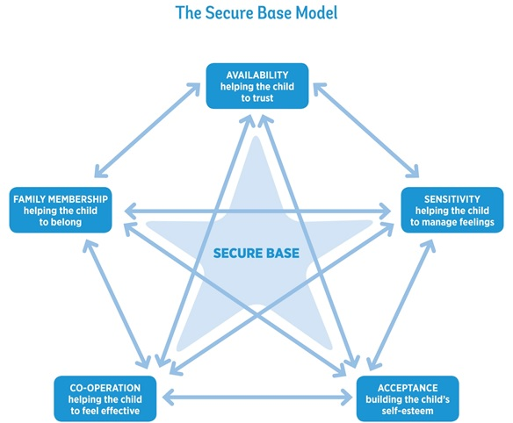
Notes:
Notes
Thank you for your thoughts and participation.
Next time we move on to consider the fourth dimension, co-operation- helping the child to feel effective.

