Slide 1
Notes
This presentation has been created with the view of taking around 15-20 minutes
The information is correct when created in June 2025 – please check any key information before delivering as the landscape can change!
User instructions
The presentation is set out as a 'true or false', where students will see the statement, decide if it is true or false, and then the answer is shown with an accompanying video to watch
You may wish for students to show hands for true/false, or split them into teams
If you wish to do it as a competition and show all the videos, you may need slightly more than the time allows or to split it over more than one session
Throughout it follows the same format – read the true or false statement, change slide, read the answer and then if there is an accompanying video these will follow before the next statement
Please see explanation sheet for further guidance

Slide 2
Get Set:
GCSE to HE
Pathways and Myth-Busting

Slide 3

Aims
To investigate some of the common myths surrounding higher education
We are going to do this through a 'true or false' session!

Slide 4


True or False
You must move away from home and live in halls to go to university
OR

Slide 5
FALSE
Many choose to live on campus or away from home
Increasing numbers remaining at home and in the local area
It is normally cheaper to live at home
Students who live close to the university and stay at home are called 'commuters'.

Slide 6

Student voice: where you live at university

Slide 7
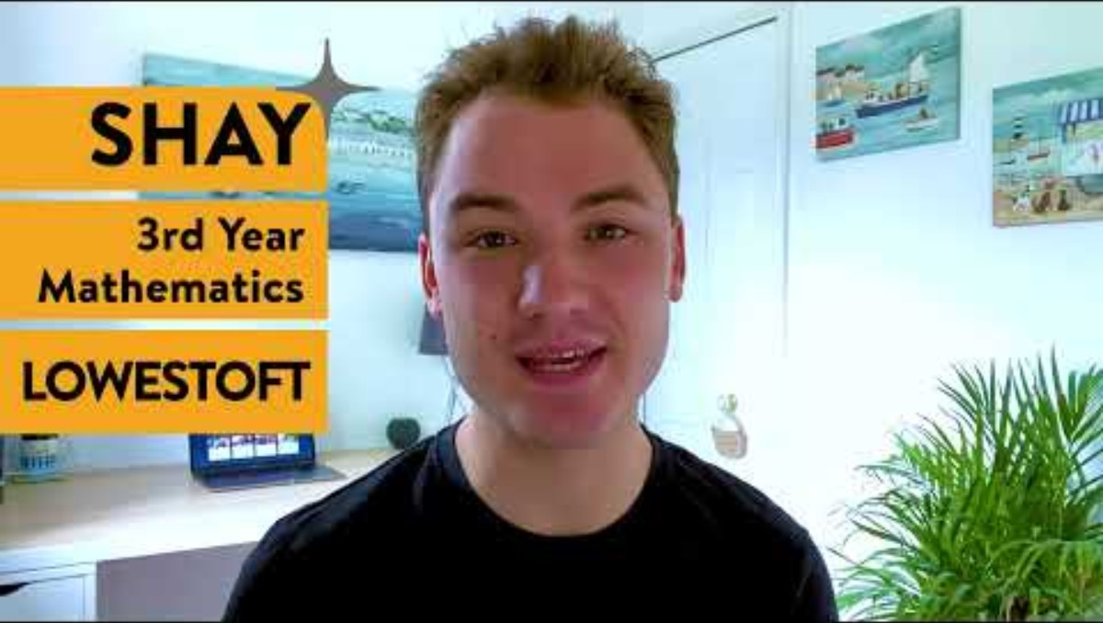
Student voice: Commuting to University

Slide 8
True or False
You must study A-Levels to be able to go to university
OR

Slide 9
FALSE
There are lots of qualifications that can get you into university, including:
BTECs
T-Levels
Apprenticeships
A-Levels
Some courses will also ask for your GCSE grades, especially in English and Maths.

Slide 10
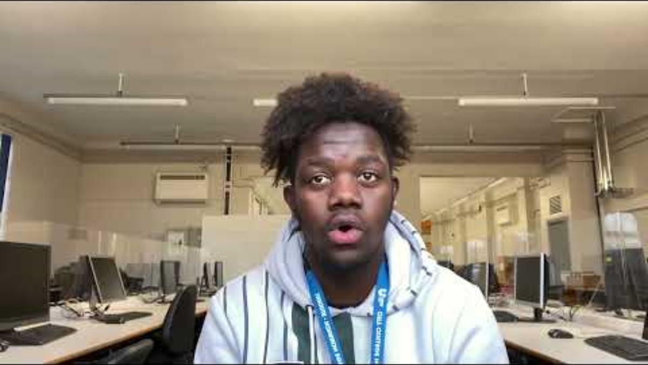
Studying Level 3 BTEC

Slide 11
True or False
If you don't get the grades needed, you might still be able to go to university that year
OR

Slide 12
TRUE
There are a few options...
Some universities may accept applicants, even if they miss the grades of their offer
Clearing - universities open up any spaces they have remaining to students
Some universities offer foundation years for some subjects. This is a base year that you would complete before your degree.

Slide 13
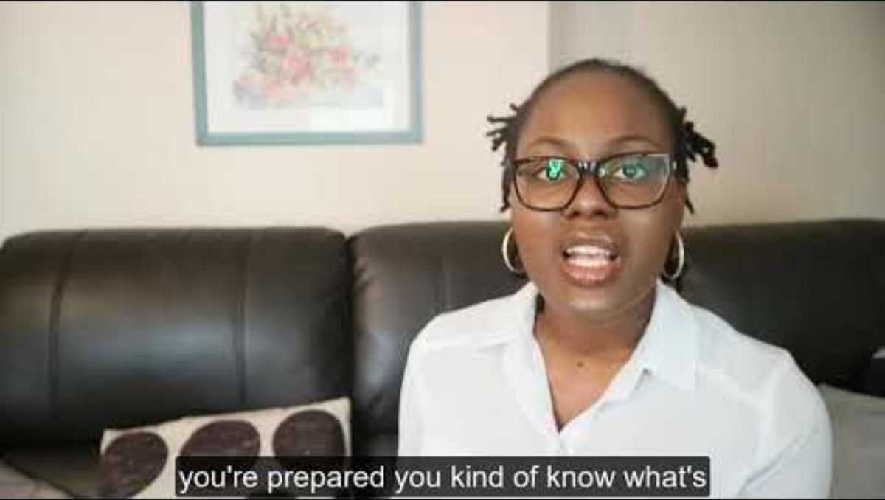
Foundation Years

Slide 14
True or False
Apprenticeships are available at university level
OR

Slide 15
TRUE
Degree apprenticeships are available, which allow you to gain a full undergraduate degree whilst you work, so you would leave with the same level of qualification as someone who had studied at university.
Intermediate apprenticeship
Level 2, equivalent to GCSEs
Advanced apprenticeship
Level 3, equivalent to 2 A-Levels
Higher & Degree apprenticeship
Levels 4-7, equivalent to bachelor's degree level and higher

Slide 16
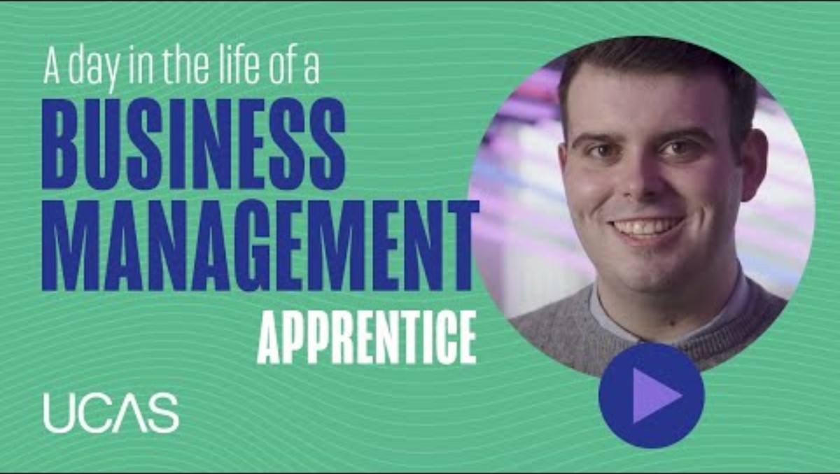
Degree Apprenticeships: A Day in the Life

Slide 17
True or False
A full-time course means you will be at university 9-5 every day
OR

Slide 18
FALSE
Timetables really vary depending on the subject
Practical subjects that feature lots of lab work or learning courses like medicine, nursing and teacher training do tend to have higher levels of teaching time
For other courses you may only have lessons on 3 days of the week but will be expected to work independently outside of that.

Slide 19
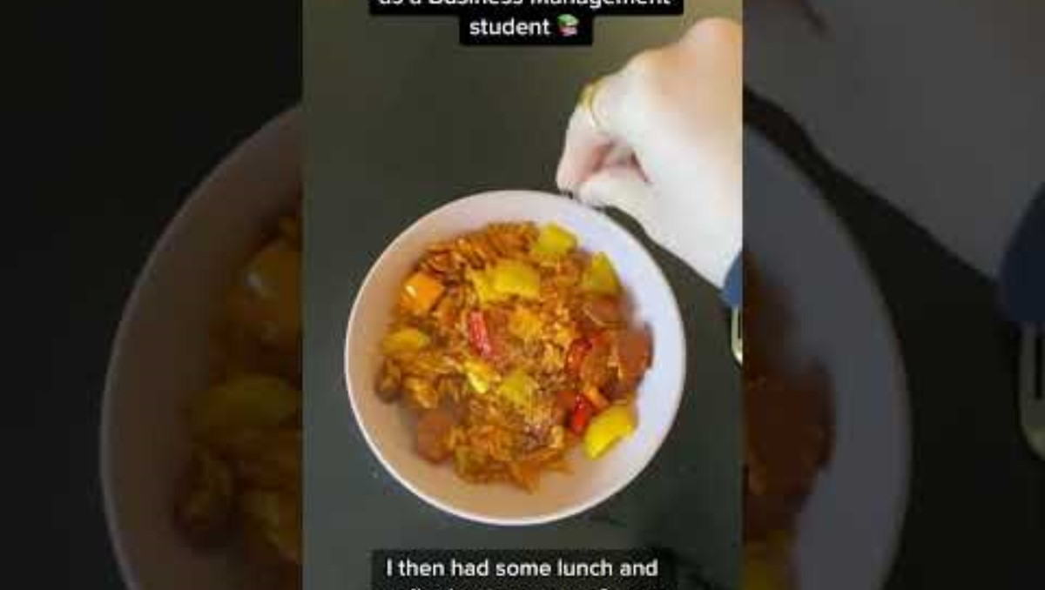
Day in the Life of a business student

Slide 20
True or False
Doing any degree will likely help you to access a wider range of jobs
OR

Slide 21
TRUE
For some careers, there is an obvious link to a university course – for example, if you study medicine, you want to become a doctor
However, many jobs open to graduates (people who have gained a degree from university) will specify that you need a degree but not necessarily the subject
This means that a wider range of jobs will be available.

Slide 22
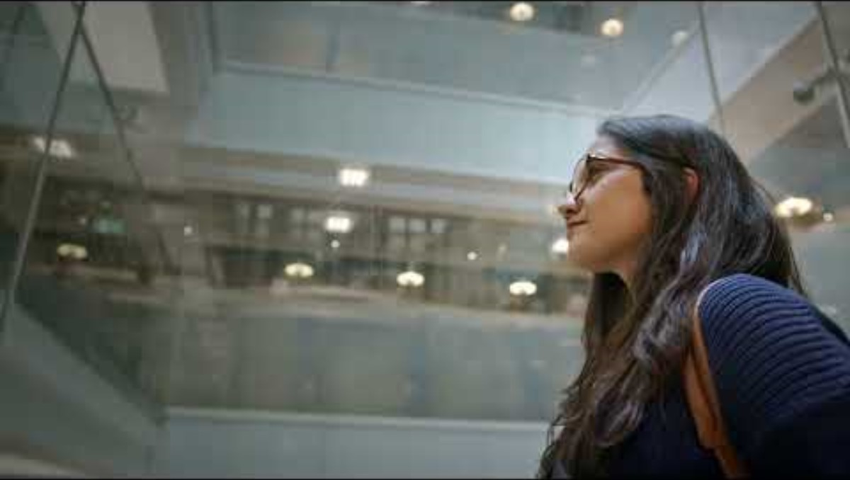
Where will your degree take you?

Slide 23
True or False
There are around 30 different degree courses to choose from
OR

Slide 24
FALSE
There are approximately 35,000 different courses you can study at university!
There are a huge variety available:
  Those you will have studied before, such as history, maths and biology
  New subjects, such as criminology and astronomy,
  Those linked to a specific job, such as midwifery or medicine.

Slide 25

Thinking without borders... bringing it all together!

Slide 26
True or False
You can study for a degree at a university, at a college or online
OR

Slide 27
TRUE
University is one option, whether you choose to move away to university or live at home
Many Further Education colleges are now opening more and more degrees
You can also study online through a provider like the Open University.

Slide 28
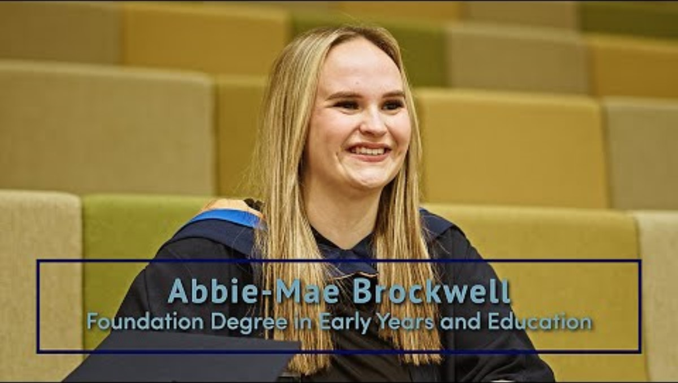
Study at a College – University Centre West Anglia

Slide 29
Optional Videos: What would you like to watch?
Student voice: where you live at university - UEA - Resource Centre
For more information on degree apprenticeships: Degree apprenticeships - Learn more here
University commuters: UEA - Resource Centre
More about foundation years: UEA - Resource Centre
Pathway options at Post-16: A-Levels, BTECs, T-Levels and Degree Apprenticeships: UEA - Resource Centre

