Slide 1
Accessing Support
at University
UEA Outreach
16 February 2026

Slide 2



What is UEA Outreach?
Our objective in Outreach is to help students overcome barriers to accessing Higher Education
We do this by providing you with the information you need to support informed decision making about your future
We're not here to promote UEA above other higher education providers
We will continue to support you regardless of your chosen pathway or choice of HE provider.
Notes:
CORE
What is UEA outreach?
As a university outreach team we are committed to providing you and your students with impartial support regarding post 18 options.
Why do we do this?
Our objective is to widen access to higher education in general regardless of HE destination for students from backgrounds underrepresented in higher education.
How do we do this?
We deliver comprehensive programmes of activity in partnership with Uni Connect, Into University, the HAS scheme, and other HE providers
We ensure our talks and workshops provide examples from multiple HE providers, with the aim of providing your students with the information they need to support informed decision making
We will support your students regardless of chosen pathway and/ or choice of HE provider

Slide 3

What are we going to cover?
What support is available at university, and how to access it
How to confidently advocate for yourself, and get support in doing this
Identifying what support might be beneficial to you throughout your studies.
Notes:
CORE These are the Learning Objectives that we want student to cover during this talk.

Slide 4



What Support Do I Need?
Activity 1
Spend a few minutes thinking about what support you might need in education.
Make a list of 3-5 changes you might be adapting to when you go to university, and keep these in mind as we go on.
What Works?
Need Help?
Differences
Do you have anything in place now? Does it work? Would you like it to continue?
Is there anything you feel you might benefit from? For example, if you struggle hand-writing notes, would a laptop make things easier?
What do you think the main differences are between sixth form / college and university?
Notes:
ACTIVITY ONE: This could be done in small groups or as a class, depending on room layout and personal preference
RESOURCES NEEDED: Paper, pens – a whiteboard might be helpful but isn't necessary.
EXAMPLE ANSWERS:
What Works?: Coloured paper for printables/worksheets, extra time in exams or extensions to assessments, smaller room for exams. It might be useful to remind students that some 'adjustments' now are just the norm in Higher Education – you can bring food and water to classes, there isn't generally a uniform policy, and you can wear things like ear defenders if they help you.
Need Help?: Alternatives to handwriting i.e. using a laptop, or the option to record lectures (if that isn't already done as standard). Students could also ask for lecture slides or other materials in advance. If students are not sure, don't worry, as they'll hear more examples within the session.
Differences: There are plenty of differences students could name, but some include: All classes are optional – no one will chase students for non-attendance. Students will likely have less time in the classroom, and more independent study – they'll have to learn to manage their time. They may also be doing new things – essays are often longer than previous study, there may be group work or practical tasks etc.

Slide 5
Disclosing Support Needs
on your UCAS Application

Slide 6

Sharing Individual Needs on your UCAS Application
The easiest way to let universities / colleges know about your support needs is through your UCAS Application.
You can let them know about any disabilities or long-term health conditions, and any other personal circumstances for which you may need additional support.
Already submitted your UCAS Application?
Don’t worry! You can email the student support services
at your Firm Choice university / college.
Notes:
If students have not yet applied through UCAS – explain that personal circumstances (i.e. care-experience or estrangement) or disability can be included in the 'More About You' section of the UCAS Application. NOTE: This section only appears after other sections are completed – don't worry if you can't see it straight away. Referees can also include these circumstances in their reference, if they feel there has been an impact on academic performance (i.e. exams missed due to illness or injury).
If students have already applied, they will need to get in touch with their Firm Choice institution – most universities and colleges have webpages about incoming students accessing support, so encourage students to look at these.

Slide 7

Why Disclose Your Needs?
Declaring your support needs does not have any negative impact on admissions. But it does mean…
Your Firm Choice university / college can have support and adjustments in place before you arrive.
You may be eligible for additional financial support from the university / college.
You may receive a contextual offer which considers any barriers which you may face in education.
Notes:
Supporting Examples:
University/College support or adjustments can include accommodation (i.e. having an accessible room).
Financial Support will vary from institution to institution – for example, UEA offers up to a £3000 bursary per year for care-experienced or estranged students.
Contextual Offers: Royal Holloway (University of London) and the University of Wolverhampton include disability/long-term health conditions as criteria for a contextual offer.

Slide 8

Remember: YOU are in Charge!
While disclosing any additional needs can be helpful, it’s completely up to you how much you share and with whom.
Any information you share with UCAS is completely confidential and it is not shared with admissions teams at universities or colleges before they respond to your application.
Information is also not shared with your lecturers or teachers – however they should be informed if you require reasonable adjustments.
Notes:
More information about how information is shared can be found here: Sharing a disability or mental health condition in the UCAS application | Undergraduate, Conservatoires | UCAS.
Student Support Services at their firm choice University will be able to provide support on disclosing support needs to other parts of the University, but should always seek consent from the student before doing so. If students would like support from within their department, most faculties have Disability Liaison Officers (DLOs) who can offer subject-specific support, and work in collaboration with university-wide services.
Make sure students know that

Slide 9
True or False
Accessing Support

Slide 10
You will need to pay for additional
Support at university.
A
True
B
False

Slide 11
Student support services are part of what is covered by your tuition fees.
If you have a disability or long-term health condition, you may also want to apply for DSA (Disabled Students’ Allowance) for financial support or equipment to assist you in your studies.
Notes:
Students can apply for DSA here: Help if you're a student with a learning difficulty, health problem or disability: Disabled Students' Allowance - GOV.UK

Slide 12
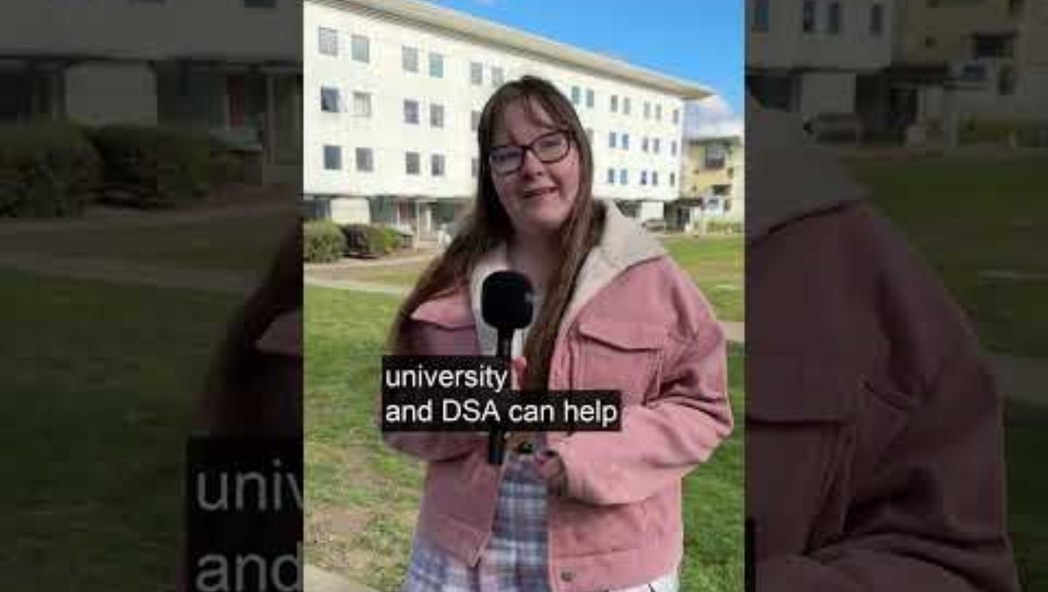


Disabled Students’
Allowance

Slide 13
Any adjustments you already have will
automatically carry on at university
A
True
B
False

Slide 14
Universities / colleges don’t receive any information about you, your support needs, or EHCPs if you or your sixth form / college don’t tell them about it.
You'll need to advocate for yourself and your needs – the support is available, you just need to ask for it.
Notes:
This might be a good point to refer students to individual school advisors if they have specific questions about their situation, and what (if anything) has been passed on to their firm choice university/college.
Remind students that the upside of this is that if they feel they would benefit from some support they are not currently receiving, this is a great time to ask for it.

Slide 15
You get to keep any equipment provided
by DSA, even after graduating
A
True
B
False
Notes:
Examples of equipment a student might be given through DSA include: specialist laptop or software, an adapted desk or chair, recording devices for live sessions.

Slide 16
Many universities record lectures for
Students to review at their own pace
A
True
B
False

Slide 17
This is an example of a reasonable adjustment made for students who may have a processing delay, or difficulty writing – but it benefits everyone!
UEA, University of Essex, University of Oxford, and many more record lectures for all students to look back at later.
If your university does not offer this as standard, you will be able to request it.

Slide 18
You must have a diagnosis to get support
for a disability / health condition
A
True
B
False

Slide 19
Universities / colleges usually offer support based on students’ needs, not a medical diagnosis.
It can be helpful if you are able to provide evidence of ‘need’, such as any previous adjustments or a letter from a medical professional, but this is not a requirement.
Many universities also offer screening services for Autism, ADHD, and other Specific Learning Difficulties (SpLDs) like dyslexia.
Notes:
Examples of Universities that offer screening services include UEA, UCL and the University of Cambridge, but this list is not exhaustive. Encourage students to research this availability at their firm choice institution if they feel it would be of benefit.

Slide 20
Support Available
at University

Slide 21



What Problems Might You Face?
Activity 2
Have a think about what kinds of problems a student might face whilst studying for a degree. You can draw on your own experiences, or think more generally.
Make a list of these and refer back to them as we discuss what support is available at universities and colleges.
Some examples include:
Being worried or stressed about assessments
Your laptop breaking and not being able to afford a new one
Experiencing a bereavement
Struggling with academic skills, such as essay writing or data analysis.
Notes:
ACTIVITY TWO: This could be done individually or in pairs, depending on student preference. If the class is confident, ask them to feed back ideas and collate them on a whiteboard/mind map.
RESOURCES NEEDED: Paper, pens, whiteboard (if applicable)

Slide 22
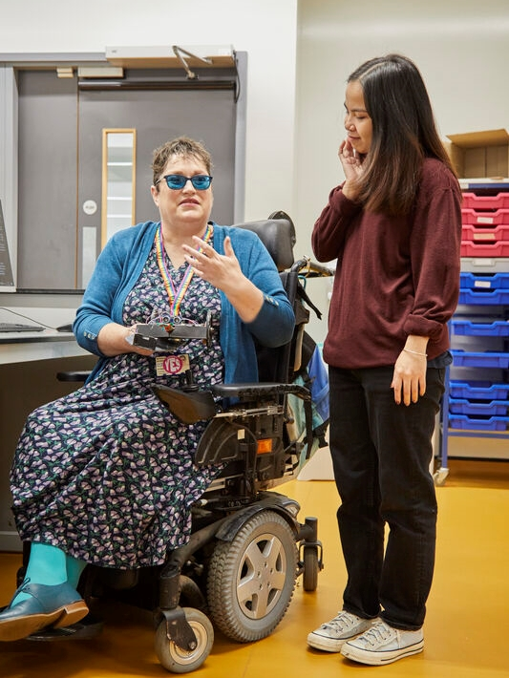
Academic Advice
You will usually have a personal / academic tutor. This is an academic in your department who is your first point of contact for any concerns or worries, and they will meet with you to discuss your progress. Things you may speak to them about include:
Choosing modules
Acting on assessment feedback
They may also signpost you to other support, including:
Wellbeing support
Academic support
Notes:
It might be helpful to compare this role with that of a form tutor, if students have those currently.

Slide 23

Academic Support
Many universities and colleges will have teams to support you in developing academic skills, which take many forms:
Group sessions on effectively managing your independent study time
One-to-one sessions to reflect on assessment feedback
Academic writing or Mathematical skills support classes
and much more…
These can be organised group events that you go along to, or individual appointments which you book.

Slide 24

Wellbeing Support
Wellbeing support is available for all students. Professional advisers run sessions on things like:
Managing stress
Maintaining a healthy work / life balance
Motivation strategies.
Some universities also offer short-term mental health support, including talking therapies and counselling, and they can help refer you to longer-term support if needed.
Universities also have teams to support students with managing disabilities or long-term health conditions, to help them succeed in their studies.
Notes:
Supporting Examples:
UEA, University of the Arts, London and University of Bradford all offer screening services for SpLDs (i.e. Dyslexia, Dyscalculia or ADHD).
UEA, University of Manchester and University of Hertfordshire all offer one-off and sustained counselling. They also refer to the NHS if needed.

Slide 25

Financial Support
The cost of living is a worry for many students. Universities and student unions understand and provide support for this:
One-to-one financial advice
Support with budgeting and managing unexpected costs
Free items food, clothing, toiletries and sanitary items.
Some universities also provide short-term / emergency financial support. Examples include:
Technology Support Funds to help buy IT equipment
Student Hardship Funds for emergency support with things such as rent, bills, or travel costs.
Notes:
Examples come from UEA, University of Suffolk and University of Essex, but similar services are available elsewhere.

Slide 26

Peer-Led Support
As well as support offered by the university or college, there are also often organised peer-support networks, enabling students to support each other. These can include:
Academic support through peer-led mentoring
Mental Health Support via Nightline, a student-led phone line providing information and a listening ear
Volunteer-led ‘buddy’ programmes, where new students are paired with a current student to support their transition to HE
Communities and networks for students to meet others in similar situations to themselves – such as commuter students, care leavers, LGBTQ+, disabled students, international students, and many more.
Notes:
Universities such as the University of Birmingham, Anglia Ruskin and University of London among others all offer Nightline – more information is on the follow-up links sheet.

Slide 27





Accessing Support
Activity 3
Now you’ve learnt a little about the support that’s available, look back at your list of problems from the previous activity, and see if you can match them to a source of support:
There is no right or wrong answer – you are in charge of the support you receive.
Academic Advisor
Academic Support
Wellbeing Support
Financial Support
Peer-Led Support
Notes:
ACTIVITY THREE: This could be done individually or in pairs, depending on student preference. If the class is confident, ask them to feed back ideas and collate them on a whiteboard/mind map.
RESOURCES NEEDED: Paper, pens, whiteboard (if applicable)

Slide 28
Summary
Support is available regularly or as and when needed
Look at what support there is at YOUR university
Support is there for you – make use of it
Don’t be afraid to reach out.

Slide 29
Notes:
CORE
Please give students time to ask any questions they might have.

