Slide 1
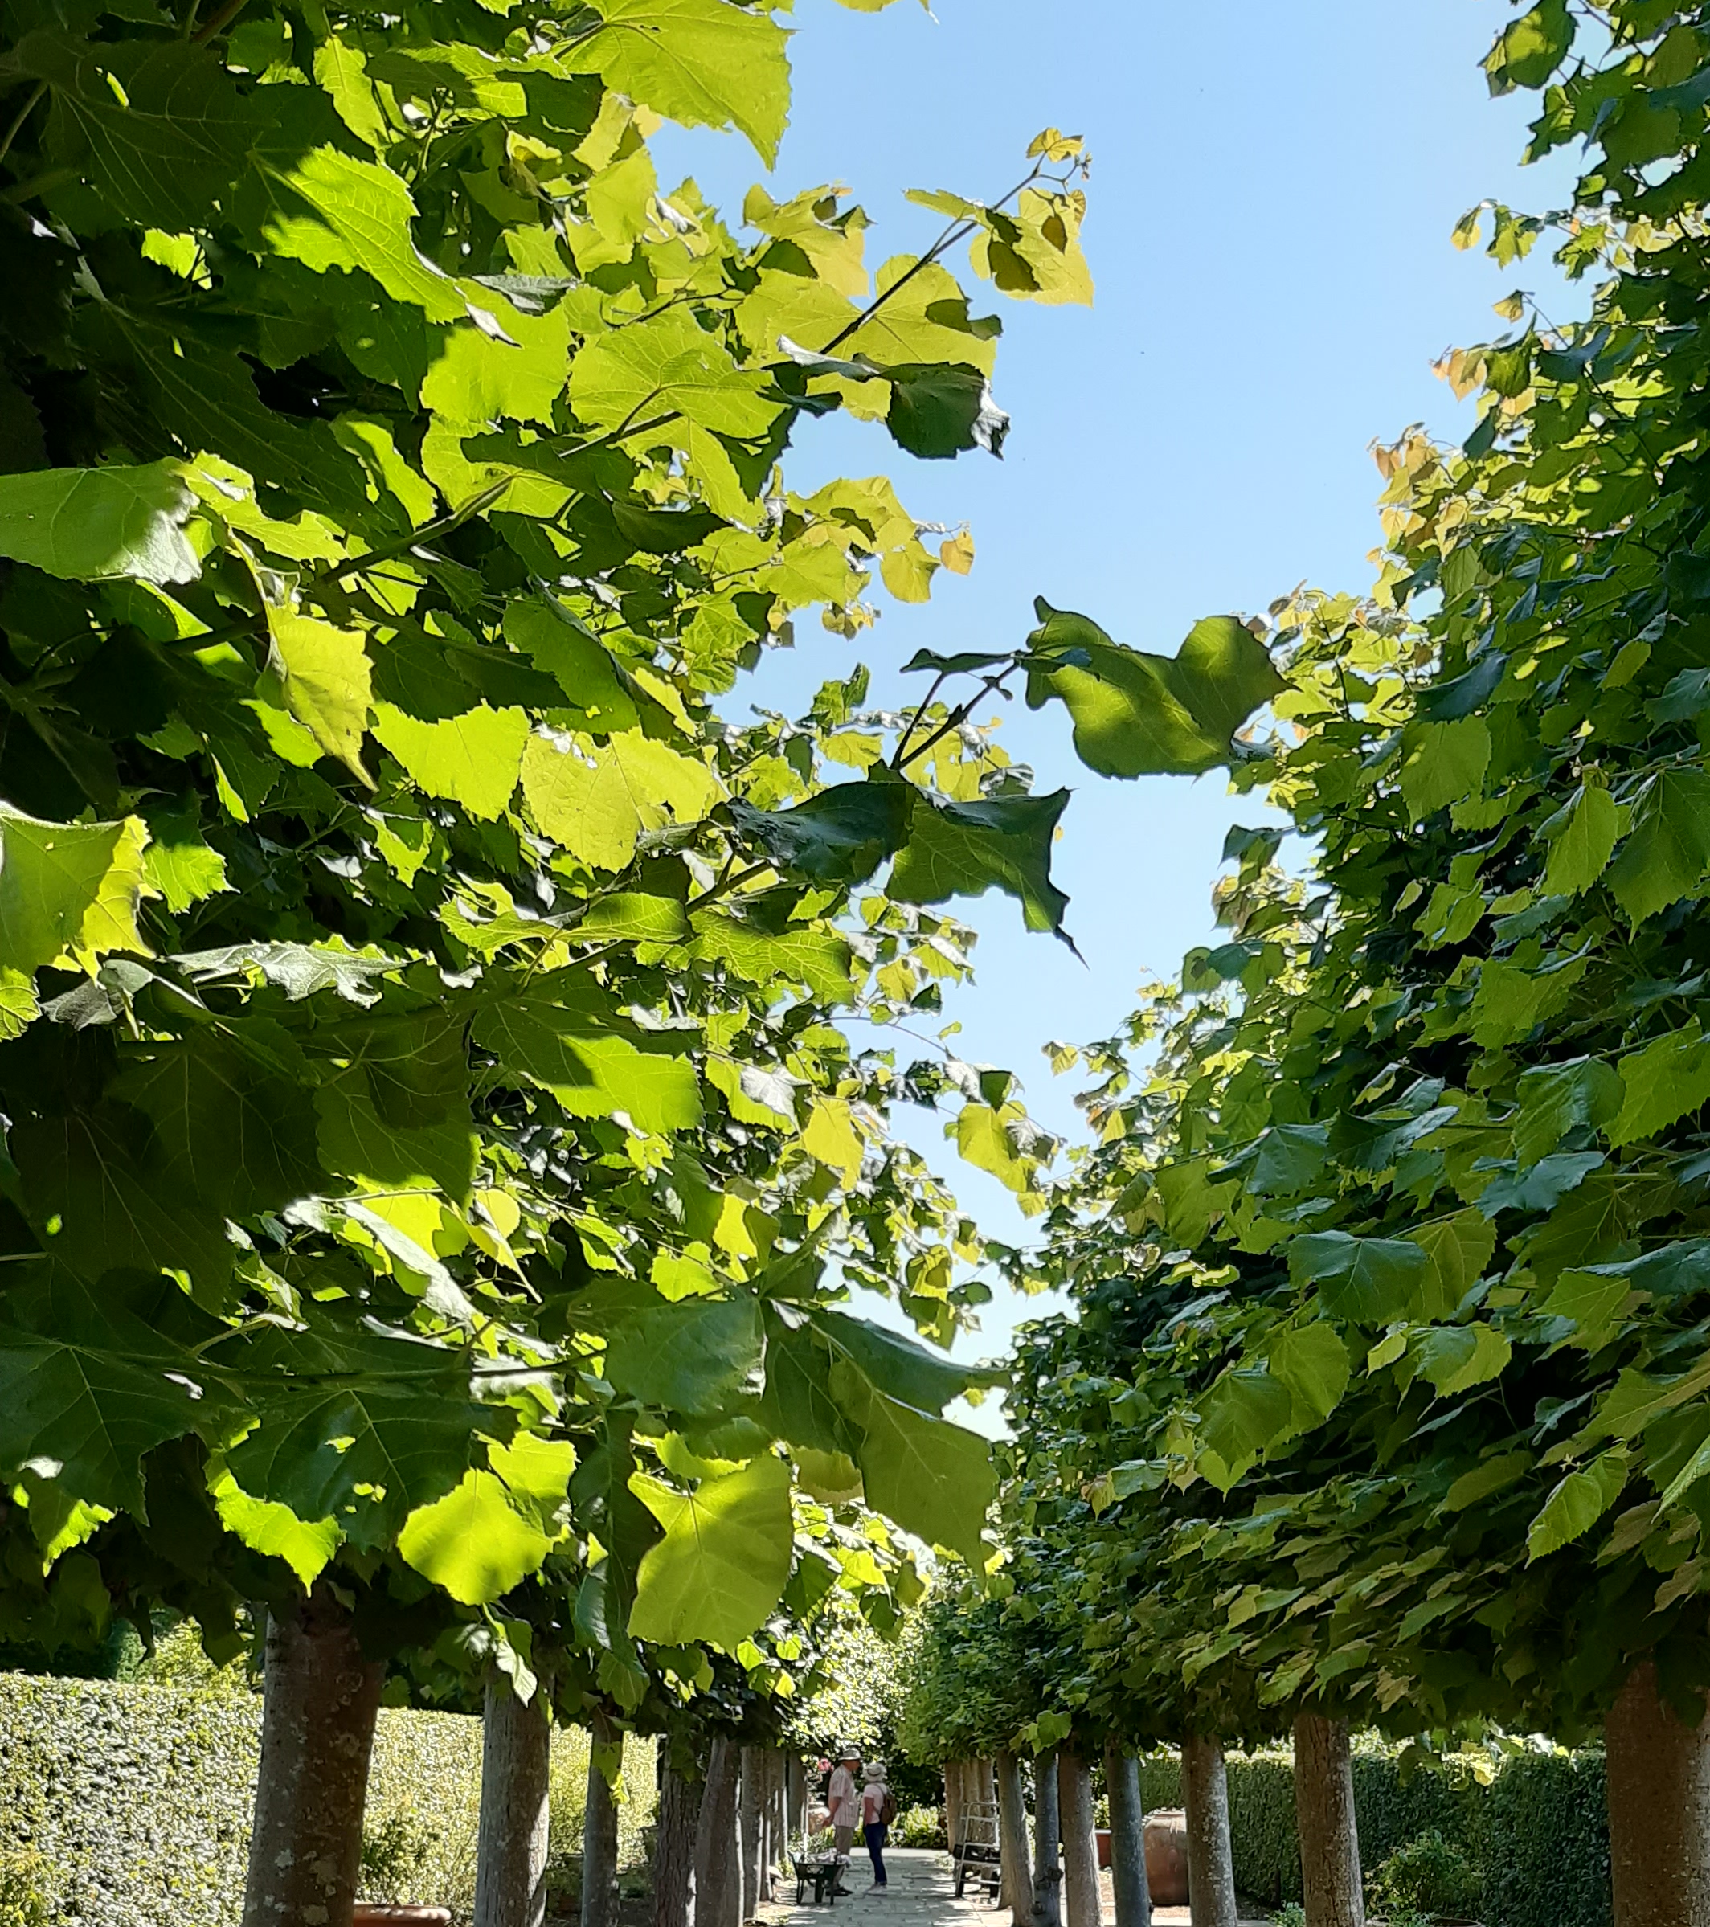

Critical Companionship between an internal and external facilitator of a participatory action research (inquiry)
Famke van Lieshout in conversation with Angie Titchen
Critical companionship video & resource guide: Facilitating career progression from person-centred practice to person centred systems: DOMAIN 4:EMBEDDED RESEARCH

Slide 2
Domain 4 Resources &
Recommended reading Main CC Frameworks & References
Critical companionship video & resource guide: Facilitating career progression from person-centred practice to person centred systems: DOMAIN 4:EMBEDDED RESEARCH
Notes:
Links to be added

