Slide 1






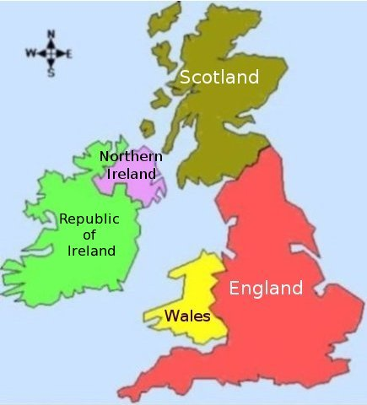


Care Homes Independent Pharmacist Prescribing Study (CHIPPS): Feasibility study- Early Experiences C.M.Bond, F.Notman and J.Inch on behalf of CHIPPS team
https://www.uea.ac.uk/chipps*
Background
Medicines use in care homes is suboptimal
One person should assume overall responsibility for medicines management
Pharmacist independent prescribing (PIP) provides an opportunity for pharmacists to assume this role
National programmes investing in increased pharmacist roles
Care homes are an identified priority area
Evidence needed to develop services
Results Nearly all residents approached agreed to participate
Outcome measures were completed well and suggest value of PIP service
39 patients received intervention, two had died at follow up.
Training package is appropriate
it has made you more motivated and … more confident in going in and making changes to a patient’s medications (PIP)
Service well received
I think it’s had a definite positive impact on patient care. (GP)
Service well received
a prescribing pharmacist on the floor even though it was just a study it was still an invaluable asset (CH manager)
Overall aim of the CHIPPS programme
To develop and deliver a cluster randomised controlled trial to assess the effectiveness and cost effectiveness of pharmacist independent prescribers (PIPs) assuming responsibility for medicines management within care homes compared to usual care
Outcome measure | Baseline | Follow up
Falls | 12/40 (30%) | 10/38 (26%)
ADRs | 0/40 (0%) | 0/38 (0%)
MMSE mean & range | 20.13 [range 9-30] (n=16/40) | 20.79 [range 11-29] (n=14/38)
Barthel mean & range | 6.53[range 0-17] | 6.38 [range 0-19]
Drug Burden Index mean & range | 1.11* [range 0.14-3.51] | 0.93* [range 0.14-3.34]
Total number of medicines (inc topical preparations) | 436 | 281
EQ-5D-5L Index | 0.666 | 0.761
Objectives of feasibility study
test and refine service specification (developed in previous work packages)
assess service and research acceptability via a qualitative process evaluation
estimate the size of eligible population
explore recruitment and retention
assess participation and follow up rates
test feasibility of data collection and identify reasons for missing data
evaluate potential outcome measures
assess appropriateness of PIP training package
*excluding 14 (35%) residents with a DBI score=0
Case Study Male 89 Years
Medication at baseline
Risperidone 1mg bd
PIP intervention
Staged reduction of risperidone to 250mcg bd
Outcome measures
EQ-5D (proxy)
Mirtazapine 30mg nocte
Memantidine 10mg nocte
Paracetamol 1g qds prn
Diazepam 5mg prn
Ranitidine 150mg bd
Lamotrigine 25mg mane 50mg nocte
Nebivolol 2.5mg od
Lactulose 10ml od
Reduced diazepam to 2mg bd prn
Stopped ranitidine and started Peptac 10mls qds prn
Started Vitamin D od
BL 0.666, VAS 45%
FU 0.788, VAS 80%
MMSE
BL unable to complete
FU 15/30
Falls
BL 2
FU 0
Drug Burden Index
BL 1.97,
FU 1.17
Method
GP/PIP
Registered PIP
Trained and competent
CH (s)
Working with GP
10
residents
65 years and older
At least one regular med
16 hours per month
Not end of life
Four
sites
Qualitative and quantitative data collected
3 month intervention
PIP Service
Discussion
  The study has
  confirmed feasibility of the CHIPPS programme
  confirmed refinements to service specification
  confirmed recruitment approach for definitive RCT
  suggested PIPs can improve patient care
Medication Review
Pharmaceutical Care Plan
Training and support
Assess and address need
Communication
Care homes
Prescribing
Optimise (doses, monitoring)
GP practice
Community pharmacy
Repeat Prescriptions
Maintain records
Initiate Rx for Minor ailments
Care home staff
Processes for Medicines
This poster presents independent research funded by the National Institute for Health Research (NIHR) under its Programme Grants for Applied Research Programme (Grant Reference Number RP-PG-0613-20007). The views expressed are those of the author(s) and not necessarily those of the NHS, the NIHR or the Department of Health.
Acknowledgement
The CHIPPS Research team acknowledges the support of the National Institute of Health Research Clinical Research Network (NIHR CRN).
CHIPPS TEAM:
UEA: David Wright, PI; Richard Holland, James Desborough, Fiona Poland, Garry Barton, David Turner, Nigel Norris, Annie Blyth, Viv Maskrey, Lee Shepstone, Anthony Arthur, J Blacklock, C. Hill; University of Leeds: David Alldred, A. Daffu-O’Reilly; Queens University Belfast: Carmel Hughes, A Millar, M Spargo; University of Aberdeen: Christine Bond, Jacqueline Inch, Frances Notman & Phyo Mint; Arnold Zermansky, Consultant; Ann Marie Swart, J Williams, Norwich CTU; Christine Handford & Kate Massey, PPI; Helen Hill, Consultant; J Ford, NNUH NHS Foundation Trust; I Small, NHS Commissioning Board; C Symms, CCG Norfolk.

