Slide 1






Difficult words
 | Advisory group | A group of people who helped us with our project.
 | Capacity difficulties | Finding it difficult to think what something means to you, to remember it, and to make a decision.
 | Code of Practice | These give some extra help on how research can take place.
 | Communication difficulties | Finding it difficult to understand what people say and to say what you think.
?

Slide 2
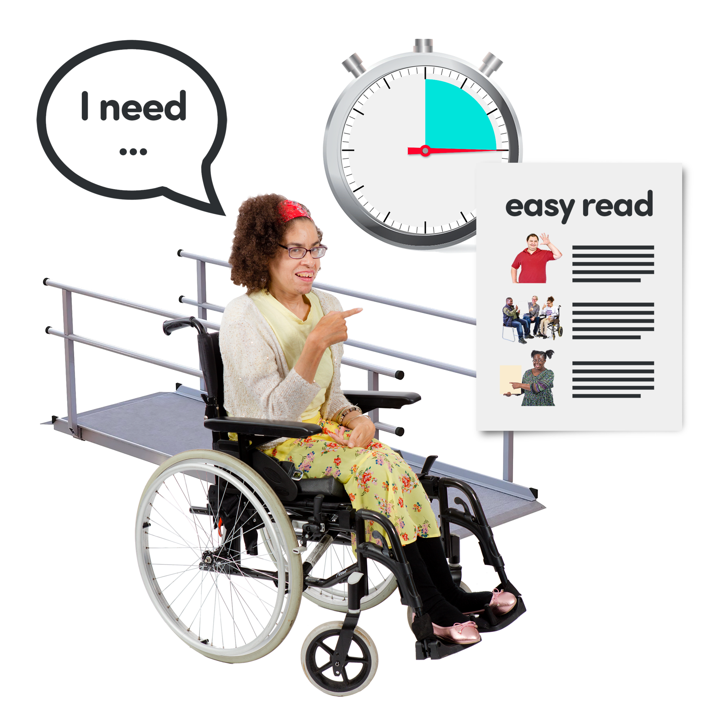
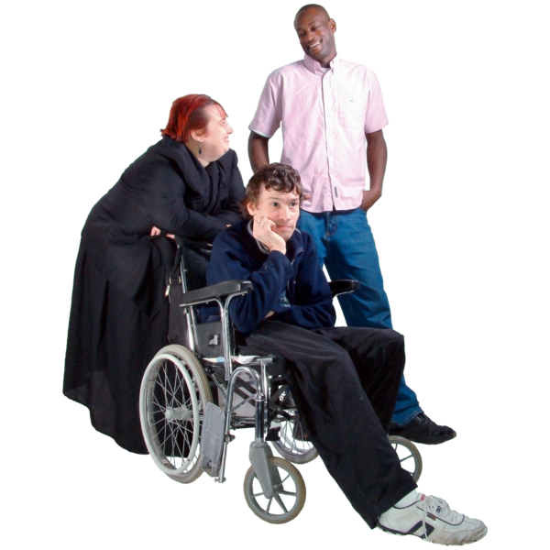


Difficult words
 | Communication aids | Different ways of helping people to understand and to express themselves.
 | Consultee | Someone who knows the person well and can advise the researcher how they feel about taking part in research.
 | Empowerment | Speaking up for yourself and making your own decisions.
 | guidelines | Advice to help researchers include people with capacity and communication difficulties in a research project.

Slide 3




Difficult words
 | internet | We use the Internet when we go online with our computers.
 | invisible | When people cannot hear you or see you
 | journal articles | These are reports that have been written about projects for other people to read.
 | law | The rules set down by the Government.

Slide 4

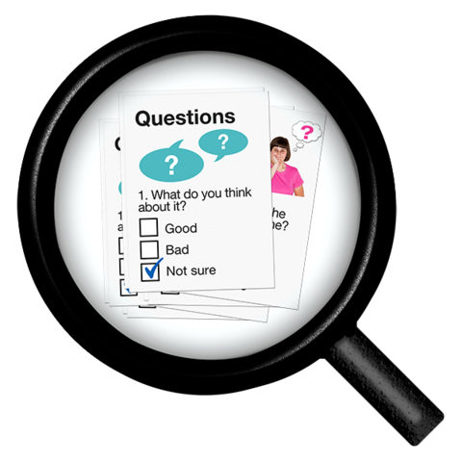
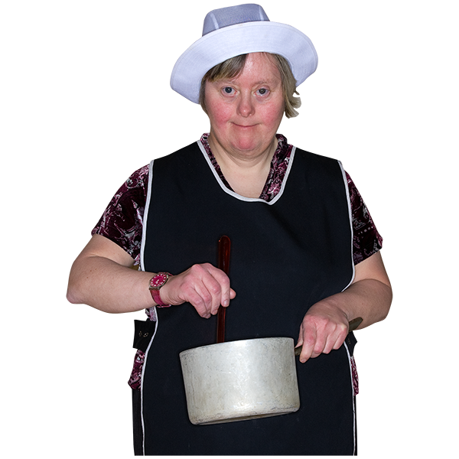
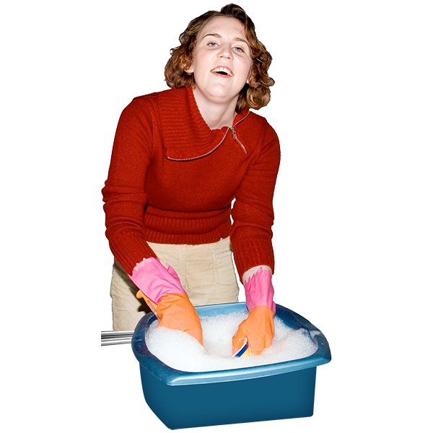
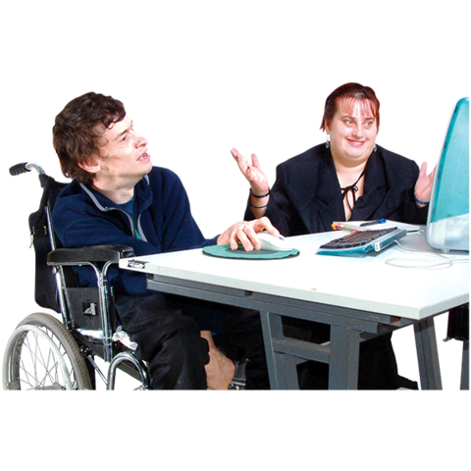
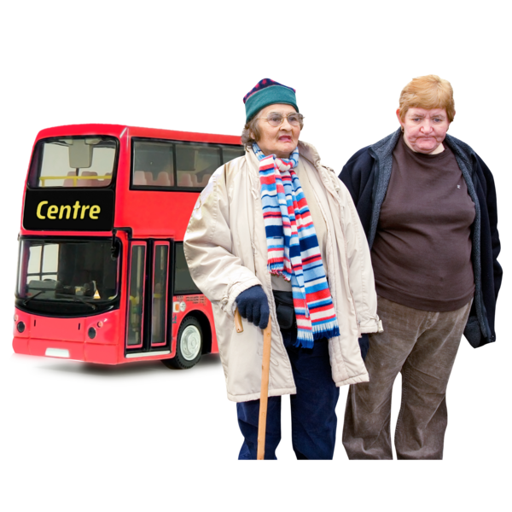

Difficult words
 | Mental Capacity Act | These are the rules that say how people with capacity difficulties must be treated in research.
 | methods | The different activities we carried out for our project, such as using questionnaires, carrying out interviews.
 | occupational therapy | Helping people with their activities in everyday life.
 | protection | Making sure people are kept safe and nothing bad happens to them when they take part in research.

Slide 5
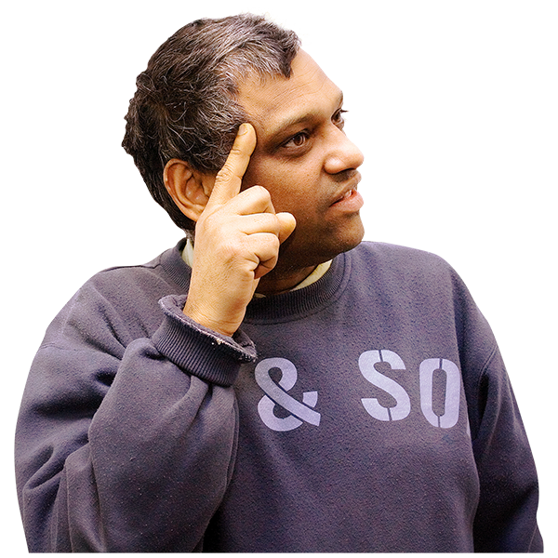



Difficult words
 | psychology | Helping people about how they think and act.
 | questionnaire | Questions for you to answer in a form.
 | research project | Some activities that help you to find the answers to your questions
 | research associate researcher | Members of the team who carry out research activities

Slide 6
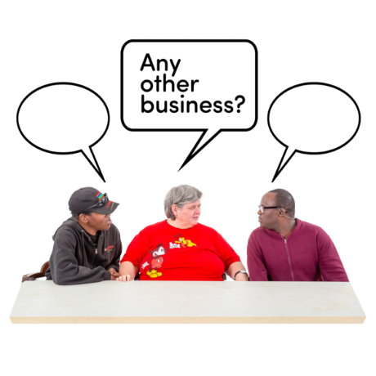

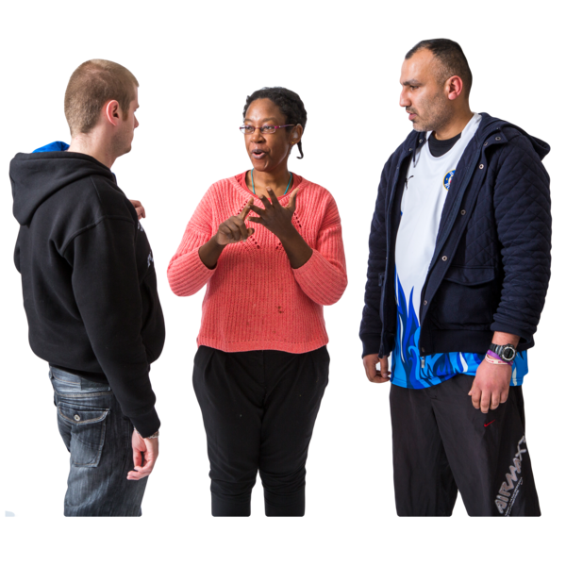
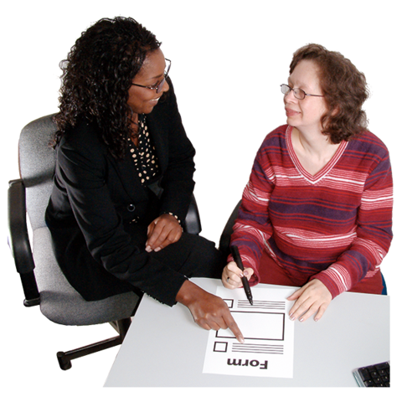

Difficult words
 | Research ethics committee | These are teams who read research proposals and say whether it is safe and sound or not.
 | speech and language therapy | Helping people with their understanding and expressing themselves.
 | supporter | Different people who provide help so that the person is able to communicate and take part.
 | treatment | The different types of help a person might be offered to improve their health and well-being.

Slide 7

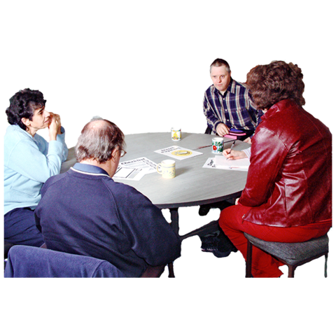
Difficult words
 | welfare | Making sure you have the people and services you need to help you.
 | working group | People meeting together to develop materials for using in the project.

