Slide 1

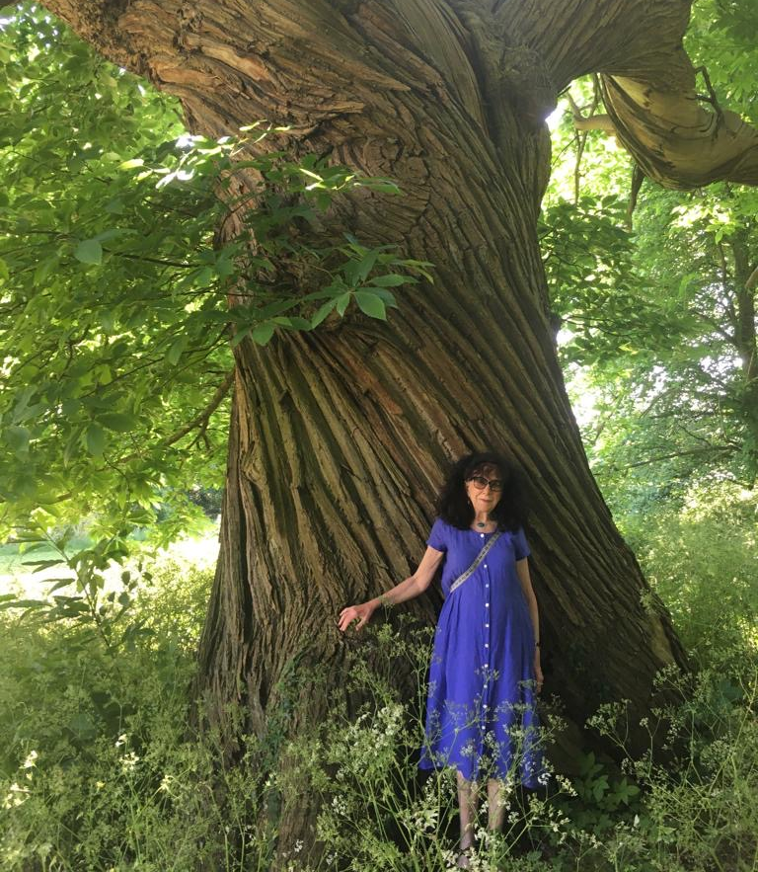

Uncovering critical companionship
Kim Manley in conversation with Angie Titchen: Part 1
Critical companionship video & resource guide: Facilitating career progression from person-centred practice to person centred systems. DOMAIN 1 BUILDING ON EXPERT PERSON-CENTRED PRACTICE THROUGH CRITICAL COMPANIONSHIP
Notes:
V1 Video Title

