Slide 1

SESSION 2
Sensitivity – helping the child to manage feelings
Notes:
Notes
Welcome to the second session of the Secure Base model training programme.
READ SLIDE

Slide 2

The Secure Base model
AVAILABILITY
helping the child to trust
FAMILY MEMBERSHIP
helping the child
to belong
SENSITIVITY
helping the child
to manage feelings
SECURE
BASE
CO-OPERATION
helping the child
to feel effective
ACCEPTANCE
building the child’s self-esteem
Notes:
Notes
Now we move to the second and also key dimension - Sensitivity – helping the child to manage feelings.
As we can see it builds on availability and trust- so before we look at Sensitivity in more detail, it would be helpful to hear feedback from your thoughts on availability and trust after last session as that is an important foundation for today.

Slide 3
Availability-helping the child to trust: reflections on this dimension
Think about the learning from this session and this dimension in relation to children in families you work with or children in your care.
Are there particular children who you can see have gained trust and feel more secure because of the availability of a caregiver?
Are there particular children who you think may be able to gain trust and feel more secure because of the availability of a caregiver?
What are the benefits and challenges of offering availability to a range of children who lack trust?
Notes:
Notes
This slide is the reflections task suggested at the end of the last session.
Encourage feedback and discussion as a full group. Time needed for this discussion will depend on how many participants have reflected on the last session and feel able to share their ideas- but max 10-15 minutes.
Prompt questions could include- did you have thoughts after last session about why some children of certain ages lack trust or how caregivers can make sure they are available to a child and build their trust?

Slide 4
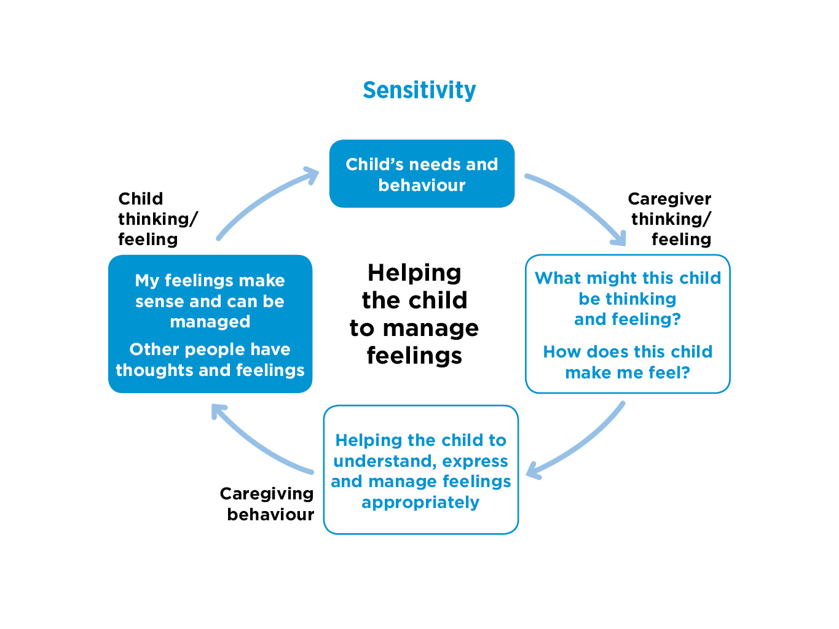

Notes:
Notes
Now we move on to today's dimension: Sensitivity-helping the child to manage feelings
READ round the cycle on the slide
Sensitivity is one of the key elements of therapeutic caregiving. It refers to the caregiver’s capacity to tune in to the mind of the child. To think about what the child might be thinking and feeling, to use this understanding in caregiving and to reflect this understanding back to the child – tentatively naming the child's thoughts and feelings and making connections with behaviour.
Over time this cycle helps children to begin to understand, discuss and manage their difficult feelings – and reduce the troubled behaviour that often accompanies those feelings.
It's important to emphasise that ‘managing’ feelings is not about suppressing them, but about expressing them appropriately, whether happiness or sadness, shame or anger, so that those feelings can be understood and responded to helpfully - by adults and by other children.
This session will follow each element of the caregiving cycle within this dimension, beginning with the child’s needs and behaviour.

Slide 5

Why children may find it difficult to manage their feelings
A child’s feelings have often not been acknowledged or responded to by previous caregivers.
From infancy, insecure children may have been overwhelmed by feelings so remain anxious.
Feelings and behaviour have often been mislabelled.
Children’s feelings may therefore be
  shut down and denied
  expressed excessively
  chaotic
  expressed through their bodies.
Notes:
Notes
READ SLIDE
These examples suggest the kind of difficulties that can arise for children who have experienced previous caregiving that did not meet their emotional needs and may have been actively harmful.
It’s helpful to give an example for the third bullet point- feelings and behaviour may have been mis-labelled: for example, a previous caregiver may have said that an accident (e.g. a child knocking a cup over) was naughty and deliberately done to upset the caregiver. Children can then find it hard to believe their own feelings / motivations/experience.
Each child will be different and have had different experiences of expressing feelings and the responses they have received. These lead to different ways of managing feelings in relationships e.g. denying feelings, becoming very demanding.
'Expressing feelings through bodies'- attachment theory may seem to have underemphasised the role of bodies, but we need to take account of the many physical problems that children / young people can have that can be linked to past experiences– such as problems sleeping, toileting, eating disorders, self-harm, drug misuse. These behaviours may be linked to negative ways in which the child is expressing and managing their emotions.
There may also be other diverse factors affecting how children’s feelings are expressed in behaviour that caregivers will need to be aware of, including learning difficulties, fetal alcohol syndrome or neurodivergence e.g. children with ADHD or autism diagnoses.

Slide 6
EXERCISE 1 Think of examples of behaviour that suggest difficulty in managing feelings
Infants (0 – 18 months)
Early childhood (18 months – 4 years)
Middle childhood (5 – 10 years)
Adolescence (11 – 18 years)
Notes:
Notes
Exercise 1 15-20 minutes Discuss in small groups then feed back to whole group.
Think of children in families that you have worked work with or of children you have cared for. Have you observed behaviours that suggest difficulties in managing feelings?
Ask the group to think of small indicators – perhaps issues that may also occur in normal development e.g. a child who gets upset during an ‘exciting' special event such as a birthday party, as well as more serious issues of managing anger and sadness, for example when children become very withdrawn or aggressive, or seek control by developing eating disorders etc. This helps to build a picture of the full range of feelings, behaviours and challenges for caregivers.
Ask for specific examples of behaviours and the context in which they occurred / may occur for each age group.

Slide 7
Notes:
Notes
We now need to think about how the caregiver makes sense of the child’s needs and behaviour by asking these key questions- move to next slide.

Slide 8
Sensitivity-helping the child to manage feelings: caregiver thinking and feeling
What might this child be thinking and feeling?
How does this child make me feel?
Notes:
Notes
READ SLIDE
Sensitivity in attachment theory is about being interested in, curious about, tuning in to the mind of the child, as the best way to understand and respond sensitively to their needs and behaviour. So the caregiver needs to be thinking: ‘ What might this child be thinking and feeling?’
Caregivers need support to be thoughtful about the child’s previous experiences and how these may have shaped the child's current thinking and feeling, especially when feelings are expressed in difficult behaviour or through their bodies.
But sensitivity is also about caregivers being able to reflect, with support, on ‘How does this child make me feel’? Each child will trigger different feelings in caregivers and at different times – perhaps affection and protectiveness or anger and frustration. These feelings will affect caregiving behaviour, so it is important that these feelings and the thoughts that lie behind them are acknowledged and explored.
Understanding something of how this child makes the caregiver feel may also give some insights into how the child may make other adults and children feel e.g. at school with teachers and peers.

Slide 9
EXERCISE 2
Children’s and caregivers’ thinking and feeling
Choose one of the case examples on the next slide
Reflect on what this child be thinking and feeling
Write 3 brief statements from the child’s perspective ( e.g. ‘Does anybody care for me?’
Reflect on what this caregiver might be thinking and feeling
Write 3 brief statements from the caregiver’s perspective. e.g. ‘It’s upsetting that he doesn’t like me’.
Notes:
Notes
Exercise 2 20 minutes
READ SLIDE
This exercise can be undertaken as individuals / in pairs / in small groups.
Then as a whole group, share ideas and examples of statements for each child and caregiver.
Emphasise that there is no ‘correct’ response - children and caregivers will have a range of possible thoughts and feelings in these situations.
This exercise focusses only on thoughts and feelings. Bear in mind that there will be a later exercise during this session /after the break to discuss caregiving behaviour that takes account of these thoughts and feelings.

Slide 10
Reflecting on thinking and feeling - write 3 brief statements from the child’s perspective and 3 from the caregiver’s
Jay (6 months) has just come into foster care. Previously, Jay had several previous caregivers who were neglectful. He sleeps a lot and doesn’t smile or interact with his new caregivers.
Connor (3) has recently been placed in an adoptive family. He spent nearly two years with his short-term foster family. He is tearful. He says he wants things (e.g. a bath or certain foods) and then refuses them.
Ashley (6) is placed long-term with grandparents. Her single mother had significant mental health problems and neglected Ashley. Ashley has monthly contact with her mother. She looks forward to it but afterwards is very quiet for several days and doesn’t play or enjoy food.
Alisha (15) is in a new foster care placement. She was rejected in her birth family and has had three moves including a recent adoption breakdown. She spends most of her time in her bedroom and has started to self harm.
Notes:
Notes
READ slide
Leave slide up during the Exercise and discussion.

Slide 11
Refreshment break

Slide 12
Sensitivity – helping the child to manage feelings: caregiver behaviour
For example:
Naming and discussing feelings
Providing a commentary on daily events
Using practical tools to help the child reflect on their thoughts and feelings
Helping the child to think about the thoughts and feelings of other people, promoting empathy
Modelling the expression and management of the caregiver’s own feelings
Notes:
Notes
Now we move on to caregiver behaviour for this Sensitivity dimension. The key task is to help the child to understand, express and manage feelings appropriately, as well as understand the feelings of others. Caregivers can use a range of approaches to achieve this, including:
Naming and discussing feelings- those of the child, the caregiver and other people.
Providing a verbal commentary on daily events. e.g. feeds, nappy changes, getting ready for school etc. This commentary gives a more predictable shape to events and helps the child to anticipate and manage the associated feelings - such as excitement or anxiety or a combination.
Using practical tools – for example, an ‘experiences book’ recording daily or special events and feelings about them. This book could include items such as photos, school commendations, tickets for significant events, etc. This can help the child to organise their thinking and reflect on each day /each event while naming the associated emotions.
Helping children to understand and take other people's feelings into account, promoting empathy. This is key to building positive, mutual relationships and is often harder to master when children are insecure.
How caregivers and their families express and manage their emotions will be a key source of learning for a child - whether this is modelling shared enjoyment or sadness or feeling safe to express anger but being able to resolve disagreements.

Slide 13
Using an experiences book to name feelings
‘Paula (8) couldn’t remember or didn’t want to remember what happened this morning or yesterday or last week and couldn't anticipate “next week”. So we started to do an experiences book together – each day writing down what had happened and her feelings about it. This helped her to reflect on the shape of each day and the immediate past and build her capacity to remember.’ (Caregiver)
Notes:
Notes
READ SLIDE
This caregiver has thought about the child’s difficulty in naming and exploring feelings in the context of also struggling to manage her time and memories.
Using a simple practical tool, an experiences book, the caregiver supports the child to recognise and name a range of feelings and gives her a sense of shape to her days.
It is common for children from troubled backgrounds to struggle with time and memory – which is why caregivers can benefit from actively using calendars as a visual framework for the child to anticipate, manage and reflect on family, school and other events, including family contact.

Slide 14
Using stories to promote empathy
‘I think Jenna (9) spent so long in self-defence and looking after herself that she never learned to look at things from anyone else’s point of view. Even things like stories. When you say, “why is that person doing that?”, she hasn’t got a clue, she doesn’t follow the motives of what people are doing, or how they are feeling. So we do a lot of story reading together and I talk it through’. (Caregiver)
Notes:
Notes
READ SLIDE
This example shows how the caregiver has been able to think about and identify an important gap in Jenna’s development - a lack of understanding of the feelings of others - and explain it with reference to Jenna’s past.
The caregiver then addresses this gap practically through focused story reading, which can not only help Jenna to name and understand the feelings of characters in books, but will also feed into wider discussions about, for example, Jenna's own feelings and the feelings of the caregiver, other family members, teachers, children at school, characters on television and reflect on how those feelings link to behaviour. This will support Jenna in building more mutually rewarding relationships with adults and other children.

Slide 15
Being creative: the worry jar
‘Sometimes Patrick (12) will really shout and stomp about, so you know something is brewing and he won’t tell anybody, because he doesn’t want to upset them. So if he has a worry, he writes it down and puts it in a worry jar and then when he wants me to read it, he gives me the jar and I read his worries. Because if it is out of you and shared, you feel better.’ (Caregiver)
Notes:
Notes
READ SLIDE
This is a good example of a caregiver thinking flexibly about what the child's behaviour might mean and, also identifying with the child a creative way to communicate difficult feelings- the worry jar.
In this case Patrick was able to decide when he wanted the caregiver to read what he had written. This promoted the child's agency and also showed the trust that had developed between them.

Slide 16
EXERCISE 3 : How might caregivers help each child to express and manage their feelings?
Jay (6 months) has just come into foster care. Previously, Jay had several previous caregivers who were neglectful. He sleeps a lot and doesn’t smile or interact with his new caregivers.
Connor (3) has recently been placed in an adoptive family. He spent nearly two years with his short-term foster family. He is tearful. He says he wants things (e.g. a bath or certain foods) and then refuses them.
Ashley (6) is placed long-term with grandparents. Her single mother had significant mental health problems and neglected Ashley. Ashley has monthly contact with her mother. She looks forward to it but afterwards is very quiet for several days and doesn’t play or enjoy food.
Alisha (15) is in a new foster care placement. She was rejected in her birth family and has had three moves including a recent adoption breakdown. She spends most of her time in her bedroom and has started to self harm.
Notes:
Notes Exercise 3 15-20 minutes
In small groups, using the same case examples as we discussed in the previous exercise before the break, list different ideas for what caregivers might say or do to help the child express and manage their feelings in more positive ways.
Participants can consider different parts of the child’s and the caregiver's daily routines and activities. Encourage creativity, drawing on some of the suggestions on previous slides and suggesting approaches that are attuned with each child’s thinking and feeling as identified in the previous exercise.
Discuss as whole group.

Slide 17
Sensitivity- helping the child to manage feelings: additional support needs for caregivers
Thinking about what is in the child’s mind can be painful
Child’s difficult feelings may be transferred to caregiver
It can be hard to ‘pause for thought’ before responding
Notes:
Notes
Explain these points about caregivers' additional support needs.
Thinking about what is in the child’s mind can be painful: Children may have had experiences which are difficult for us to contemplate, especially physical, emotional and sexual abuse and extreme neglect. It is often painful to think about these experiences and to begin to imagine their impact on the child and what is in their mind. Caregivers may need additional help in understanding what is known of the child’s earlier experiences and the ways in which these might have shaped his or her thinking and expectations.
Child’s difficult feelings may be transferred to caregiver: It is common for caregivers to find themselves taking on the child’s difficult feelings (anger, sadness, powerlessness etc.) and experiencing them as if they were their own. Caregivers may need help to recognise what is happening, to take a step back, and to separate their own feelings from those of the child.
It can be hard to pause for thought before responding to a child's behaviour. When children are finding it hard to manage their feelings, caregivers may feel under pressure to respond in the moment. They may need help to pause for thought and reflect on what the child might be thinking and feeling and how they can respond positively.
Helping the child to learn to pause for thought will also be an important part of sensitively helping them to manage their feelings and behaviour.

Slide 18
EXERCISE 4 Additional support for caregivers
When caregivers are experiencing difficult feelings (e.g. sadness for the child, anger, disappointment, lack of confidence), what do they need from their support networks?
What do social workers and other professionals need to offer?
Notes:
Notes Exercise 4 15 minutes
Discussion of these questions can be as a whole group – if time, after participants have written down their individual thoughts to prepare for the discussion.

Slide 19
Sensitivity-helping the child to manage feelings: child thinking and feeling
My feelings make sense and can be managed.
Other people have thoughts and feelings – that need to be taken into account.
Notes:
Notes
READ SLIDE
Gradually, the child becomes aware that their caregiver is interested in and can understand even the child’s more difficult feelings and make sense of them. This helps the child over time to name, make sense of, express appropriately and manage their own feelings. This will also support the child in regulating their behaviour.
Small steps by the child towards these goals (e.g. expressing anger in words on a particular occasion) should be acknowledged and praised.
Gradually the child will also become aware of the range of other people’s feelings and be better able to respond appropriately to them – an important step in building and sustaining relationships.

Slide 20
Sensitivity- helping the child to manage feelings: reflections on this dimension
Before the next session, think about the learning from this session and this dimension in relation to children in families you work with or children in your care.
Are there particular children who have become better able to express and manage their feelings because of the sensitive responsiveness of a caregiver?
Are there particular children who you think need help to express and manage their feelings and could benefit from some of the sensitivity caregiving strategies discussed today e.g. naming feelings, story reading?
What are the benefits and challenges of offering sensitive, attuned care to children who struggle to manage their feelings?
Notes:
Notes
Read slide
This is a suggested activity to help participants build on their learning and understanding of this this dimension - and will act as a bridge to the next session / next dimension Acceptance- building the child's self-esteem.
Mention that there will be a whole group discussion of this task at the start of the next session.

Slide 21
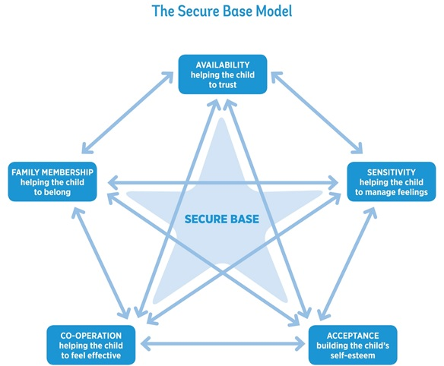
Notes:
Notes
Any final thoughts or questions?
Thank you for your participation.

