Slide 1

Family membership – helping the child to belong
Notes:
Notes
Welcome to our fifth and final session to complete the Secure Base model- Family membership- helping the child to belong
This is a rather different and more psychosocial caregiving dimension, as it engages not only with the quality of relationships in the family but with the wide range of issues for children and young people in thinking about their identity and where they belong - and for caregivers in thinking about how they define their family.
The last part of this session today, as it is our final session, will be an opportunity to discuss ways of including the model in your practice and to learn more about the Secure Base tools on the website that can assist you in implementation.

Slide 2
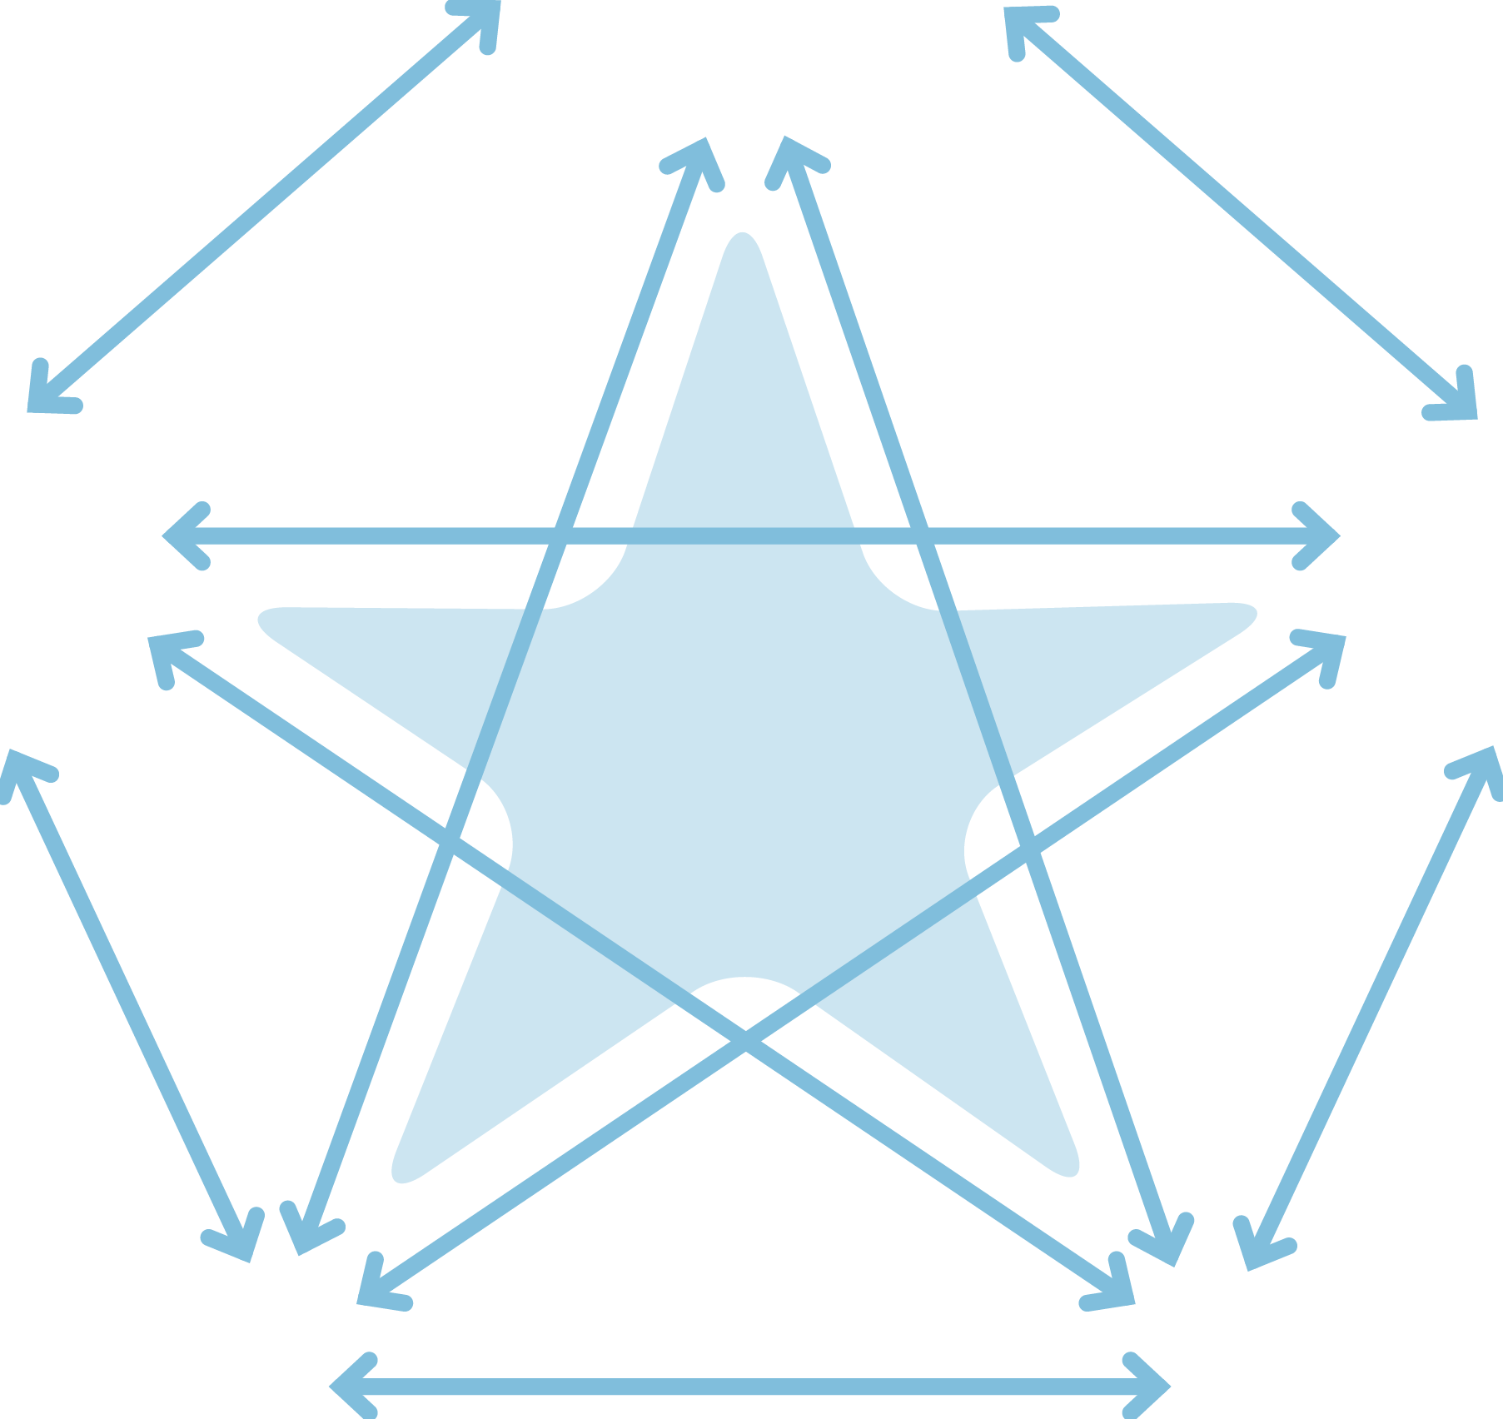
The Secure Base model
AVAILABILITY
helping the child to trust
FAMILY MEMBERSHIP
helping the child
to belong
SENSITIVITY
helping the child
to manage feelings
SECURE
BASE
CO-OPERATION
helping the child
to feel effective
ACCEPTANCE
building the child’s self-esteem
Notes:
Notes
The Family membership –helping the child to belong dimension draws on all the other dimensions – from a child’s point of view , a sense of belonging relies on their capacity to trust, to reflect on and manage their feelings, to feel accepted and to exercise agency alongside co-operation as part of the family.
But before we look at this dimension in more detail, we will take a few minutes to discuss the reflections task from last session, as co-operative caregiving, working together, can support a child’s sense of belonging and capacity to develop and make choices about their identity.

Slide 3

Co-operation- helping a child to feel effective: reflections task
Think about the learning from the session and this dimension in relation to children in families you work with or children in your care.
Are there particular children who found it difficult to be appropriately assertive, but who made more positive choices / became less controlling with help from caregivers?
Are there children who you think would benefit from some of the co-operative caregiving strategies discussed today e.g. offering choice, working together?
What are the benefits and challenges of offering more co-operative caregiving to children of different ages?
Notes:
Notes
This slide is a reminder of the reflections task suggested at the end of the last session. The focus was on how co-operative caregiving can promote a child’s self-efficacy – but participants may well have needed to draw on references to previous dimensions, such as availability and building trust.
Encourage feedback and discussion as a full group. Time needed for discussion will depend on how many participants have undertaken this task / feel able to share their ideas- but max 10-15 minutes. Prompt questions could include - how in your experience does this dimension apply to children of very different ages, toddlers to teenagers, with different issues around boundaries and choice? How do you think caregivers and children working together might contribute to a child's sense of belonging-today's topic?

Slide 4
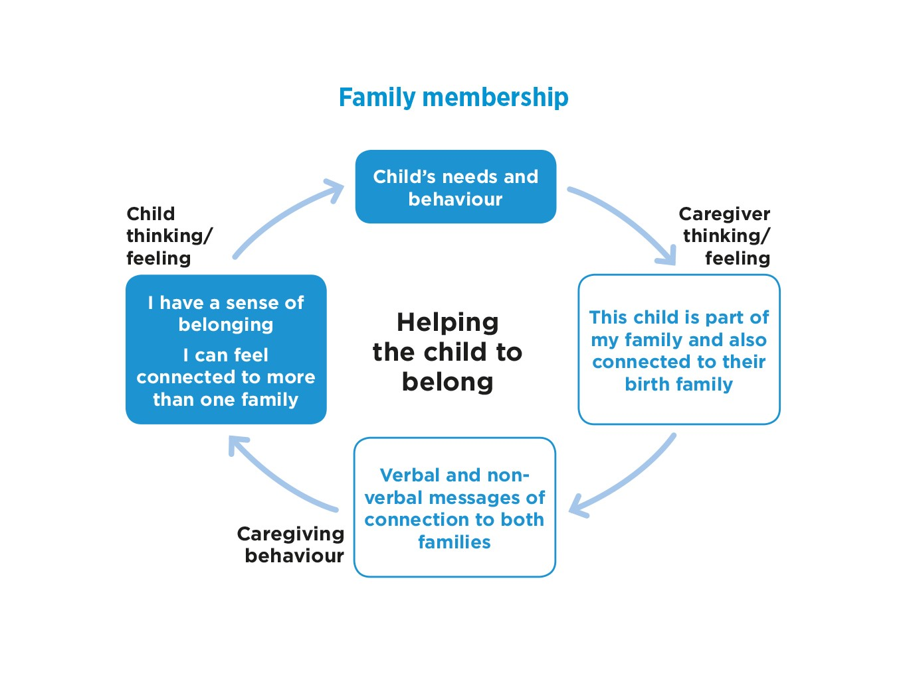
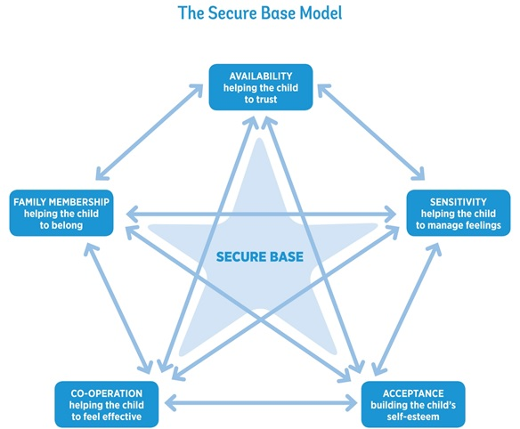

Notes:
Notes
Now to look at the caregiving cycle for this fifth dimension, focusing on family membership and a sense of belonging.
Read round slide.
This dimension refers to the capacity of the caregiver to include the child as a family member in any family placement. At the same time, the caregiver must help the child to retain or establish an appropriate sense of connection and belonging to their birth family. In this way the child can develop a comfortable sense of belonging and connection to more than one family.
Family membership is important because it confers a wide range of practical, social and psychological benefits for all of us and is part of the child's secure base. In a family-based society, a child who has no family connections may feel psychologically and socially dislocated.
Family membership can be extended to several households and does not have to involve biological or legal ties if there is a commitment to the child belonging as part of the family.

Slide 5
EXERCISE 1 Family membership and a sense of belonging in different families
Why is family membership important for all children?
Which of these elements can present additional challenges for children in new families?
Notes:
Notes
Exercise 1 15 -20 minutes. Whole group or small group discussion
This exercise is an important opportunity to reflect on all aspects of family membership- and some of the challenges for foster, kinship, adoptive and special guardianship families.
The following themes may be covered in relation to the first question:
security of relationships,
identity and belonging
cultural norms and values
shared history and support throughout childhood and into adulthood.
The following themes may be covered in relation to the second question:
meanings of family membership when managing membership of more than one family
managing a dual identity, especially when there are cultural or religious differences between families and potential for conflict
contact/ birth family time, which may support or disrupt a comfortable sense of membership in both the birth or placement family
permanence planning involving building family membership can be lengthy and uncertain, making a sense of permanence hard to achieve
children may not accept the patterns/rituals /expectations of a new family - so caregivers may feel the child does not want to be part of their family.

Slide 6
Family membership-helping the child to belong: caregiver thinking and feeling
This child is part of my family - and also connected to their birth family.
Notes:
Notes
READ SLIDE
The discussion generated in Exercise 1 will have emphasised the importance of this underpinning, flexible thinking and feeling about family membership when caregivers are helping children to gain a positive sense of belonging - but the exercise will also have raised some of the challenges.
Caregivers need to have in mind that children and young people in placement families place high value on feeling loved and cared for, but also on being fully included as part of the family they now live with. This will be true of children in short and long-term foster care, kinship care and adoption.
At the same time, children will need to establish an appropriate sense of connection and belonging to their birth family - and sometimes other families, such as former foster families. This can raise difficult questions and emotions for some current caregivers and families, as well as the associated practical challenges in maintaining safe and beneficial connections.
But if these connections are handled positively, the child can develop a coherent sense of belonging / being connected to more than one family., with members of birth and current caregiving families often playing different roles in a child's life at different stages of the placement, of their childhood- and into adult life.

Slide 7
Family membership - helping the child to belong: caregiver behaviour
Helping the child to feel welcome as part of the family
Making physical space for the child in the home
Helping the child to value their birth family identity
Managing family contact positively
Notes:
Notes
Caregivers in all placements need to support the child to feel welcome as part of the family.
This includes helping the child new to a placement to understand how this family does simple things (get dressed before or after breakfast?), but also to consider what will help this child to feel welcome and included. For example, one child said that she knew her new long-term foster carers really wanted her because when she arrived, she found that they had placed a duvet cover representing her favourite band on her bed.
Making physical space for the child. Having special places for the child in the family home – for their clothes, in their bedroom, at the table, in the garden.
Helping the child to talk about and value their birth family identity - and to develop a realistic and balanced understanding of their life story.
Managing birth family contact positively (whether frequent or infrequent, face to face or indirect), in ways that, where possible, promotes the child’s well-being and a comfortable and appropriate sense of belonging in both families. Contact should be adding to not detracting from the child's secure base / sense of security.
‘Managing family contact positively' will include ensuring that contact feels safe to the child, so may include suggesting supervising or reducing contact to some family members while promoting contact with others.
Over time, caregivers can help children to process their complex feelings, manage multiple family memberships and develop a coherent sense of self and identity that will continue to evolve into adulthood.

Slide 8
Welcoming a child as part of the family
‘We always say – from the moment you walk through the door, you are part of us. No matter how long you’re staying or how many other families you relate to, you are part and parcel of our family, the same as everyone else who lives here. We say it and we show it to them as well.’ (Caregiver)
Notes:
Notes
READ SLIDE
This is a good example of how a short-term caregiver can see the value for all children of feeling explicitly welcomed as part of the family, regardless of the placement plan and how long the child will be with them.
Short-term placements often occur at turning points in a child's life and feeling well supported in this way at times of transition will often be remembered and valued.
This experience will also provide a good foundation, whether a child is returning home or moving to a kinship family, long-term foster placement or adoption.

Slide 9
Foster and birth family memberships
  ‘My foster family is amazing! They have given me opportunities that I would have never been able to have and it is really lovely how much they are there for me. You know, because I am not with my family, they sort of fill that space, but never replace. They wouldn’t, they are respectful, they know how much I love my family. They know that I care so much equally about all of them and that I could never choose between them.’ (Kate, 14, long-term foster care)
Notes:
Notes
READ SLIDE
Kate's description of her family relationships shows how both foster and birth families are important to her, with her foster carers providing opportunities and being there / being available for her but also supporting her ongoing relationship with her birth family.

Slide 10
Comfortable and valuable birth family time
  ‘I usually see my grandad once a fortnight if I can. He’s 83. He used to be in the Navy so that kept him fit and stuff. When I go down there, we read the news, talk about stuff, maybe I’ll watch a bit of telly, he reads his book and makes me egg and chips and then I go home.’ (Jon, 16, long-term foster care)
Notes:
Notes
READ SLIDE
This is good example of informal and valuable birth family time /contact and relationships for a young person - although home for Jon is the foster home.
It’s important, where possible, to identify birth family members, including grandparents or uncles and aunts, who can offer a warm and safe relationship and a sense of connection to that part of the young person’s identity. They may also offer important links and support into adulthood.
Contact will be discussed more specifically after the break.

Slide 11
Refreshment break

Slide 12
Birth family membership: promoting positive contact
Contact / time connecting with birth family members is an important part of any placement plan, but has the potential to be helpful or harmful to children’s development.
The Secure Base model dimensions can provide a framework for assessing the benefits and risks of arrangements for contact / time with birth family members
Notes:
Positive contact /time spent with birth family members, whether indirect or face to face, has the potential to help children manage their identities and to develop or sustain positive relationships with relatives built on realistic understandings and appreciation of their strengths and difficulties.
However, contact with birth family members can in some cases involve difficult transitions, the arousal of painful memories and feelings and the exploration of relationships that may have have been harmful in the past.
For all children it is important that the potential benefits and risks of contact and contact arrangements are assessed and managed in ways that enable children to feel secure, comfortable, supported and free from anxiety when they spend time with their birth family members. This includes plans for contact with parents, siblings and extended family members.
To achieve a positive experience for the child, the plan for contact needs to include support for the child but also for birth family members and caregiver families- foster carers, kinship carers and adopters.
The five dimensions of the Secure Base model can help to identify both positive and potentially harmful elements of the plan for contact.

Slide 13
Caregiving dimensions and planning contact
Availability – helping the child to trust
Sensitivity – helping the child to manage feelings
Acceptance – building the child’s self esteem
Co-operation – helping the child to feel effective
Family membership – helping the child to belong
Notes:
Notes
The aim is to ensure contact plans support the child's sense of security. For example:
Availability – helping the child to trust
Positive contact arrangements should be such that the child has access to a trusted source of security (e.g. trusted family member, caregiver, familiar contact supervisor) or can hold the secure base in mind.
Sensitivity – helping the child to manage feelings
Contact is likely to involve some positive, hopeful feelings, but also some difficult, mixed feelings for the child that caregivers need to acknowledge and reassure the child about.
Acceptance – building the child’s self esteem
Before, during and after contact, children need to feel accepted, valued and good about themselves.
Co-operation – helping the child to feel effective
Children need to make choices during contact and feel appropriately included in planning and reviewing contact arrangements.
Family membership – helping the child to belong
Contact arrangements should aim to promote a child's comfortable sense of belonging in both families, with caregivers and birth family members respectful of each other.

Slide 14
EXERCISE 2
Promoting positive contact
Harry (6 months)
Has been fostered for 2 months and settled well.
Lisa (his mother) has learning difficulties - Harry has failed to thrive in her care.
Lisa has contact in the foster home three times a week for 3 hours.
Lisa is often tired and preoccupied, reluctant to engage with Harry.
Harry is unsettled and fretful afterwards.
Use the Secure Base model to make a contact plan that meets Harry’s needs and builds the relationship with Lisa.
Notes:
Notes
Give participants a few minutes to jot down thoughts – and then discuss in a whole group the kind of features a contact plan might need to include.
Make connections with each of the Secure Base dimensions.
Availability – helping the child to trust
Sensitivity – helping the child to manage feelings
Acceptance – building the child’s self esteem
Co-operation – helping the child to feel effective
Family membership – helping the child to belong
It is worth bearing in mind that contact for infants is a difficult area of caregiving and social work practice, as attempts to build a relationship between infant and parent occur alongside assessments of the parent's potential to care for the child longer term.

Slide 15
Family membership-helping the child to belong: child thinking and feeling
I have a sense of belonging in the family I live with.
I can belong / feel connected to more than one family.
Notes:
Notes
READ SLIDE
The combination of feeling part of the family the child is living with while also being supported to be a member of another family can enhance the child’s felt security – ‘I am safe and secure in this family, but I can also feel part of another family.’

Slide 16
Notes:
Notes
It is important to see that the five caregiving dimensions work together to form a secure base for the child. Many caregiving approaches contain elements of different dimensions and promote different aspects of the child’s development. For example, when the caregiver takes part in an activity alongside a child, this might
show their availability/build the child’s trust
be sensitive to the child’s mixed feelings (perhaps excitement and anxiety) about the activity and help the child to name and manage their feelings
show acceptance of the child/help to build the child’s self-esteem
enable the child to make choices about the activity
promote the child’s sense of belonging in the family
Finally - we will conclude the programme by moving on to discuss some specific ways in which the Secure Base model can be used in participants’ own areas of practice.

Slide 17
Using the Secure Base model- examples of areas of practice
Assessing children
Assessing and preparing caregivers
Matching children and caregivers
Setting goals and assessing children’s progress in placement
Supporting caregivers with caregiving - and with self-care
Moving children from foster care to adoption
Making the team a secure base for practitioners
Notes:
Notes
READ SLIDE
Because the Secure Base model is a framework for understanding key aspects of caregiving and child development, it can be used in any situation where assessment is needed to plan the next steps e.g. assessing children's development and relationships; recommending that caregivers are approved; deciding on a child’s permanence plan or match; planning a move to adoption; planning short and longer term support for the child and the caregiver.
Added here is the idea of a 'team as a secure base', which has been a development of the Secure Base model (links are on the Secure Base model website). In any team, including the team around the child, workers benefit from supporting each other and being supported by managers and the organisation. Social workers who are providing a secure base to foster carers who are providing a secure base to vulnerable children, also need to have their anxiety reduced and to feel secure in their role in the organisation in order to reduce stress and function at their best.

Slide 18
Secure Base model tools for practice
Secure Base developmental checklists
Secure Base progress record
Caregiving approaches for each dimension
Secure Base model dimensions summary chart
Secure Base caregiver interview and analysis
Secure Base interview for young people and analysis
Secure Base model implementation guide
https://www.uea.ac.uk/groups-and-centres/centre-for-research-on-children-and-families/secure-base-model
Notes:
Notes
These Secure Base model tools are relevant for different but often connected areas of practice.
The developmental checklists focus on each dimension by age, which helps to support assessments at any stage but also to support setting goals for the child through the progress record.
The progress record notes how the child is functioning / making progress on each dimension but also links this to current and possible future changes in caregiving. These caregiving suggestions can use the caregiving approaches- the summary chart helps brings these approaches together.
The Secure Base caregiver interview will help assess how the child is functioning but also how the caregiver is thinking, feeling and caring for the child in their day-to-day relationship. This can then identify possible support needs for the child and the caregiver. There is an analysis guide for this interview with suggestions about what to look for in each dimension. Similar tools are available for the Secure Base interview for children.
The tools – and the implementation guide - are all available and free to download and use under Resources on the Secure Base model website.
Other materials on the website include, for example, videos of caregivers and young people talking about examples for each dimension; information about international dissemination.
The main tools and guidance on how to use them are also to be found in the CoramBAAF good practice guide Secure Base Model: promoting attachment and resilience in foster care and adoption, Schofield and Beek 2023.

Slide 19
EXERCISE 3 Using the Secure Base model in practice
How might you/your team/your organisation begin to use or further develop the use of the Secure Base model in your practice?
List the next steps that you would need to take to achieve this
Notes:
Notes
Discussion can be in small groups or with the whole group.
The goals of implementing the Secure Base model e.g. routine use of the model in training, support and supervision.
The detail of ‘next step' needed to work towards this goal (e.g. discuss with manager, discuss at team meeting, look at website, share with carer group)
Any resources and support needed
Points at which progress in implementation can be reviewed (e.g. team meeting)

Slide 20
Notes:
Notes
I hope very much you have enjoyed this session and the programme as a whole - and will be able to explore further how the Secure Base model can be helpful for you when you are supporting caregivers and children to build their relationships and promote children's security and well-being.

