Slide 1
Which Course and University
is Right for Me?
UEA Outreach
26 March 2026
Notes:
Key Message: This talk covers the key factors students need to consider when choosing their course and university, as well as providing guidance on useful sources and interactive activities to help with the research and selection process.

Slide 2


What are we Doing Today?
Looking at choosing the right course for you
Thinking about different universities.
Knowing where to go to for help and advice.
Interactive Elements
Booklet
Pose and Point Questioning
Videos with music and loud noises
Notes:
Today we will be talking through the wide range of choice that is available when studying at university and some top tips on how to narrow down your options. To begin we will cover the things you need to consider when choosing a course, we will then focus on the things you need to consider when choosing the right university for you.

Slide 3
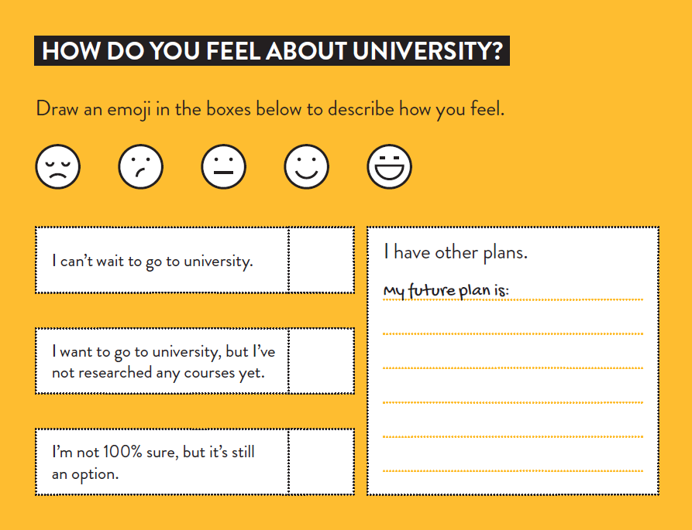
What are your Future Plans?
Activity 1
How do you feel about University?
Use the activity to reflect on how you
feel about going to university.
Notes:
Activity: What are your Future Plans?
How to use: Students to fill in the answers in their booklet.

Slide 4

Choosing a
Course
Notes:
Questions: Before we get started -
- How many of you have a rough idea of what you want to study?
- How many of you are still deciding?

Slide 5
What do you want to Study?
How Many Courses?
49,000+
Listed on the UCAS website.
Notes:
UCAS Search: March 2026
Question: Can anyone guess how many courses are available to choose from on the UCAS website?
Explain that UCAS is the website that you both search for courses and apply to universities.
Why are there so many?
Because studying History at one university for example could be completely different to studying History at another university.
Why?
Because the areas the courses specialise in could be completely different which is why doing your research is key.

Slide 6
Real or Fake Courses?
Which courses are real and which ones are made up?
Urban Planning
Ethical Hacking
Youth Studies
Equestrian Coaching
Surf Science
American Studies
International Development
Golf Management
Glass
Notes:
Question: Which of these do you think these are real degrees?

Slide 7









Real or Fake Courses?
Which courses are real and which ones are made up?
Urban Planning
Ethical Hacking
Youth Studies
Equestrian Coaching
Surf Science
American Studies
International Development
Golf Management
Glass
Notes:
Answer: THEY ARE ALL DEGREES.
Ethical Hacking definition: This course combines computer networking, digital forensics and expert development as well as programming. You will learn how to protect data and information systems.
It might be that you already have an idea of what you would like to study. That’s great! Make sure you take that research a step further and look at what degree subjects are available in that area as they may be a degree subject that is a perfect match for your skills and experience, you may not have heard of it yet!

Slide 8
Making Your Choice
You can choose
5
courses
Notes:
You have 5 choices available.
These could be 5 of the same subject at different institutions or you could apply for different courses at the same institution.
Remember that you only submit one personal statement when applying to university so if you would like to apply for different subjects, they will need to relate in some way so they can both be covered in your application.
If you are looking to apply for Medicine you can only apply for 4 medicine courses, the other option must be an alternative course.
If you are thinking about applying to Oxford or Cambridge, you can only apply to one of those institutions and not both.

Slide 9

Some courses have the
option of adding…
Semester / Year Abroad
Year in Industry
Integrated Masters
Notes:
Many courses now offer the option of adding a year abroad or a year in industry.
For example, a language degree may require you spending a year in another country, giving you the option of studying when you’re away, teaching English to foreign students, or finding a job and working for a year. Universities have links all over the world with opportunities available to study in America, Europe or Australasia.
A year in industry is a great way to get some valuable work experience as part of your course. This can be paid, and it may even help you to secure a job for when you graduate.

Slide 10
Where to Start?
Ask Yourself…
What do you enjoy doing now?
What are you good at?
Could this be something to study at uni?
… or turn into a future career?
Notes:
First, ask yourself:
What you enjoy doing now? Think about the subject(s) you like or an area you’re interested in.
What part of that subject interests you the most? Practicals? A particular topic? Be specific!
If it’s not something you’ve done before, why are you drawn to it? What are you most looking forward to doing?
Linking back to what we said earlier, different universities will structure courses differently and cover different modules so always have this information in the back of your mind in your research process. There's so much to think about and you can get bogged down by content and information overload, so always come back to what it is you want to get out of it and make sure your course enables you to do that.

Slide 11

What are your Skills?
Activity 2
What are you good at?
Use the activity to recognise what
skills you have.
Notes:
Activity: What are your Skills?
How to use: Students to fill in the answers in their booklet.

Slide 12
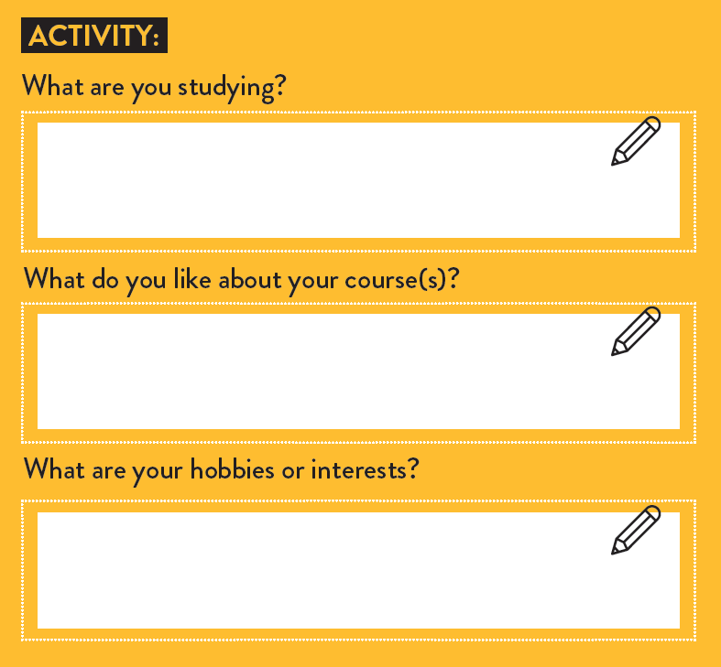
What do you want to Study?
Page
2
Activity 3
Choosing a Course
Whatever you choose, do something you love.
Notes:
Questions:
What are you studying?
What do you like about your course(s)?
What are your hobbies or interests?
Are you passionate about something? For instance, do you enjoy a subject and are you passionate about an issue?
Maybe something like Geography and International Development might be a good choice.

Slide 13



Hear from
Our Students…
Notes:
Video: Hear from one of our students and their 5 Top Tips on choosing a course (55 seconds)
Link: https://www.youtube.com/shorts/scxIN0t8QIk

Slide 14

Narrow Down Your Options
Page
11
Activity 4
Ask Yourself…
Do you want to study for 3+ years?
Does it give you the accreditation you need?
What modules are on offer?
How is each course assessed?
How do you prefer to learn?
Notes:
Questions:
How would you evaluate yourself? Students to mark themselves out of 10 for each of the assessment methods / ways of learning
Assessment methods at university are not that different from those used in school or college. However, the assessment types used will vary by course. Students have the opportunity to search for courses that match their interests and assessment method preference.
Check out Discover Uni and university prospectuses for a breakdown of assessment type by course.
Do you want to study this for the next 3 or more years? 3 years is a long time to be studying something you don’t enjoy.
How do you like to learn? Some courses have mainly lectures approximately 100-200 people, with just a few seminars to follow up a topic but this can change from year to year. You could have a combination of lab work and regular small seminars. It helps to think about how you learn best when choosing a course.
How well do you perform in different types of assessment? If exams aren’t your strong point, then you don’t want to pick a course which is 100% assessed on examinations. Discover Uni has a graph comparing coursework to exams to tell you if a course will be suited to your learning style.
What are you good at currently? Are you interested in a subject you are taking now, a specific module (e.g., organic chemistry) or do you want to try something new? Try and gain experience in that new subject before applying to see what it is like. A history course at one university can be very different from a history course at another university, and this is due to the modules that are on offer. If there is a particular part that you are interested in, make sure that university offers it as a module.
Some courses need to be accredited in order for you to go into a certain career. E.g., psychology needs to be accredited by the BPS.

Slide 15
Where do you want to Study?
How Many Higher Education Institutions in the UK?
400+
… and even more around the world!
Notes:
UCAS Search: March 2026
Question: How many universities do you think there are to choose from in the UK?
Answer: There are over 400 higher education institutions in the UK.
By Higher Education Institution we mean anywhere in the UK where you can study a degree. Most degrees are taught at universities, but some FE colleges also offer degrees which are usually validated by a university. For example, in Norfolk your options are UEA, NUA, City College, East Coast College, and College of West Anglia.

Slide 16
Choosing a University
Page
5
Activity 5
List 5 locations that take your fancy
You can move away from home
You can stay at local and commute from home
Everyone has their idea of what they want to do
Notes:
Questions: List your top 5 locations
This next part will focus on the key things you need to consider when thinking about the right institution for you.
With so many universities to choose from it’s a good idea to think about where in the UK you may like to live. You can decide to stay at home and commute to your local university, or you can move away from home and live on campus. Everyone will have their own idea of how far away from home they’re prepared to travel, so it's worth having a think about this now.

Slide 17
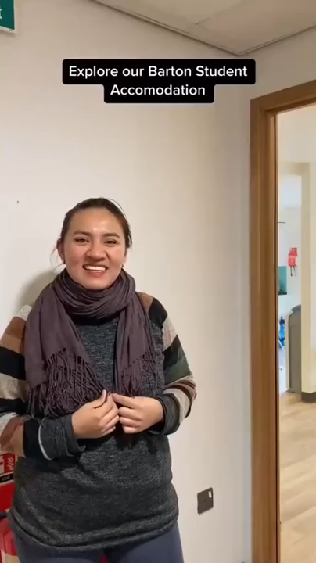
Hear from
Our Students…
Notes:
Video: Students talking about where they live (1 of 3)
Barton House: https://www.youtube.com/watch?v=EQVNas7g9ME

Slide 18

Hear from
Our Students…
Notes:
Video: Students talking about where they live (2 of 3)
Nelson Court: https://www.youtube.com/shorts/ayBVnSlTY0Q

Slide 19
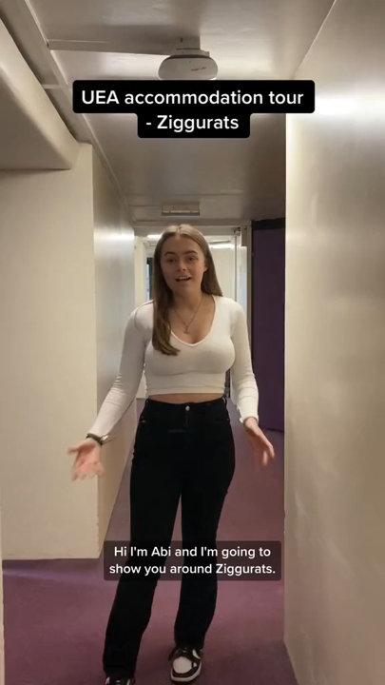
Hear from
Our Students…
Notes:
Video: Students talking about where they live (3 of 3)
Ziggurats: https://www.youtube.com/shorts/RPcH9XzgzjQ

Slide 20

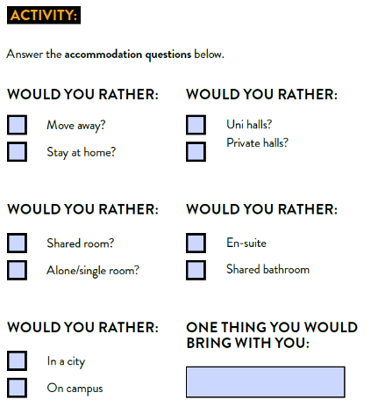
Accommodation
Page
16
Activity 6
Ask Yourself…
Do they have on-campus accommodation?
En-suite or shared bathroom?
Do you want catered accommodation?
What is rent like in that city?
Notes:
Questions: Complete the accommodation check list
If you choose to move away for university, you will likely stay in university accommodation for the first year of your course. The majority of universities have accommodation on campus that students can stay in for the first year of study. When deciding on your university, it’s important to look at the accommodation options to see if you’re happy with them. This will be your home for a year, so you want to make sure you’re happy with it.
Always an important consideration when choosing where to go, there are several basic questions about accommodation that need to be answered.
Questions:
Does the university have accommodation on campus?
Is there a mixture of ensuite and shared accommodation?
Are you looking for catered accommodation? (this is more expensive, but meals are included)

Slide 21


Which Type of University?
Campus
or
City
Can’t Decide? Make a List of Pros and Cons
Notes:
There are two main types of university: Campus Universities and City Universities.
Campus: A campus university or college means that all aspects of the university are on the same ‘site’. If you like the idea of simply rolling out of bed and walking to your lecture in the morning, this may be the right choice for you. From a social point of view, campus universities like UEA usually have a great atmosphere and community feel about them.
City: City universities or colleges tend to be larger and much busier. Because they’re spread across a city at a number of different sites, you may need to cycle or catch a bus between seminars and lectures. The advantage of a city university or college is that you truly feel a part of the place. Portsmouth university and Sheffield university are great examples of city universities. If you’re not sure which you prefer it might be an idea to put together a list of pros and cons for each one.

Slide 22

Student Experience
Do they have a range of clubs / societies?
Are there any that match your interests?
Can’t find any you like? Make your own!
Notes:
Universities have lots going on. They all have Student Unions which are run by the students for the students, in a similar way to a school council. SUs put on a range of activities throughout the year.
All universities have a range of different clubs and societies to choose from. At UEA we have over 200 that you can take part in. Make sure you look at what's on offer to see if there is something that takes your interest!
If you’re into sport, does the university or college have a range of clubs?
Do they play in a British Universities and Colleges Sport (BUCS) League and are they any good?!
Are there any clubs or societies that match your interests?
For example, UEA has over 200 societies, from the Vegan Society to the Assassins Society.
Remember if you don’t find a society you like, you can always create one of your own.

Slide 23

Tuition Fees
and Living Costs
Notes:
It’s important to note at this stage that there is a fee for doing a degree, and that fee is currently at £9535 a year. But you do not need to have this money in advance. If you are a UK student, you will be eligible for a Tuition fee loan to cover the cost of this. Students will also be able to get a Living cost loan to support the cost of living. These are repayable in small monthly instalments based on how much you earn after you graduate. Do not let money worries put you off going to university. More information will be provided on this at a later stage in your university cycle.

Slide 24
Tuition Fees
Most university courses cost
£9,790 / yr
You don’t have to pay this upfront!
Figures for 2026 entry
Notes:
All figures based on 2026/27: SFE - Student Finance England
SFE is split into TWO main areas: The first cost we’ll talk about is tuition fees.
At the moment tuition fees are a maximum of £9790 per year. Everyone who applies and is eligible will receive this loan. This is a lot of money!
Some of it goes towards paying for your actual teaching (lectures and seminars) but tuition fees contribute to lots of other things too, for example: teaching facilities and lab equipment, licenses for journals, 24-hour library and IT services, support services including counselling and specialist advice staff, and accommodation and catering.

Slide 25
Tuition Fee Loans
If you’re a UK national, Irish citizen, or have ‘settled status’ in the UK, you can apply for a loan that covers your fees.
This will go straight to your chosen college or university.
Notes:
As long as you’re a UK national, Irish citizen, or have ‘settled status’ in the UK, you can apply for a tuition fee loan from Student Finance England (SFE) that will cover the cost of up to 4 years of study. You never actually see the money as it goes directly from SFE to your university or college.

Slide 26
Maintenance Loan
Goes directly into your bank account
Helps keep on top of living costs
All eligible students get support
Depends on household income
Depends on where you live and study
Let’s see how much you might get…
Notes:
Living cost loans are sometimes called a Maintenance Loan.
These are completely different from the Tuition Fee Loan, as the Living Cost Loan is paid directly into your own bank account each term and helps you keep on top of your living costs when you’re away at university or college.
All eligible students get some level of maintenance support. How much depends on your household income and where you live and study.

Slide 27


Student Finance / LLE Calculator
Notes:
OPTIONAL (hide this slide if you are not using it)
For a more exact amount students can use the Student Finance calculator.
If you have time, you can run through a quick demo with household income of (e.g.) £25,000 (www.gov.uk/student-finance-calculator) for link.
Let students know that if applying with parental support, it will ask about household income (which we will explain on our next slide).
Encourage students to complete this later on with parents/carers, or those within their household who may contribute towards household income total.

Slide 28
Extra Funding
Scholarships
Bursaries
Additional Support
Research and apply for these at your firm choice
Can go toward discounted tuition fees, reduced accommodation, or cash
Disabled Students’ Allowance
Limited in numbers
Travel Grant
Often automatically awarded, so no need to apply.
Often linked to exceptional ability.
Childcare Grant
Dependent Grant
Notes:
Many universities and colleges provide additional financial support to their students through bursaries and scholarships:
Scholarships: Subject-specific and limited in numbers, scholarships are linked to academic results or an exceptional ability in an area such as sport or music. More details can usually be found on the university or college website.
Bursaries: Awards – or bursaries – can include discounted tuition fees, reduced accommodation costs, or cash, and are linked to personal circumstances and, often, household income.
DSA: You can apply for Disabled Students’ Allowances (DSAs) to cover some of the extra costs you have because of a mental health problem, long term illness, specific learning difficult or any other disability.
DSA support is non-repayable: DSAs are not paid in set amounts because they depend on what you need, however there are maximum allowances in place. Look at the gov.uk site for details of current figures [we can’t advise about possible allowances for individual needs]. DSAs are not intended to pay for disability-related costs that you would have whether you were a student or not. If you need personal assistance on a daily basis, (e.g. getting dressed) you should be able to get help through your local social care department. DSAs are also not available to pay for study costs that all students might have. If you already have a care package, you’re allowed to take it with you, including if you go away to university outside of your local area.
Helpful links:
https://www.gov.uk/disabled-students-allowances-dsas
https://www.disabilityrightsuk.org/applying-disabled-students%E2%80%99-allowances-dsas
Childcare Grant: Help with childcare costs for dependent children aged under 15 (or under-17 if they have special educational needs) in registered or approved childcare.
Parents’ Learning Allowance: Help with course-related costs for students with dependent children.
Adult Dependants’ Grant: If a student has an adult who depends on them financially, and who is not the student’s own grown-up child or another adult who gets student finance themselves, support is available.
Travel Grants: Travel Grants help with travel costs if you’re attending a clinical placement in the UK or studying abroad as part of your course. It covers reasonable travel expenses during the academic year.
Student Support: Student services at universities can also provide support with finances. UEA has a budgeting tool you can use, you can book in an appointment with a financial advisor, and you can apply for a hardship fund (a non-repayable discretionary fund used to provide grants to students who are not eligible to apply for help from the Government-funded Access to Learning Fund).

Slide 29
Put the Search into Research
Search the Course Title on UCAS.com
English
1407
Courses
Biology
771
Courses
Law
1666
Courses
League Tables
Prospectuses
TEF
The Student Room
Notes:
UCAS Search: March 2026
This next section will give you some top tips of how to start researching courses and universities.
A good place to start is on the UCAS website. To discover how many courses are available in your chosen subject area and the number of universities and colleges that offer it, start by searching the course title. Here are a few examples of what you might find. You can also filter by location if you know you want to study in a particular area.
League Tables: There are overall university rankings as well as course rankings. Rankings do provide a good overview of the quality of the university, but it is also important that you go to a university that is right for you.
Universities also have prospectuses which you can request as a hard copy or can view on their website, like what your college has, this gives an overview of all the subjects they offer along with entry requirements.
TEF (teaching excellence framework) is a new measure of teaching quality. Universities are given either a bronze, silver or gold rating.
The student room is an online forum where you can post questions and get them answered by current university students.

Slide 30

University Open Days
Open Days
Chat to Current Students and Academics
Learn More about the Campus or City
Find Out the Pros and Cons of Courses
Notes:
A great opportunity to check out a university or college for yourself, Open Days give you a unique opportunity to chat to current students, learn more about the campus or city, and find out the pros and cons of a particular course.
We would always recommend visiting the university in person.
Travel funds might be available for students to help with cost.
UCAS Open Days: Explore | UCAS

Slide 31

University Open Days
Other Opportunities
Careers Fairs / UCAS Fairs
Massive Open Online Courses (MOOCs)
University Subject Webinars
TED Talks
Notes:
There are lots of useful activities that you can do to support your research process online.
UCAS/ Careers Fairs: usually face to face, some of these will be taken place online this year. This gives you an opportunity to ask questions of the provider directly.
MOOCs: MOOCs are massive online open courses. There are loads of subject specific ones available on Future learn website that can give you insight into what studying that subject is like at university. Its also a great opportunity to build on your independent learning skills and experience a digital form of learning.
TED Talks: Listen to talks on subject experts to find out more about different subject areas.

Slide 32
What are they?
Contextual Admissions
Universities use additional information from your UCAS application to assess your potential to succeed.
You could receive a reduced offer to study or an invite to interview/audition.
Notes:
What is contextual admissions?
Contextual admissions is how universities recognise the potential that students have to succeed in an undergraduate course at university, in the context of their educational experience. To do this they use additional information to review students applications and performance, before making reduced offers to eligible students.
Am I eligible? Universities will have different eligibility criteria so doing your research is key.

Slide 33


UEA 2027 Scheme Eligibility
You must meet at least one of the following:
Live in Index of Multiple Deprivation (IMD) decile 1-3
Eligible for Free School Meals
Care experienced
Estranged
* Information given in your UCAS application – no need to apply!
Notes:
UEA National Scheme 2026
Our 2026 national scheme is available to our home fee paying students who meet one of the below criteria
• Come from an area of deprivation – we use postcode data to obtain this (IMD decile 1, 2, or 3) students can check this using the eligibility checker on the webpage
• Who are (or have been) eligible to receive FSM (free school meals)
• Care experienced
• Estranged
Students could receive a reduced offer to study, or an invite to interview/ audition
• All of this information comes from your UCAS application so there is no need to apply or provide the university with additional information.
• It is therefore important that you complete all sections of the UCAS application accurately so universities have access to all the information they need
• The scheme is open for students studying A levels, BTECs, an A Level/ BTEC combination, or an Access to HE course
• Every applicant who is flagged through contextual admissions, and meets the academic criteria, will be made an offer which is lower than the typical offer for that programme. For A levels, this is a 2 grade reduction. For BTEC’s this is a 1 grade reduction. For mixed qualifications, it will be a 1 grade reduction in an A level. For Access to HE the offer is 45 credits with 30 at Merit and 15 at Pass

Slide 34
To Conclude…
University helps with Career Opportunities
Develop Valuable Life Skills
Meet new people and try new things
Study something you love
Doing your research is key!

