Slide 1
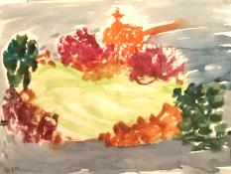
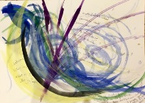
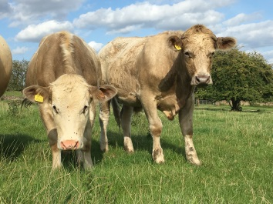
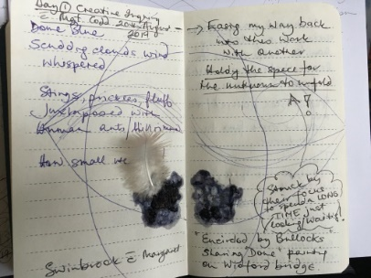
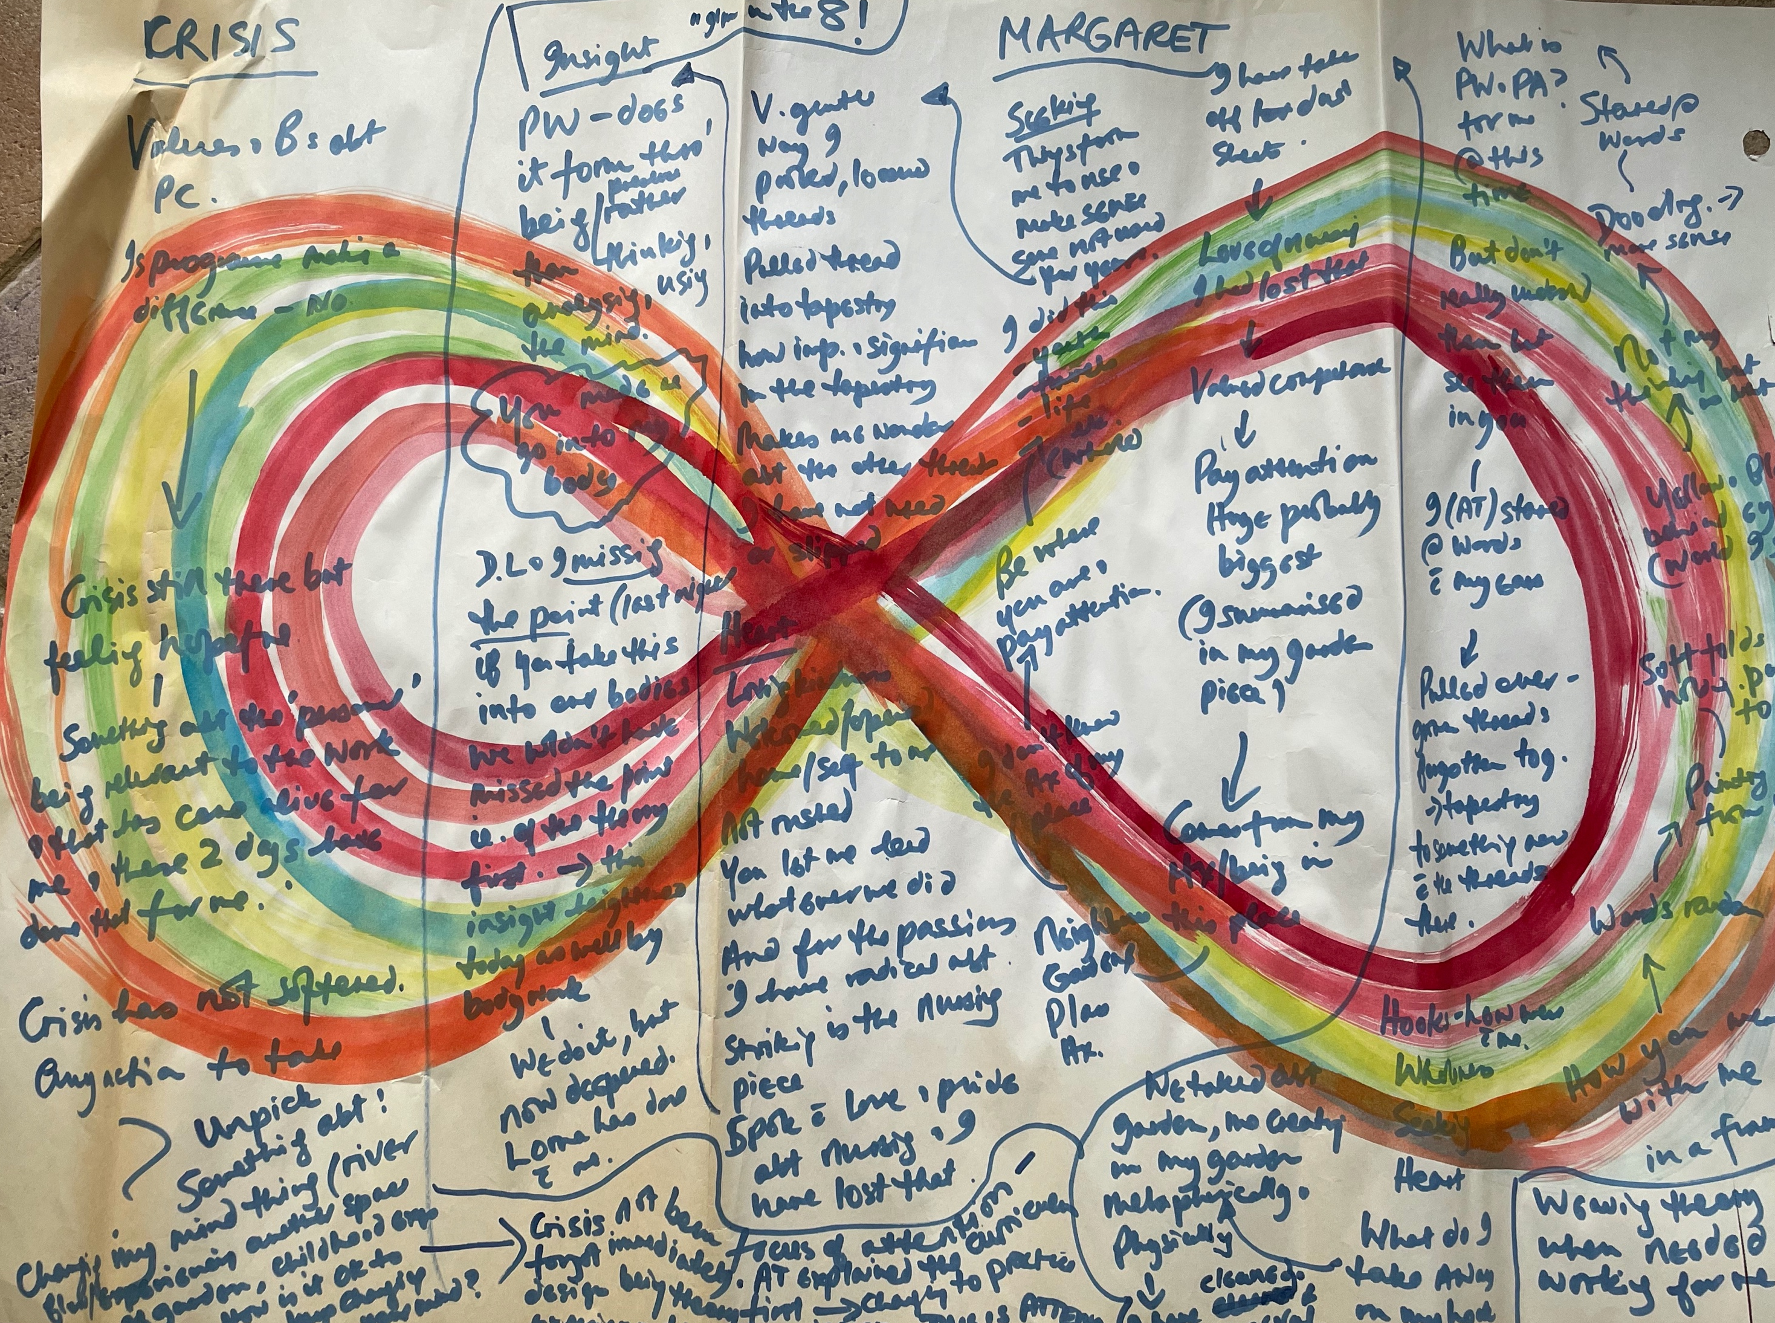

Critical-creative retreat
Developing symbols and metaphors from nature to inform inquiry question
Margaret Codd & Angie Titchen
Critical companionship video & resource guide: Facilitating career progression from person-centred practice to person centred systems: DOMAIN 2: LEARNING, DEVELOPING, IMPROVING

Slide 2
Critical-creative retreat

Slide 3
Domain 2:
Resources & recommended reading
Main CC frameworks & references
Notes:
Links please!

