Slide 1

The Secure Base model: promoting attachment and resilience TRAINING SESSION
Notes:
Notes
Welcome to this training session on the Secure Base model.
Introductions.
NB This training session can be delivered in person or online. Exercises are flexible to allow for both. If delivered online, additional instructions regarding using the chat function, raising a hand, keeping video on etc. will need to be given.
For further context see the Trainer Guide for this training session.

Slide 2
Guidelines for the session
It’s important to respect differences of perspective and opinion.
All discussion is confidential to the group - unless someone was felt to be at risk, which would be discussed with the participant.
Do take a break or discuss with the trainer if the teaching or the discussion provoke difficult feelings.
Notes:
Notes
READ SLIDE
These guidelines set out some core principles for the conduct of the training session

Slide 3
Aims of the session
To learn about the Secure Base model as a framework for therapeutic caregiving
To consider ways of applying the model in practice
Notes:
Notes
READ SLIDE
The focus of this session will be on Secure Base caregiving relationships and social work practice in all family settings.
Exercises will focus on practice applications and encourage sharing ideas and experiences.
Please feel free to raise issues / ask questions.

Slide 4
What is the Secure Base model?
A strengths-based framework for therapeutic caregiving
Drawn from attachment and child placement theory, research and practice
Based in the everyday interactions of family life
Designed to promote children’s security and resilience
Helpful to caregivers and practitioners
Developed by Gillian Schofield and Mary Beek at the University of East Anglia
Notes:
Notes
READ SLIDE
This slide can simply be read as more detail of the model will follow.

Slide 5
What is Secure Base caregiving?
Secure Base caregiving provides a child of any age with reliable comfort, closeness and reassurance.
This reduces the child’s anxiety and provides the child with a secure base from which to explore, play, learn and fulfil their potential.
Notes:
Notes
READ SLIDE
Providing a child with reliable comfort, closeness and reassurance – a secure base for exploration- - is very important for babies and young children who have to learn to cope with the many ‘ups and downs’ of life (for instance, hunger, thirst, discomfort, separation), but it is also necessary for older children and teenagers, who face additional complex challenges at school and in peer groups.
This secure base helps the child – whether a toddler or a teenager- to enjoy all kinds of exploration, because they know and trust that their needs will be met and that support and help will always be available to them.

Slide 6
Therapeutic care: the significance of Secure Base caregiving for children from troubled backgrounds
Because of the impact of abuse, neglect, trauma and loss, children will need therapeutic Secure Base caregiving.
Everyday interactions between caregiver and child can be therapeutic; helping the child to recover from difficult experiences in previous relationships, trust new relationships and become more secure and resilient.
The child’s internal working model (their beliefs about self and others) can change from negative to positive – to become ‘I am lovable, I can achieve things’; ‘Other people are available, care about me, understand my needs and can be trusted’.
Notes:
Notes
READ title and first bullet point
It’s important to think about the impact on the child’s thinking, feeling and behaviour of their previous experiences of caregiving before this placement –including harmful caregiving and separations - and the implications for the care they now need.
READ second bullet point
The Secure Base model shows how each moment of each day in a family is an opportunity for therapeutic care- which here means promoting positive experiences, security, resilience and healing.
READ third bullet point
A child’s beliefs and expectations about self and others ( their internal working model) develop in early relationships and are key to building security and resilience. Children may have developed negative beliefs such as ‘I’m not a good person’ ‘adults can’t be trusted’, ‘other children don’t like me’, ‘the world is frightening and unpredictable’.
This can lead to patterns of behaviour/relating to others that may have helped them survive in their previous relationships (for example, withdrawing and not sharing their feelings).
However, a child’s internal working model can change to become more positive over time, as they start to trust caregivers and other significant adults, such as. teachers. Thus, Secure Base caregiving helps children to believe that they are loved and lovable and that adults can be available and trustworthy.

Slide 7
Secure Base caregiving dimensions that promote security and resilience
Availability – helping the child to trust
Sensitivity – helping the child to manage feelings
Acceptance – building the child’s self-esteem
Co-operation – helping the child to feel effective
Family membership – helping the child to belong
Notes:
Notes
These are the five caregiving dimensions that make up the Secure Base model – with each having a specific developmental benefit for the child.
READ SLIDE
The first four dimensions come from attachment theory and research and the fifth- family membership-comes from child placement research.
We will explore each dimension in turn during this training session, but first we need to think about how they interact with each other.

Slide 8
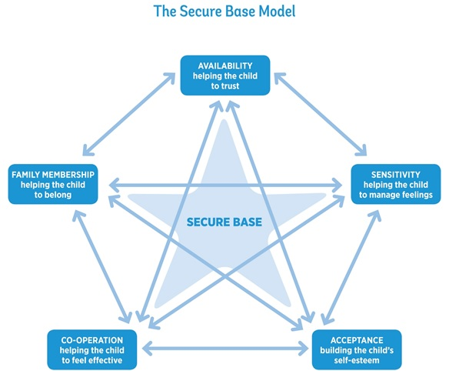
Notes:
Notes
As this diagram illustrates, the five dimensions interact to create the secure base for the child – for example, the child needs to trust caregivers if they are to manage their feelings and they need to feel accepted in order to feel that they belong in the family.

Slide 9
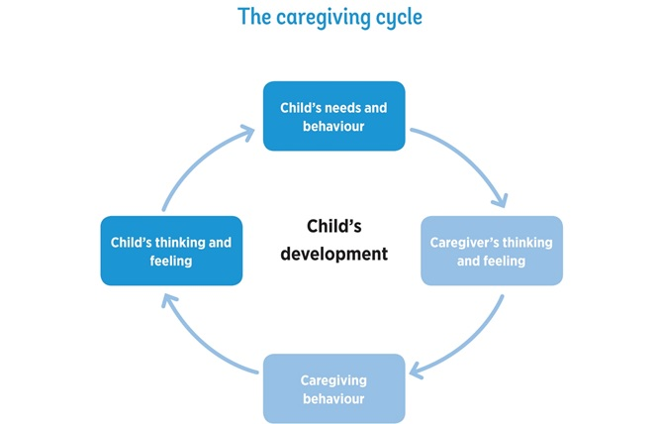
Notes:
Notes
This caregiving cycle is at the heart of the Secure Base model and represents the interaction of thinking, feeling and behaviour in the caregiver-child relationship. It begins with the child’s needs and behaviour and then focuses on what is going on in the mind of the caregiver.
How a caregiver thinks and feels about a child’s needs and behaviour will determine their caregiving behaviour. The caregiver will draw on their own ideas about what this child may need or what makes a good caregiver from, for example, their own experiences as a child or parent or from what they have learned from training.
The different caregiving behaviours that result from caregivers’ different thoughts and feelings convey very different messages to the child, which could be positive or negative..
The child’s thinking and feeling about themselves and other people will be affected by these messages and there will be a consequent impact on their behaviour and development.
This caregiving cycle goes round many times in a day and can build positive or negative beliefs and feelings in the child. For example, a caregiver believing positively ‘I can help this child’ will lead to supportive behaviour and build positive self-esteem in the child. Negative caregiver thinking, such as ‘This child doesn’t like me’, can lead to anxious or negative feelings and behaviour towards the child, increasing the child’s anxiety and doubts about their lovability- in turn affecting their behaviour.

Slide 10
Availability – helping the child to trust
Notes:
Notes
READ SLIDE

Slide 11
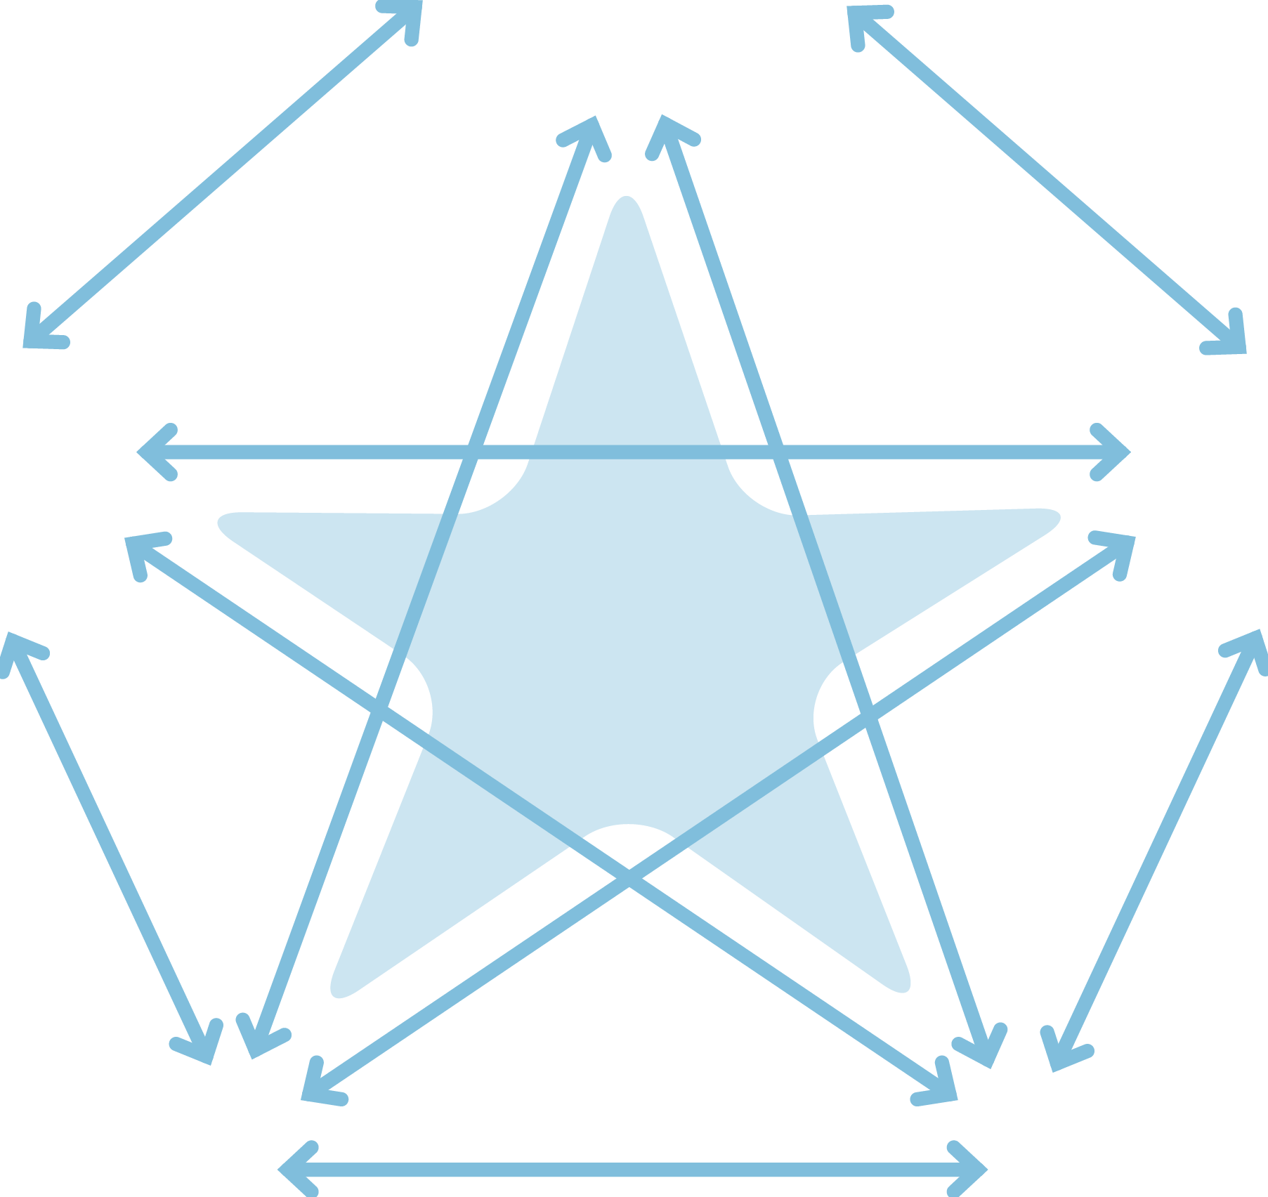

The Secure Base model
AVAILABILITY
helping the child to trust
FAMILY MEMBERSHIP
helping the child to belong
SENSITIVITY
helping the child to manage feelings
SECURE
BASE
CO-OPERATION
helping the child to feel effective
ACCEPTANCE
building the child’s self-esteem
Notes:
Notes
We are going to start with Availability -helping the child to trust--and then work clockwise round the dimensions.

Slide 12
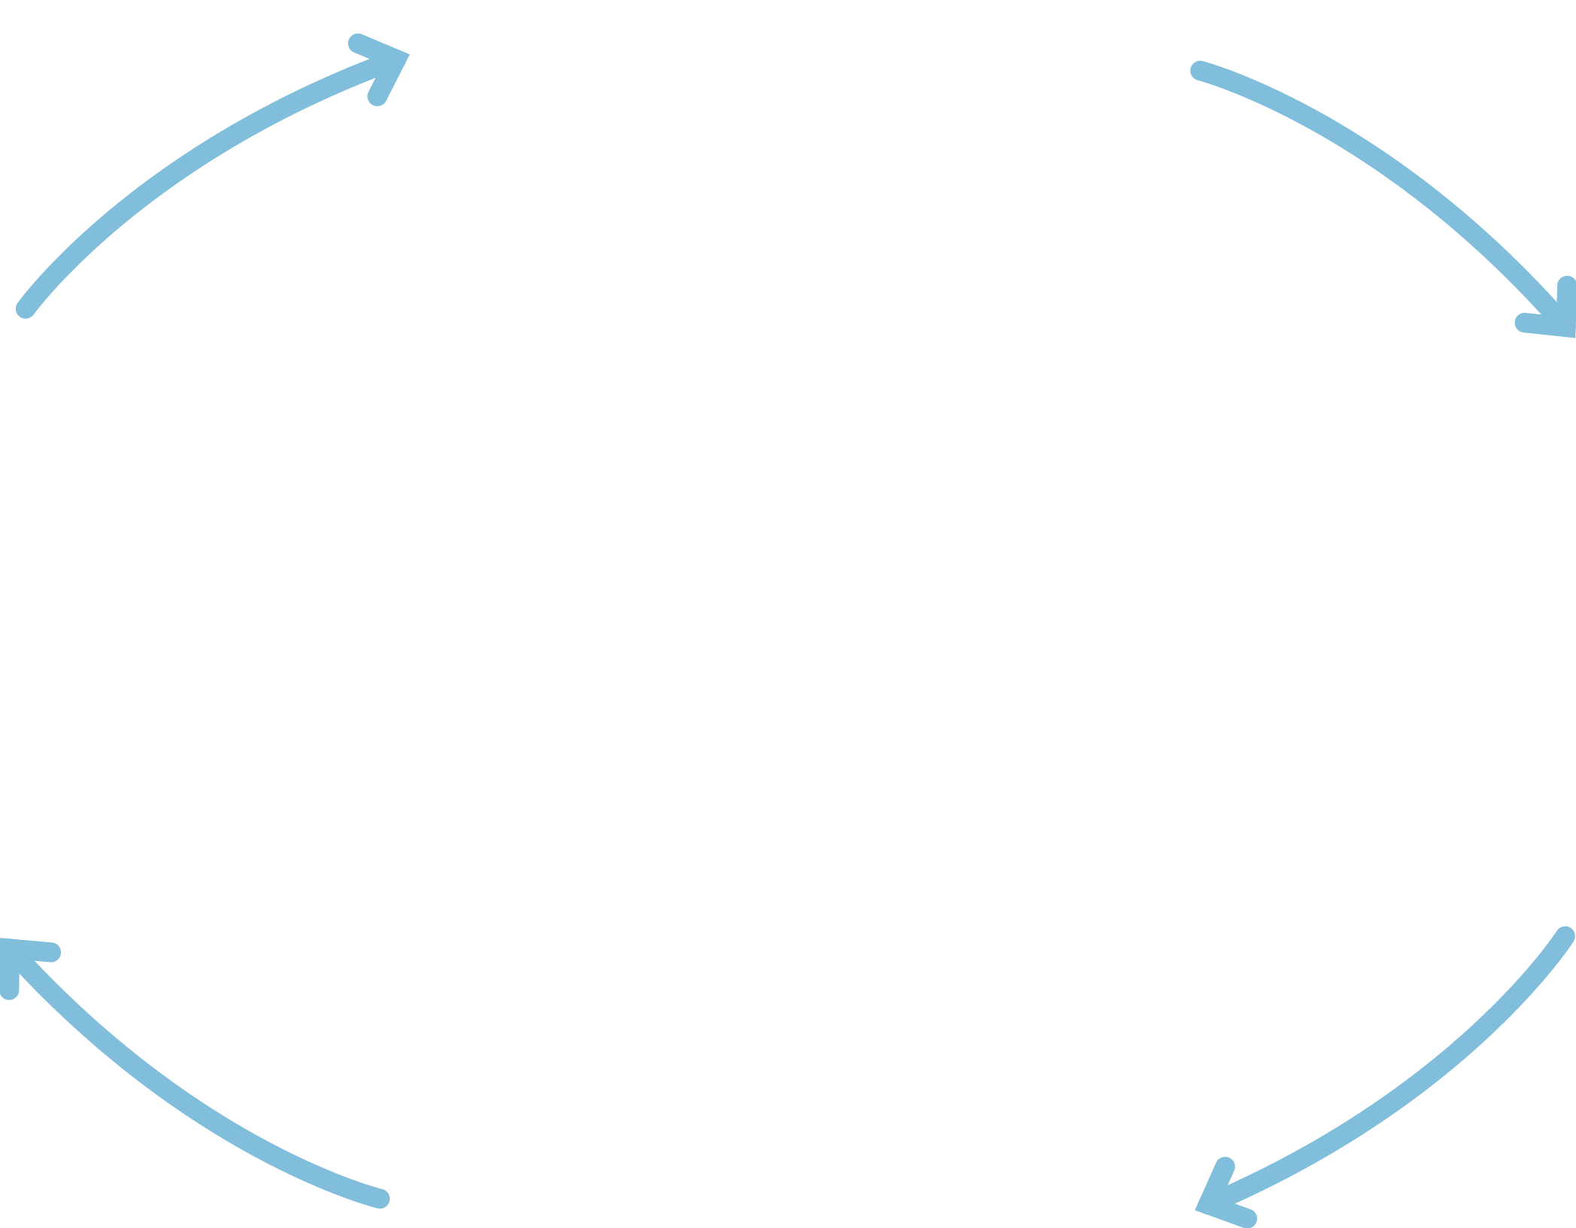
Availability
Child
thinking/
feeling
Child’s needs and behaviour
Caregiver
thinking/
feeling
I matter, I am safe
I can explore and return for help
Other people can be trusted
What does this child expect from adults?
How can I show this child that I will not let them down?
Helping the child to trust
Alert to the child’s needs/signals
Verbal and non-verbal messages of availability
Caregiving behaviour
Notes:
Notes
Availability is the first dimension and underpins the others - because of the importance of the caregiver’s practical and emotional availability and the link to the child’s fundamental need to learn to trust.
The caregiving cycle is used for each dimension – showing the interaction of minds and behaviour in the relationship between caregivers and children.
READ round this cycle.
We are now going to look at each element of this cycle in turn.

Slide 13
Why children may lack trust
Troubled children have often lacked consistent care and protection from reliable caregivers.
Previous caregivers may have been unavailable through domestic abuse, misuse of drugs, mental health difficulties, learning disability, abuse in their own childhood.
Caregivers may have
rejected the child’s emotional demands
responded unpredictably
been frightening or frightened
Insecure children may have developed patterns of behaviour to cope with this lack of trust e.g. shutting down on their feelings; being excessively demanding; becoming chaotic or controlling.
Notes:
Notes
READ SLIDE
A child's lack of trust may also be compounded by multiple caregiver changes and moves- in the birth family and /or in care.
It is important to think about the links between a child’s past experiences and current patterns of behaviour - for example, links between the child experiencing rejection from parents when they made emotional demands as infants and young children to subsequently shutting down and avoiding showing their feelings in relationships to avoid rejection.

Slide 14
EXERCISE 1 Lack of trust in children of different ages
Think about examples of behaviour in one of these age groups that might suggest a child’s lack of trust.
Infants (0 – 18 months)
Early childhood (18 months – 4 years)
Middle childhood (5 – 10 years)
Adolescence (11 – 18 years)
Notes:
Notes
Exercise 1 20 minutes
The focus in this exercise is on the first part of the cycle – how might a child's lack of trust show in their behaviour? What might a caregiver observe / be looking for?
Ask for examples of specific behaviour for each age group.
After participants have had 10 minutes to discuss in small groups, the whole group discussion (10 minutes) will need to be fairly concise – but should highlight
the range of behaviour in each age group
how children's lack of trust in caregivers may look different at different ages
the importance of caregivers being helped to observe and note the detail of a child’s behaviour.
Mention the Secure Base Development Checklists - on the Secure Base model website. These are for each dimension and for children in each age range. The checklists can help practitioners assess children’s development. Here they are useful in helping caregivers observe and think about where the child is in their development of trust and what caregivers might be working towards by their availability.

Slide 15
Availability-helping the child to trust: caregiver thinking and feeling
What does this child expect from adults?
How can I show this child that I will not let them down?
Notes:
Notes
The caregiver’s capacity to be available and build this child’s trust will depend on the caregiver's thinking and feeling- asking themselves first, ‘What does this child expect from adults?’
The previous exercise showed the importance of observing and reflecting on the child’s behaviour and its possible meaning.
THEN the caregiver needs to ask themselves, 'How can I show this child that I will not let them down?’
For the supporting social worker, it's essential to give the caregiver time to reflect on the child’s behaviour and what that might suggest about the child’s thinking and feeling /capacity to trust - before discussing practical and age-appropriate ways in which to offer availability, a secure base for exploration.

Slide 16
Availability-helping the child to trust: caregiver behaviour
Being alert to the child’s needs and signals
Being available physically and emotionally, when together and apart
Signalling availability verbally and non-verbally in age-appropriate ways
Timing the relationship interactions at the pace of the child
Notes:
Notes
It is important for caregivers to be alert to the child’s needs and signals so that they can give reassurance when it is needed- verbally and non-verbally. This reassurance may need to be given repeatedly in many different situations, especially at times of potential anxiety, such as eating, sleeping, separation.
Physical availability includes having time and energy to focus on the child’s needs.
Emotional availability includes being able to reflect on the child’s emotional state. If caregivers are preoccupied by their own unresolved emotional issues, it can be more difficult for them to respond to the emotional needs of the child. Caregivers will also have to think through with their support worker what they can do to demonstrate their physical and emotional availability in age-appropriate ways to this particular child. This includes demonstrating to the child that the caregiver is thinking about them when apart.
When building trust, it is important to take the relationship at the child’s pace and be ready to respond to the smallest signals from the child. Some children may not signal their needs or they may give misleading signals. Caregivers may need to gently ‘prompt’ the child by talking about their needs and then respond to these needs in ways that are comfortable and acceptable to the child.

Slide 17
Being alert and responding to the needs and signals of a small baby
‘When Jennie came to me at 12 weeks old, she was completely unresponsive, not waking for feeds, not responding to me, not showing any emotion. She had just switched off. I had to stay close to her and respond to even the slightest sound or facial movement and keep talking to her and touching her. It took time to replace those first weeks, but gradually she started to show different feelings and become more responsive.’ (Caregiver)
Notes:
Notes
READ SLIDE
By 12 weeks- or even earlier- children who have not experienced available caregivers may have learned not to trust adults. So it is important that caregivers of small babies actively use their availability to help the child recover, become more responsive and be able to explore and enjoy their environment.
This takes time and commitment. But this caregiver also shows how thinking about the baby’s early experiences has helped them plan how they need to care for this baby.

Slide 18
Helping a child to trust in the caregiver’s availability when they are apart
‘When Aiden (4) had contact with his father he was always very anxious about what might happen and whether he would come back to me and I would be here for him. On one occasion I gave him a small cushion to take with him so that he had something to hold onto, but also so that he would know he would be coming home.’ (Caregiver)
Notes:
Notes
READ SLIDE
This is a powerful example of tuning in to this young child’s anxiety and finding a practical and sensory way of making them feel safe - and communicating availability when apart.

Slide 19
Demonstrating availability to teenagers
‘I try, if they talk to me, to stop what I’m doing. Because there’s a lot of young people in the house, I feel it’s important because otherwise, opportunities disappear. With Liam (13) in particular, I might take the long road home if I sensed he wanted to talk about something.’ (Caregiver)
Notes:
Notes
READ SLIDE
This is another good example of a caregiver finding a strategy for communicating availability and building trust that is right for a particular child, even in a busy household.

Slide 20
Availability helping the child to trust: child thinking and feeling
I matter, I am safe.
I can explore and return for help.
Other people can be trusted.
Notes:
Notes
READ SLIDE
The caregiver's consistent physical and emotional availability over time reduces the child’s anxiety, which will help them start to enjoy play and learning - even small steps must be valued as progress.
Seeking comfort AND then starting to play are good evidence that the child is beginning to feel more secure and that the caregiver's availability is working.
Availability and thoughtful responsiveness can help a child to think and feel better about themselves and others – developing a more positive internal working model that will help them to feel lovable and to trust and enjoy relationships inside and outside the family.

Slide 21
Refreshment break

Slide 22
Sensitivity – helping the child to manage feelings
Notes:
Notes
READ SLIDE

Slide 23
The Secure Base model
AVAILABILITY
helping the child to trust
FAMILY MEMBERSHIP
helping the child to belong
SENSITIVITY
helping the child to manage feelings
SECURE
BASE
CO-OPERATION
helping the child to feel effective
ACCEPTANCE
building the child’s self-esteem
Notes:
Notes
Now we move to the second and also key dimension - Sensitivity – helping the child to manage feelings.

Slide 24
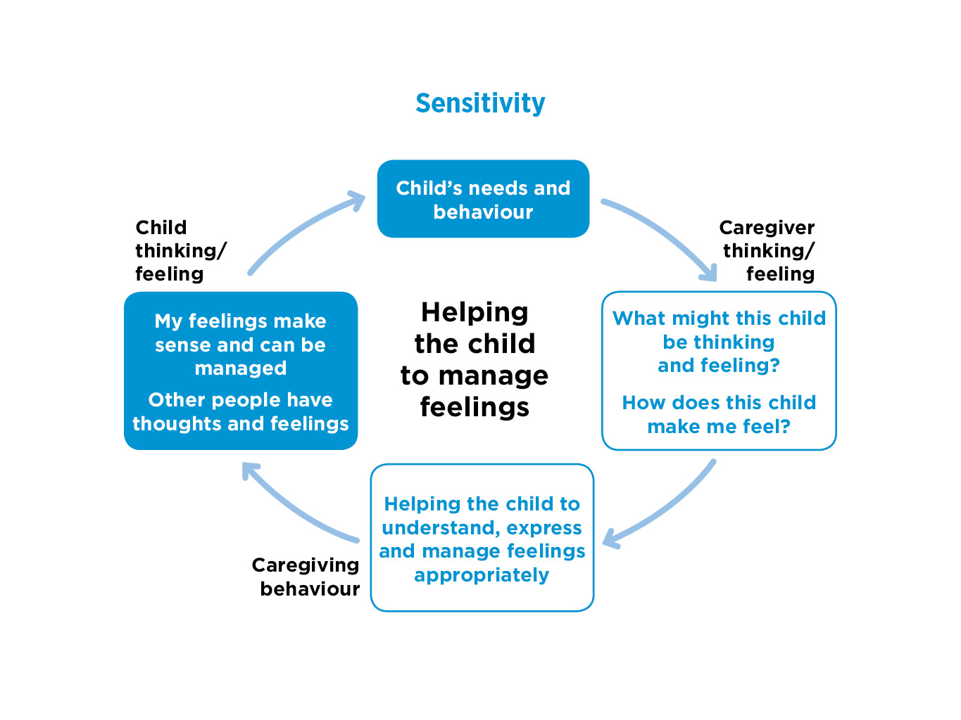

Notes:
Notes
READ round the cycle on the slide- mention that all aspects of the cycle will be looked at in more detail.
Emphasise that ‘managing’ feelings is not about suppressing them, but about expressing them appropriately, whether happiness or sadness, shame or anger, so that those feelings can be understood and responded to helpfully - by adults and by other children

Slide 25

Why children may find it difficult to manage their feelings
A child’s feelings have often not been acknowledged or responded to by previous caregivers.
From infancy, insecure children may have been overwhelmed by feelings so remain anxious.
Feelings and behaviour have often been mislabelled.
Children’s feelings may therefore be
shut down and denied
expressed excessively
chaotic
expressed through their bodies.
Notes:
Notes
READ SLIDE
These examples suggest the kind of difficulties that can arise for children who have experienced previous caregiving that did not meet their emotional needs and may have been actively harmful.
It’s helpful to give an example for the third bullet point- feelings and behaviour may have been mis-labelled: for example, a previous caregiver may have said that an accident (e.g. a child knocking a cup over) was deliberately done to upset the caregiver. Children can then find it hard to believe their own feelings / motivations/experience.
Expressing feelings through bodies- attachment theory may seem to have underemphasised the role of bodies, but we need to take account of the many physical problems that children / young people can have that may be linked to past experiences– such as sleeping, toileting, eating disorders, self-harm, drug misuse. These may in some cases be linked to how the child is expressing and managing their emotions.
Each child will be different and have had different experiences of expressing feelings and the responses they have received.
There may also be other factors affecting how children’s feelings are expressed in behaviour that caregivers will need to be aware of, such as for children with ADHD or ASD,

Slide 26
Sensitivity-helping the child to manage feelings: caregiver thinking and feeling
What might this child be thinking and feeling?
How does this child make me feel?
Notes:
Notes
READ SLIDE
Sensitivity in attachment theory is about being interested in, curious about, tuning in to the mind of the child, as the best way to understand and respond sensitively to their needs and behaviour. So the caregiver needs to be thinking: ‘ What might this child be thinking and feeling?’
Caregivers need support to be thoughtful about the child’s previous experiences and how these may have shaped the child's current thinking and feeling, especially when feelings are expressed in difficult behaviour or through their bodies.
But sensitivity is also about caregivers being able to reflect, with support, on ‘How does this child make me feel’? Each child will trigger different feelings in caregivers – perhaps affection and protectiveness or anger and frustration. These feelings will affect caregiving behaviour, so it is important that these feelings and the thoughts that lie behind them are acknowledged and explored.
Information on how this child makes the caregiver feel may also give some insights into the child's other relationships e.g. with teachers and peers.

Slide 27
EXERCISE 2 Children’s and caregivers’ thinking and feeling
Choose ONE of the TWO case studies on the next slide
Reflect on what this child might be thinking and feeling.
Write 3 brief statements from the child’s perspective. (e.g. ‘Does anybody care for me?’)
Reflect on what this caregiver might be thinking and feeling.
Write 3 brief statements from the caregiver’s perspective. (e.g. ‘It’s upsetting that he doesn’t like me.’).
Notes:
Notes
Exercise 2 20 minutes
READ SLIDE
This exercise can be undertaken as individuals /in pairs / in small groups.
Then as a whole group, share ideas and examples of statements for both cases Emphasise that there is no ‘correct’ response - children and caregivers will have a range of possible thoughts and feelings in these situations.
Note that these are both young children, which creates important challenges for carers tuning into their thoughts and feelings.

Slide 28
EXERCISE 2 Case studies
Choose one case study
Write three statements from the child’s perspective
Write three statements from the caregiver’s perspective
Mia (6 months) has just come into foster care. She has had several previous caregivers who were neglectful. She sleeps a lot and doesn’t smile or interact with her carers.
Connor (3) has recently been placed in an adoptive family. He spent nearly two years with his short-term foster family. He is tearful. He says he wants things (e.g. a bath or certain foods) and then refuses them.
Notes:
Notes
READ SLIDE

Slide 29
Sensitivity – helping the child to manage feelings: caregiver behaviour
Naming and discussing feelings
Providing a ‘commentary’ on daily events
Using practical tools to help the child reflect on their thoughts and feelings
Helping the child to think about the thoughts and feelings of other people, promote empathy
Modelling the expression and management of the caregiver’s own feelings
Notes:
Notes
The key task for a caregiver in this dimension is to help the child to understand, express and manage feelings appropriately. Caregivers can use a range of approaches to achieve this, including:
Naming and discussing feelings- those of the child, the caregiver's and other peoples.
Providing a verbal 'commentary' on daily events. e.g. feeds, nappy changes, getting ready for school etc. This gives a predictable shape to events and helps the child to anticipate and manage the associated feelings - whether excitement or anxiety or a combination.
Using practical tools – for example, an ‘experiences book’ recording daily or special events and feelings about them. This book could include items such as photos, school commendations, tickets for significant events, etc. This can help the child to organise their thinking and reflect on each day /each event while naming the associated emotions.
Helping children to understand and take other people's feelings into account, promoting empathy.
How caregivers and their families express and manage their emotions will be a key source of learning for a child - whether this is modelling shared enjoyment or sadness or feeling safe to express anger but being able to resolve disagreements.

Slide 30
Using an experiences book to name feelings
‘Paula (8) couldn’t remember or didn’t want to remember what happened this morning or yesterday or last week and couldn't anticipate “next week”. So we started to do an experiences book together – each day writing down what had happened and her feelings about it. This helped her to reflect on the shape of each day and the immediate past and build her capacity to remember.’ (Caregiver)
Notes:
Notes
READ SLIDE
This caregiver has thought about the child’s difficulty in naming and exploring feelings in the context of also struggling to manage time and memories.
Using a simple practical tool, an experiences book, they support the child to name a range of feelings and give her a sense of shape to her days.
It is common for children from troubled backgrounds to struggle with time and memory – which is why caregivers can benefit from actively using calendars as a visual framework for the child to anticipate, manage and reflect on family, school and other events, including family contact.

Slide 31
Using stories to promote empathy
‘I think Jenna (9) spent so long in self-defence and looking after herself that she never learned to look at things from anyone else’s point of view. Even things like stories. When you say, “why is that person doing that?”, she hasn’t got a clue, she doesn’t follow the motives of what people are doing, or how they are feeling. So we do a lot of story reading together and I talk it through’. (Caregiver)
Notes:
Notes
READ SLIDE
This example shows how the caregiver has been able to think about and identify an important gap in Jenna’s development - a lack of understanding of the feelings of others - and explain it with reference to Jenna’s past.
The caregiver then addresses this gap practically through focused story reading, which can help Jenna not only to name and understand the feelings of characters in books, but will also feed into wider discussions about, for example, the feelings of the caregiver, other family members, teachers, children at school, characters on television and reflect on how those feelings link to behaviour. This will support Jenna in building more mutually rewarding relationships with adults and other children.

Slide 32
Being creative: the worry jar
‘Sometimes Patrick (12) will really shout and stomp about, so you know something is brewing and he won’t tell anybody, because he doesn’t want to upset them. So if he has a worry, he writes it down and puts it in a worry jar and then when he wants me to read it, he gives me the jar and I read his worries. Because if it is out of you and shared, you feel better.’ (Caregiver)
Notes:
Notes
READ SLIDE
This is a good example of a caregiver identifying, with the child, a creative way to communicate difficult feelings
In this case Patrick was able to decide when he wanted the caregiver to read what he had written. This showed the trust that had developed between them and also promoted agency.

Slide 33
Sensitivity-helping the child to manage feelings: child thinking and feeling
My feelings make sense and can be managed.
Other people have thoughts and feelings – that need to be taken into account.
Notes:
Notes
READ SLIDE
Gradually, the child becomes aware that their caregiver can understand even the child’s more difficult feelings and make sense of them. This helps the child over time to name, make sense of, express appropriately and manage their own feelings. This will also support the child in regulating their behaviour.
Small steps towards these goals (e.g. expressing anger in words on a particular occasion) should be acknowledged and praised.
Gradually the child will also become aware of the range of other people’s feelings and be better able to respond appropriately to them – an important step in building and sustaining relationships.

Slide 34
Acceptance - building the child’s self-esteem
Notes:
Notes
READ SLIDE

Slide 35
The Secure Base model
AVAILABILITY
helping the child to trust
FAMILY MEMBERSHIP
helping the child to belong
SENSITIVITY
helping the child to manage feelings
SECURE
BASE
CO-OPERATION
helping the child to feel effective
ACCEPTANCE
building the child’s self-esteem
Notes:
Notes
Now we move on to the third dimension, Acceptance – building the child’s self-esteem.
Self-esteem is recognised as an important issue for many children – and this dimension builds on caregiver availability and sensitivity enabling the child to trust and manage feelings.

Slide 36
Acceptance
Child
thinking/
feeling
Child’s needs and behaviour
Caregiver
thinking/
feeling
I am accepted and valued for who I am
I do not have to be perfect
Building the child’s self-esteem
This child needs me to value and accept them
I need to value and accept myself
Helping child to feel good about them and manage setbacks
Caregiving behaviour
Notes:
Notes
READ round the cycle on the slide
Acceptance refers to the fundamental acceptance of the child – from infancy to adolescence - for who they are, as a person of value, interest and concern, even when some of their behaviours may need help to change.

Slide 37
Why children may have low self-esteem
Children may have
had experiences of abuse, neglect and loss
been treated as different or of less value
started to feel unworthy of love, success, praise
learned to fear failure and avoid new activities
Notes:
Notes
READ SLIDE
All forms of abuse and neglect, especially caregiving that was negative and lacked warmth and sensitivity, can make children feel profoundly worthless.
Some children may blame themselves for family difficulties and their own and their siblings’ removal from the family and this can further lower self-esteem.
Losses and moves within the care system can also contribute to low self-esteem.
Children who have not been supported to manage setbacks may have a deep fear of failure and so will not take risks / try new things - they may refuse to join in with games and activities.
Children may develop a sense of being inferior, different, unworthy of success.
Children may defend against feelings of worthlessness and become boastful, or make exaggerated/untrue claims (for example, ‘I am the best in my class at football’, ‘I’ve got hundreds of friends’). The caregiver needs to find a way to respond to this that shows acceptance and understanding.

Slide 38
Acceptance-building the child’s self-esteem: caregiver thinking and feeling
This child needs me to value and accept them.
I need to value and accept myself.
Notes:
Notes
READ SLIDE
A caregiver may need help to hold in mind that this child needs the caregiver to value and accept them, even though the child 's behaviour may need to change.
Alongside this, and especially if caring for the child is challenging, it is important for caregivers to hold in mind the need to value and accept themselves, so that their own emotional resources do not become depleted.
This may be a key area of intervention for support workers. Caregivers who are feeling overwhelmed by their children’s needs and finding it hard to care positively may need to be reminded of their strengths and skills and that it is the child’s history that is likely to be linked to behaviour that is making it difficult for them to care for the child in the way they would want to.
However, it is also important for caregivers to reflect on what interactions with the child may be triggering in terms of their own anxieties, perhaps rooted in their own past experiences of feeling undervalued or their current sources of stress.

Slide 39
Acceptance -building the child’s self-esteem: caregiving behaviour
Offering praise and positive attention
Encouraging activities and interests
Supporting the child with setbacks and disappointments
Accepting and supporting the child’s developing identity
Modelling and supporting the child to accept and celebrate difference e.g. ethnicity, abilities, appearance
Notes:
Notes
Young people who have grown up in foster care or adoption say that what they want most is to be loved and accepted for themselves – whatever their difficulties might be.
Praise and positive attention, activities and interests where the child can feel successful – for example, caring for a pet, small tasks in the home, enjoying a sport or activity –are important for building self-esteem and resilience. They can have a ripple effect in helping children to gain confidence, relate to peers, use their time productively, improve their skills.
All children have setbacks and disappointments at times and need to be supported through these. It is important for caregivers to have realistic expectations of the child and to reassure the child that they are still loved, whether or not things go well. They can promote the idea in the caregiving family- ‘Nobody’s good at everything but everybody’s good at something'.
When thinking about accepting and supporting identity it is helpful to think about identity as being linked to both self-concept and self-esteem - who am I and how do I and other people value me? We will come back to questions of identity when we look at the dimension of family membership and belonging.
Caregivers also need to model and teach the child to accept and celebrate difference / diversity of all kinds, in themselves but also in others. Children who are anxious about themselves may struggle with accepting others.

Slide 40
Offering and explaining praise
‘Kelly’s not used to being praised and she doesn’t always make the connection, so you have to spell it out to her. Instead of just saying ‘Well done’, we might say “You’ve done really well to get a good behaviour star. You must have tried hard. We’re really proud of you”.’ (Caregiver)
Notes:
Notes
READ SLIDE
This caregiver has thought about the child’s response to praise in terms of her history.
Explaining to a child the connection between their behaviour and adult praise can help the child to accept praise, enjoy it and learn from it.

Slide 41
Building self-esteem through activities
‘We encourage a lot of activities, because we want to build Gemma’s confidence and help her to be more sociable. So she goes to theatre school, and since she has done this we feel her confidence has grown more. This year she took the part of the main character in the school play and she was amazing – and she knew she was.’ (Caregiver)
Notes:
Notes
READ SLIDE
This is another example of active support from caregivers - to help this child to be more sociable, but also to feel positive about themself and their identity.

Slide 42
Showing pride - promoting self-esteem and resilience in a child with learning difficulties
‘Rob (11) loves his fishpond. Now he’s in charge of his own and he’s totally reliable in that department. We encourage him all we can. We say, ”Rob’s the top pond man”. He gave his talk at school on goldfish and got top marks.’ (Caregiver)
Notes:
Notes
READ SLIDE
Rob had learning difficulties and had few opportunities to excel at school. But the long-term foster family, where he was placed age 10, took pride in their fishpond and encouraged Rob to have his own pond, next to his caregivers'.
Their pride in Rob and his own sense of achievement became a source of self-esteem right through to age 18 and beyond - but also became a part of Rob's sense of belonging and permanence in this family.

Slide 43
EXERCISE 3 Acceptance - building the child’s self-esteem
Choose one of the case examples below and discuss:
How might caregivers show acceptance and build the child’s self-esteem?
How might caregivers for the child be supported to value themselves?
When Hassan (7), recently placed with grandparents, is praised or admired he seems angry and says, ‘Don’t say that!’. Often, he will then do something to invite a negative response.
Alisha (15) is in a new long-term foster care placement. She was rejected in her birth family and has had three moves including an adoption breakdown. She spends most of her time in her bedroom and has started to self-harm.
Notes:
Notes
Exercise 3 20 minutes
READ SLIDE
In small groups, discuss one of these two cases with the focus on these questions about acceptance and self-esteem. Followed by feedback and whole group discussion
First how can these two children of different ages, stages and situations be helped to value themselves and manage setbacks.
These are older children than in the previous exercise on Sensitivity – managing feelings and with greater communication skills. But tuning in to their thoughts and feelings will be an important task when thinking about practical ways of building their self-esteem.
The exercise also focuses on the kind of support that caregivers for these different children, in different types of placement, may need to maintain their own self-esteem when they are feeling challenged by a child's troubled behaviour.

Slide 44
Acceptance- building the child’s self-esteem: child thinking and feeling
I am accepted and valued for who I am.
I do not have to be perfect.
Notes:
Notes
READ SLIDE
When children begin to feel accepted and valued for who they are and learn that this does not depend on being ‘perfect’, they will gain confidence, enjoy their successes and manage their setbacks. Small steps towards this should be acknowledged and celebrated.
Another key message is that self-esteem building does not only take place within the family and extended family. Schools and community groups can also play an important role in building a child's self-esteem – but children often need caregivers to be advocates for them and support their participation.

Slide 45
Lunch break

Slide 46
Co-operation-helping the child to feel effective
Notes:
Notes
READ SLIDE

Slide 47
The Secure Base model
AVAILABILITY
helping the child to trust
FAMILY MEMBERSHIP
helping the child to belong
SENSITIVITY
helping the child to manage feelings
SECURE
BASE
CO-OPERATION
helping the child to feel effective
ACCEPTANCE
building the child’s self-esteem
Notes:
Notes
We now move on to the fourth dimension Co-operation- helping the child to feel effective, which again builds on the previous dimensions. Enabling children to feel effective requires availability, sensitivity and acceptance.

Slide 48
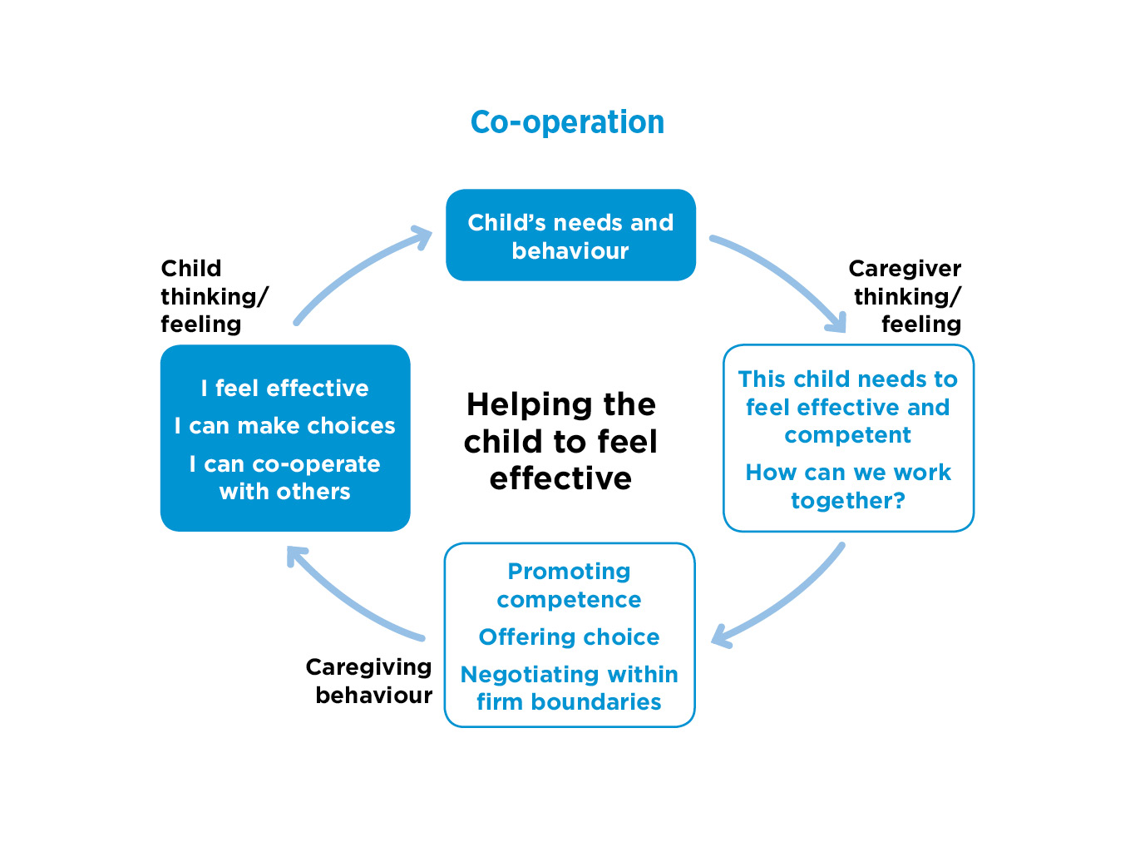
Notes:
Notes
READ round the cycle on the slide
.

Slide 49
Why children may not feel effective and find it hard to co-operate
Children may
lack confidence in getting their needs met
have rarely experienced co-operative caregiving
have previously felt powerless or too powerful in their birth families or in the care system
Notes:
Notes
READ SLIDE
Children may lack confidence in getting their needs met. Many children who enter the care system have rarely experienced co-operative caregiving where they were able to ask for what they needed. Their caregivers, perhaps because of their own histories or current circumstances, may have been either too controlling and not giving children choices or neglectful and ineffective. Boundaries may have been harsh and rigid or weak and inconsistent - or inconsistent.
Children may feel powerless when they are placed into care or moved within the care system. They may have had little preparation for their moves and been left feeling that they do not have a say in what happens to them.
Some children may become over-compliant, passive, unable to assert their views and wishes – and be vulnerable as a result.
In contrast, some anxious, insecure children may feel too powerful and out of control - perhaps being so challenging that they break placements. They may feel they need to control adults they don’t trust, both at home and at school, so find it hard to co-operate. They may not accept the family or classroom rules and small issues become battles. They may also be controlling with peers and become unpopular at school.
For all these reasons, this is an important but complex dimension to think about.

Slide 50
Co-operation-helping the child to feel effective: caregiver thinking and feeling
This child needs to feel effective and competent.
How can we work together?
Notes:
Notes
Caregivers need to be thinking about how important it is for children’s development that they feel effective. The link between effectiveness and co-operation may need some explanation for caregivers i.e. the more trusting and effective the child feels in relationships, the more likely they will be to let go of controlling behaviours, to co-operate and to compromise.
.

Slide 51
Co-operation-helping the child to feel effective: caregiver behaviour
Offering choices
Enabling the child to take the lead
Helping the child to achieve results on their own and with help
Setting clear rules and boundaries – but being willing to negotiate within them
Using fun and playfulness to achieve co-operation
Notes:
Notes
Offering some choice (within safe limits), even in small things and from the start of a placement, can help children to feel more effective and able to have some influence in their lives. e.g. ‘Which breakfast cereal would you like?’ ‘Would you like to wear your blue T shirt or the red one?’
Enabling children to take the lead, feel effective and competent in a safe, structured setting. This form of play with younger children can be referred to as ‘attending’, where the adult follows the child. It can be done for short periods (about 10 minutes) each day and it can be named as a special activity (e.g. Special Playtime).
Supporting children to achieve positive results (for example, completing small household tasks, planning an activity) is beneficial for effectiveness and self-esteem.
It is important that caregivers have clear rules and boundaries, which are appropriate and reasonable for the child’s age and stage of development. These should be clearly explained to the child, along with the reasons behind them but caregivers should also be supported to negotiate and compromise within these boundaries.
Use fun and playfulness to achieve co-operation, where possible. This will help the child to understand that it is safe and rewarding to co-operate.

Slide 52
Helping a child to feel effective - and be co-operative
‘We try, actually, never to tell Salim (7) to do anything. It’s a matter of phrasing it differently, so that you are not triggering his feelings of threat. So, instead of saying, “You need to wash your hands before you have a sandwich”, we might just say “Would you like to come and have a sandwich after you’ve washed your hands?” ’ (Caregiver)
Notes:
Notes
READ SLIDE
This is a good example of a caregiver using small but important changes in their language and approach - offering choice and working together with the child to avoid getting into a battle.

Slide 53
Using fun and offering choice to achieve co-operation
‘Jack (7) often doesn’t want to go to bed. He loves stories and when it is bedtime, I might say “Race you up the stairs. First one up gets to choose the story”. This works well as Jack is keen to run upstairs first so that he can choose a long story. Bedtime is no longer a battle.’ (Caregiver)
Notes:
Notes
READ SLIDE
A good example of a caregiver tuning into the child and using fun to engage them in making a positive choice and avoiding conflict.

Slide 54
Attending- the therapeutic effect of enabling a child to take the lead
‘George (3) would only relax in the garden, so although it was winter we wrapped up warm and everyday we spent time outside. He would potter about, looking at stuff, sometimes pulling up flowers, and I would follow him and talk occasionally and he would stop and he’d look at an insect, or whatever it was he’d found. I pretty much let George lead, but sometimes I’d draw his attention to things.’ (Caregiver)
Notes:
Notes
READ SLIDE
George was very troubled - he had been with previous foster carers who found it difficult to take to him / cope with him and he was developmentally delayed. This caregiver knew that she needed to give him the opportunity to feel valued and to find himself – as he had been unable to do as an infant. This meant finding a safe space for him, then allowing George to take the lead, make choices and explore the sensory world around him freely.
The timing of this therapeutic ‘attending’ approach was important, given his age. This caregiver needed to help George become more secure and able to benefit from a permanent placement. There was also less than two years to help him to be developmentally ready for school - so an intensive therapeutic approach to his daily care was crucial.

Slide 55
EXERCISE 4 Co-operation- helping children of different ages to feel effective/ be co-operative
What could a caregiver do to help each child feel more effective - and be more co-operative?
Tina (12 months) does not show interest in toys or play.
James (4) can’t sit still, runs around, jumps on furniture.
Toby (8) gets very angry when he can’t have more sweets.
Annette (15) stays out later than agreed.
Notes:
Notes
Exercise 4 15 minutes
For this exercise, discussion can be in small groups or the whole group - but start by giving participants a few minutes to jot down their first caregiving suggestion for each child that would help them feel more effective and become more co-operative.
What small signs of progress might the caregiver aim for /observe?
In the discussion - be aware of what the caregiver might be thinking and feeling about co-operation in different cases: a lack of interest in choosing a toy in a baby compared to an older child who seems out of control? What support would be needed for caregivers in different cases?

Slide 56
Co-operation- helping a child to feel effective: child thinking and feeling
I feel effective.
I can make choices.
I can co-operate with others.
Notes:
Notes
When children begin to feel more effective, able to make choices and appropriately in control of their lives within safe boundaries, they will be more able to let go of inappropriate control and be more willing to compromise and co-operate.

Slide 57
Family membership – helping the child to belong
Notes:
Notes
READ SLIDE

Slide 58
The Secure Base model
AVAILABILITY
helping the child to trust
FAMILY MEMBERSHIP
helping the child to belong
SENSITIVITY
helping the child to manage feelings
SECURE
BASE
CO-OPERATION
helping the child to feel effective
ACCEPTANCE
building the child’s self-esteem
Notes:
Notes
Finally, we come to this rather different and more psychosocial fifth caregiving dimension – Family membership –helping the child to belong.
Family membership is important because it confers a wide range of practical, social and psychological benefits and can be thought of as part of the child's secure base. In a family-based society, a child who has no family connections may feel psychologically and socially dislocated.
Family membership can be extended to several households and does not have to involve biological or legal ties if there is a commitment to the child as part of the family.

Slide 59
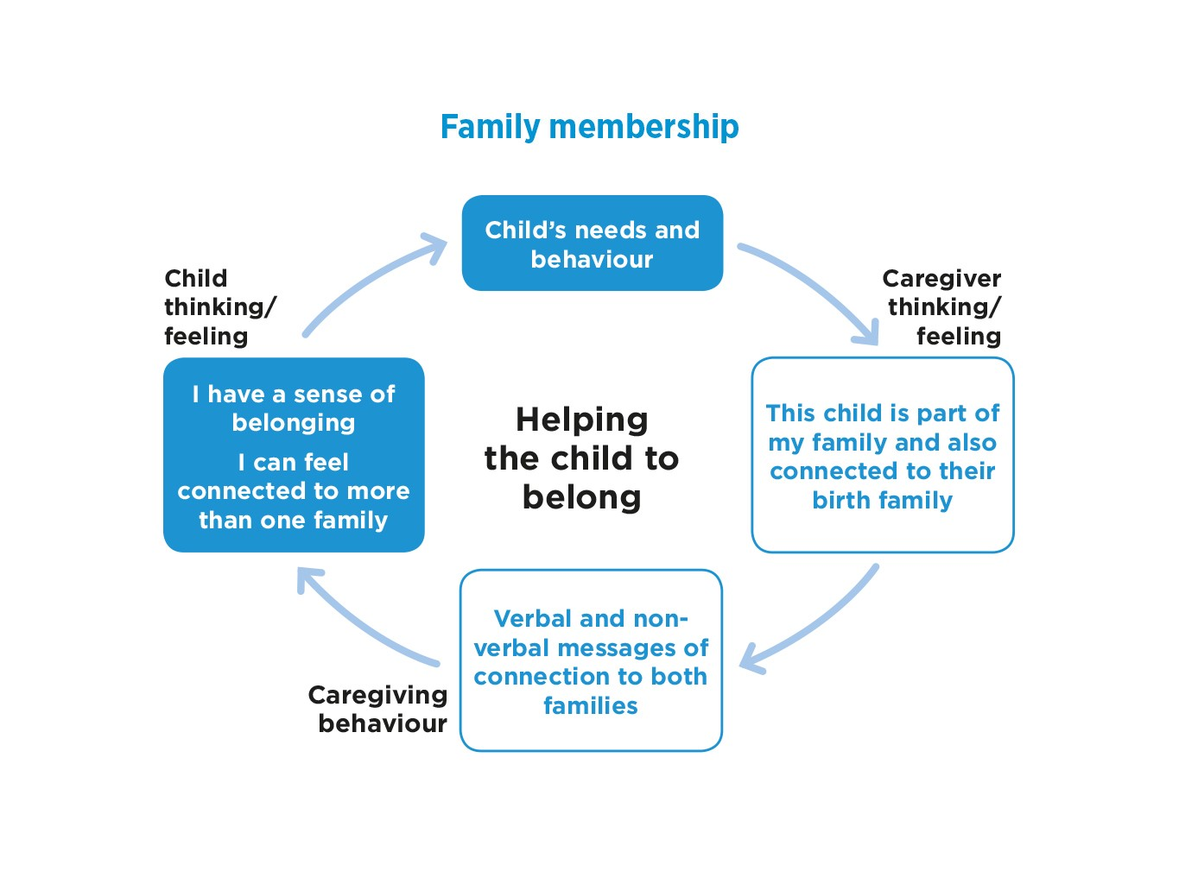

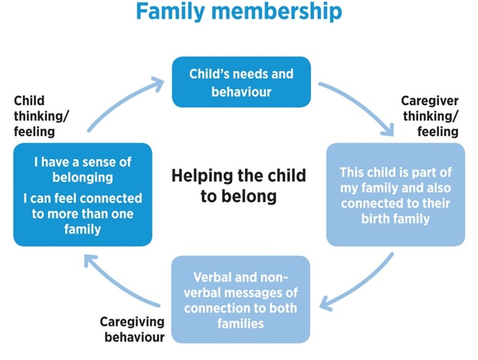

Notes:
Notes
This is the caregiving cycle applied to Family membership - helping the child to belong
READ round the cycle

Slide 60
EXERCISE 5 Family membership and a sense of belonging in different families
Why is family membership important for all children?
Which of these elements can present additional challenges for children in new families?
Notes:
Notes
Exercise 5 15 minutes
Group or small group discussion
This exercise is an important opportunity to reflect on all aspects of family membership- and some of the challenges for new families.
Children and young people in new families place high value on feeling loved and cared for but also on being fully included as part of the family they live with.
At the same time, the child will need to establish an appropriate sense of connection and belonging to their birth family - and perhaps other families, such as former foster families.
In this way, the child can develop a coherent sense of belonging to more than one family.

Slide 61
Family membership-helping the child to belong: caregiver thinking and feeling
This child is part of my family - and also connected to their birth family.
Notes:
Notes
READ SLIDE
The discussion generated in Exercise 5 will emphasise the importance of this underpinning thinking when caregivers are helping children to gain a sense of belonging.

Slide 62
Family membership - helping the child to belong: caregiver behaviour
Helping the child to feel welcome as part of the family
Making physical space for the child in the home
Helping the child to value their birth family identity
Managing family contact positively
Notes:
Notes
Caregivers need to support the child to feel welcome as part of the family.
This includes helping the child new to a placement to understand how this family does simple things (get dressed before or after breakfast?), but also to consider what will help this child to feel welcome and included. For example, one child said that she knew her new long-term foster carers really wanted her because when she arrived, she found that they had placed a duvet cover representing her favourite band on her bed.
Making physical space for child. Having special places for the child in the family home – for their clothes, at the table, in the garden
Enabling the child to talk about and value their birth family identity - and to develop a realistic and balanced understanding of their life story.
Manage family contact positively (whether frequent or infrequent, face to face or indirect), in ways that, where possible, promotes the child’s well-being and a comfortable and appropriate sense of belonging in both families. Contact should be adding to not detracting from the child's secure base /sense of security.
‘Managing family contact positively' will include ensuring that contact feels safe to the child, so may include suggesting supervising or reducing contact to some family members while promoting contact with others.
Over time, caregivers can help children to process their complex feelings, manage multiple family memberships and develop a coherent sense of self and identity.

Slide 63
Welcoming a child as part of the family
‘We always say – from the moment you walk through the door, you are part of us. No matter how long you’re staying or how many other families you relate to, you are part and parcel of our family, the same as everyone else who lives here. We say it and we show it to them as well.’ (Caregiver)
Notes:
Notes
READ SLIDE
This is a good example of how a short-term caregiver can see the value for all children of feeling explicitly welcomed as part of the family, regardless of the placement plan.

Slide 64
Foster and birth family memberships
‘My foster family is amazing! They have given me opportunities that I would have never been able to have and it is really lovely how much they are there for me. You know, because I am not with my family, they sort of fill that space, but never replace. They wouldn’t, they are respectful, they know how much I love my family. They know that I care so much equally about all of them and that I could never choose between them.’ (Kate, 14, long-term foster care)
Notes:
Notes
READ SLIDE
This quote shows how both families are important to Kate, with her foster carers providing opportunities and being there / being available for her but also supporting her ongoing relationship with the birth family.

Slide 65
Comfortable birth relative contact
‘I usually see my grandad once a fortnight if I can. He’s 83. He used to be in the Navy so that kept him fit and stuff. When I go down there, we read the news, talk about stuff, maybe I’ll watch a bit of telly, he reads his book and makes me egg and chips and then I go home.’ (Joe, 16, long-term foster care)
Notes:
Notes
READ SLIDE
This is good example of informal and valuable contact for a young person - and home for Joe is the foster home.
It’s important, where possible, to identify birth family members, maybe grandparents or uncles and aunts, who can offer a warm and safe relationship and a sense of connection to that part of the young person’s identity. They may also offer important links and support into adulthood.

Slide 66
Family membership-helping the child to belong: child thinking and feeling
I have a sense of belonging in the family I live with.
I can belong / feel connected to more than one family.
Notes:
Notes
READ SLIDE
The combination of feeling part of the family the child is living with while also being supported to be a member of another family can enhance the child’s felt security – ‘I am safe and secure in this family, but I can also think and talk about how it feels to be part of another family.’

Slide 67
Refreshment break

Slide 68
Using the Secure Base model in practice
Notes:
Notes
For this final session, we will put together information and practice ideas about the Secure Base model that we’ve discussed across the day to think about how you might use the model in your own practice.
We will also look at the Secure Base model tools for practice from the Secure Base model website.

Slide 69
Using the Secure Base model- examples of areas of practice
Assessing children
Assessing and preparing caregivers
Matching children and caregivers
Setting goals and assessing children’s progress in placement
Supporting caregivers with caregiving - and with self-care
Moving children from foster care to adoption
Making the team a secure base for practitioners
Notes:
Notes
READ SLIDE
Because the Secure Base model is a framework for understanding key aspects of caregiving and child development, it can be used in any situation where assessment is needed to plan the next steps e.g. assessing children's development and relationships; recommending that caregivers are approved; deciding on a child’s permanence plan or match; planning a move to adoption; planning support for the child and the caregiver.
Added here is the idea of a 'team as a secure base', which has been a development of the Secure Base model (links are on the Secure Base model website). In any team, including the team around the child, workers benefit from supporting each other and being supported by managers and the organisation. Social workers who are providing a secure base to foster carers who are providing a secure base to vulnerable children, also need to have their anxiety reduced and to feel secure in their role in the organisation.

Slide 70
Secure Base model tools for practice
Secure Base developmental checklists
Secure Base progress record
Caregiving approaches for each dimension
Secure Base model dimensions summary chart
Secure Base caregiver interview and analysis
Secure Base interview for young people and analysis
Secure Base model implementation guide
https://www.uea.ac.uk/groups-and-centres/centre-for-research-on-children-and-families/secure-base-model
Notes:
Notes
Read slide
These Secure Base model tools are relevant for different but often connected areas of practice. The developmental checklists focus on each dimension by age which helps to support assessments at any stage but also to support setting goals for the child through the progress record.
The progress record notes how the child is functioning / making progress on each dimension but also links this to current and possible future changes in the caregiving. These caregiving suggestions can use the caregiving approaches- the summary chart helps brings these approaches together.
The Secure Base caregiver interview will help assess how the child is functioning but also how the caregiver is thinking, feeling and caring for the child in their day-to-day relationship. This can then identify possible support needs for the child and the caregiver. There is an analysis guide with suggestions about what to look for in each dimension. Similar tools are available for the Secure Base interview for children.
The tools – and the implementation guide - are all available and free to download and use under Resources on the Secure Base model website.
Other materials on the website include, for example, videos of caregivers and young people talking about examples for each dimension.
The main tools and guidance on how to use them are also to be found in the CoramBAAF good practice guide Secure Base Model: promoting attachment and resilience in foster care and adoption, Schofield and Beek 2023.

Slide 71
EXERCISE 6 Using the Secure Base model
How might you, your team or your organisation use, or further develop your use of, the Secure Base model?
List the next steps that you would need to take to achieve this.
Notes:
Notes
Exercise 6 20 minutes
READ SLIDE
This exercise can be done in small groups with whole group feedback- adjusted to suit the group size and composition.
It is important to allow time for this exercise at the end of the session as it allows participants to think about what they have learned and will take away from the training to apply in practice.

Slide 72
The Secure Base model
AVAILABILITY
helping the child to trust
FAMILY MEMBERSHIP
helping the child to belong
SENSITIVITY
helping the child to manage feelings
SECURE
BASE
CO-OPERATION
helping the child to feel effective
ACCEPTANCE
building the child’s self-esteem
Notes:
Notes
Hope you enjoyed the day and found it helpful- thank you for your participation.

Slide 73
Additional resources
Schofield, G and Beek, M (2018 2nd edition) Attachment Handbook for Foster Care and Adoption, London: CoramBAAF.
Schofield, G and Beek, M (2023 2nd edition) The Secure Base Model: Promoting attachment and resilience in foster care and adoption, London: CoramBAAF.
Schofield, G and Beek, M (2023 2nd edition) Promoting Attachment and Resilience: A guide for foster carers and adopters on using the Secure Base model, London: CoramBAAF.
https://www.uea.ac.uk/groups-and-centres/centre-for-research-on-children-and-families/secure-base-model

