Slide 1




Insights from Children about Abuse and Neglect
Barriers and enablers

Slide 2
Aims of the session
Exploring how school and college staff can manage interactions with children who have been abused and neglected
Considering barriers and enablers to telling from children’s point of view
Considering barriers and enablers for staff supporting children

Slide 3
Professionals in universal services cannot and should not replace the function of social work, but they do need to be able to understand, engage and think professionally about the children, young people and families they are working with (Munro, 2010, p26)
Munro, E. (2010) the Munro Review of Chlid Protection, Part One: A systems analysis. Available at: https://www.gov.uk/government/publications/munro-review-of-child-protection-part-1-a-systems-analysis
Notes:
Safeguarding is everyone's business but it can be hard for school and college staff to deal with. Note that all three Munro reviews are available on the iCAN website.

Slide 4
Barriers
It can be really difficult for both children and school or college staff to talk about and deal with concerns about abuse and neglect
What stops children from telling?
What stops teachers from listening and responding?
Notes:
We will explore what might stop children from telling and staff from really listening – barriers
Group exercise:
On the Barriers handout, list some barriers for children and staff.

Slide 5
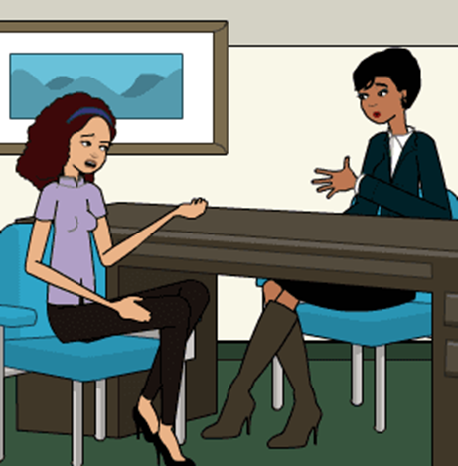
Barriers to telling from the child’s point of view:
Age, gender, ethnicity (younger children, boys, minority ethnic groups) Emotional: shame, embarrassment, self-blame They can’t get the words out, not having the vocabulary Lack of recognition that what is happening counts as abuse Loyalty to family members Fear: someone they care about may get into trouble, they might get taken away from family, worry about brothers and sisters Fear: No one will believe them Fear: it happened a long time ago Fear: they will have to go home to family who will know they have told Fear: threats from abuser of consequences of telling Self-reliance – they are used to dealing with things on their own, they can’t trust anyone with it Negative past experience of telling, careful what they say around professionals – no one will do anything or they’ll do something the child doesn’t want
Notes:
Signpost to literature review which gives outline of research on what prevents children from telling. Or hand out printout of literature review.
Allow further discussion and comparison of points raised by staff after doing the exercise.

Slide 6

Barriers to listening and responding from the teacher’s point of view:
I haven’t got time for this It’s not my job, I’m a teacher It doesn’t happen to children here This is painful to hear What if I’m wrong about this? Her parents seem so nice I’m scared of her parents I don’t know what to do, what if I do the wrong thing I don’t know what to say to her Someone else must already know, the family is well known Someone else will deal with it If I make a referral no one will do anything and she will lose trust in me I haven’t had enough training I’m not sure what the process is Limited resources for pastoral support, restricted budgets

Slide 7
Enablers
It can be really difficult for both children and school or college staff to talk about and deal with concerns about abuse and neglect
What enables children to tell?
What enables teachers to manage interactions with children who tell them about abuse and neglect?
Notes:
We will explore what might enable children to tell and teachers to effectively help and support them.
Group exercise:
On the Enablers handout, list some enablers for children and staff.

Slide 8
Enablers for the child:
School is a safe place to be Education about relationships and abuse is included in the curriculum so pupils are aware of risks and have the words to voice concerns Pupils are encouraged to approach staff with concerns Pupils can form trusting relationships with members of staff
Notes:
Allow further discussion and comparison of points raised by staff after doing the exercise.

Slide 9
Enablers for the teacher*:
Senior managers within schools encourage a culture where safeguarding is central Well-funded services including pastoral support Appropriate spaces for children to go to within the school Staff know students well enough to recognise potential signs of abuse such as changes in behaviour Staff have access to high quality training, including non-teaching staff There are strong collaborative links between school staff and other agencies Adults and children are respectful of each other and there are effective measures to address bullying and other forms of abuse by peers or adults within school There is a culture of openness and trust amongst staff and between staff and students There is a culture of participation where students are involved in the development of policy and systems
* The points listed include findings from Lefevre et al (2013) Good Practice in Safeguarding and Child Protection in Secondary Schools, London: Office of the Children’s Commissioner

Slide 10
Learning points
Children need supportive environments and relationships to allow them to talk about abuse and neglect
School and college staff need knowledge and training to respond effectively to children who disclose abuse and neglect
Schools and colleges need resources and supportive environments to allow staff to listen and respond to children who disclose abuse and neglect
Notes:
Developing an action plan could be the next step to improve safeguarding in your school. Participants may need a safe space to raise organisational factors that could be improved, think about how that may be done.
Celebrate what you do well!
NOTE TO FACILITATOR:
WE ARE KEEN TO COLLECT FEEDBACK ABOUT WHO IS USING THE TRAINING MATERIALS AND HOW EFFECTIVE THEY ARE.
YOUR FEEDBACK CAN HELP US DEVELOP THE MATERIALS FURTHER SO PLEASE SEND YOUR COMMENTS TO jeanette.cossar@uea.ac.uk INCLUDING YOUR ROLE, SCHOOL AND FEEDBACK.
THANK YOU!

